Slide 1
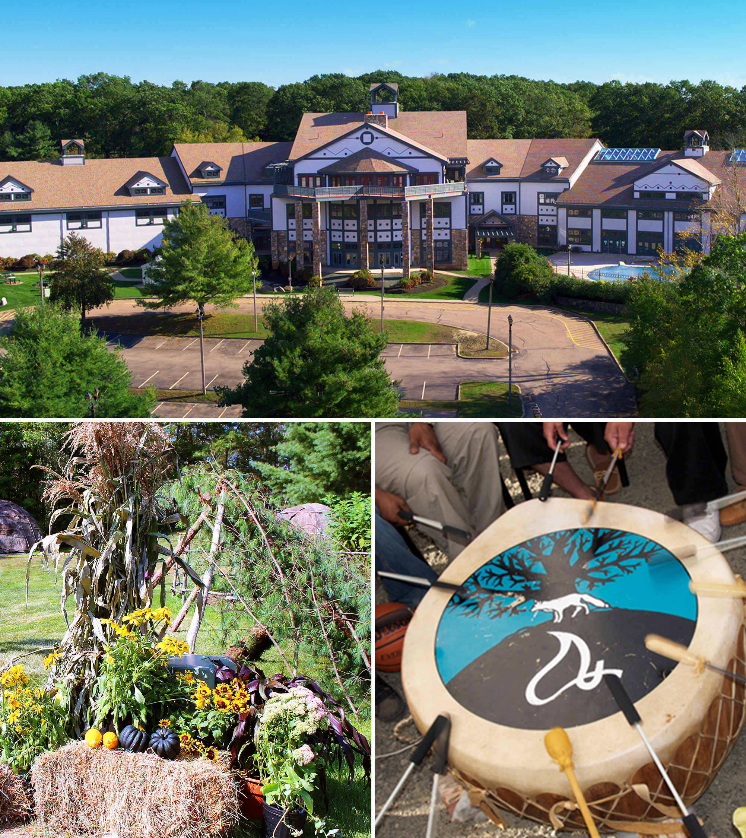

USET Tribal Best Practices Conference
Supporting Native Businesses:
Rebuilding Tribal Trade through Entrepreneurship
Tribal Councilor Michele Scott
August 2024

Slide 2

Mashantucket Pequot Community
~1220 enrolled members (70% adults)
Majority live within 100 mile radius of reservation
Remainder of tribal members live in 31 states and 2 countries
Economic Development Committee is constitutional standing committee
Mashantucket Pequot Strategic Plan includes economic prosperity

Slide 3
Why Did This Become a Hot Topic?
Strategic objective for the Nation
The 7th objective states that “Mashantucket Pequot Tribal Nation will sustain and grow our tribal economy.”
COVID-19 highlighted the individual prioritization of self-determination
Piecemeal efforts with good intentions
  Webinars offered sporadically
  Entrepreneurship loan program established
  Tribal Member vendor events
Community meetings consistently mentioned variations of chamber of commerce structure

Slide 4
Best Practices Thus Far
Policy and System Changes
  Tribal Member Business Certification
  Explicitly assisting Tribal Members to navigate the procurement process
  Setting a goal to double certified businesses by 2030!
Allocation of Resources
  Entrepreneurship Loan Program
  Applying for External Resources (Examples: T Mobile and EDA funding)
  Vocational Rehabilitation Program start-up assistance
Behavior Changes
  “Do we have a Tribal Member business that does this?” when hosting events
    Examples: Women’s Brunch gift bags, Auto detailing, Seamstresses, Candidate headshots
  Addition of annual tribal meeting vendor fair (2023)
  Formally highlighting businesses to each other (hired Digital Communications Manager)
Networking Opportunities
  Creation of Business Center in the heart of the community center building
  Entrepreneurship Symposium (Inaugural event 2023)

Slide 5
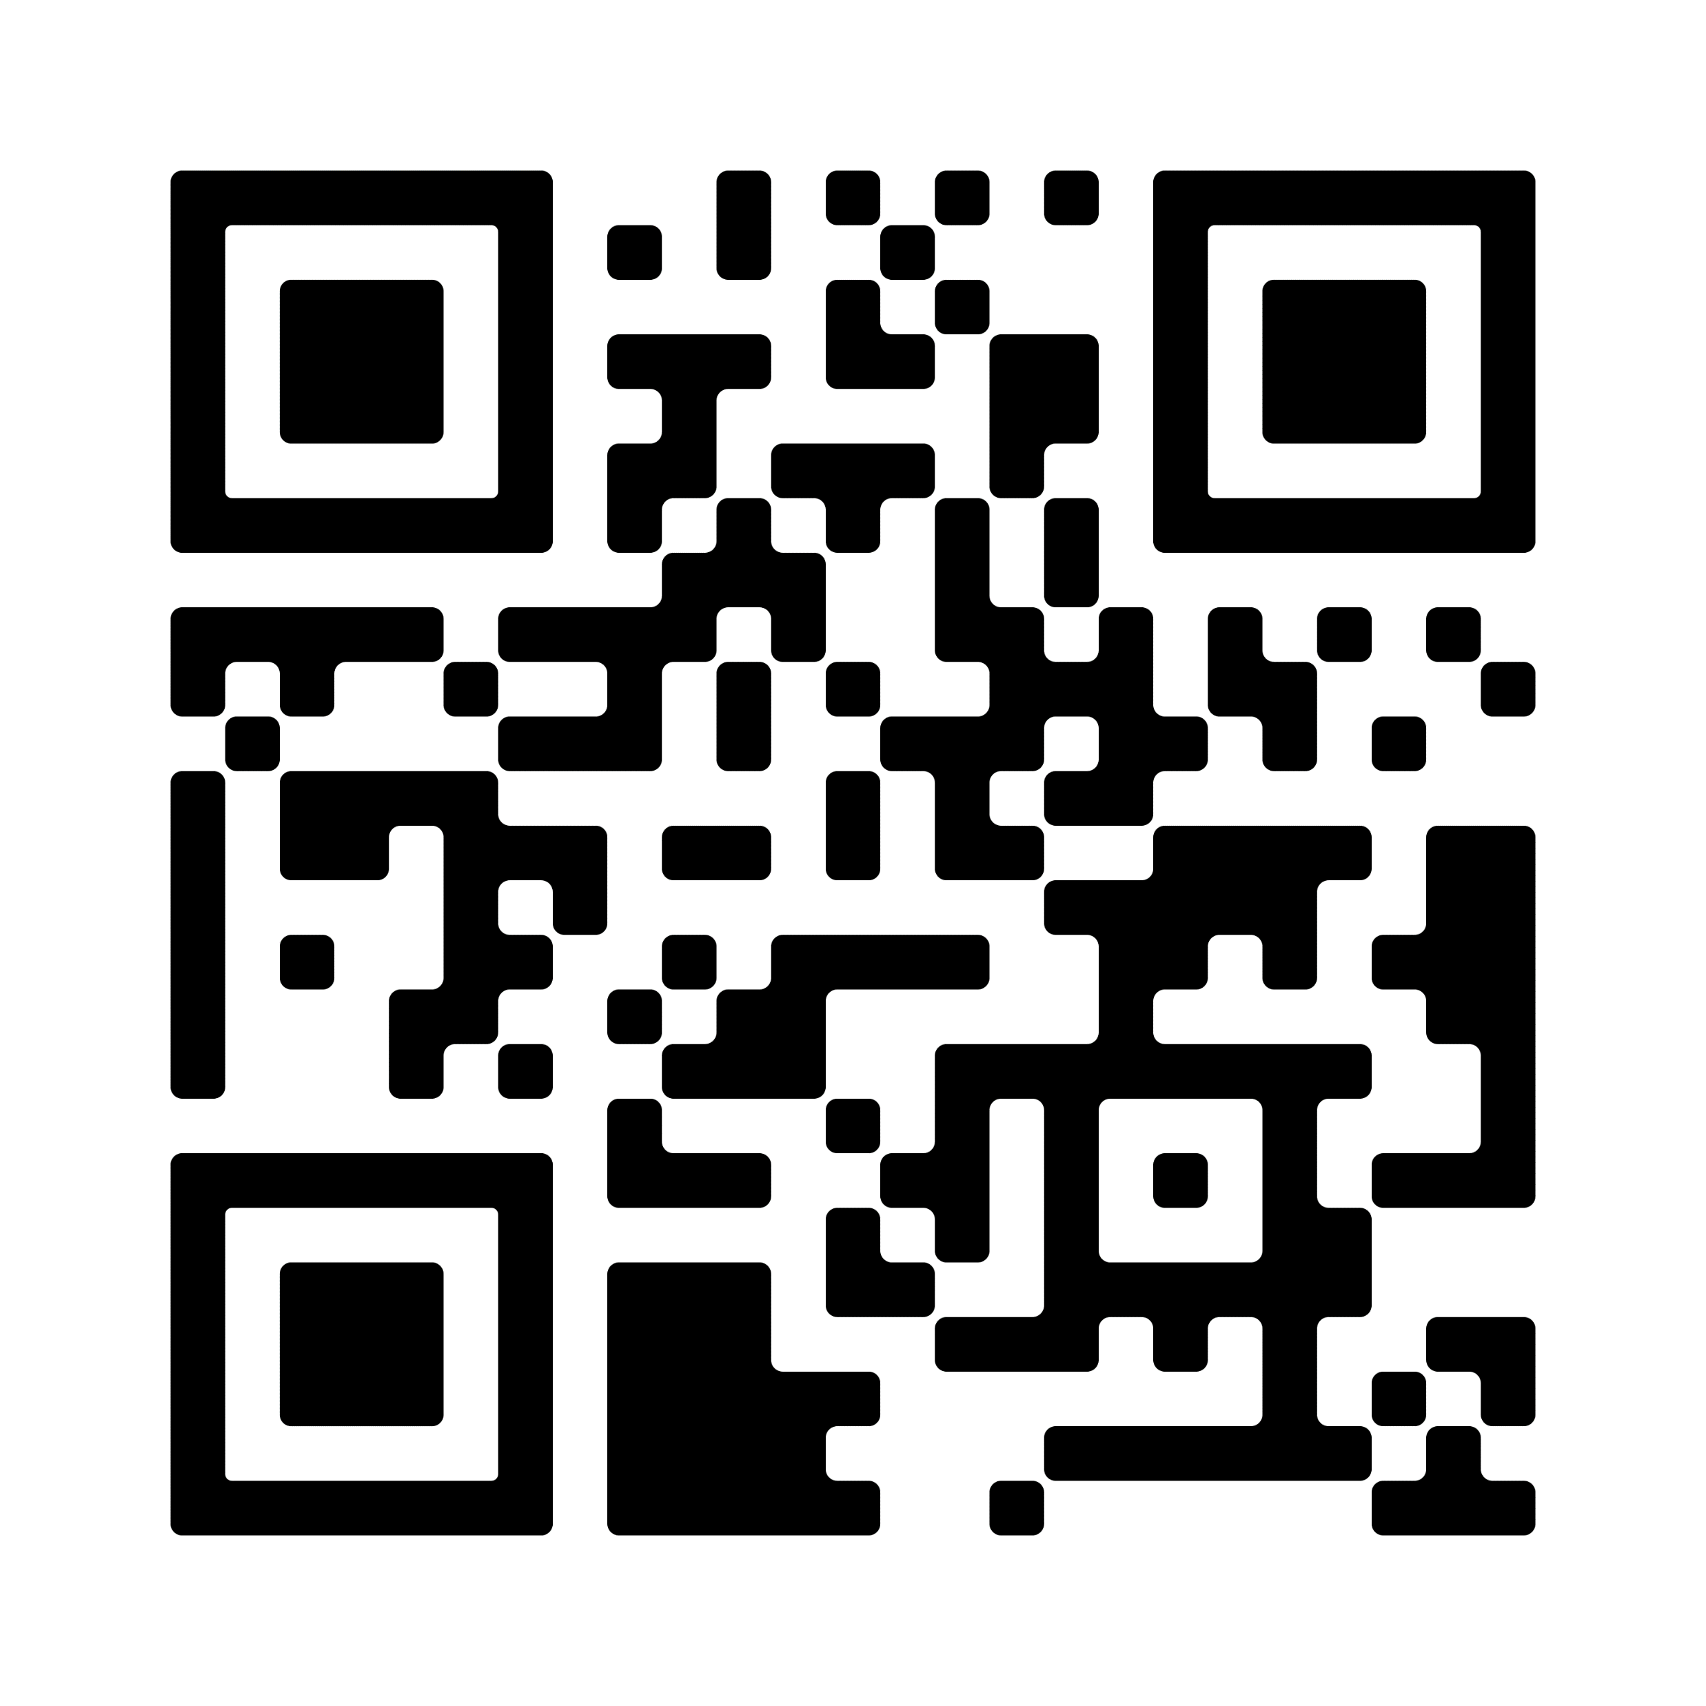

Upcoming Tribal Entrepreneurship Symposium!

