Slide 1

Evolution of the
Poarch Band of Creek Indians Emergency Management Program
From Inception to
Present Day
April Sells
Director
Tribal Emergency Services

Slide 2
Overview
Early Beginnings
Natural Disaster Response
  Hurricanes
  Tornadoes
COVID-19 Pandemic Response
Training & Exercises
Proactive Steps
Proactive Programs
Current Status
Future Directions

Slide 3
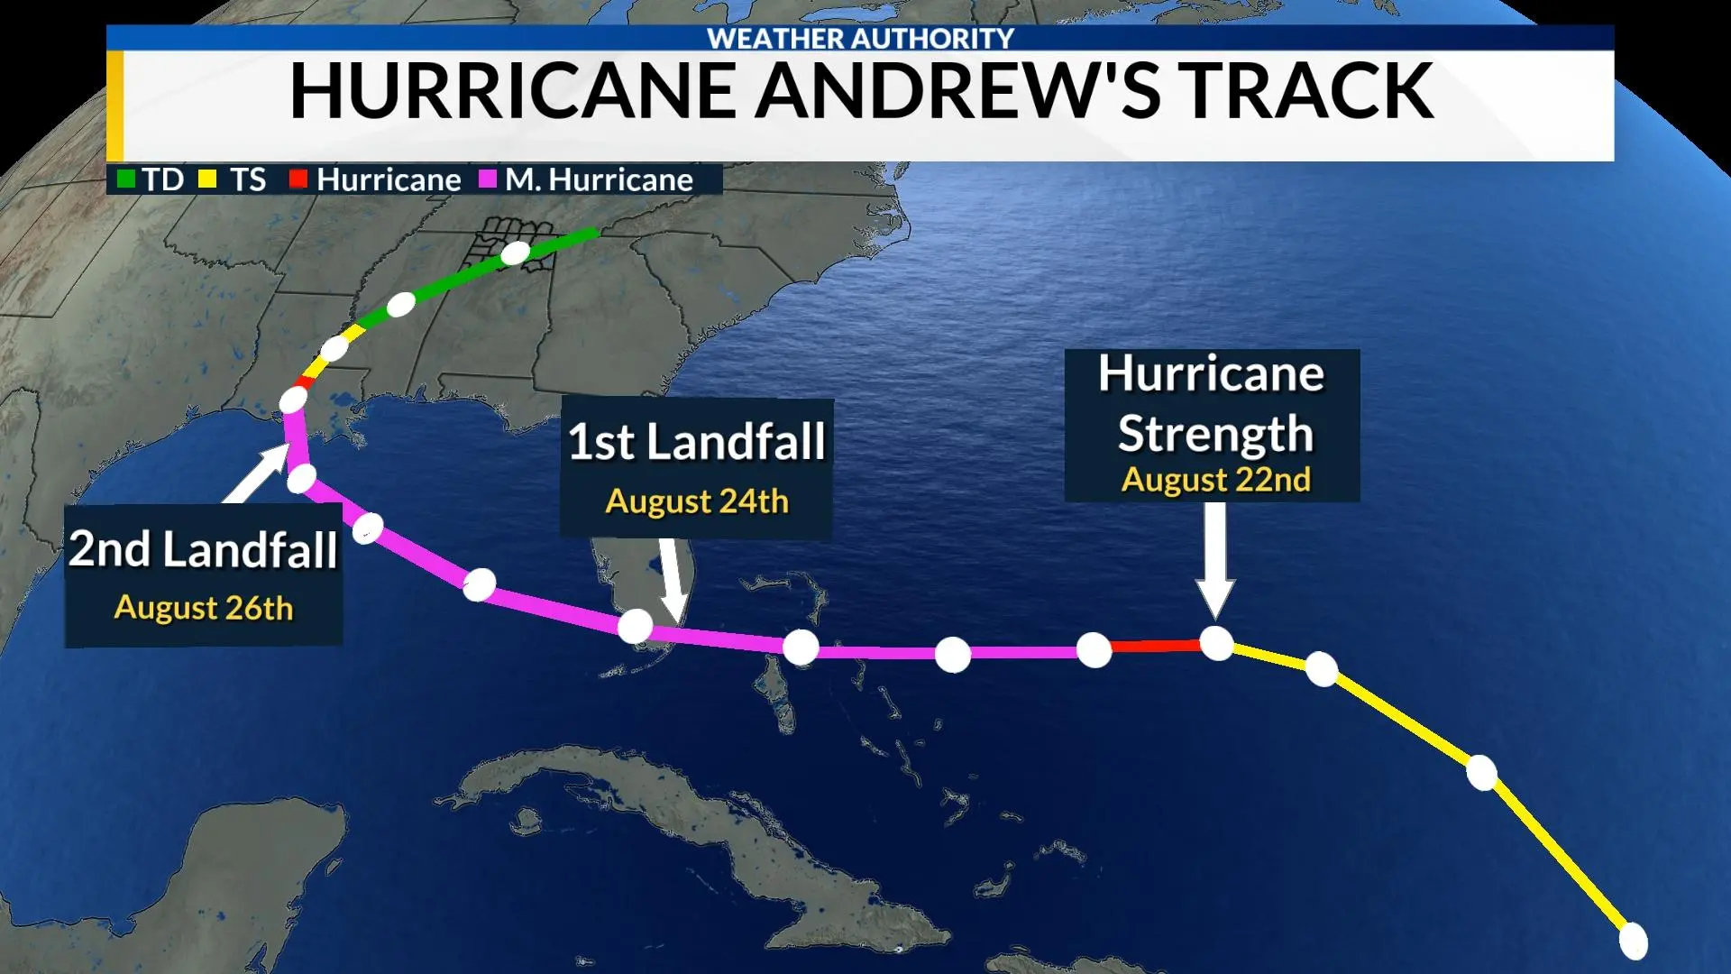
Early Beginnings
Photo courtesy of WHNT News 19

Slide 4
Natural Disaster Response

Slide 5
Response
1992 Hurricane Andrew (Chitimacha Tribe of Louisiana)
2004 Hurricane Ivan
2005 Hurricane Dennis
2005 Hurricane Katrina (Chitimacha Tribe of Louisiana)
2005 Hurricane Rita (Alabama-Coushatta Tribe of Texas)
2011 Tornado Outbreak – Cordova, AL in Walker County
2011 Tornado Outbreak – Tuscaloosa County, AL
2011 Tornado Outbreak – Jackson County, AL
2016 Hurricane Matthew
(Catawba Indian Nation of South Carolina)
2017 Hurricane Harvey
2018 Hurricane Michael
2019 Lee County, AL Tornado

Slide 6
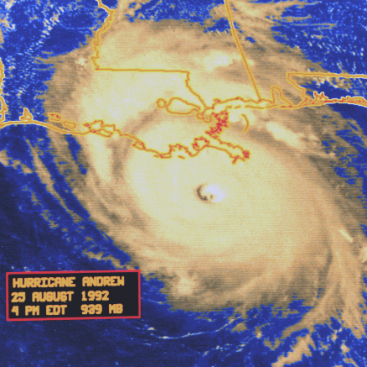
Hurricane Andrew Response
1992
As of 1992, FEMA had not yet established a relationship with Indian Tribes
With passable clearance, Poarch Creek lead two 18-wheelers of supplies to the Chitimacha Tribe of Louisiana
Photo courtesy of NWS Lake Charles, LA
6

Slide 7
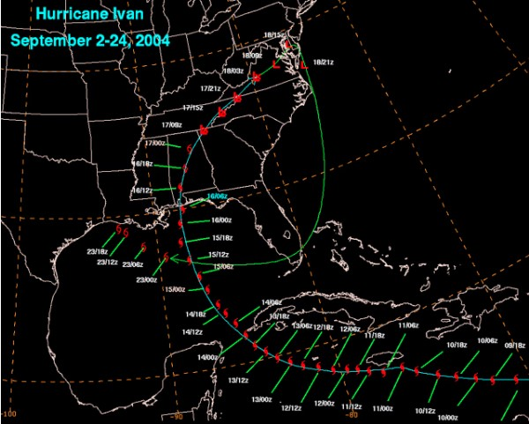

Hurricane Ivan better known as...
“Ivan the Terrible”.
Photo courtesy of AL.com

Slide 8
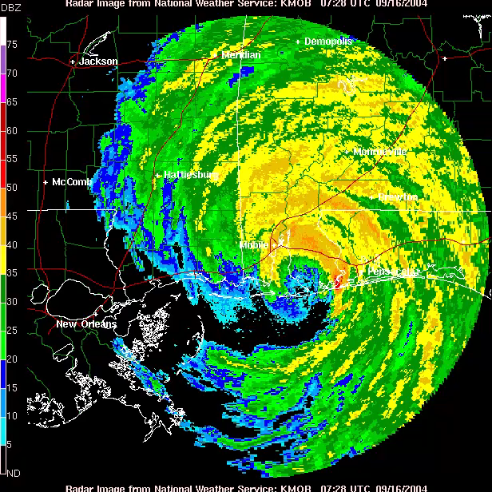
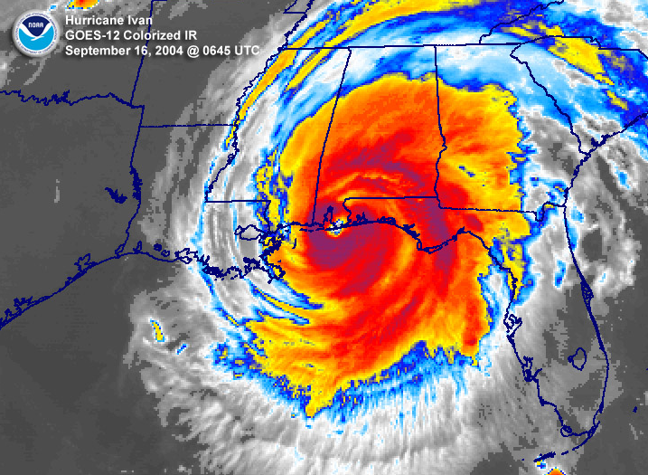
Hurricane Ivan Response
2004
Poarch Creek Reservation on East side of storm’s eye
Maintained coverage of Reservation
Assisted Escambia County, AL in coverage of west end of county
Damage Assessments / Cleanup / Distribution Site for ice, water & MREs
Animation & Photo courtesy of
NWS Mobile
8

Slide 9
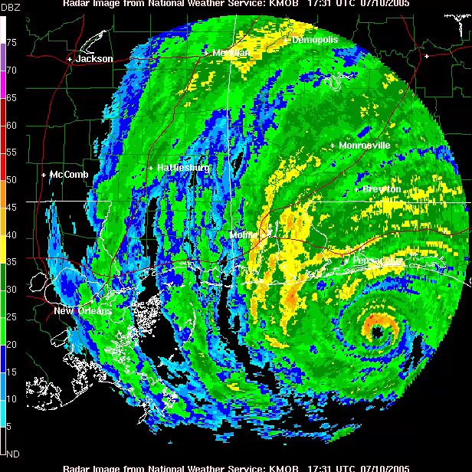
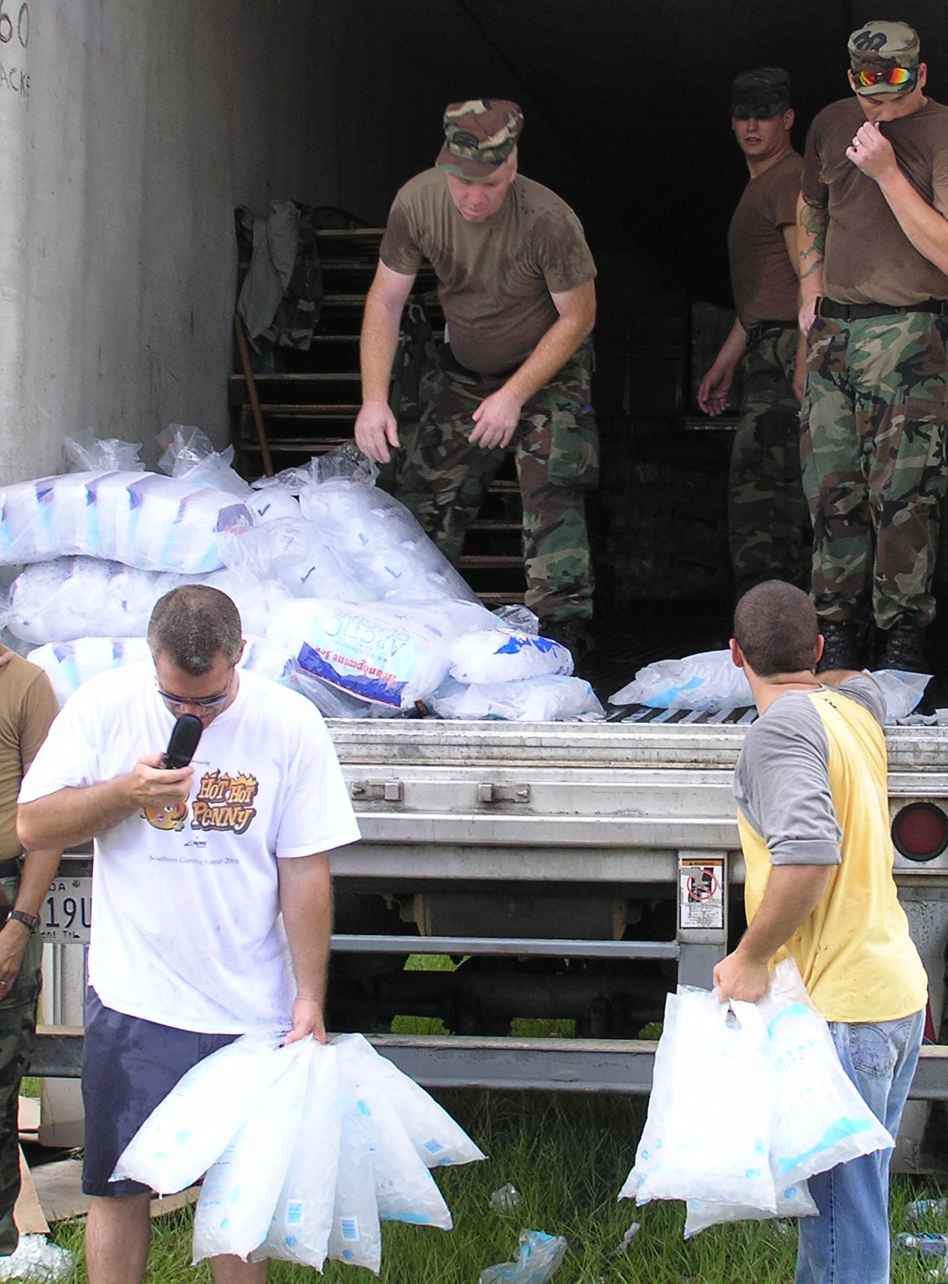

Hurricane Dennis Response
2005
Poarch Creek Fire Station 1 acted as a safe- haven for 54 Alabama State Troopers
Distribution Site for ice, water & MREs
Maintained coverage of Reservation
9

Slide 10
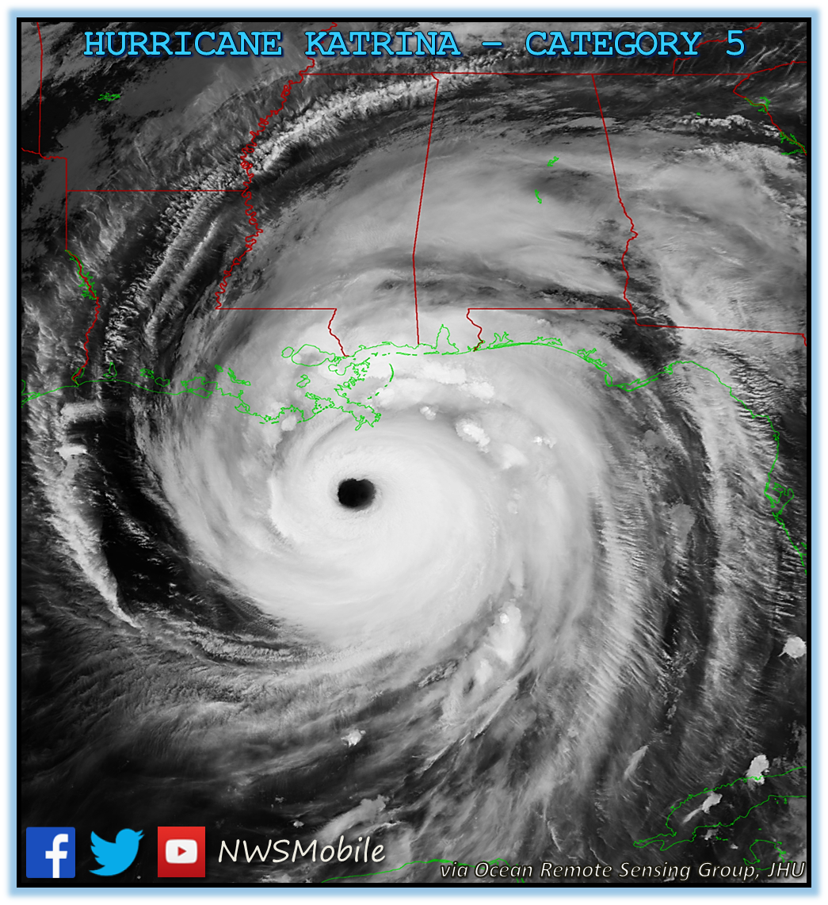
Hurricane Katrina Response
2005
Poarch Creek Fire Station 1 housed Seminole Tribe while waiting for mission assignment in Waveland, MS
Poarch Creek given clearance to pass through area to deliver requested supplies
Chitimacha Tribe of Louisiana requested supplies from Poarch Creek, including stethoscopes & otoscopes
Casino parking garage used as a shelter for hurricane victims from Orleans Parish
Photo courtesy of NWS Mobile

Slide 11
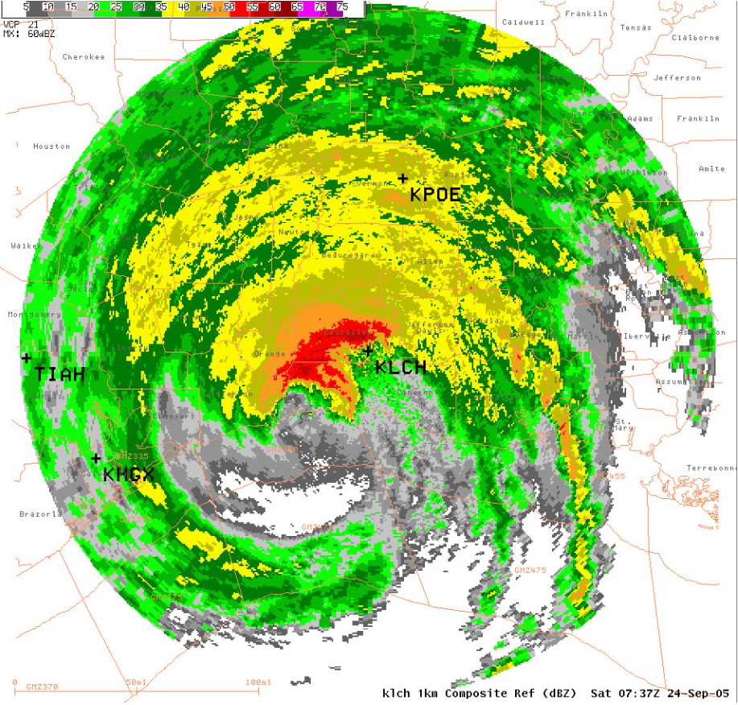
Hurricane Rita Response
2005
Poarch Creek Tribal Members drove generators to Alabama-Coushatta Tribe of Texas prior to Hurricane Rita’s landfall
Unplanned route north out of hurricane’s path in order to return to Poarch Creek Reservation
Photo courtesy of NWS Houston/Galveston, TX

Slide 12
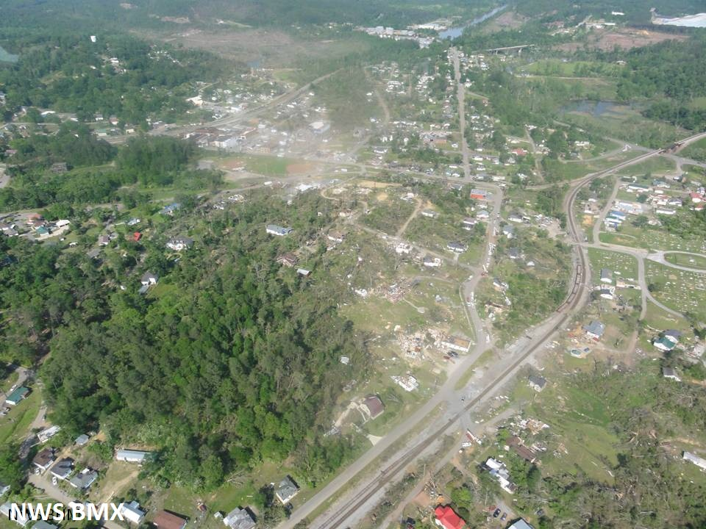
2011 Tornado Outbreak
Cordova, AL in Walker County
Poarch Creek Personnel set up Mobile Clinic in Cordova, AL after Tornadoes
Aerial of Cordova from the West
Photo courtesy of NWS Birmingham

Slide 13

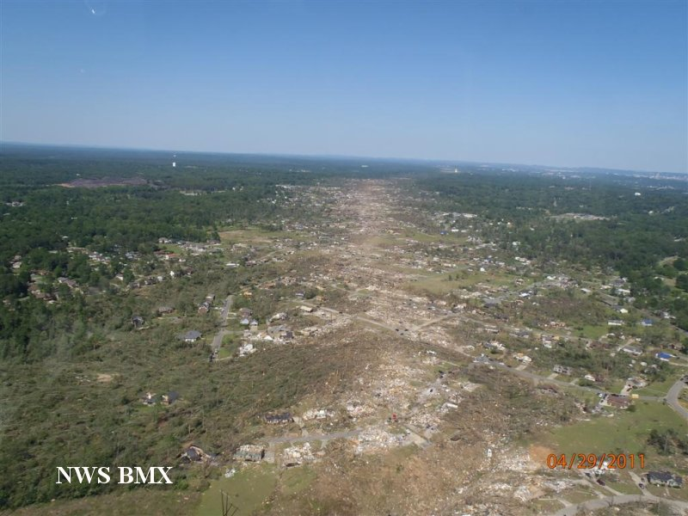
2011 Tornado Outbreak
Tuscaloosa County, AL
Escorted trucks with generators to Tuscaloosa
Poarch Creek Personnel stayed during the weekend to help clean up Alabama Fire College Campus
Aerial View of Damage Path
Photo courtesy of NWS Birmingham

Slide 14
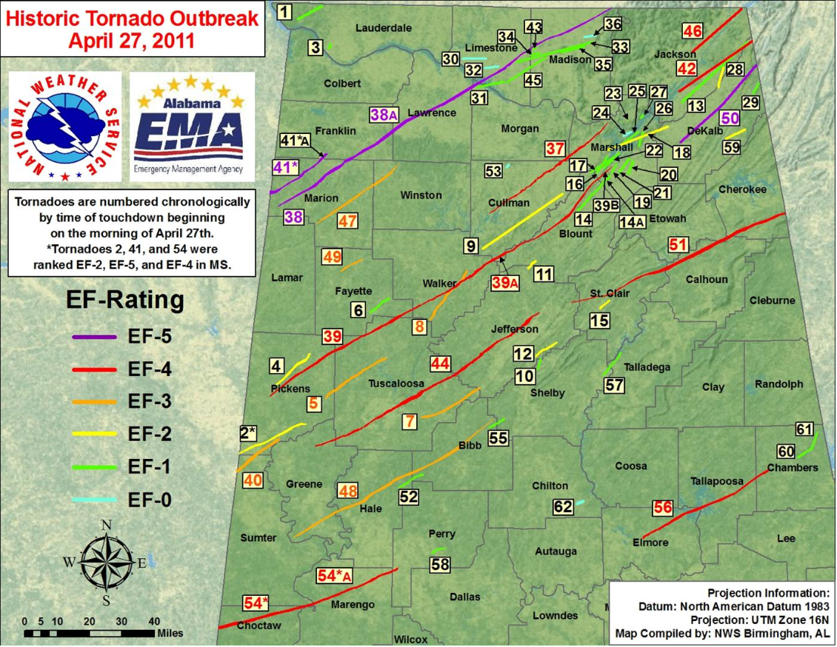
2011 Tornado Outbreak
Jackson County, AL
State of Alabama requested the assistance of Poarch Creek
Poarch Creek Personnel acted in the role of EMA Directors while current EMA Directors assessed damaged of their own homes and properties.
14
Photo courtesy of NWS Birmingham

Slide 15
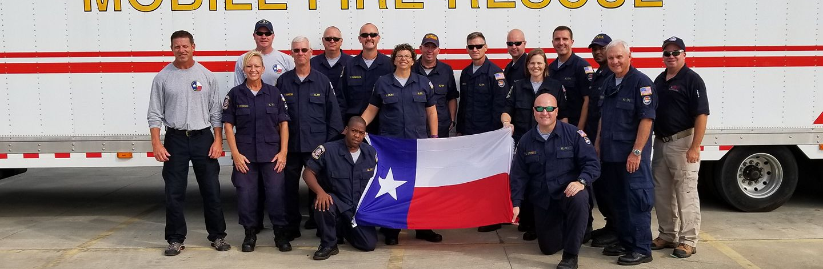

Hurricane Harvey Response
2017
Poarch Creek Fire Personnel on AL-TF1 Team deployed to College Station, TX
Deployed to mission in Vidor, TX and Orange, TX
Searched by land and boat for survivors and victims of Hurricane Harvey

Slide 16
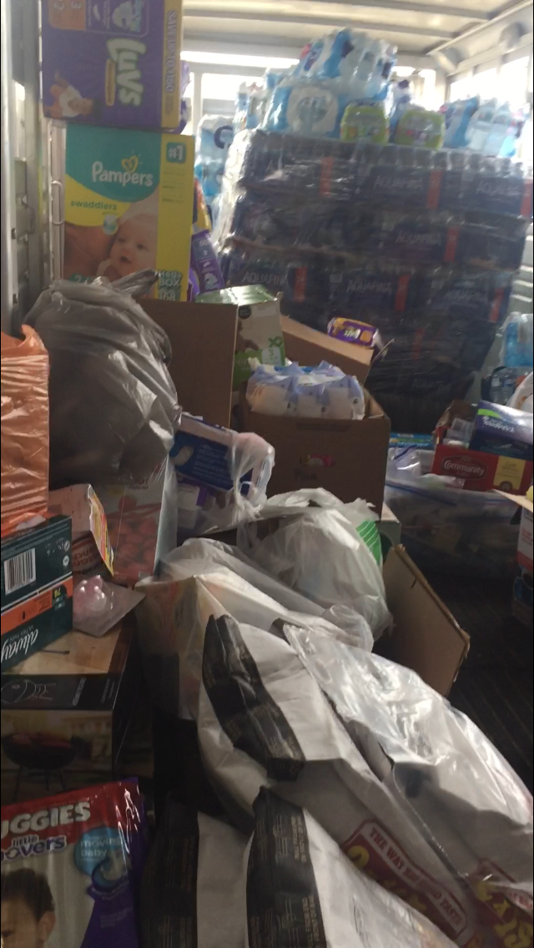
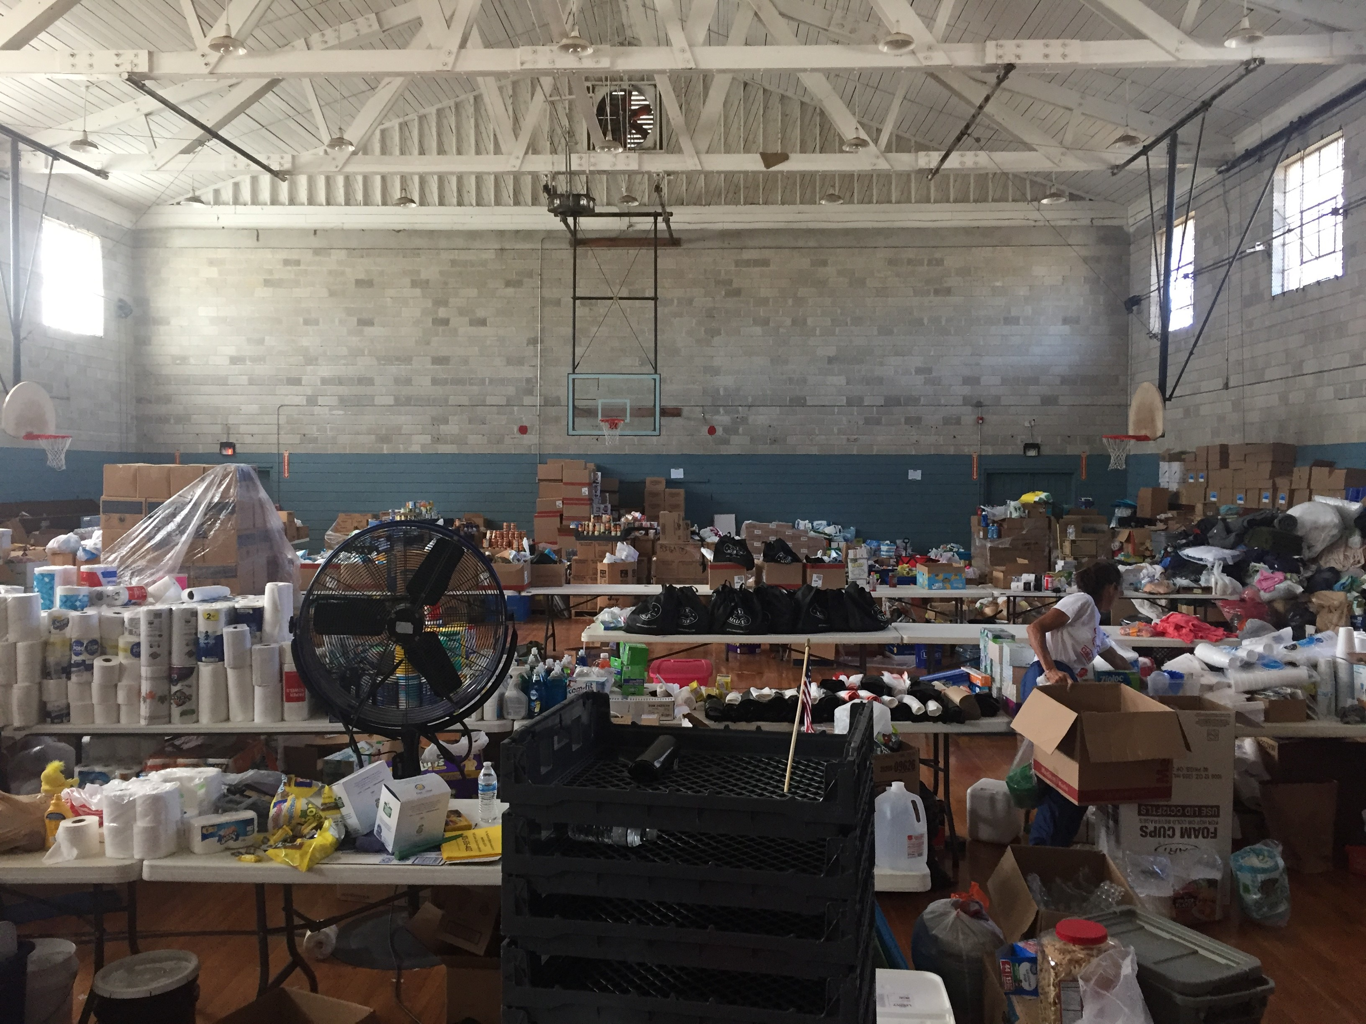
Hurricane Michael Response
2018
Poarch Creek Fire Dept. accepted community donations for Wewahitchka, FL residents
Fire Personnel transported donations in a
24-foot stock trailer to a local church in Wewahitchka, FL
“There were a lot of things that we saw on the trip that are still hard to grasp. It seemed like we constantly compared the things we saw to the damage we experienced in the days after Hurricane Ivan hit our area. The damage was much more widespread.” – Spencer Williamson, Poarch Creek Firefighter/Advanced-EMT

Slide 17
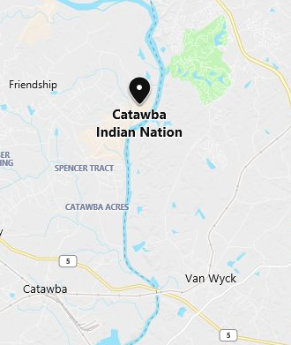
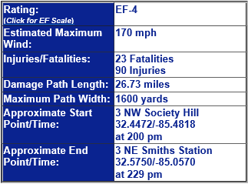
Additional Responses
March 2019
Lee County, AL Tornado
2016
Hurricane Matthew
Poarch Creek was on standby for the Catawba Indian Nation of Rock Hill, NC
Bing Maps
Chart courtesy of NWS Birmingham

Slide 18
COVID-19 Pandemic Response

Slide 19
COVID -19 Pandemic Response
Established the Tribal COVID-19 Health Task Force
Key actions taken:
  PPE assessment and procurement
  Establishing logistics and vaccination plans
  Securing the first Federal Declaration for the Tribe in response to COVID-19
  June 2020
  PPE assessment and procurement
  Establishing logistics and vaccination plans
  Securing the first Federal Declaration for the Tribe in response to COVID-19

Slide 20
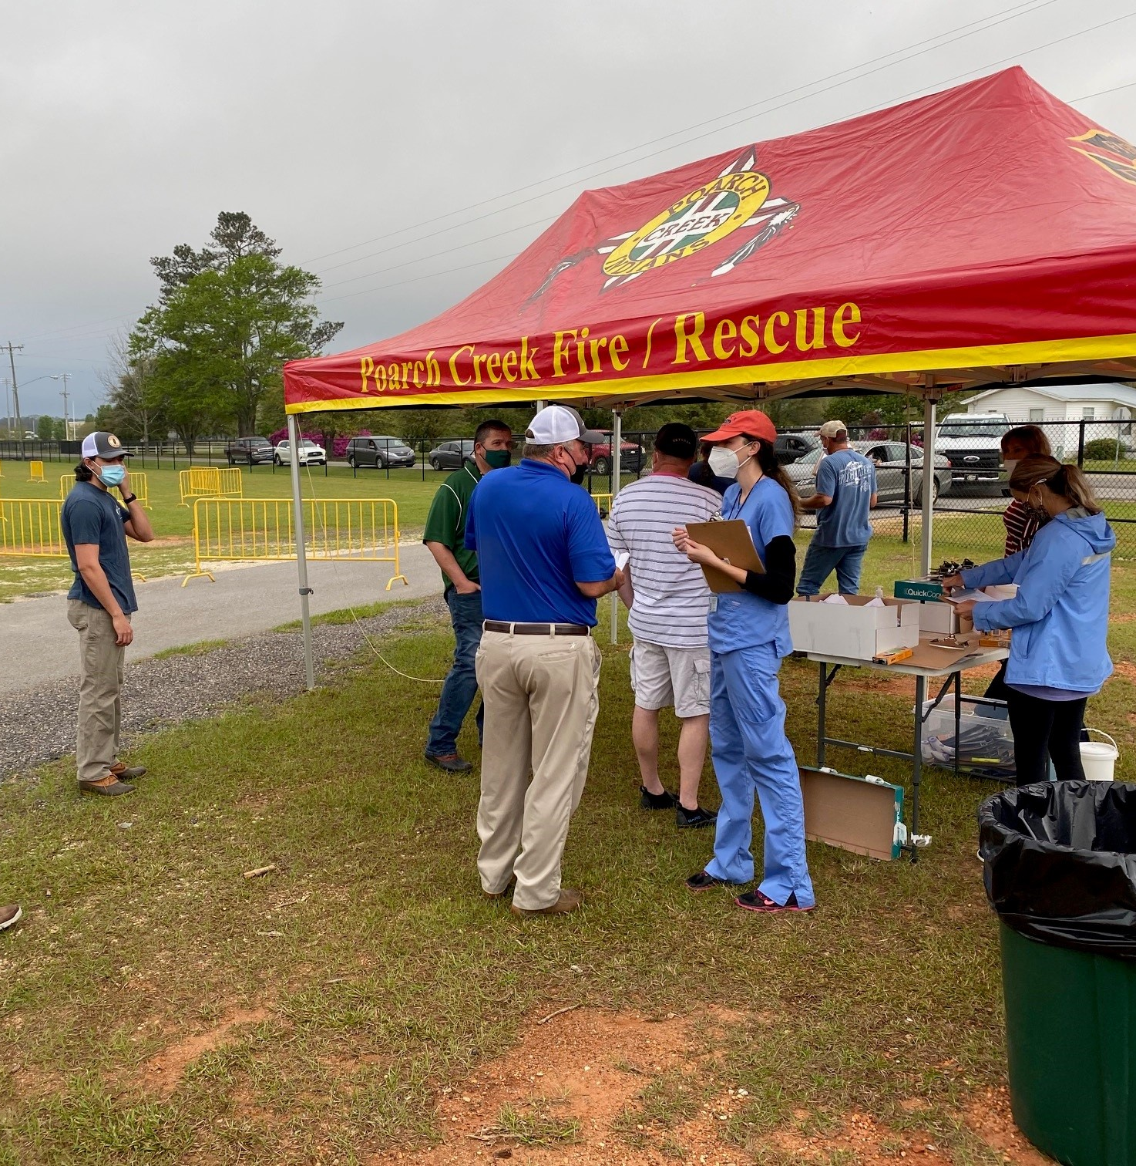
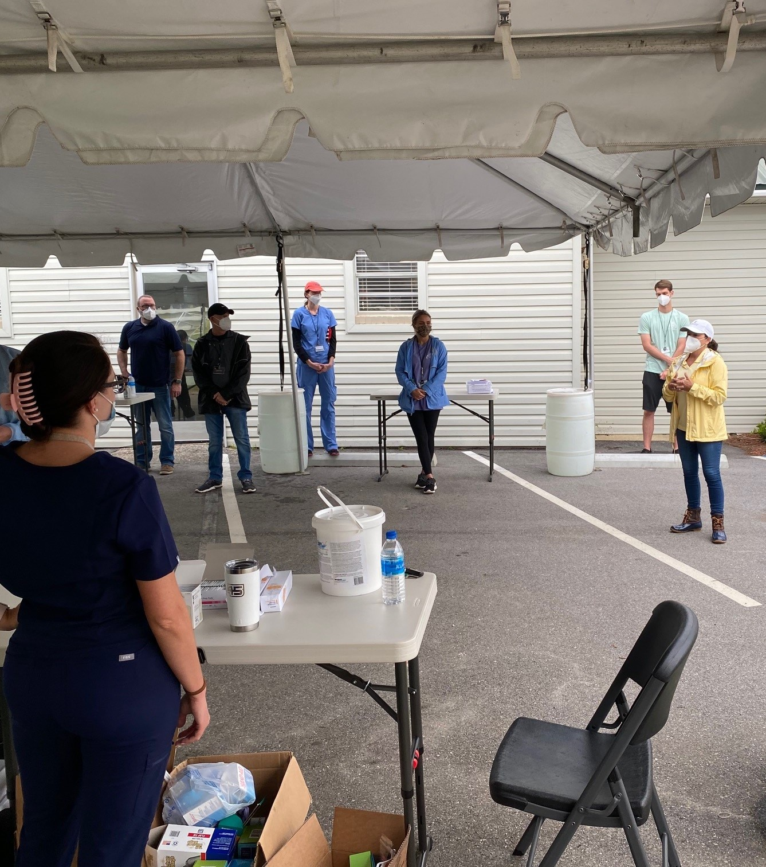
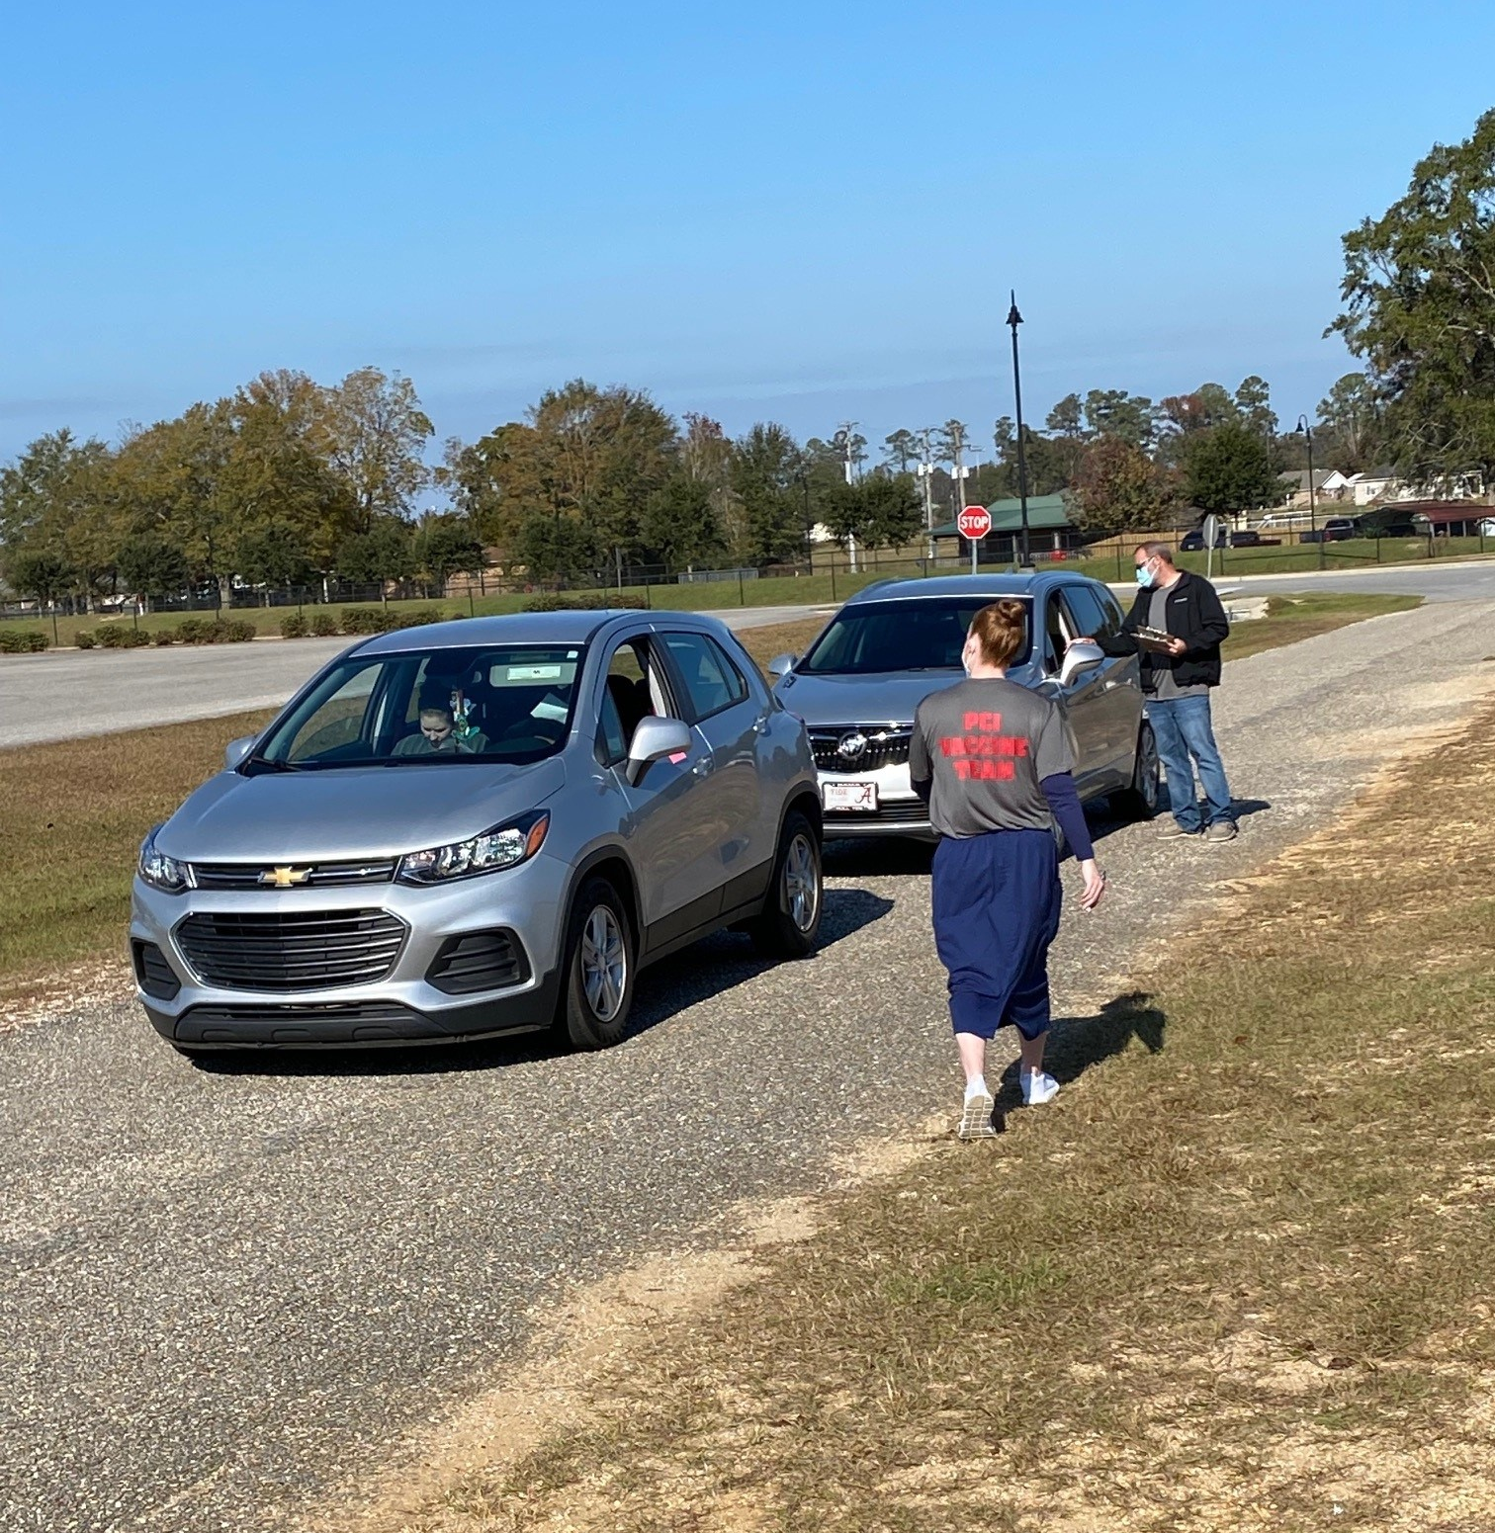
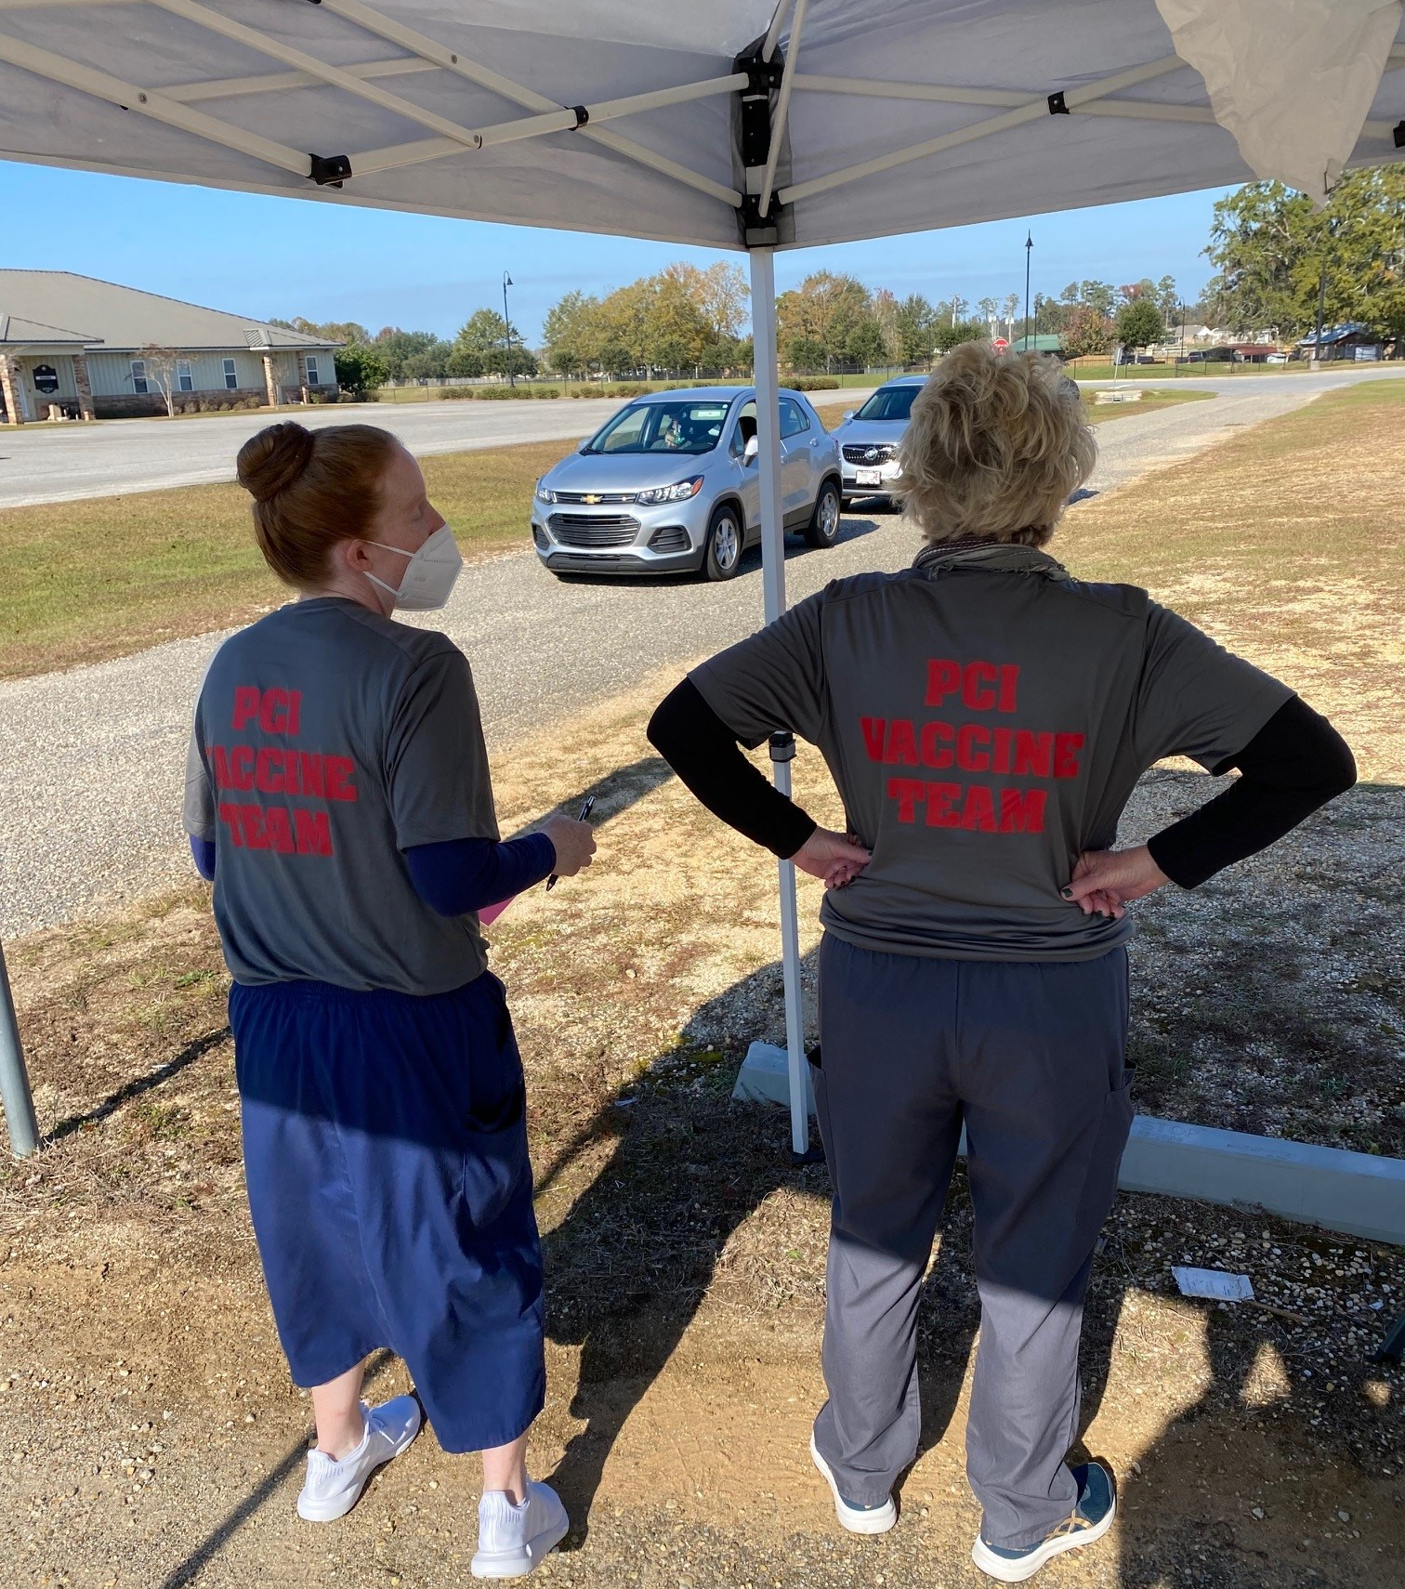
COVID-19 Pandemic Vaccination Clinics

Slide 21
Training & Exercises

Slide 22
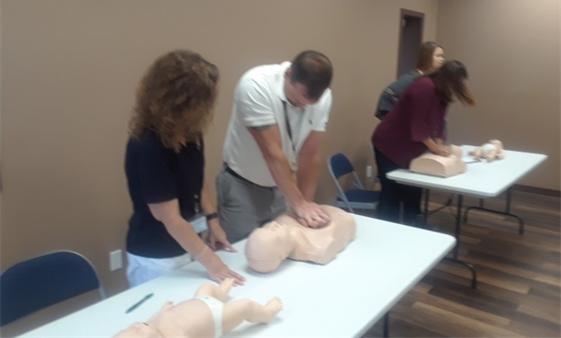
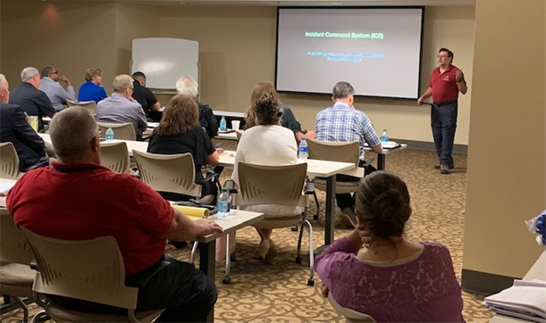
Training
CPR
AED
First Aid
Fire Extinguisher
Bus Evacuation
Fire Prevention

Slide 23
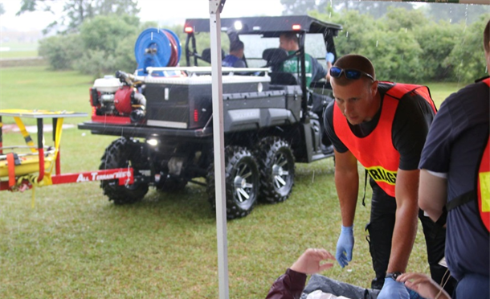
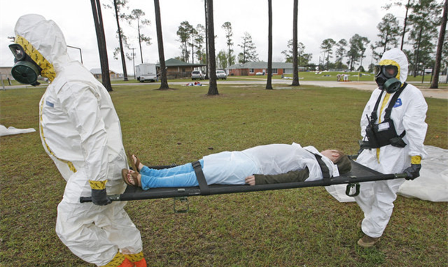
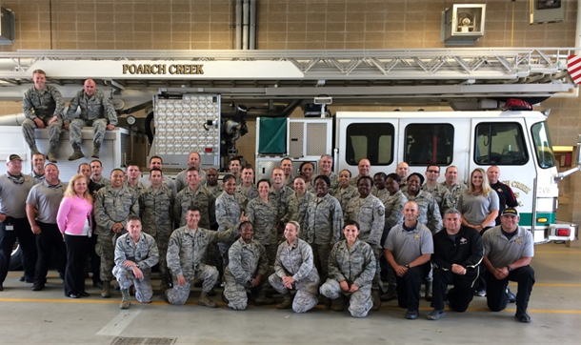
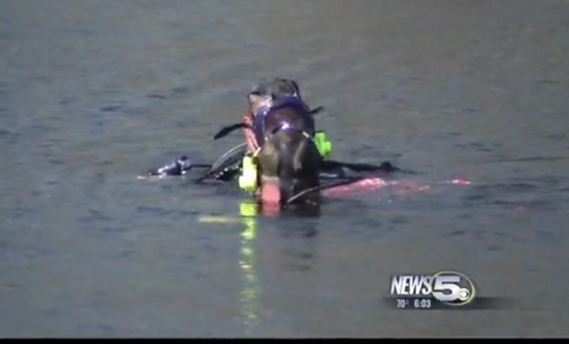
Exercises
Mass Casualty
Hazmat
Rescues

Slide 24
Proactive Steps

Slide 25
Poarch Creek Reservation Proactive Steps
Tornado Shelters
Mass Notification Speaker Arrays
WeatherCall / Edwards Fire Control System
RapidCast
Baron Saf-T-Net
National Weather Service (via Slack)
Alabama EMA WebEOC
P25 Radio Capability
Training & Exercises

Slide 26
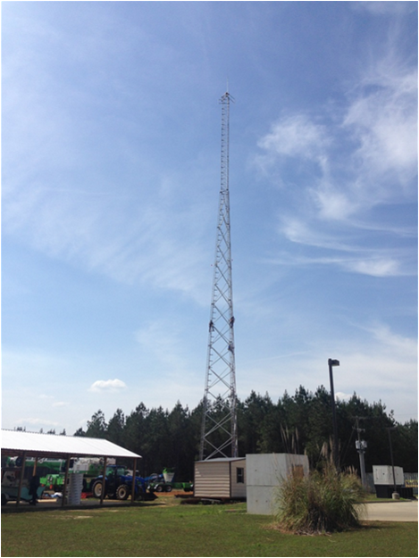



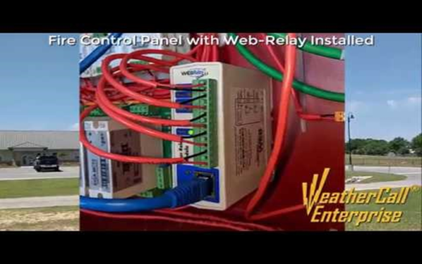


Proactive Programs

Slide 27
Current Status

Slide 28
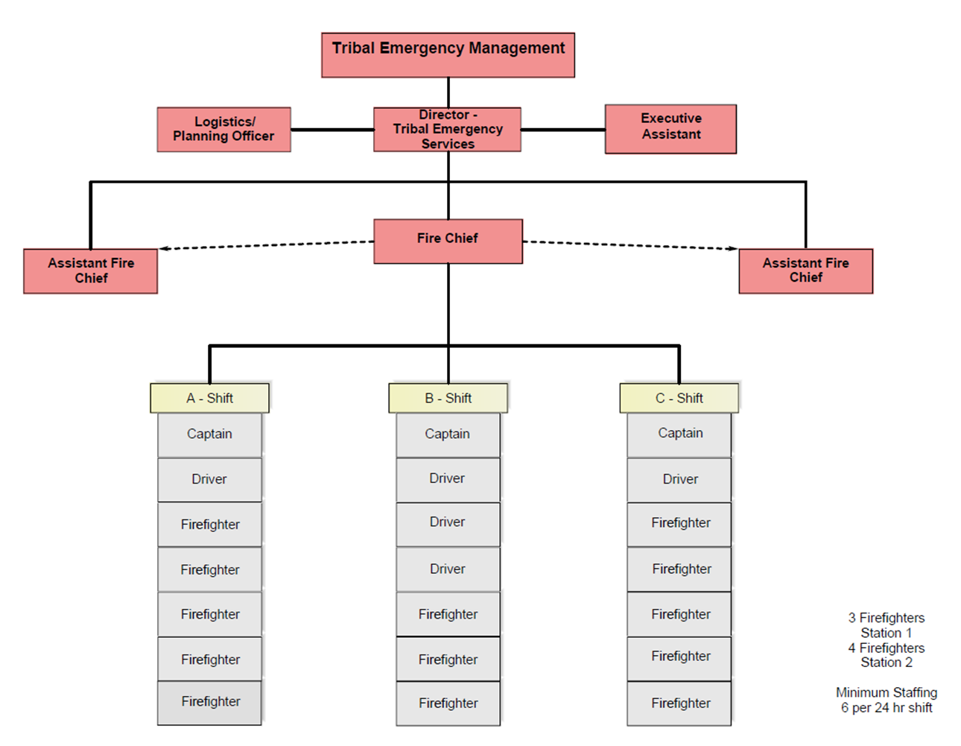
Internal Structure

Slide 29






Wind Creek Hospitality

Slide 30
Future Directions

Slide 31
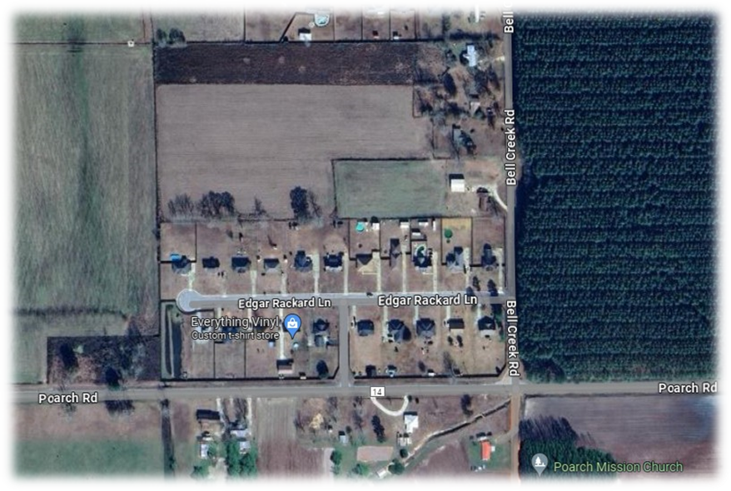
Future Directions
Addition to mass notification speaker array to Tullis Manor Subdivision within Tribal community
EMS Warehouse Build-Out
Update to Hazard Mitigation Plan
EV Training
Dams and their impacts to Wind Creek Hospitality properties
Aerial view of Tullis Manor

Slide 32


April Sells
Director – Tribal Emergency Services
Poarch Band of Creek Indians
Email: asells@pci-nsn.gov
Cell: (251)253-5972
Tribal Website: https://pci-nsn.gov/

