Slide 1












DIABETES AND ORAL HEALTH: Understanding the Connection
Speaker
Karen-Ann Gordon DC, RDH
The Braided Path
Weaving together wisdom, innovation, and community.
https://linktr.ee/Thechirohygienist
Thechirohygenist@gmail.com
http://linkedin.com/in/karen-ann-gordon-dc-rdh-92144498
@thechirohygienist

Slide 2
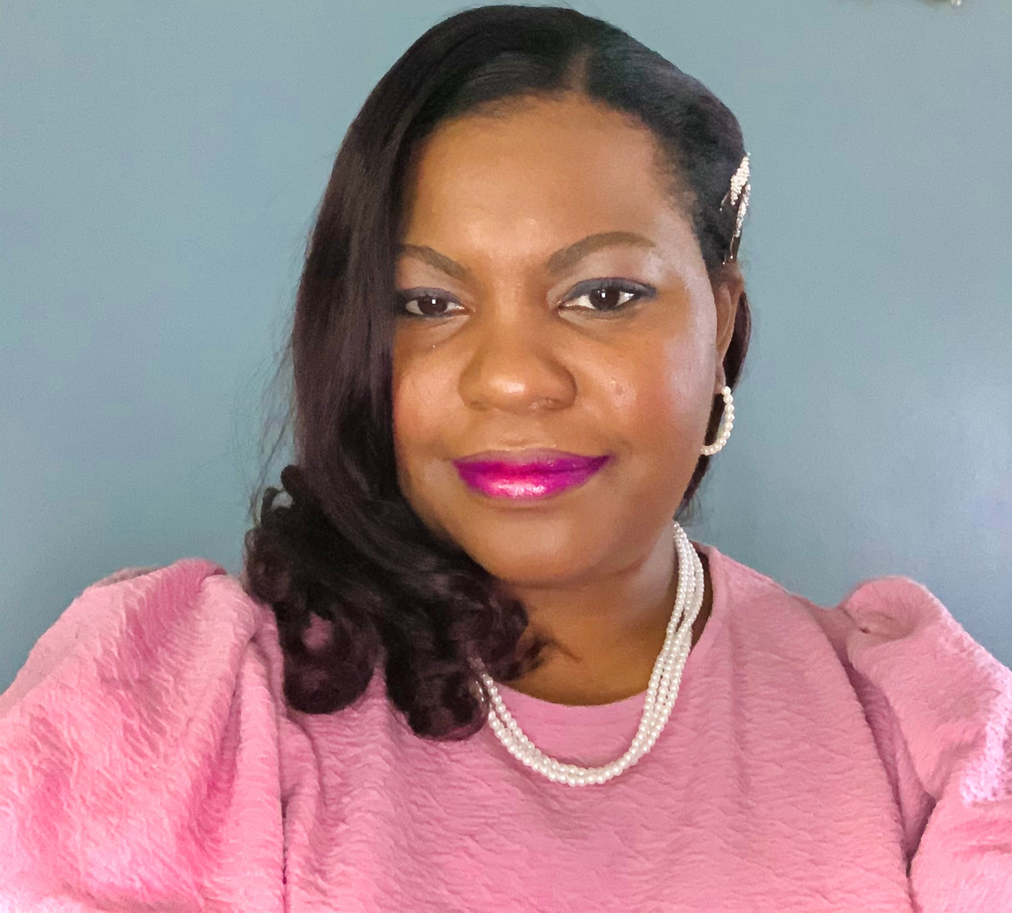
Karen-Ann Gordon DC, RDH
https://linktr.ee/Thechirohygienist
Thechirohygenist@gmail.com
http://linkedin.com/in/karen-ann-gordon-dc-rdh-92144498
@thechirohygienist

Slide 3
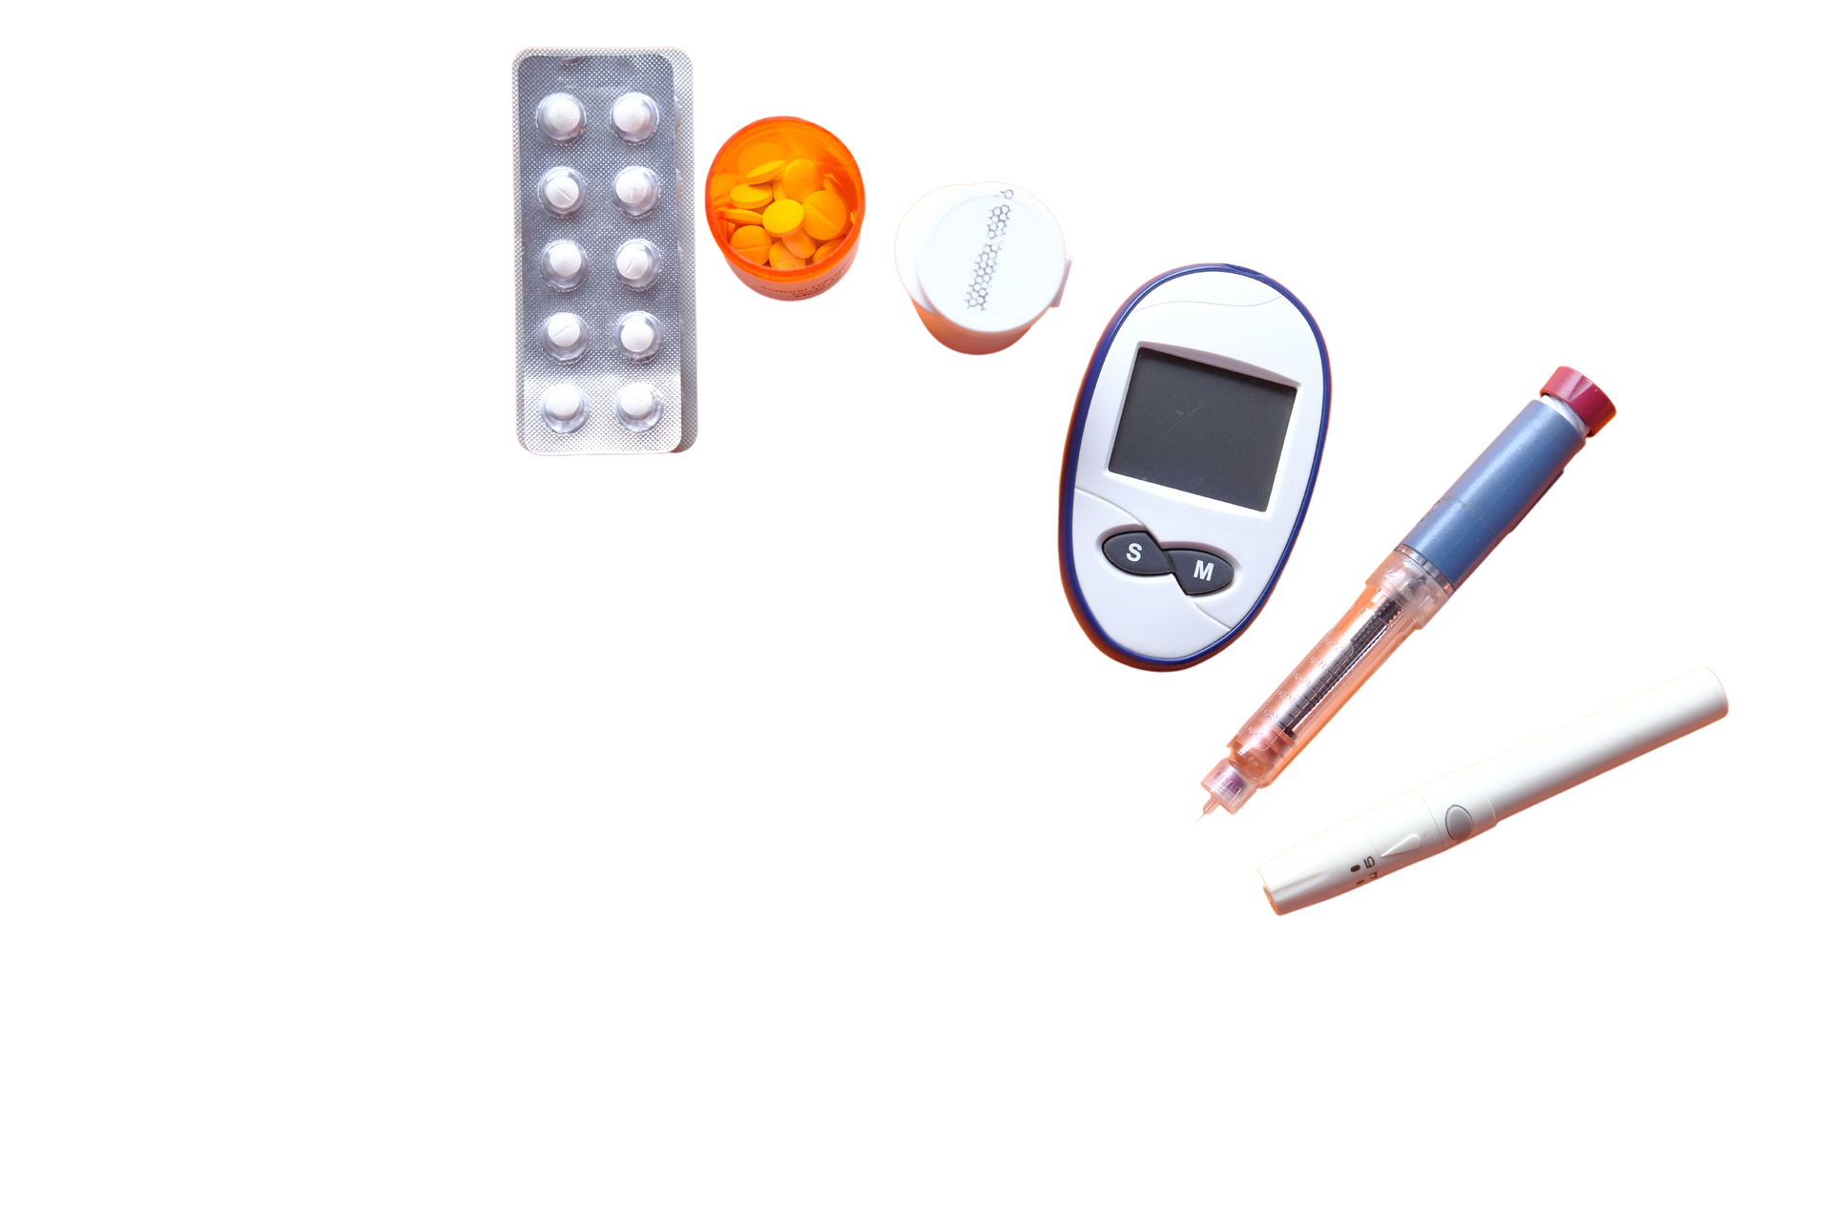

Objectives
1. Understand and recognize signs of diabetes in the oral cavity
2. Implement effective oral hygiene techniques
3. Apply a basic management plan to control oral health with diabetes
https://linktr.ee/Thechirohygienist
Thechirohygenist@gmail.com
http://linkedin.com/in/karen-ann-gordon-dc-rdh-92144498
@thechirohygienist

Slide 4
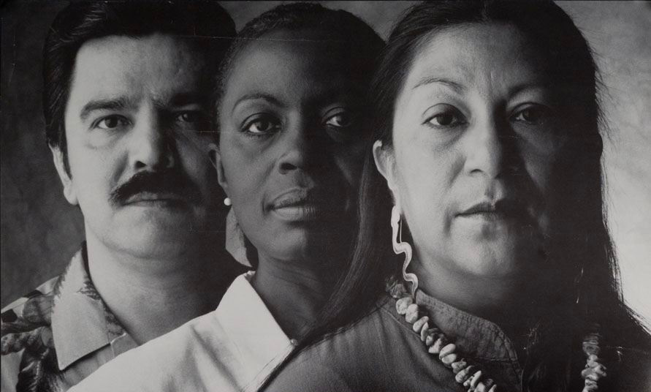
What do these people all have in common?
https://linktr.ee/Thechirohygienist
Thechirohygenist@gmail.com
http://linkedin.com/in/karen-ann-gordon-dc-rdh-92144498
@thechirohygienist

Slide 5

What do these people all have in common?
According to American Diabetes Association
  1 in 3 Native Americans
  1 in 7 Hispanic Americans
  1 in 14 African Americans
https://linktr.ee/Thechirohygienist
Thechirohygenist@gmail.com
http://linkedin.com/in/karen-ann-gordon-dc-rdh-92144498
@thechirohygienist

Slide 6
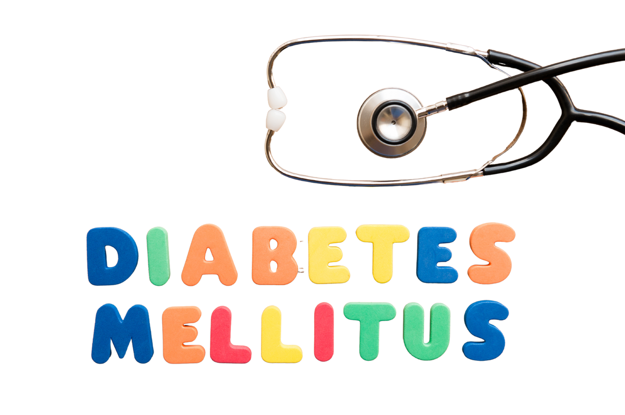
Types of Diabetes
  Pre-diabetes
  Gestational Diabetes (GDM)
  Type 1 Diabetes (T1DM)
  Type 2 Diabetes (T2DM)
https://linktr.ee/Thechirohygienist
Thechirohygenist@gmail.com
http://linkedin.com/in/karen-ann-gordon-dc-rdh-92144498
@thechirohygienist

Slide 7
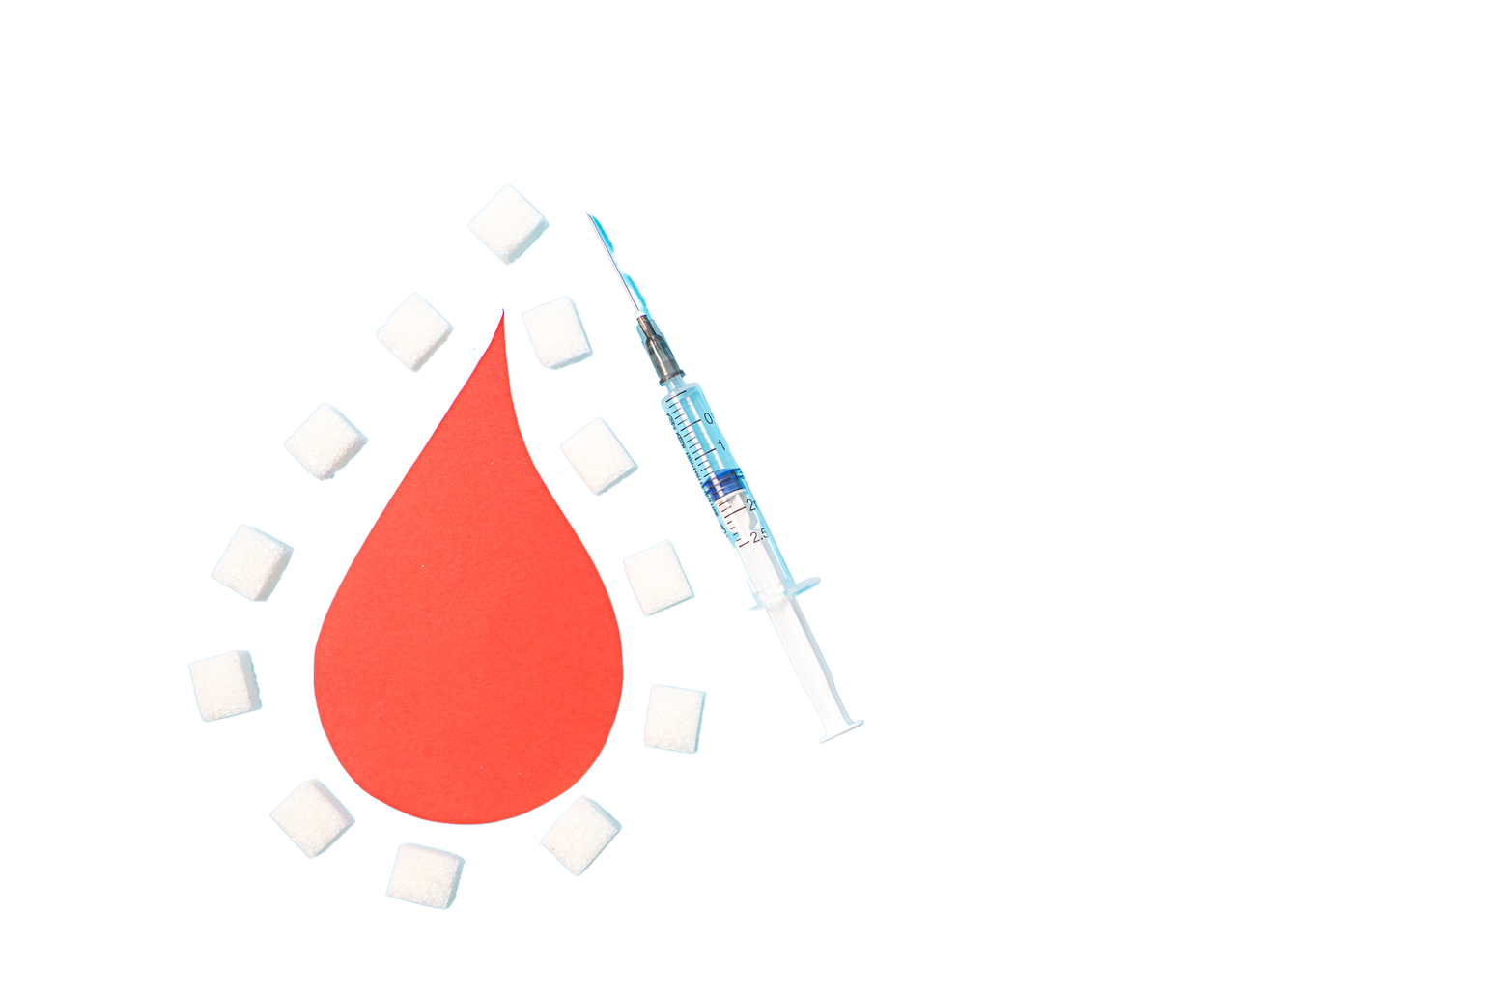
Pre-Diabetes
Pre-diabetes, by definition, is a condition that is a pre-cursor to diabetes mellitus.
  Fasting blood glucose of 100mg/dL- 125mg/dL
  Glucose tolerance test 140-199 md/dL
  HbA1c of 5.7 to 6.4%
  50% of people will develop T2DM within 3-5 years
  70% of pre-diabetic develop T2DM over their lifetime
https://linktr.ee/Thechirohygienist
Thechirohygenist@gmail.com
http://linkedin.com/in/karen-ann-gordon-dc-rdh-92144498
@thechirohygienist

Slide 8

How many people are pre-diabetic in the US?
A. 30.1 million
B. 40.5 million
C. 50.6 million
D. 97.6 million
https://linktr.ee/Thechirohygienist
Thechirohygenist@gmail.com
http://linkedin.com/in/karen-ann-gordon-dc-rdh-92144498
@thechirohygienist

Slide 9
How many people are pre-diabetic in the US?
A. 30.1 million
B. 40.5 million
C. 50.6 million
D. 97.6 million
https://linktr.ee/Thechirohygienist
Thechirohygenist@gmail.com
http://linkedin.com/in/karen-ann-gordon-dc-rdh-92144498
@thechirohygienistt

Slide 10

What are the risk factors ?
  BMI > 25kg/m2
  Family History of Diabetes
  Diabetes during pregnancy
  High Risk Ethnic groups
  Hypertension
  Lack of Physical activity
  Dyslipidemia
  PCOS
https://linktr.ee/Thechirohygienist
Thechirohygenist@gmail.com
http://linkedin.com/in/karen-ann-gordon-dc-rdh-92144498
@thechirohygienist

Slide 11

What to look for?
  Increased appetite
  Unexplained weight loss or gain
  Increase in BMI
  Increased waist circumference
  Fatigue
  Blurred Vision
  Diaphoresis
  Slowed/delayed wound healing
  Recurrent infections
  Bleeding Gums
https://linktr.ee/Thechirohygienist
Thechirohygenist@gmail.com
http://linkedin.com/in/karen-ann-gordon-dc-rdh-92144498
@thechirohygienist

Slide 12
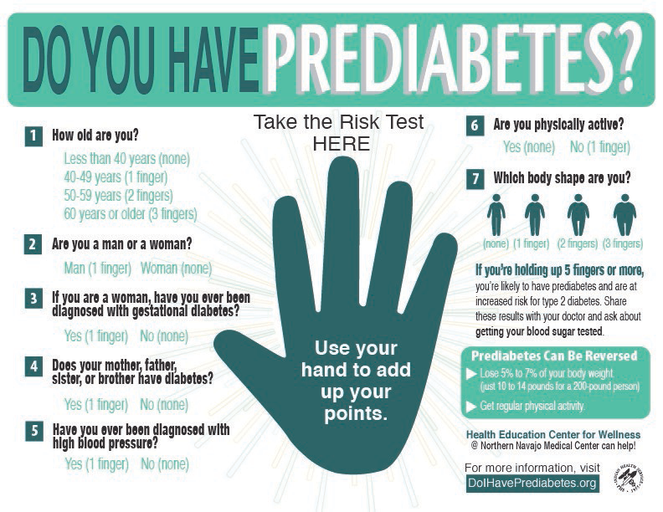
Do you have pre-diabetes?
https://linktr.ee/Thechirohygienist
Thechirohygenist@gmail.com
http://linkedin.com/in/karen-ann-gordon-dc-rdh-92144498
@thechirohygienist

Slide 13

Gestational Diabetes
  10% of pregnancies in the US are affected by gestational diabetes every year
  30% of pregnant women suffer from periodontal diseases
https://linktr.ee/Thechirohygienist
Thechirohygenist@gmail.com
http://linkedin.com/in/karen-ann-gordon-dc-rdh-92144498
@thechirohygienist

Slide 14
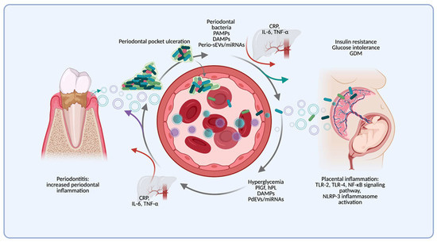
Gestational Diabetes
  Oral hygiene manifestation caused by release of estrogen and progesterone increasing blood flow to the gingiva
  The acute phase response in the liver & pro-inflammatory cytokines generate a cross-linked systemic activation
https://linktr.ee/Thechirohygienist
Thechirohygenist@gmail.com
http://linkedin.com/in/karen-ann-gordon-dc-rdh-92144498
@thechirohygienist

Slide 15
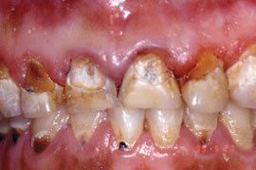
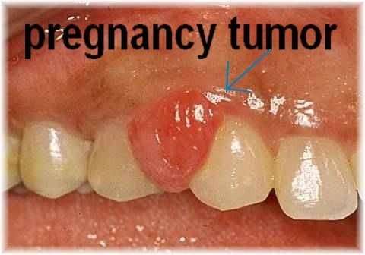
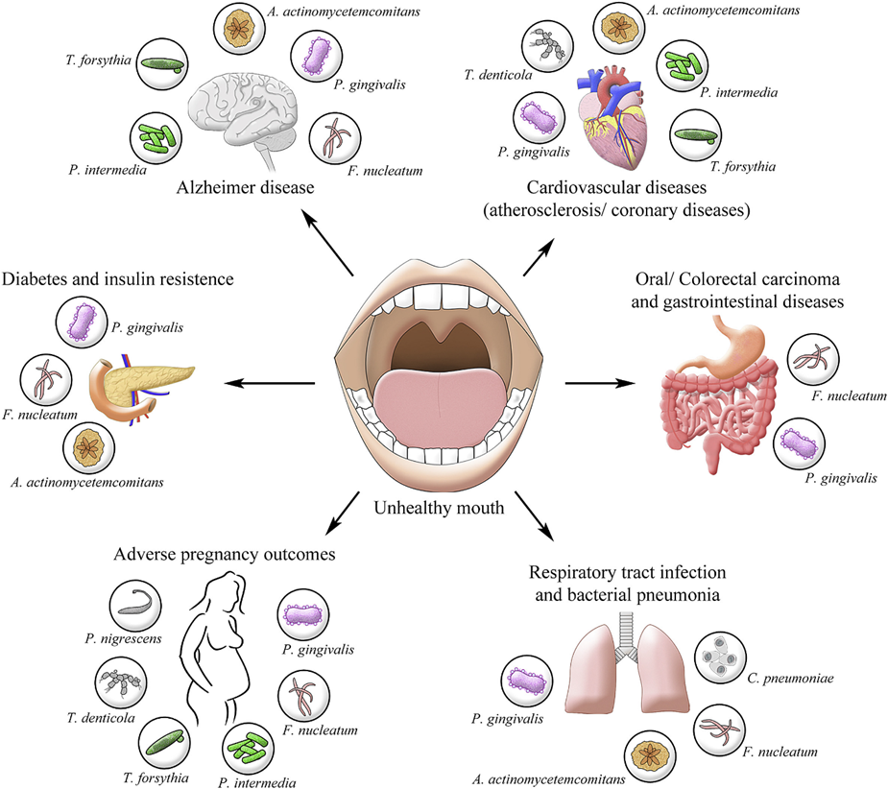
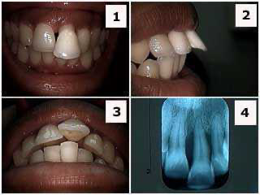

Gestational Diabetes
https://linktr.ee/Thechirohygienist
Thechirohygenist@gmail.com
http://linkedin.com/in/karen-ann-gordon-dc-rdh-92144498
@thechirohygienist

Slide 16




Type 1 Diabetes Mellitus
  1% of the population is affected by T1DM
  Autoimmune Disease
  Adverse immune response to genetic and environmental factors.
  Type 1 diabetes typically appears in 2 peaks.
    1st peak occurs in children between 4 and 7 years old.
    2nd peak is in children between 10 and 14 years old.
https://linktr.ee/Thechirohygienist
Thechirohygenist@gmail.com
http://linkedin.com/in/karen-ann-gordon-dc-rdh-92144498
@thechirohygienist

Slide 17
Type 1 Diabetes Mellitus
  Type 1 diabetes occurs when insulin lose the ability to convert sugars in the blood to create energy.
  Immune system destroys the insulin-producing (islet) cells in the pancreas
  As a result, the insulin deficiency causes pancreatic B cell apoptosis —> impaired cell function and metabolism
https://linktr.ee/Thechirohygienist
Thechirohygenist@gmail.com
http://linkedin.com/in/karen-ann-gordon-dc-rdh-92144498
@thechirohygienist

Slide 18
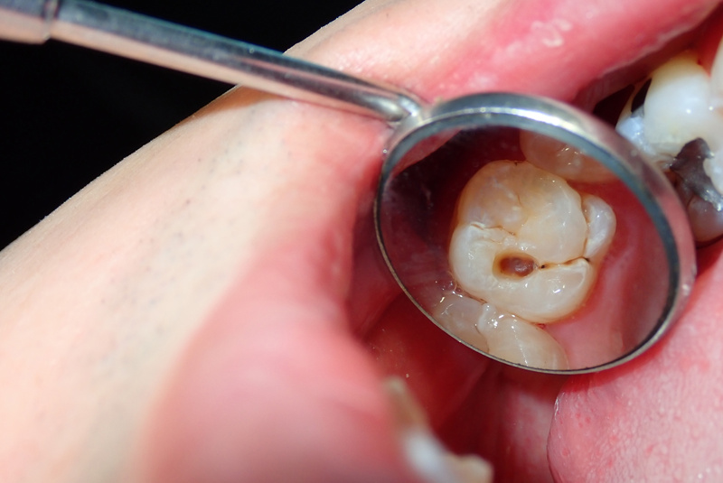
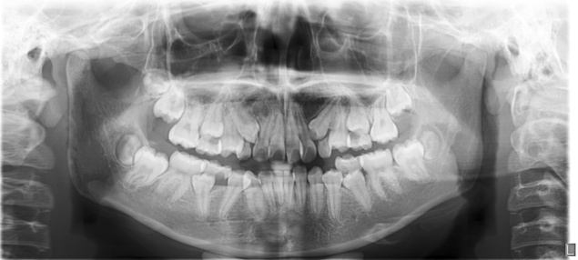
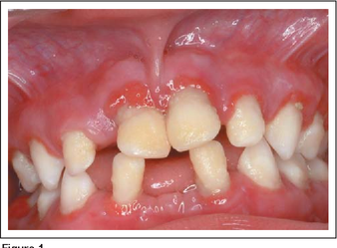
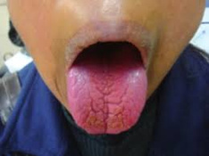

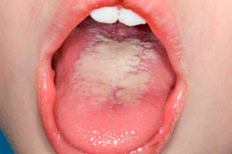
Oral Manifestations of T1DM
Increased risk of dental caries due to salivary hypofunction
Accelerated tooth eruption with increasing age
Gingivitis with high risk of periodontal disease (poor control increases risk)
Salivary gland dysfunction leading to xerostomia
Impaired or delayed wound healing
Taste dysfunction
Oral candida
https://linktr.ee/Thechirohygienist
Thechirohygenist@gmail.com
http://linkedin.com/in/karen-ann-gordon-dc-rdh-92144498
@thechirohygienist

Slide 19
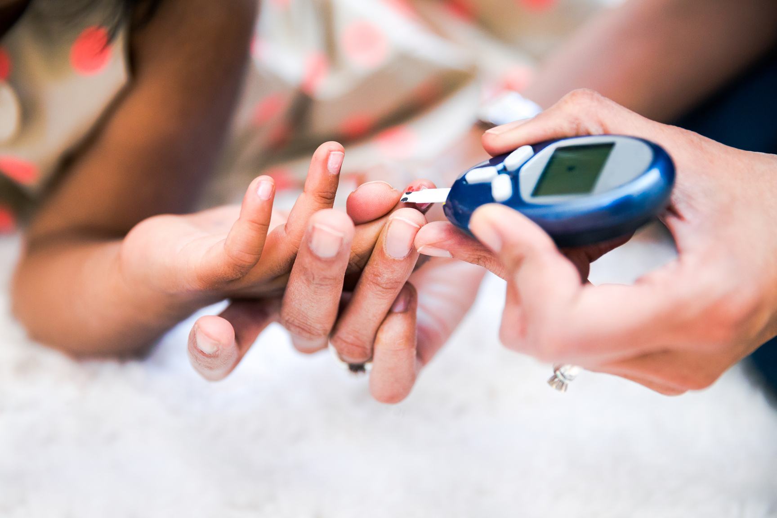
Type 2 Diabetes
  Insulin resistance is coupled with reduced insulin output.
  Pancreatic islet cells cannot make or effectively use its insulin.
  Excess buildup of glucose in the blood causing starvation—> apoptosis.
https://linktr.ee/Thechirohygienist
Thechirohygenist@gmail.com
http://linkedin.com/in/karen-ann-gordon-dc-rdh-92144498
@thechirohygienist

Slide 20
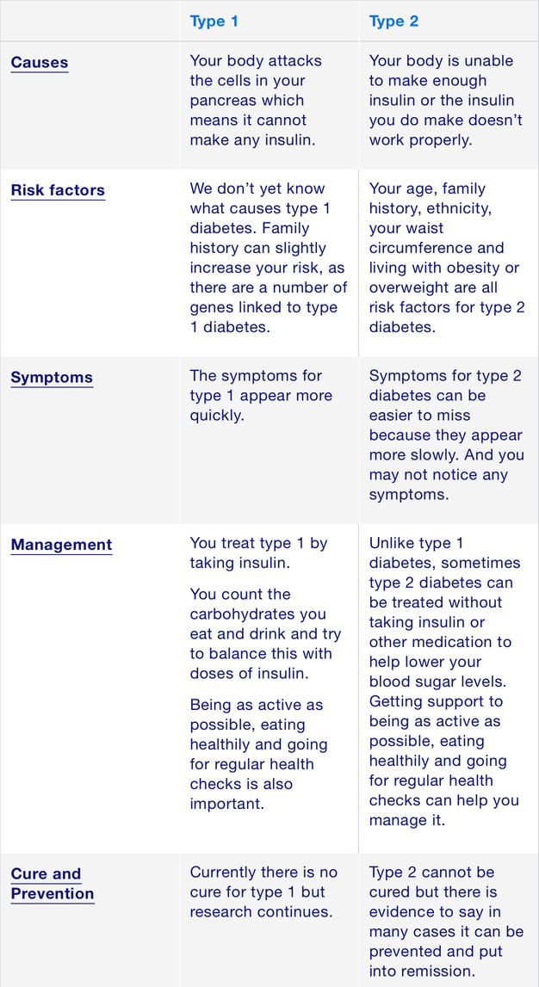
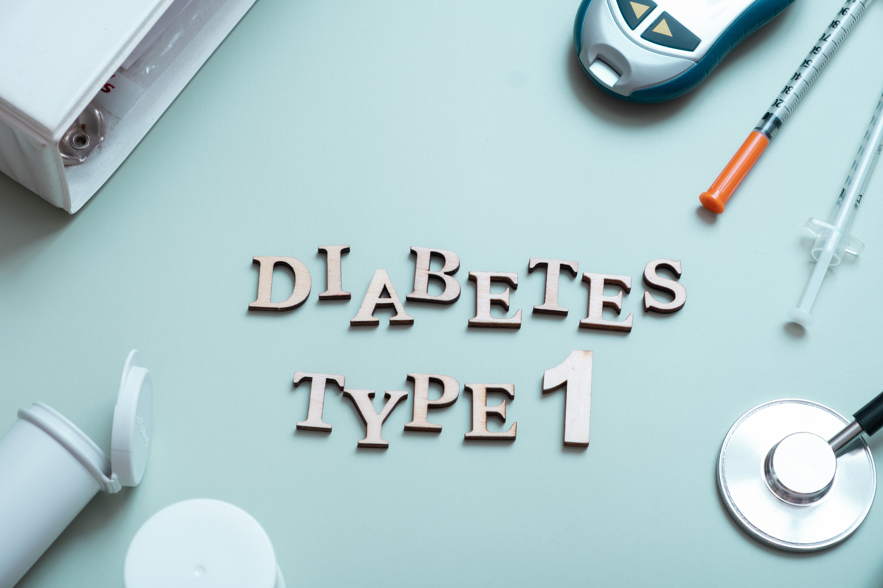
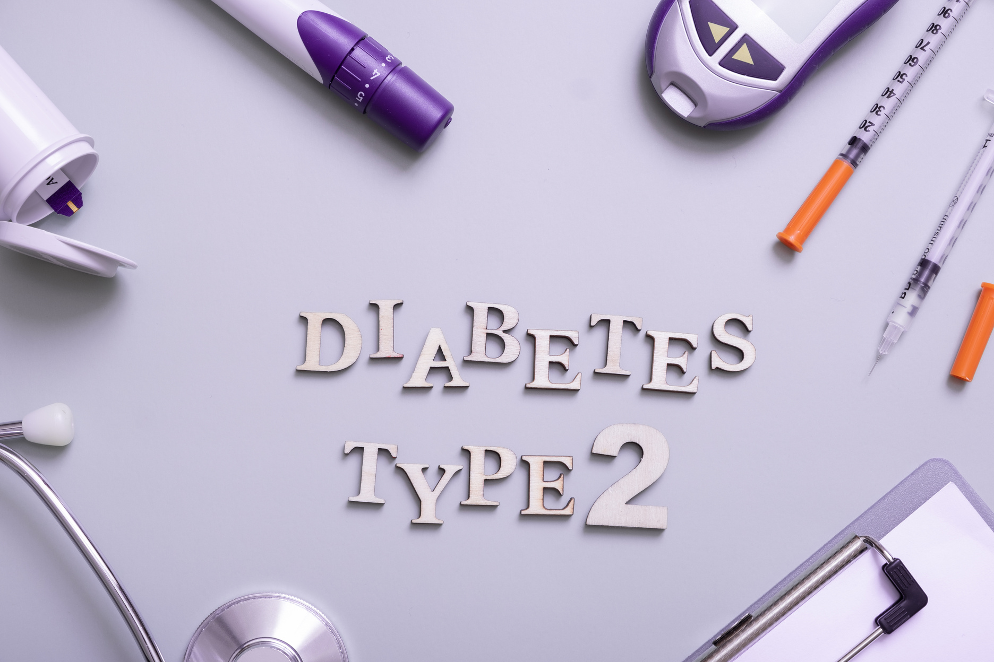
Type 1 vs Type 2
https://linktr.ee/Thechirohygienist
Thechirohygenist@gmail.com
http://linkedin.com/in/karen-ann-gordon-dc-rdh-92144498
@thechirohygienist

Slide 21
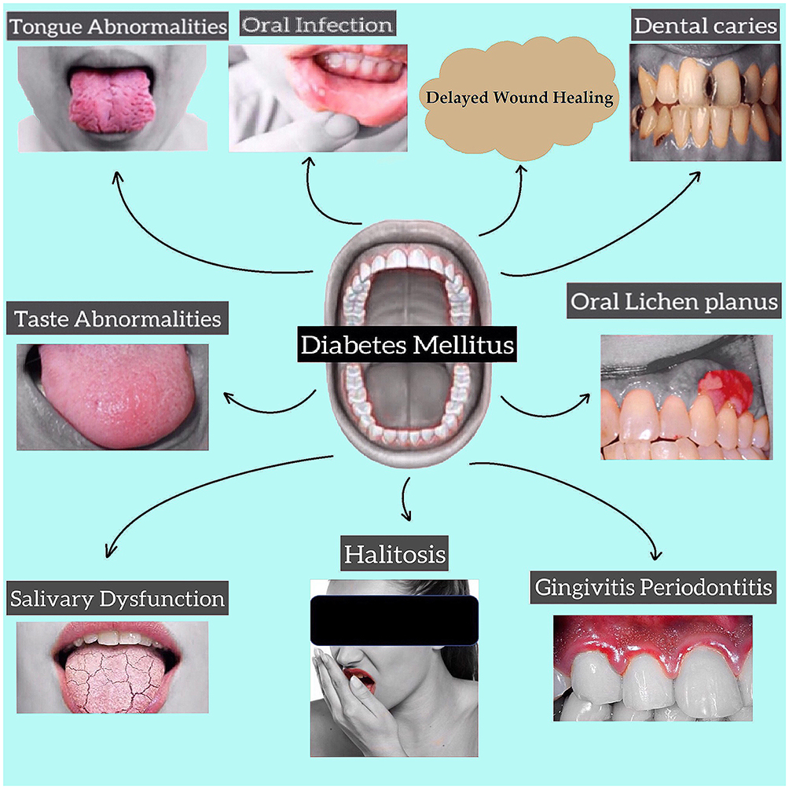
Oral Manifestation of Diabetes
https://linktr.ee/Thechirohygienist
Thechirohygenist@gmail.com
http://linkedin.com/in/karen-ann-gordon-dc-rdh-92144498
@thechirohygienist

Slide 22
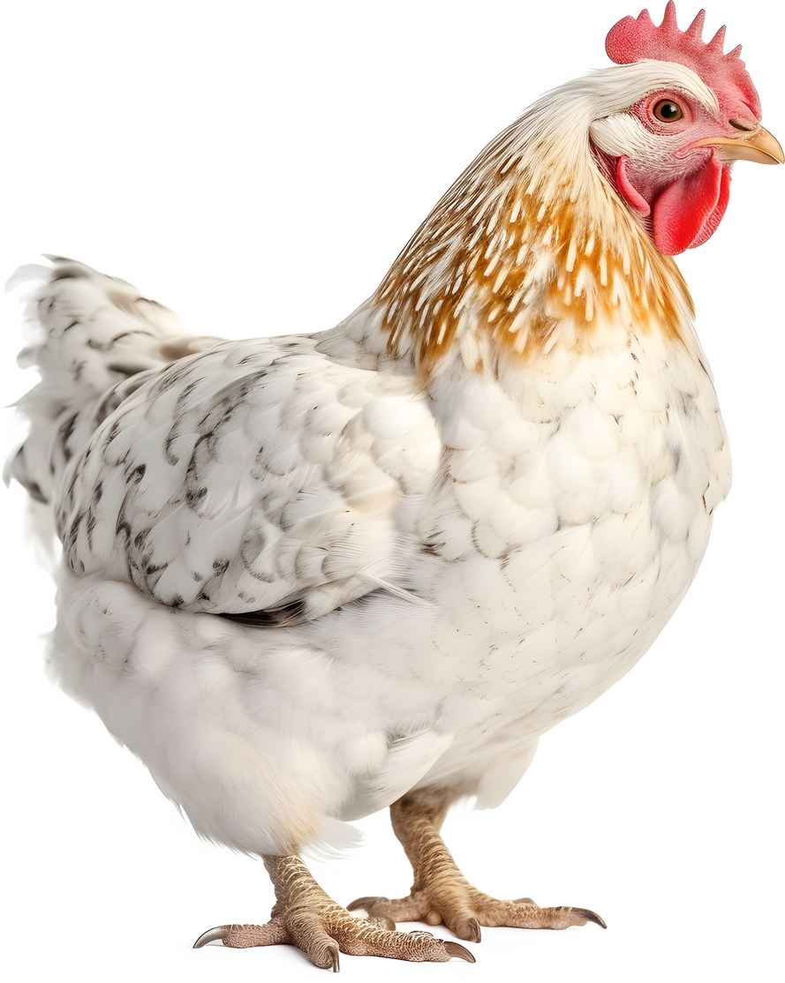
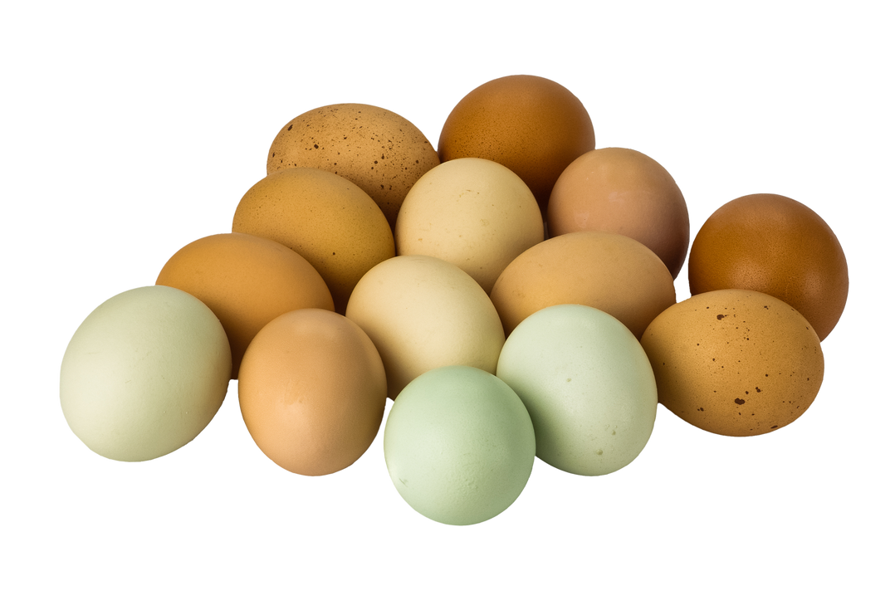
Which came first ?
Diabetes
or
Gum Disease
https://linktr.ee/Thechirohygienist
Thechirohygenist@gmail.com
http://linkedin.com/in/karen-ann-gordon-dc-rdh-92144498
@thechirohygienist

Slide 23
Periodontal Disease and Diabetes a Bidirectional Relationship
  THE ORAL CAVITY CREATES THE OPTIMAL ENVIRONMENT AS AN INCUBATOR FOR BACTERIA
  THE BIOFILM, MORE COMMONLY KNOWN AS “PLAQUE”, WHICH IS THE PRIMARY CAUSE FOR PERIODONTAL DISEASE
https://linktr.ee/Thechirohygienist
Thechirohygenist@gmail.com
http://linkedin.com/in/karen-ann-gordon-dc-rdh-92144498
@thechirohygienist

Slide 24
Periodontal Disease and Diabetes a Bidirectional Relationship
https://linktr.ee/Thechirohygienist
Thechirohygenist@gmail.com
http://linkedin.com/in/karen-ann-gordon-dc-rdh-92144498
@thechirohygienist

Slide 25
Oral Hygiene Management
https://linktr.ee/Thechirohygienist
Thechirohygenist@gmail.com
http://linkedin.com/in/karen-ann-gordon-dc-rdh-92144498
@thechirohygienist

Slide 26
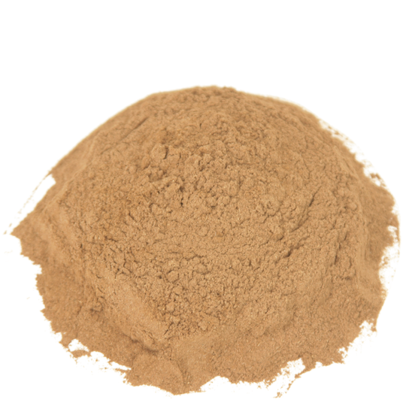
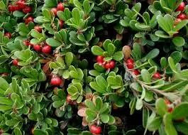
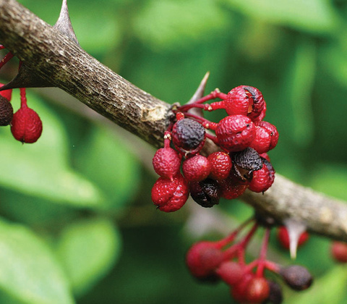
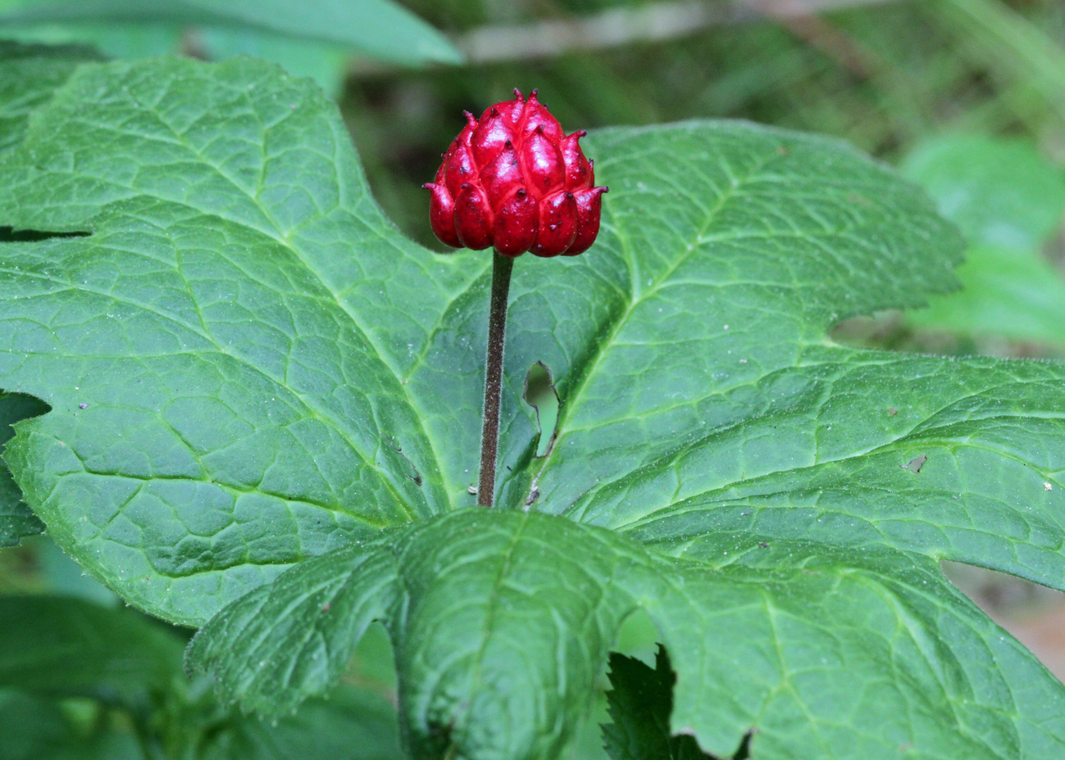
Traditional Oral Hygiene Methods
White Oak bark powder used by the Iroquois , Penobscot and Menominee Tribes
  Used as an antiseptic and anti-inflammatory agent
  Directly placed on the gums to reduce inflammation
Bearberry (Arctostaphylos uva-usi) is a herbal knnikinnic used by Objwa, Blackfoot, Navaho & Cheyenne tribes as a treatment to numb tooth pain, treat headaches, canker sores and anxiety
Prickly Ash(Zanthoxylum) used by the Cherokee, Chippewa, Comanche etc. It is unique as it posses antibacterial and antifungal properties . Used to treat toothaches increase saliva flow and support digestive health. Prickly Ash is known to enhance blood circulation and treat nerve pain.
Goldenseal/Bitter Herb (Hydrasis canadensis) Used by the Cherokee and Iroquois for its antiseptic and anti-inflammatory properties. It was used to treat gum inflammation, mouth ulcers and cavities
https://linktr.ee/Thechirohygienist
Thechirohygenist@gmail.com
http://linkedin.com/in/karen-ann-gordon-dc-rdh-92144498
@thechirohygienist

Slide 27
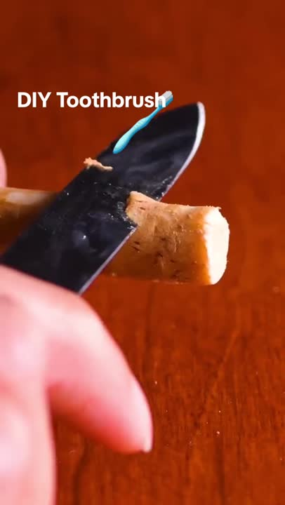
Traditional Oral Hygiene Methods
Natural Toothbrush the Miswak is
made from roots and branches of the
Salvadora Persica plant or Arak plant
It is known for :
  Plaque reduction
  Teeth whitening
  Reduce malodorous breath
  Kills harmful bacteria
  Increases salivation
  Assists with nicotine addiction
https://linktr.ee/Thechirohygienist
Thechirohygenist@gmail.com
http://linkedin.com/in/karen-ann-gordon-dc-rdh-92144498
@thechirohygienist

Slide 28
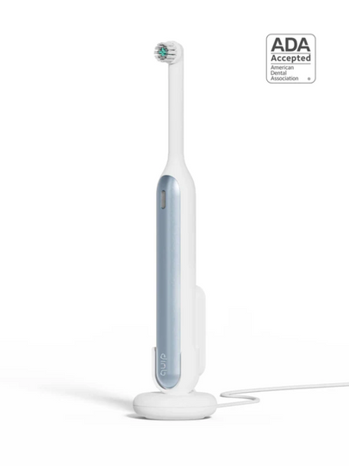
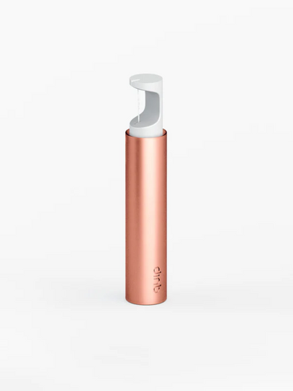

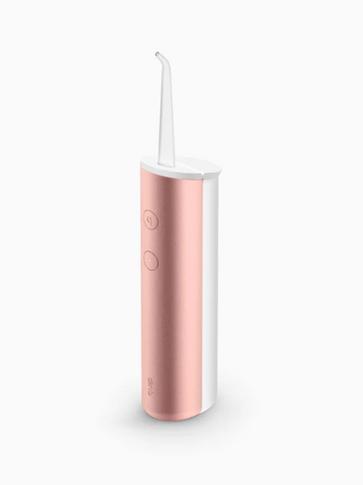
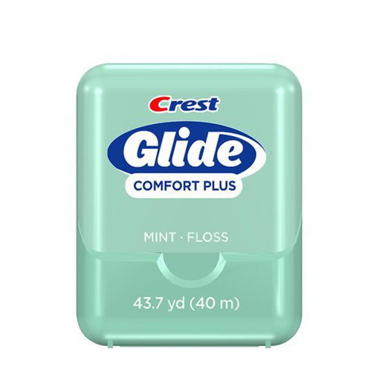
Modern Day Methods
https://linktr.ee/Thechirohygienist
Thechirohygenist@gmail.com
http://linkedin.com/in/karen-ann-gordon-dc-rdh-92144498
@thechirohygienist

Slide 29
Diabetes Management
https://linktr.ee/Thechirohygienist
Thechirohygenist@gmail.com
http://linkedin.com/in/karen-ann-gordon-dc-rdh-92144498
@thechirohygienist

Slide 30

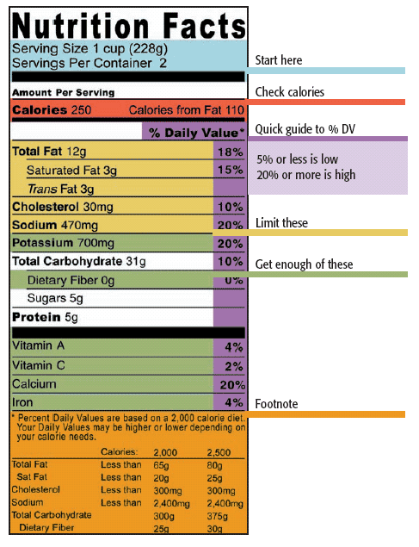
Nutritional Counseling For Patients With Oral Health Conditions
https://linktr.ee/Thechirohygienist
Thechirohygenist@gmail.com
http://linkedin.com/in/karen-ann-gordon-dc-rdh-92144498
@thechirohygienist

Slide 31

Nutritional Counseling For Patients With Oral Health Conditions
https://linktr.ee/Thechirohygienist
Thechirohygenist@gmail.com
http://linkedin.com/in/karen-ann-gordon-dc-rdh-92144498
@thechirohygienist

Slide 32
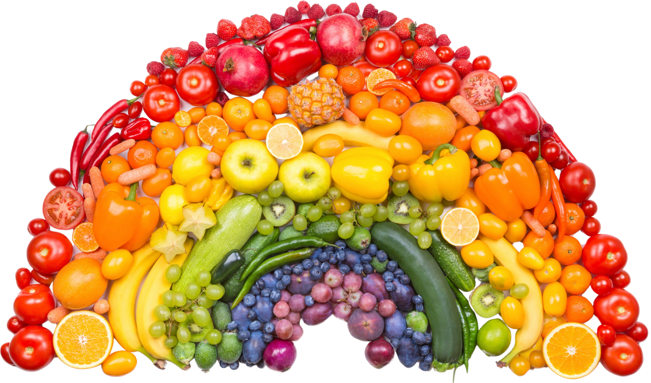
Eat The Rainbow
https://linktr.ee/Thechirohygienist
Thechirohygenist@gmail.com
http://linkedin.com/in/karen-ann-gordon-dc-rdh-92144498
@thechirohygienist

Slide 33
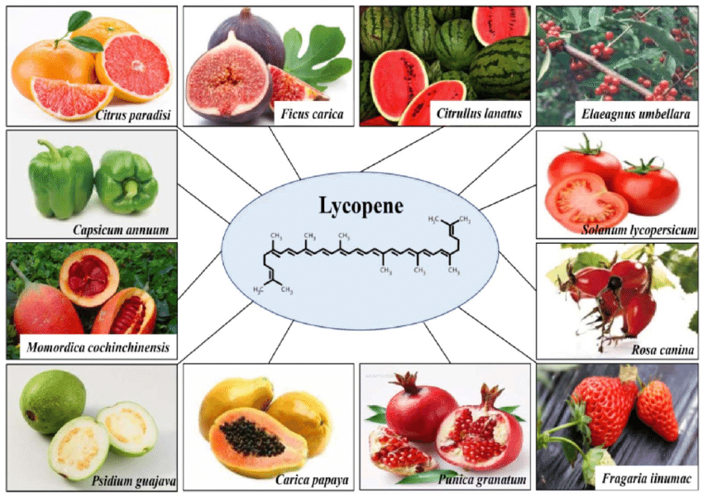
RED (Lycopene)
Keeps our heart healthy and decreases risk of stroke.
Prevents and even fights cancer, especially prostate and breast.
Good for urinary tract health and for memory!
https://linktr.ee/Thechirohygienist
Thechirohygenist@gmail.com
http://linkedin.com/in/karen-ann-gordon-dc-rdh-92144498
@thechirohygienist

Slide 34
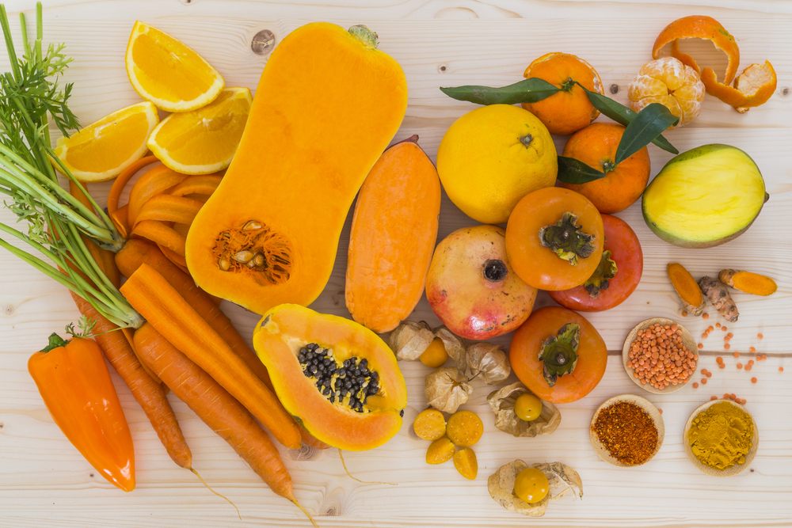
ORANGE/YELLOW (Carotenoids)
Decreases inflammation in the body and helps prevent cancer.
Keeps our immune system strong and our skin healthy.
Good for our vision - helps us see at night!
https://linktr.ee/Thechirohygienist
Thechirohygenist@gmail.com
http://linkedin.com/in/karen-ann-gordon-dc-rdh-92144498
@thechirohygienist

Slide 35
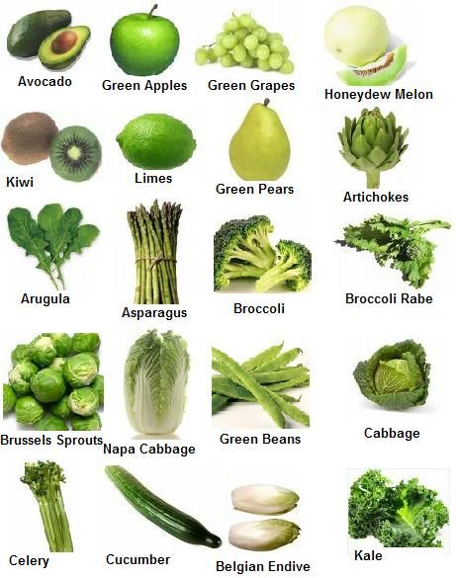
GREEN (Lutein)
Protects our eyes by preventing cataracts and slowing age-related macular degeneration (natural worsening of eyesight as we get older).
Keeps our bones, teeth and nails strong and also, prevents blood clots!
https://linktr.ee/Thechirohygienist
Thechirohygenist@gmail.com
http://linkedin.com/in/karen-ann-gordon-dc-rdh-92144498
@thechirohygienist

Slide 36
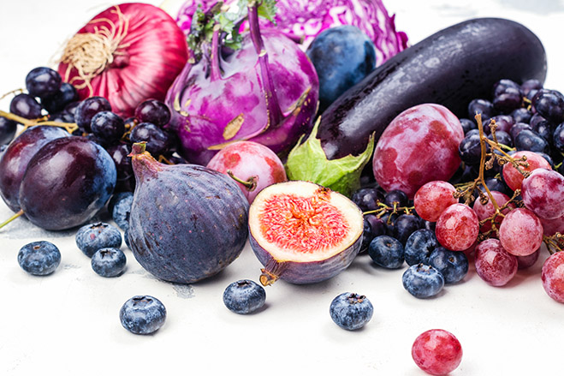
BLUE/PURPLE (Anthocyanins)
Helps us age gracefully by improving our memory and keeping our skin looking young.
Reduces blood pressure and lowers the risk of stroke and heart disease.
Helps fight cancers, especially those in the GI tract (mouth, esophagus, colon)!
https://linktr.ee/Thechirohygienist
Thechirohygenist@gmail.com
http://linkedin.com/in/karen-ann-gordon-dc-rdh-92144498
@thechirohygienist

Slide 37
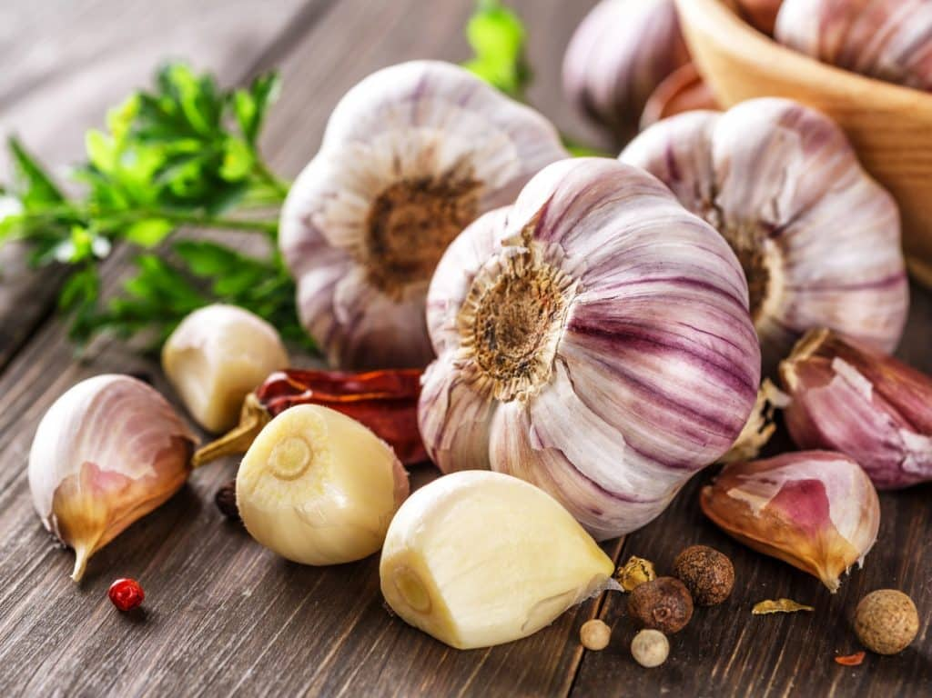
WHITE/TAN (Allicin)
Lowers cholesterol and blood pressure.
Keeps our bones strong and healthy.
Helps fight cancers, especially stomach cancer!
Antibacterial properties against gram-negative and gram-positive bacteria.
https://linktr.ee/Thechirohygienist
Thechirohygenist@gmail.com
http://linkedin.com/in/karen-ann-gordon-dc-rdh-92144498
@thechirohygienist

Slide 38
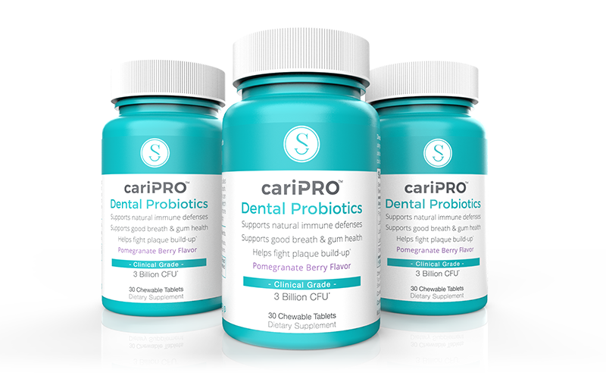
Dental Probiotics
ORAL SYSTEMIC APPROACH-HEALING FROM THE GUT
DENTAL PROBIOTICS
  BALANCES ORAL AND GUT MICROBIOTA
  ENHANCE GOOD BACTERIA
  IMPROVES DIGESTION AND NUTRIENT ABSORPTION
https://linktr.ee/Thechirohygienist
Thechirohygenist@gmail.com
http://linkedin.com/in/karen-ann-gordon-dc-rdh-92144498
@thechirohygienist

Slide 39


Chef Márquez
@chefnite2015 on Instagram
@taoschef2021 on TikTok
https://linktr.ee/Thechirohygienist
Thechirohygenist@gmail.com
http://linkedin.com/in/karen-ann-gordon-dc-rdh-92144498
@thechirohygienist

Slide 40




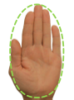
Portion Control
Vegetables (non-starchy)
Two handfuls
Poultry or Meat
Grains and starchy vegetables
or legumes
Vegetables(non-starchy),
Fruits or nuts
Fish- A fillet
https://linktr.ee/Thechirohygienist
Thechirohygenist@gmail.com
http://linkedin.com/in/karen-ann-gordon-dc-rdh-92144498
@thechirohygienist

Slide 41
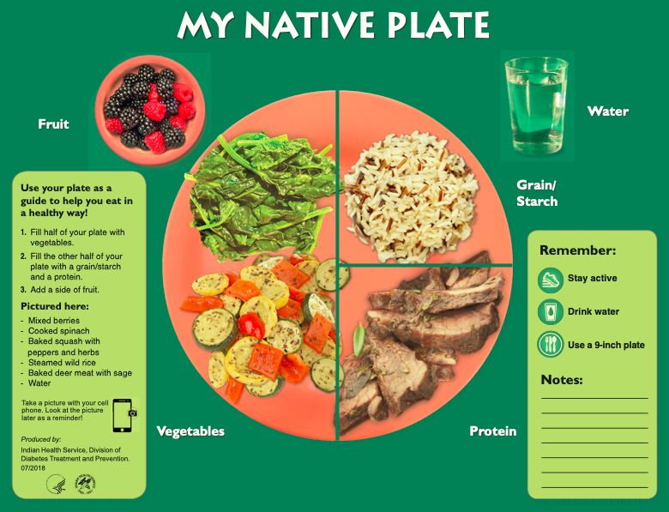
Portion Control
https://linktr.ee/Thechirohygienist
Thechirohygenist@gmail.com
http://linkedin.com/in/karen-ann-gordon-dc-rdh-92144498
@thechirohygienist

Slide 42
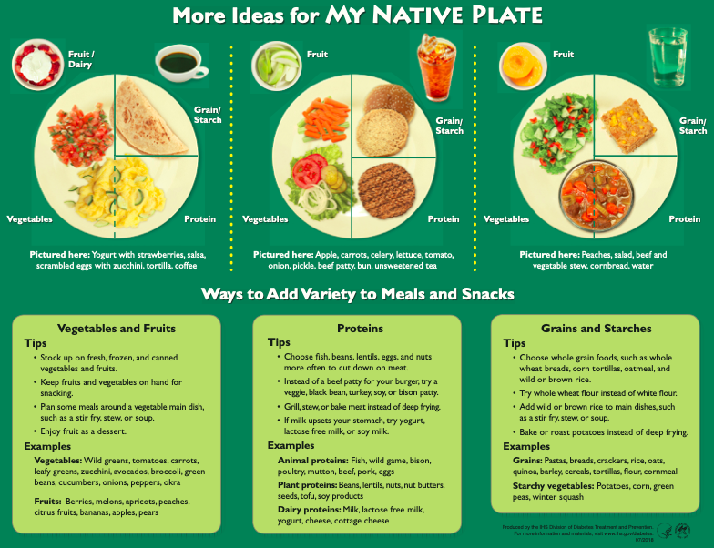
Portion Control
https://linktr.ee/Thechirohygienist
Thechirohygenist@gmail.com
http://linkedin.com/in/karen-ann-gordon-dc-rdh-92144498
@thechirohygienist

Slide 43

Nutritional Counselling For Patients With Oral Health Conditions
Key Points
Food Choices Add Up during the day
Choose Healthy Foods throughout the 5 food groups
Try to Roast and/or Steam
Read Food Labels
Small changes add up to big gains
https://linktr.ee/Thechirohygienist
Thechirohygenist@gmail.com
http://linkedin.com/in/karen-ann-gordon-dc-rdh-92144498
@thechirohygienist

Slide 44

Exercise Management for Diabetic Patients
MOVEMENT IS MEDICINE
30 minutes of exercise Everyday
Walk 10000 steps everyday
20/20 RULE
Every 20 minutes : Change your position
https://linktr.ee/Thechirohygienist
Thechirohygenist@gmail.com
http://linkedin.com/in/karen-ann-gordon-dc-rdh-92144498
@thechirohygienist

Slide 45

Mind Body Connection and Diabetes Control
ORAL SYSTEMIC APPROACH-SELF REGULATION
CONNECT WITH NATURE
DIAPHRAGMATIC BREATHING
DEVELOP A RELAXATION ROUTINE
SLEEP HYGIENE
EXERCISE
GRATTITUDE AND JOURNALING EXERCISES
https://linktr.ee/Thechirohygienist
Thechirohygenist@gmail.com
http://linkedin.com/in/karen-ann-gordon-dc-rdh-92144498
@thechirohygienist

Slide 46

Case Study
a 53-year-old female patient present with a history of well-controlled diabetes mellitus, depression, hypertension, and allergies. today, she presents for routine follow-up for her multiple medical conditions.
https://linktr.ee/Thechirohygienist
Thechirohygenist@gmail.com
http://linkedin.com/in/karen-ann-gordon-dc-rdh-92144498
@thechirohygienist

Slide 47
Case Study
She is a type 2 diabetic, so you perform an oral examination at this visit and advise her to see a dental care provider regularly. what is the probable mechanism connecting periodontal disease with diabetes mellitus?
a. diabetics with chronically high blood sugar levels have high salivary sugar levels that promote tooth decay in the same way eating foods in high sugar content cause tooth decay.
b. the bacterial and host response in periodontitis releases inflammatory chemical mediators into the bloodstream that have distant effects.
c. patients with elevated blood sugars have high levels of oral bacteria that lead to increased rates of decay.
d. the medications to treat diabetes mellitus cause dry mouth, which in turn promotes dental decay.
https://linktr.ee/Thechirohygienist
Thechirohygenist@gmail.com
http://linkedin.com/in/karen-ann-gordon-dc-rdh-92144498
@thechirohygienist

Slide 48
Case Study
She is a type 2 diabetic, so you perform an oral examination at this visit and advise her to see a dental care provider regularly.
What is the probable mechanism connecting periodontal disease with diabetes mellitus?
b. The bacterial and host response in periodontitis releases inflammatory chemical mediators into the bloodstream that have distant effects.
https://linktr.ee/Thechirohygienist
Thechirohygenist@gmail.com
http://linkedin.com/in/karen-ann-gordon-dc-rdh-92144498
@thechirohygienist

Slide 49
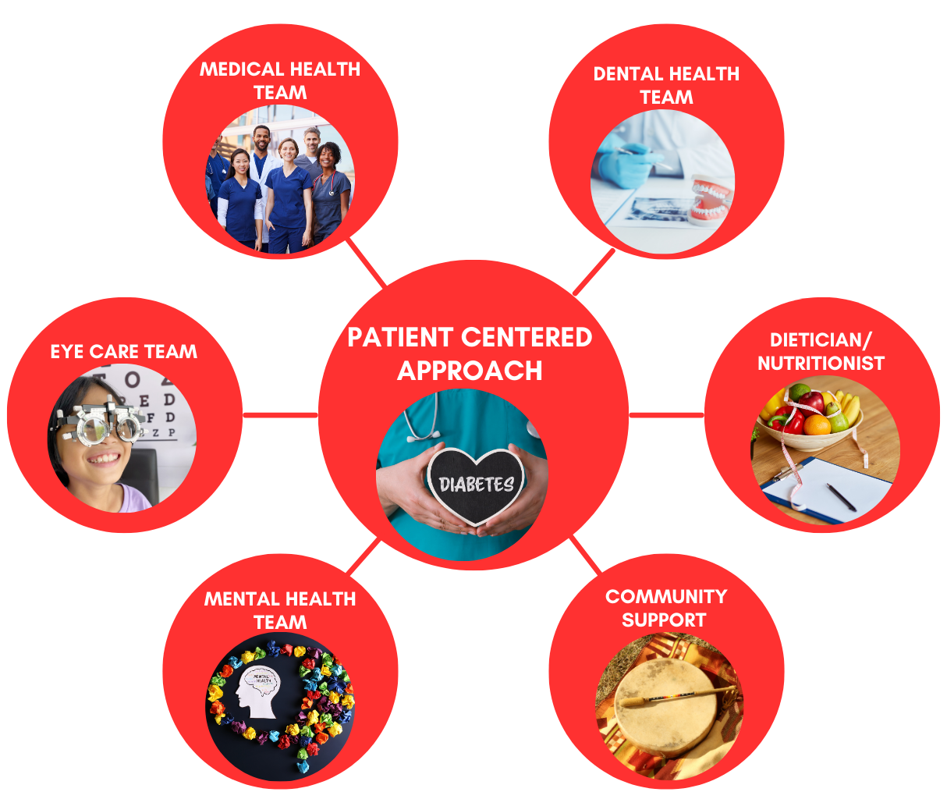
Treat Diabetes as an Integrative Multimodal Approach
https://linktr.ee/Thechirohygienist
Thechirohygenist@gmail.com
http://linkedin.com/in/karen-ann-gordon-dc-rdh-92144498
@thechirohygienist

Slide 50

Take Aways
Diabetes is a preventable disease
Bidirectional relationship between diabetes and periodontal disease
Control Oral Health outcomes
Avoid Processed food
Movement is Medicine
Decrease body weight by 7-10%
Health Equity can only be achieved if we are proactive and accountable
https://linktr.ee/Thechirohygienist
Thechirohygenist@gmail.com
http://linkedin.com/in/karen-ann-gordon-dc-rdh-92144498
@thechirohygienist

Slide 51
Questions
https://linktr.ee/Thechirohygienist
Thechirohygenist@gmail.com
http://linkedin.com/in/karen-ann-gordon-dc-rdh-92144498
@thechirohygienist

Slide 52
References
Ahmad, R., & Haque, M. (2021). Oral Health Messiers: Diabetes Mellitus Relevance. Diabetes, Metabolic Syndrome and Obesity: Targets and Therapy, Volume 14, 3001–3015. https://doi.org/10.2147/dmso.s318972
Alluri, C., Puckett, K., Sampath, C., Mott, D. A., Logan, K., Walker, J., Davis, G., Cherae Farmer-Dixon, & Gangula, P. R. (2023). The Two-Way Relationship between Diabetes Mellitus and Periodontal Disease: A New Insight. Dentistry. https://doi.org/10.5772/intechopen.108948
Botelho, J., Mascarenhas, P., Viana, J., Proença, L., Orlandi, M., Leira, Y., Chambrone, L., Mendes, J. J., & Machado, V. (2022). An umbrella review of the evidence linking oral health and systemic noncommunicable diseases. Nature Communications, 13(1), 7614. https://doi.org/10.1038/s41467-022-35337-8
Bui, F. Q., Almeida-da-Silva, C. L. C., Huynh, B., Trinh, A., Liu, J., Woodward, J., Asadi, H., & Ojcius, D. M. (2019). Association between periodontal pathogens and systemic disease. Biomedical Journal, 42(1), 27–35. https://doi.org/10.1016/j.bj.2018.12.001
CDC. (2019, November 25). Centers for Disease Control and Prevention. Centers for Disease Control and Prevention. http://www.cdc.gov/
CDC. (2024, May 9). About Type 1 Diabetes. Diabetes. https://www.cdc.gov/diabetes/about/about-type-1-diabetes.html
D’Aiuto, F., Gable, D., Syed, Z., Allen, Y., Wanyonyi, K. L., White, S., & Gallagher, J. E. (2017). Evidence summary: The relationship between oral diseases and diabetes. British Dental Journal, 222(12), 944–948.
Dental Hygiene ETDs | Electronic Theses and Dissertations |University of New Mexico. (2024). Unm.edu. https://digitalrepository.unm.edu/dehy_etds
Home - Oral Health Group. (2023, March 3). Oral Health Group. http://www.oralhealthgroup.com
Krause, M., & De Vito, G. (2023). Type 1 and type 2 diabetes mellitus: Commonalities, differences and the importance of exercise and nutrition. Nutrients, 15(19), 4279–4279. https://doi.org/10.3390/nu15194279
Kurtzman, G. M., Horowitz, R. A., Johnson, R., Prestiano, R. A., & Klein, B. I. (2022). The systemic oral health connection: Biofilms. Medicine, 101(46), e30517. https://doi.org/10.1097/md.0000000000030517
Loose teeth that move or are mobile when chewing. (2022). Dental Education Information from Dr. Jeffrey Dorfman. https://dental-edu.com/services/gum-disease-treatment/loose-teeth-that-move-or-are-mobile-when-chewing/
Nacakgedigi, O. (2020). Miswak: An Alternative Approach to Oral Hygiene Practices. https://cdha.org/Portals/CDHA/PDF/CE%20Exams/Miswak%20An%20Alternative%20Approach.pdf?ver=Uq7ffH7-9zQkP70OX9ecUg%3D%3D
Niazi, F., Naseem, M., Khurshid, Z., Zafar, M. S., & Almas, K. (2016). Role of Salvadora persica chewing stick (miswak): A natural toothbrush for holistic oral health. European Journal of Dentistry, 10(02), 301–308. https://doi.org/10.4103/1305-7456.178297
Prevalence Manifestations Clinical of untreated diabetes • High blood glucose level • Excessive thirst • Frequent urination • Weight loss • Fatigue • Poor growth in infants. (n.d.). https://dental.washington.edu/wp-content/media/sp_need_pdfs/Diabetes-Dental.pdf
Rowles, G. (2009). Montana Adventure Guide. Hunter Publishing, Inc.
Silk, H., Douglass, A., & Douglass, J. (2008). Oral Health during Pregnancy .
Takanori Shinjo, & Nishimura, F. (2024). The bidirectional association between diabetes and periodontitis, from basic to clinical. Japanese Dental Science Review, 60, 15–21. https://doi.org/10.1016/j.jdsr.2023.12.002
Type 1 Vs Type 2 Diabetes. (n.d.). DRIF. https://diabetesresearch.org/type-1-vs-type-2-diabetes/
Zarora, R., Immanuel, J., Chivese, T., MacMillan, F., & Simmons, D. (2022). Effectiveness of Integrated Diabetes Care Interventions Involving Diabetes Specialists Working in Primary and Community Care Settings: A Systematic Review and Meta-Analysis. International Journal of Integrated Care, 22(0), 11. https://doi.org/10.5334/ijic.6025
(n.d.). P1 /5 Saved from URL: Https://Www.news-Medical.net/News/20221228/How-Could-Probiotics-Be-Used-In-The-Management-of-Gingivitis-a Nd-Periodontitis.aspx.
https://linktr.ee/Thechirohygienist
Thechirohygenist@gmail.com
http://linkedin.com/in/karen-ann-gordon-dc-rdh-92144498
@thechirohygienist

Slide 53
ORAL HEALTH AND DIABETES
THANK YOU
The Braided Path
Weaving together wisdom, innovation, and community.
https://linktr.ee/Thechirohygienist
Thechirohygenist@gmail.com
http://linkedin.com/in/karen-ann-gordon-dc-rdh-92144498
@thechirohygienist

