Slide 1
USET Tribal Best Practice Conference
Energy of Healing
Presented by: Ivan Anderson, N.D.
Date: August 14, 2024

Slide 2


Come to the Edge
“Come to the edge,” he said.
“We can’t, we’re afraid!” they responded.
“Come to the edge,” he said.
“We can’t, We will fall!” they responded.
“Come to the edge,” he said.
And so they came.
And he pushed them.
And they flew.
Guillaume Apollinaire

Slide 3
What can you Expect from me?
  I’ll invite you to come to the edge.
  If allowed, I’ll push.
  It’s up to you to fly!

Slide 4
Where We Are Going?
Today's Approach to Healing Energy
vs.
Tomorrow's Approach

Slide 5
Let’s Start Where We Are Today

Slide 6
(Let’s Start Where We Are Today Continued)
  Our bodies are seen as solid objects
  We view the body as organs or glands within a system
  We use chemistry (Rx) and/or surgery to address disease in organs

Slide 7
(Let’s Start Where We Are Today Continued)
  Finding the root cause of a disease is not the priority
  We can quantify disease and illness with repeatable tests
  The impact of the entire system (body) is normally not considered

Slide 8
Characteristics of
Newtonian Physics

Slide 9
Along Came
Albert Einstein and his
Thoughts About Matter

Slide 10
My Healing Journey
A Mother’s Love

Slide 11
Asthma
My Own Crisis

Slide 12
The Little Sugar Pills, How Could This Be?

Slide 13
Some of Einstein's Thought

Slide 14
(Takeaways From Albert Einstein Continued)
  We are not solid objects; we are more energy than matter
  The observation is influenced by the observer

Slide 15
(Takeaways From Albert Einstein Continued)
  The test may not be completely replicable
  Imbalances start in the energetic body before entering the physical body
  “Big Picture” Approach of the entire energetic body

Slide 16
  Aura
  Chakras
  Meridians
  Interstitium
Energetic Body

Slide 17
  .Physical body
  .Mental Body
  Emotional Body
  .Etheric bodies to nth dimensions
  .Impacted by emotions and trauma
Aura - Multi-dimensional Body

Slide 18
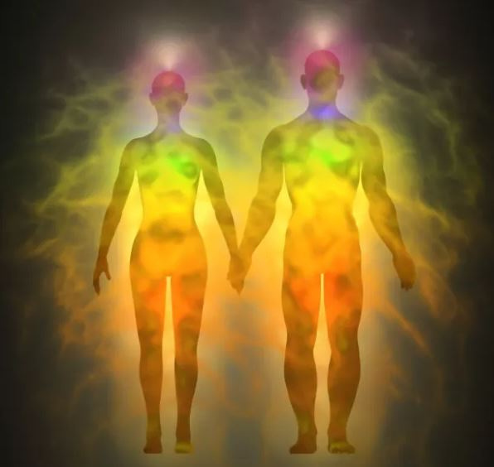

Slide 19
Chakras System
(Native Medicine of India)
  Seven Chakras (Base to Crown)
  Whirling Vortices
  Corresponds to the glandular system
  Indicates emotional (im)balance

Slide 20
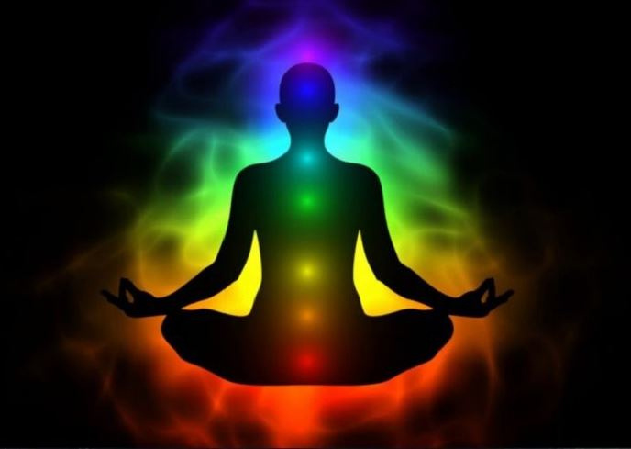

Slide 21
Meridians
(Traditional Chinese Medicine)
  Electrical Circuitry in the body
  Corresponds to the health of organs and some glands
  Sounds the alarm for emotions and pathogen imbalances

Slide 22
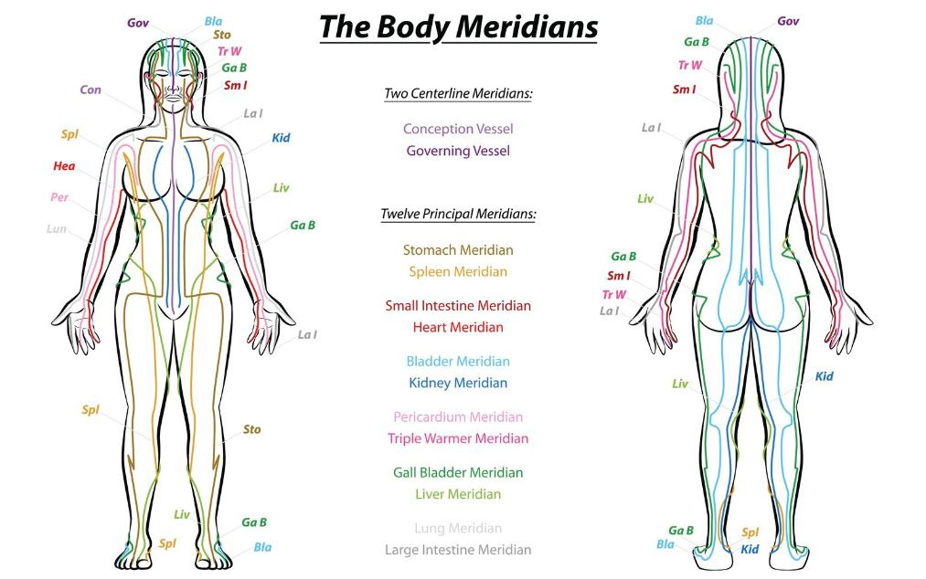

Slide 23
Interstitium
  Space around the cells of the body
  Where scientists have discovered generational habits and emotions are passed down energetically (epigenetics)

Slide 24
The Benefits
of Energy
Medicine Approach

Slide 25
(The Benefits of Energy Medicine Approach Continued)
  We may determine imbalances in the body perhaps 5-10 years before they may be found using conventional methods
  Looks at the root cause of the problem
  Noninvasive
  Distant healing opportunities

Slide 26
(The Benefits of Energy Medicine Approach Continued)
  Brings about holistic healing—mind, body and spirit
  Helps prevent reoccurrence
  Helps identify trauma and remove it from the system
  The healing possibilities are limited to only knowledge and imagination

Slide 27
Examples of
Energy Medicine
Modalities

Slide 28
(Examples of Energy Medicine Modalities Continued)
  Acupuncture
  Shiatsu/Acupressure
  Homeopathy
  Reiki
  Radionics

Slide 29
Show & Tell
The Radionic Box

Slide 30
Contact Information
Ivan Anderson, N.D.
info@healingtreehealth.com
(540)745-3030

Slide 31
Questions
&
Answers

Slide 32

Thank You

