Slide 1
Aspirnaut™: K20 STEM Pipeline for Diversity and wellness
USET Tribal Best Practices Panel

Slide 2
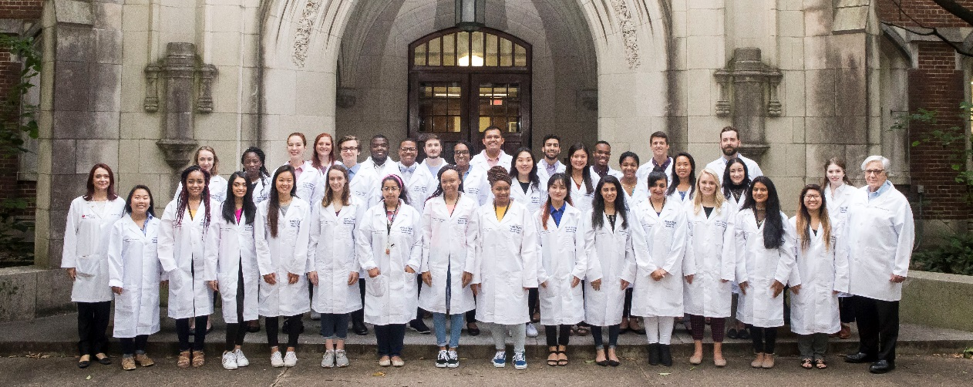
ASPIRNAUTS are
Aspiring Voyagers
Talented Youth
“Hidden Gems”
Seeking opportunity in STEM

Slide 3
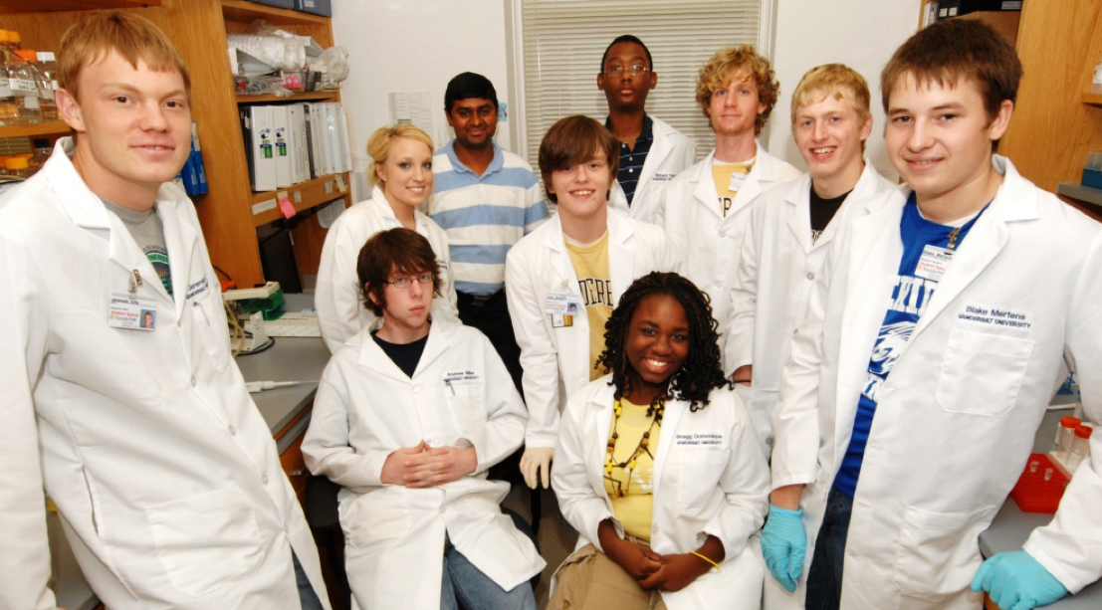
Summer Research Internships
AspirnautTM STEM Diversity Pipeline is a residential, hands-on laboratory experiences for high school and undergraduate students from rural and diverse backgrounds. Participants are mentored by biomedical researchers in conducting discovery research.

Slide 4
Aspirnaut™ Holistic Approach
Discovery Science Experience
40 hrs/week
Professional Skills Development
10 hrs/week
Self-Discovery
10 hrs/week
Research Experience
Science Communication
Psychological Thriving Skills
Lab Skills Course
Distinguished Speaker Luncheons
Wellness Training
Crafting Research Questions
ACT/SAT and Gen Chem Prep
Fitness Any Time
Any Where
Kidney 101
Long Term Mentorship
1-on-1 Career Mapping
Wellness for Life

Slide 5


Slide 6
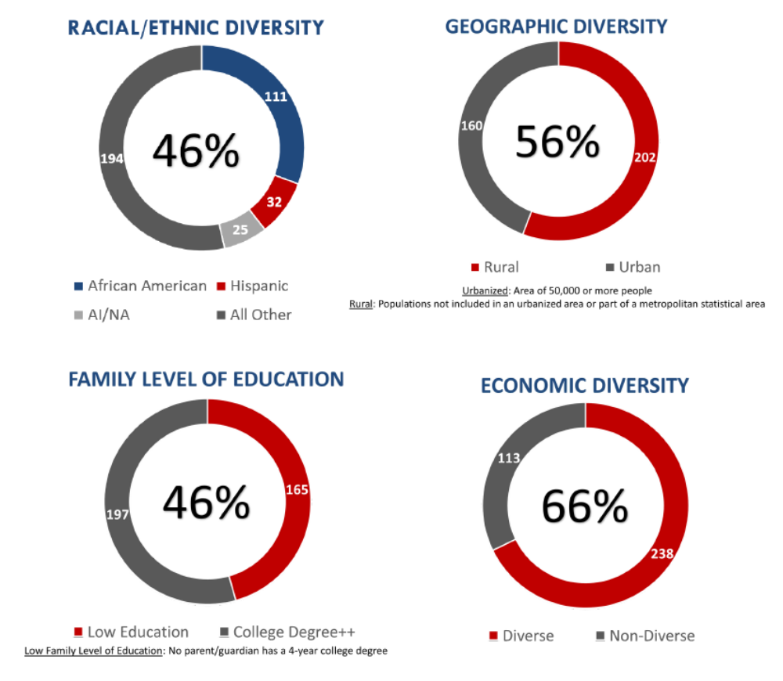

Slide 7

Other Life Experiences
25% of participants have an Adverse Childhood Experiences (ACE) score of 4 or higher

Slide 8
Our Vision
To provide students with the tools and empowerment to effect positive change in themselves, their families, and communities for generations to come.

Slide 9
www.aspirnaut.org

