Slide 1

James Spillane
Improvement Advisor PCMH

Slide 2
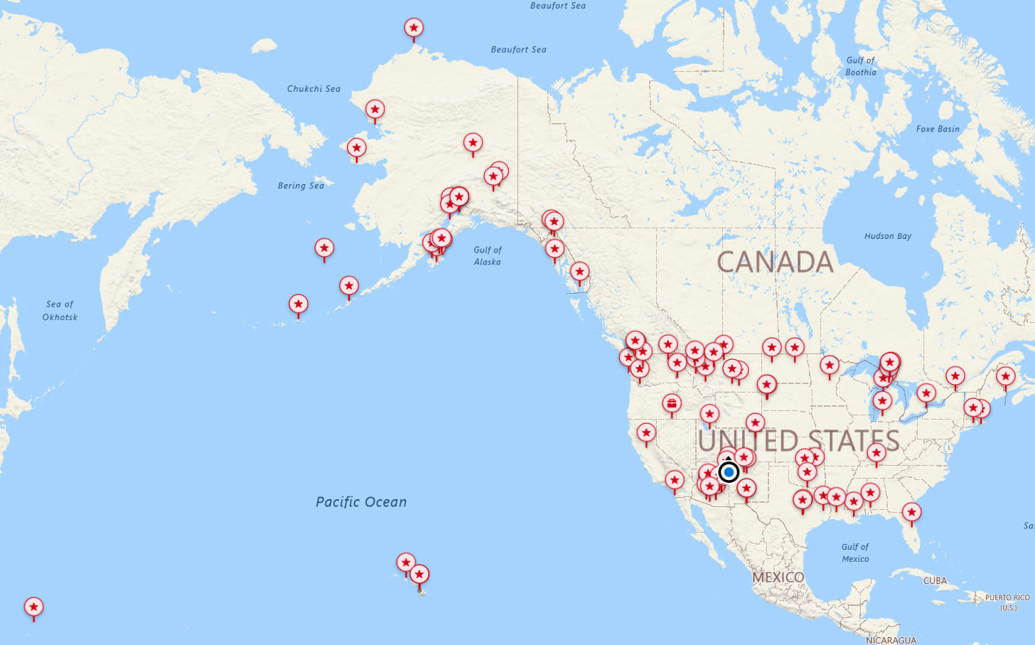

Slide 3



Slide 4
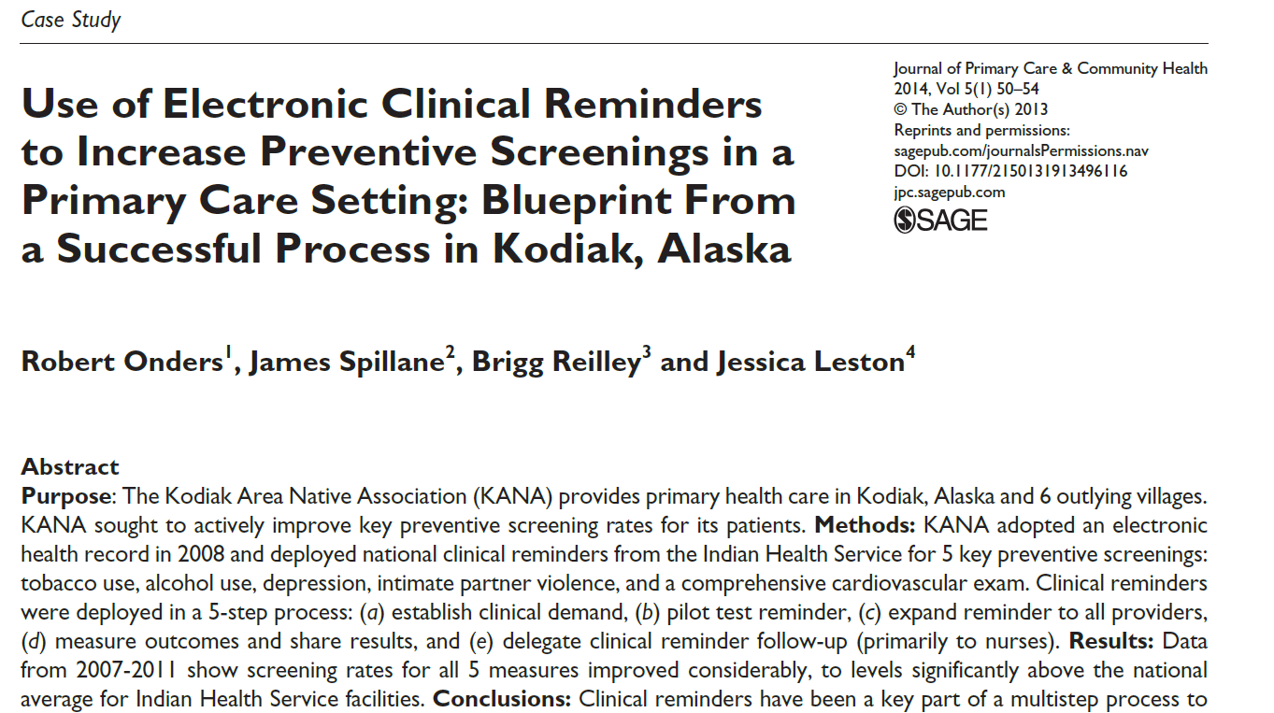

Slide 5
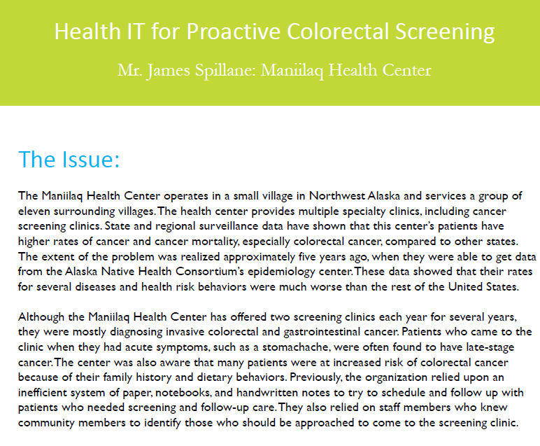

Slide 6
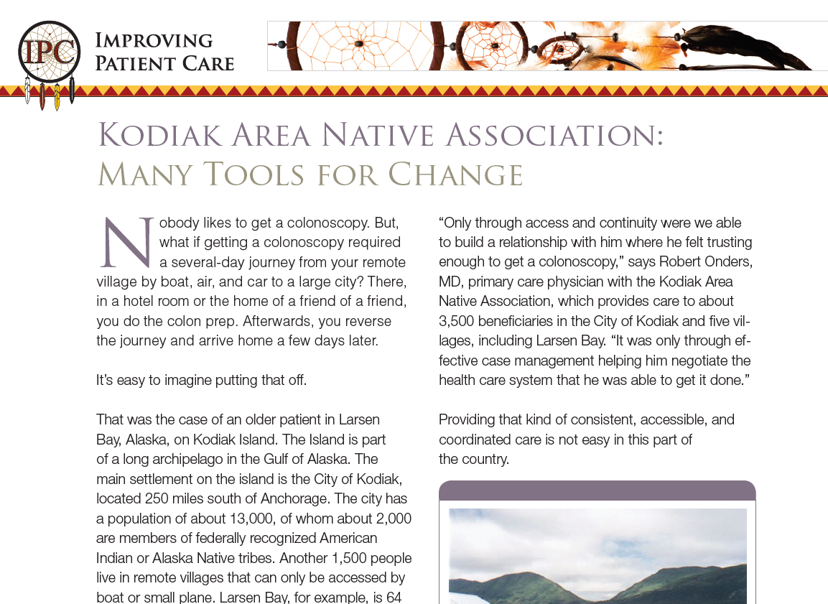

Slide 7
We are not in “Healthcare”
We are in “Health Caring”

Slide 8
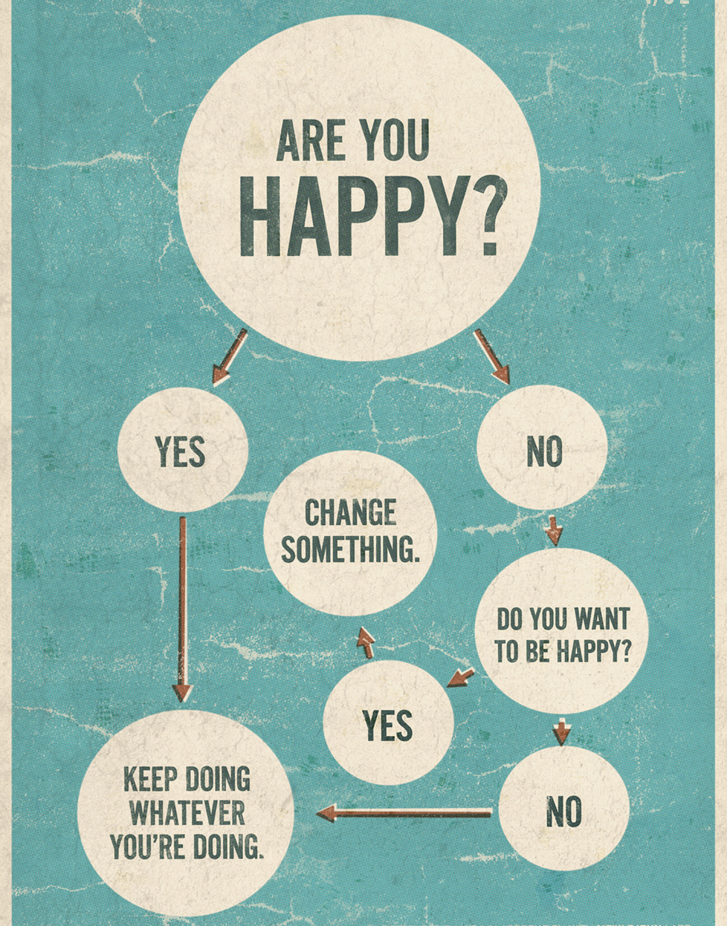

Slide 9
Solutions…
To address some of these outstanding “big” issues, thousands of little “tweaks” needed to be made.
Examples:
We needed to hire staff with medical knowledge in medical records to enter historical data into EHR for documentation and credit
PRC was backlogged, patients weren’t getting appointments schedule until months out, more schedulers were hired and trained to reduce this backlog
Policies, procedures and job descriptions were revised throughout this process
Lots or process mapping to identify the high leverage points in the system
Tons of training in EHR, iCare, CMET usage, roles and responsibilities to include case management, care coordination and quality measures such as GPRA
Training on population health management, sending out patient due letters and notification for Paps, Mammos, Colon Cancer Screens, Flu shots, etc.
Empaneling patients
Fast track clinic was set up to alleviate some of the ED unnecessary utilization and reduce pressure on the PCP outpatient schedules
    A Patient Centered Medical Home model is truly taking shape!
    Moved from a reactive to proactive healthcare system!

Slide 10

PCMH

Slide 11
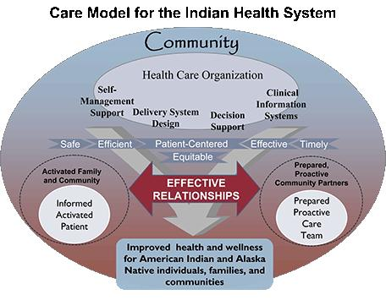

Slide 12
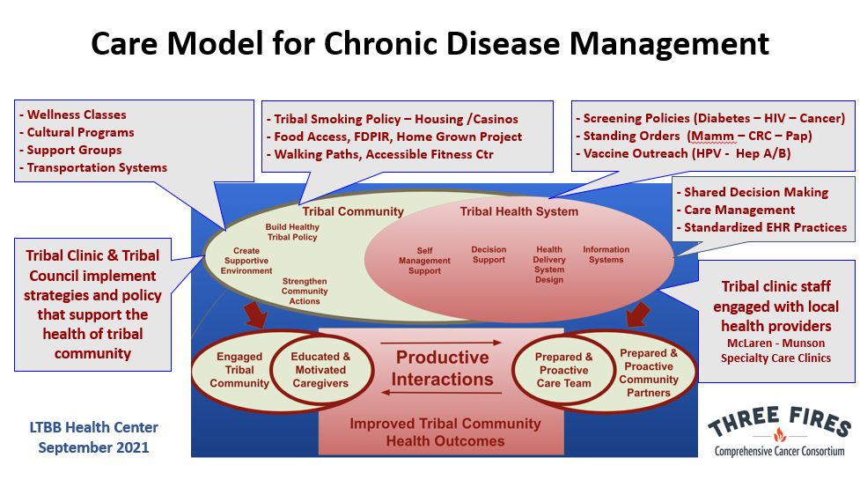

Slide 13

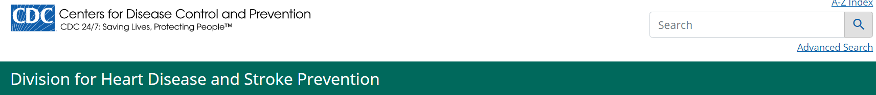
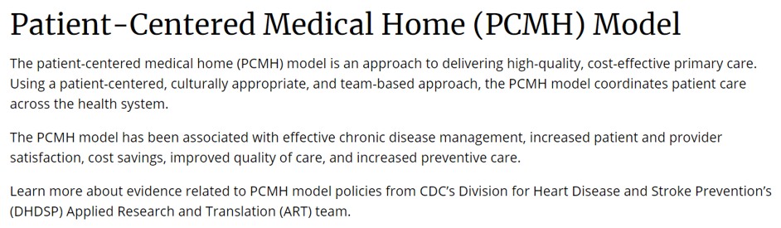
PCMH
https://www.ahrq.gov/ncepcr/tools/pcmh/defining/index.html

Slide 14
Access
Care team
Comprehensive
Coordinated
Quality

Slide 15

Access to Care
Timely access to care
24/7 availability
  Lab results
  Advice
  Scheduling
  Medications
Electronic communication
Alternative Appointments
  Telephonic
  Telehealth
Notes:
The first element of the PCMH model is access to care. This means that patients should be able to access care when they need it, whether it's during regular office hours or after hours. Timely access to appointments, electronic communication, and 24/7 availability are some ways to improve access to care.

Slide 16
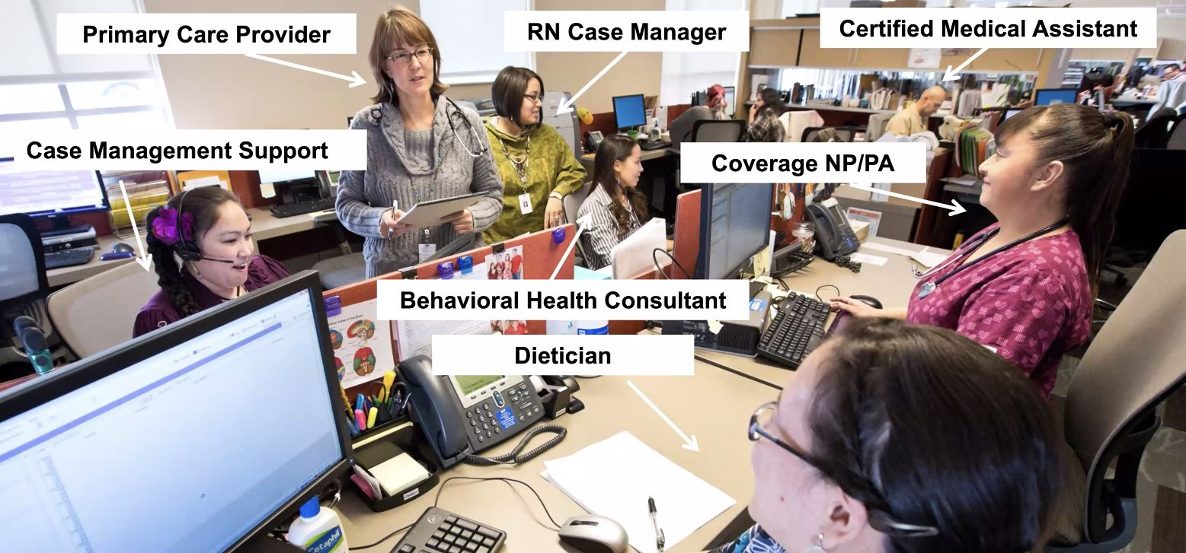
Care Team
Patient-centered care
Team Based Care
A Primary Care Provider
Notes:
The second element of the PCMH model is a care team. This means that patients should have a team of healthcare professionals who work together to provide coordinated, patient-centered care. Collaborative care, team-based care, and patient-centered care are some ways to improve the quality of care provided by the care team.

Slide 17

Comprehensive Care
Preventive care
Chronic care management
Behavioral health integration
Wholistic
Traditional
“Mind, Body, Spirit, sometimes teeth”
Notes:
The third element of the PCMH model is comprehensive care. This means that patients should receive preventive care, chronic care management, and behavioral health services to improve their overall health. Preventive care, chronic care management, and behavioral health services are some ways to improve the comprehensiveness of care provided by the care team.

Slide 18

Coordinated Care
Care coordination
Referral management
Transition of care
ER follow up
PRC management
Notes:
The fourth element of the PCMH model is coordinated care. This means that patients should receive care that is coordinated across different healthcare settings and providers. Care coordination, referral management, and transition of care are some ways to improve the coordination of care provided by the care team.

Slide 19
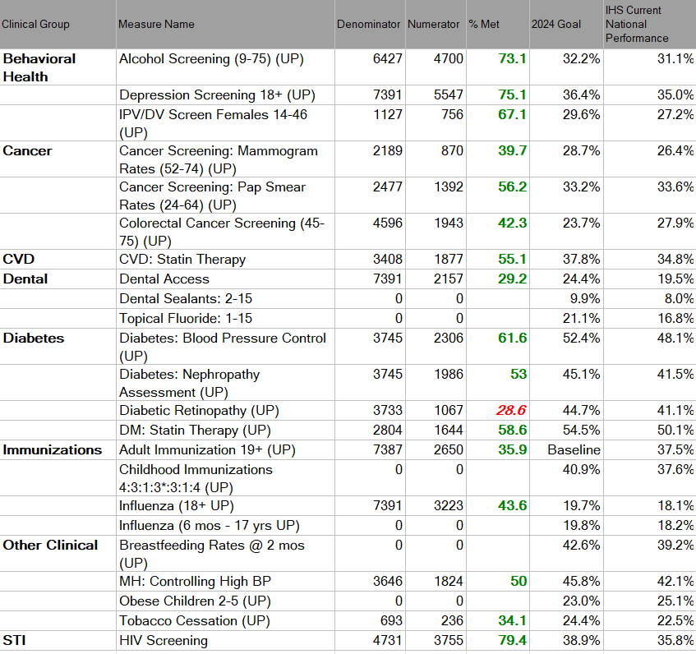
Quality Care
Quality Measures (GPRA)
Patient safety
  RX order checks
  Clinical Reminders
  Adverse reaction, problem list and Med Rec
Continuous improvement
Notes:
The fifth and final element of the PCMH model is quality care. This means that patients should receive care that is safe, effective, efficient, patient-centered, timely, and equitable. Clinical quality, patient safety, and continuous improvement are some ways to improve the quality of care provided by the care team.

Slide 20
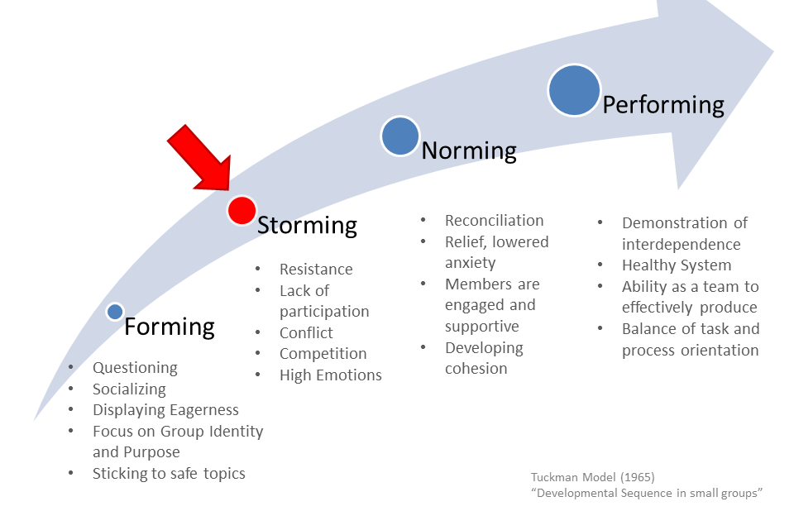
Great leadership helped
push through this phase
“we are doing this!”

Slide 21
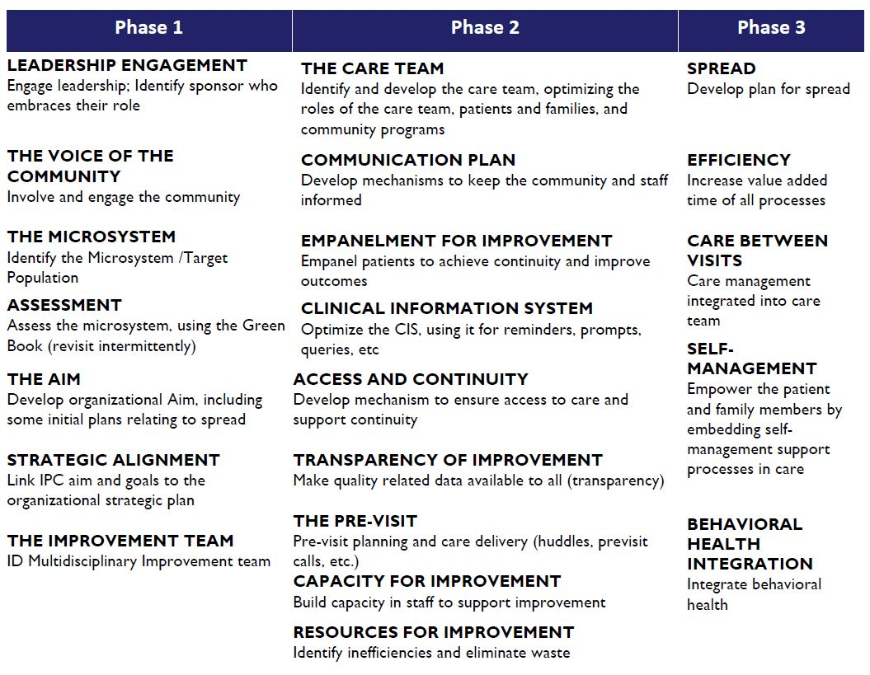

Slide 22
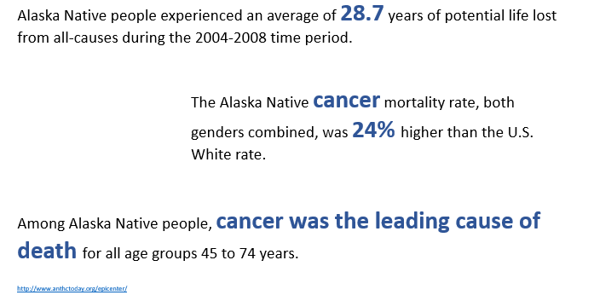

Slide 23
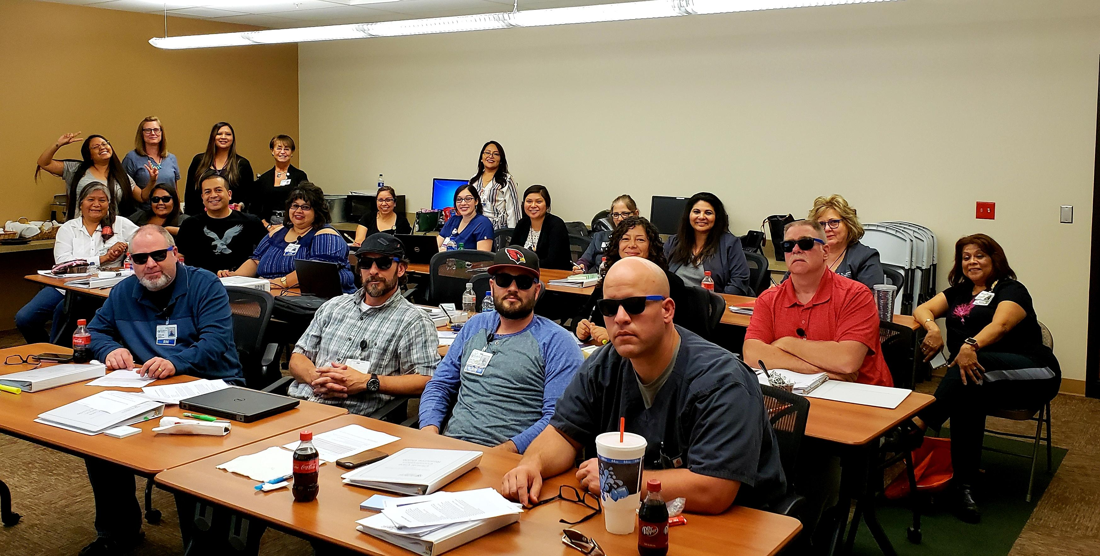

Slide 24
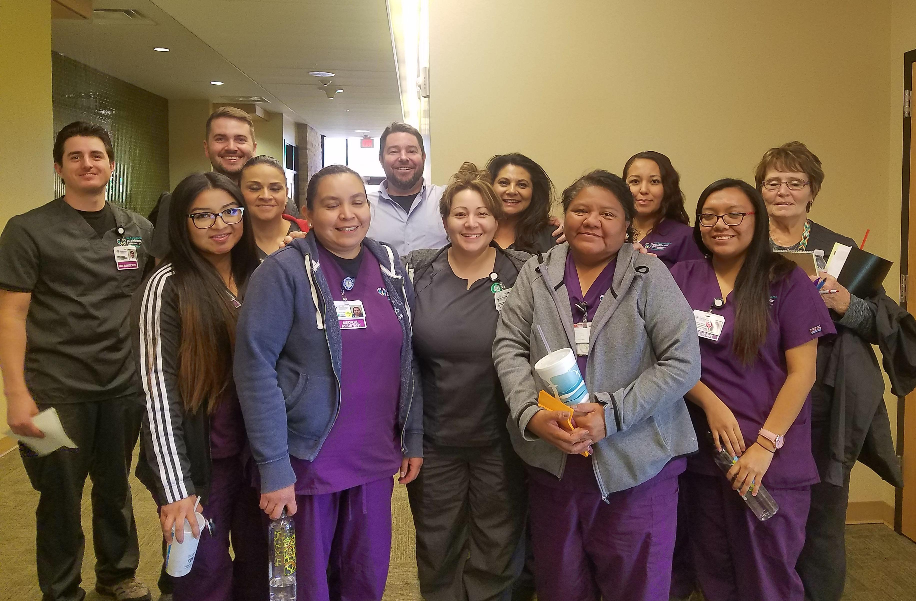
GPRA

Slide 25
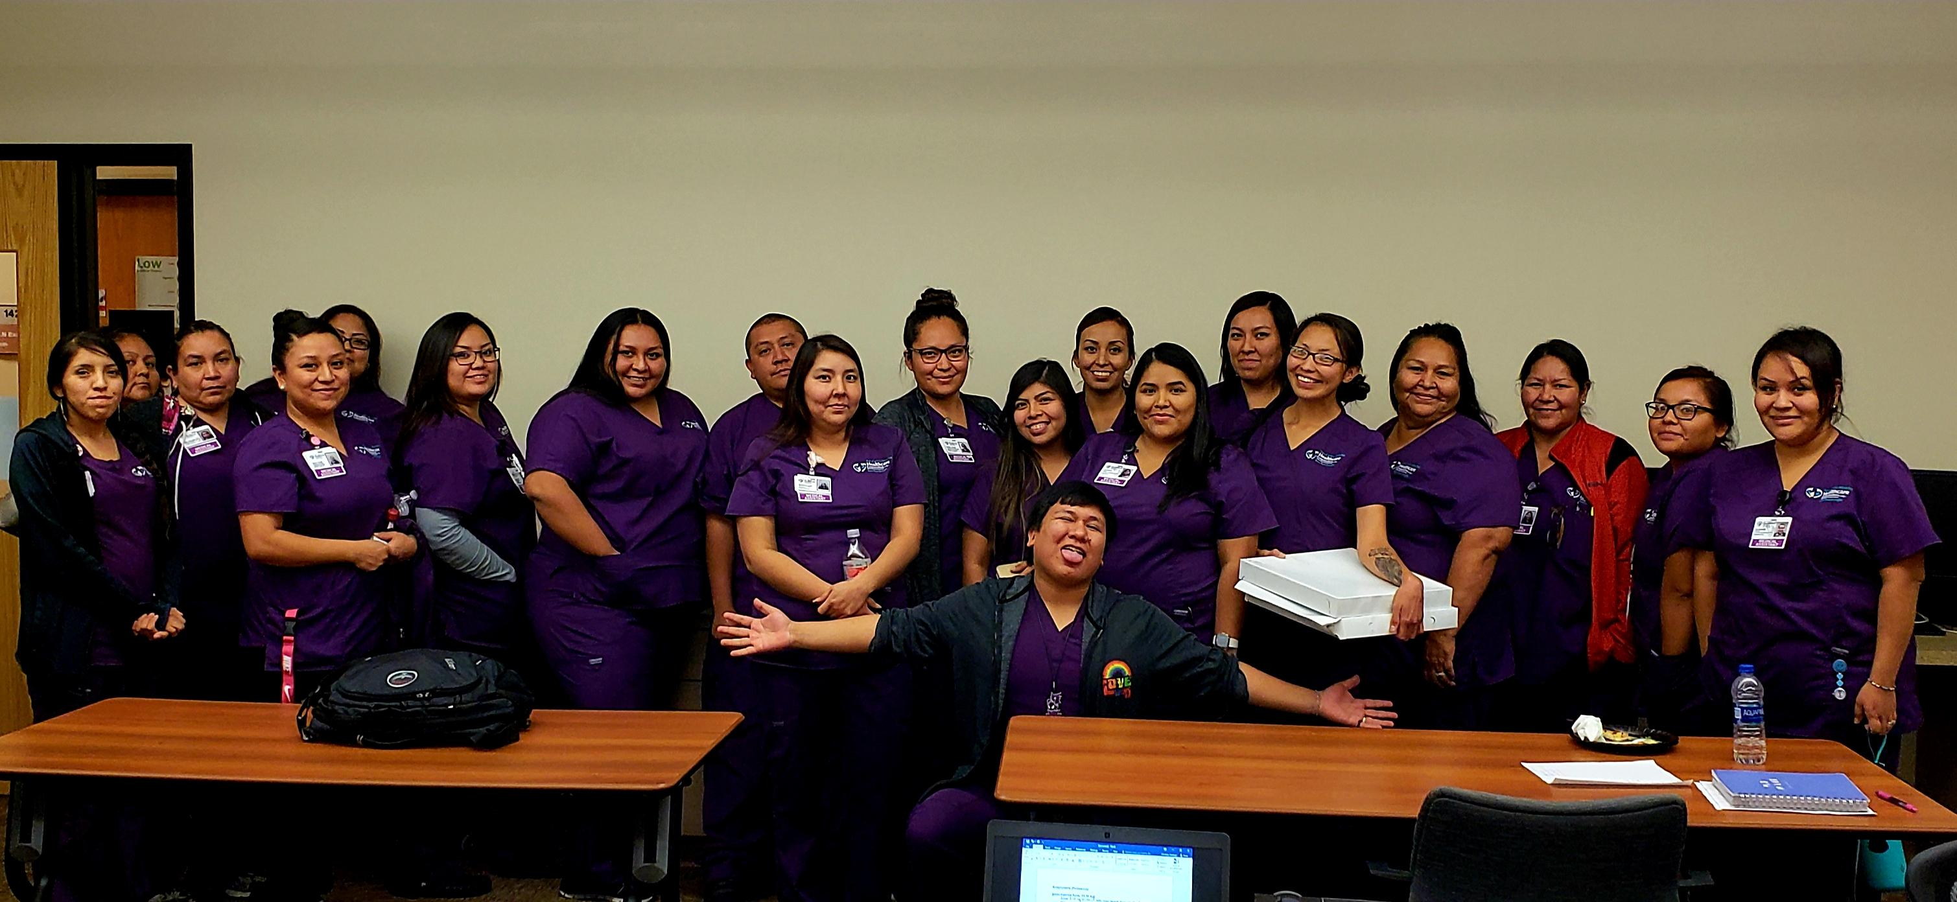
GPRA

Slide 26
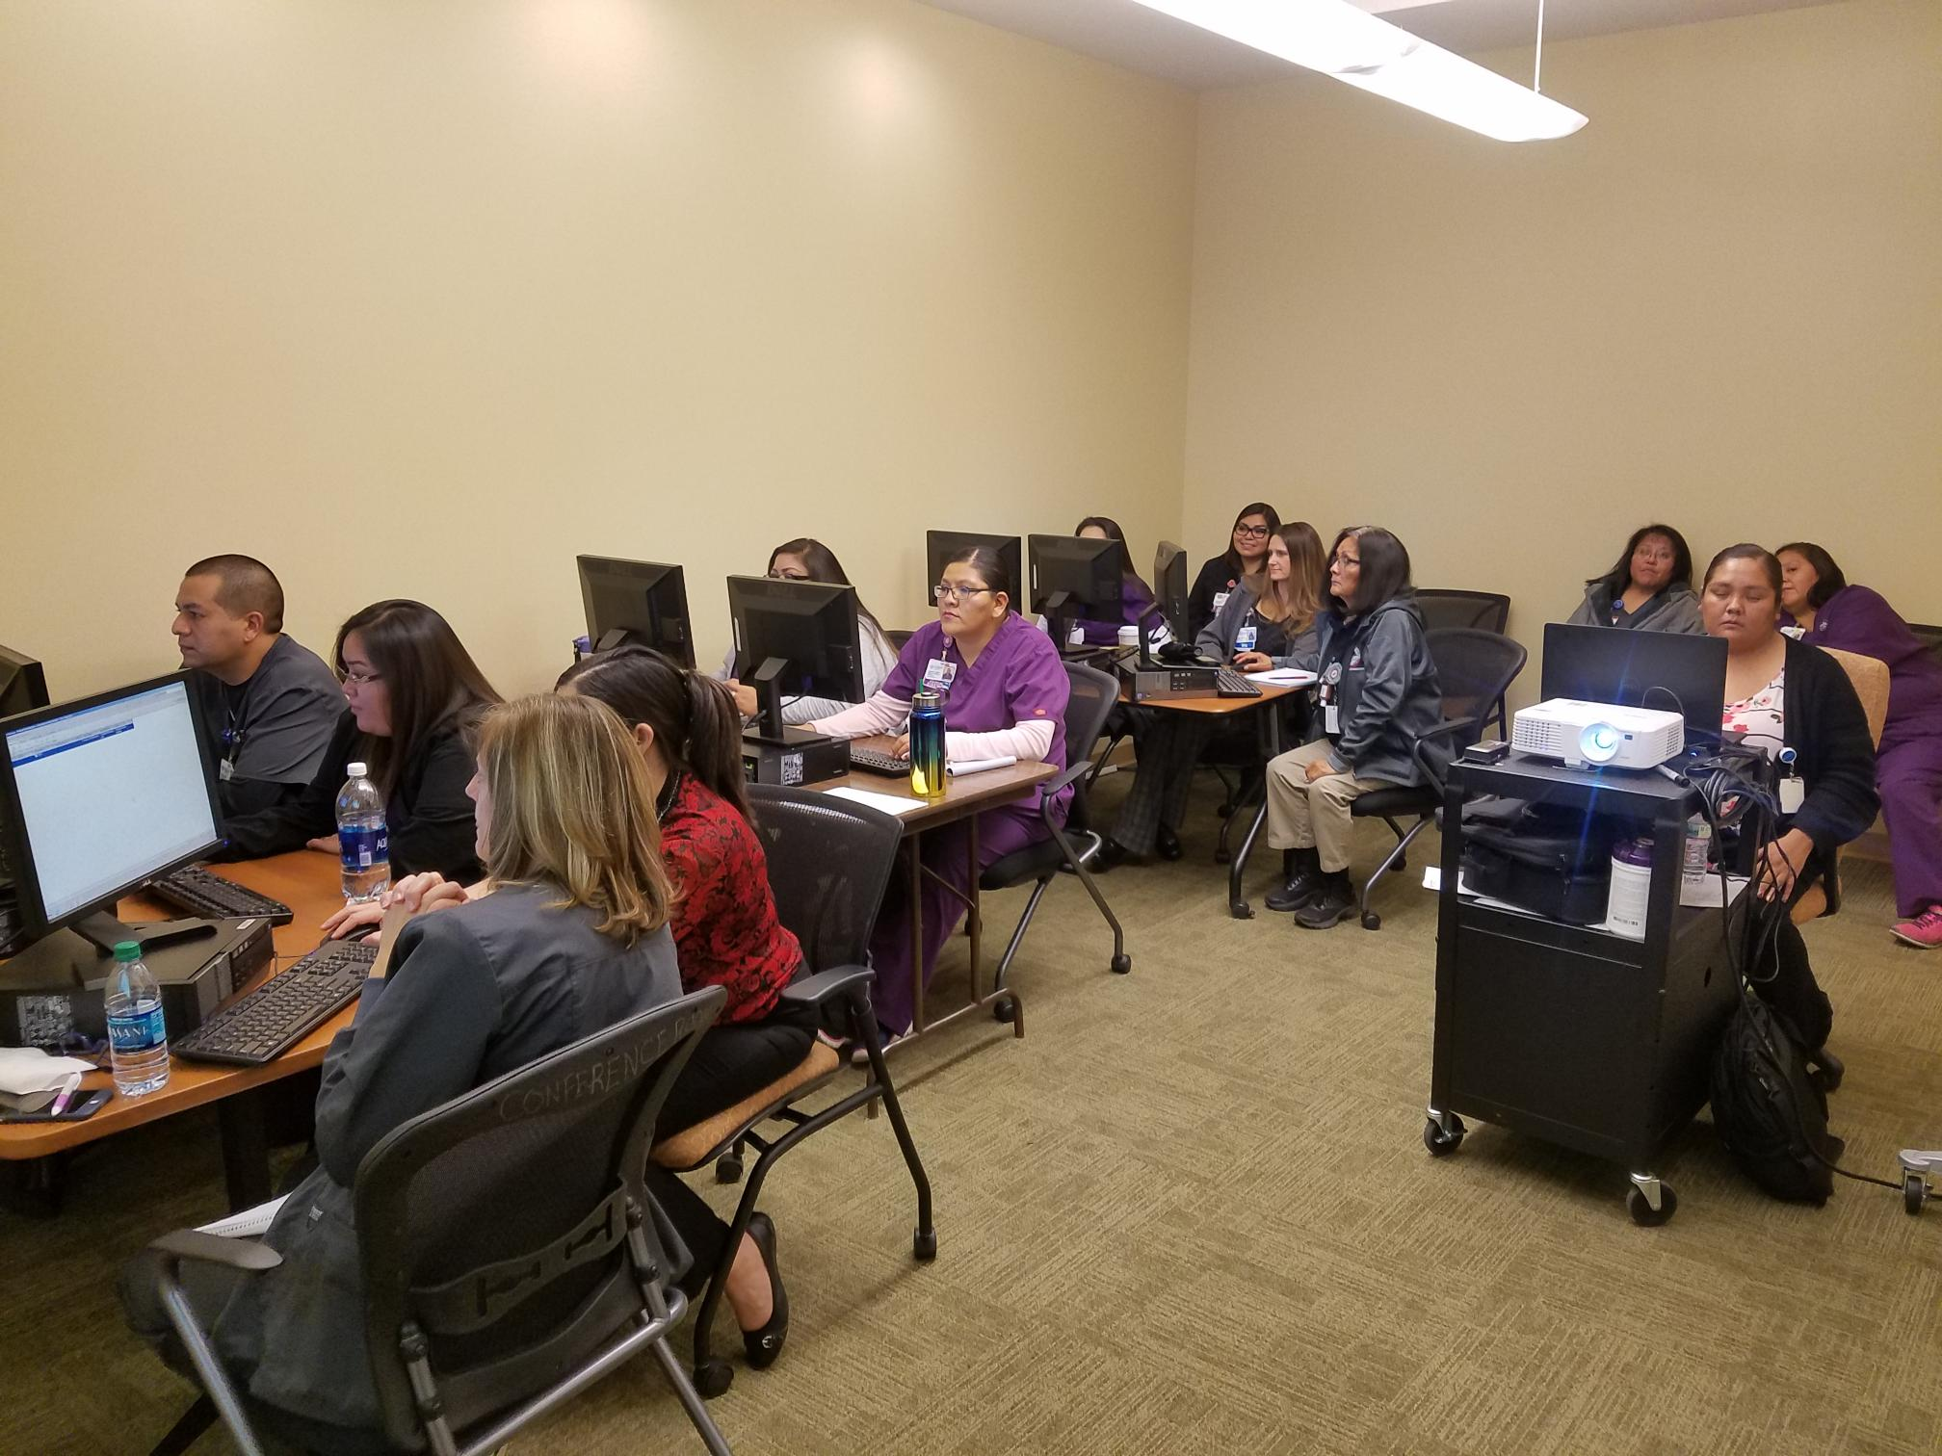
GPRA

Slide 27
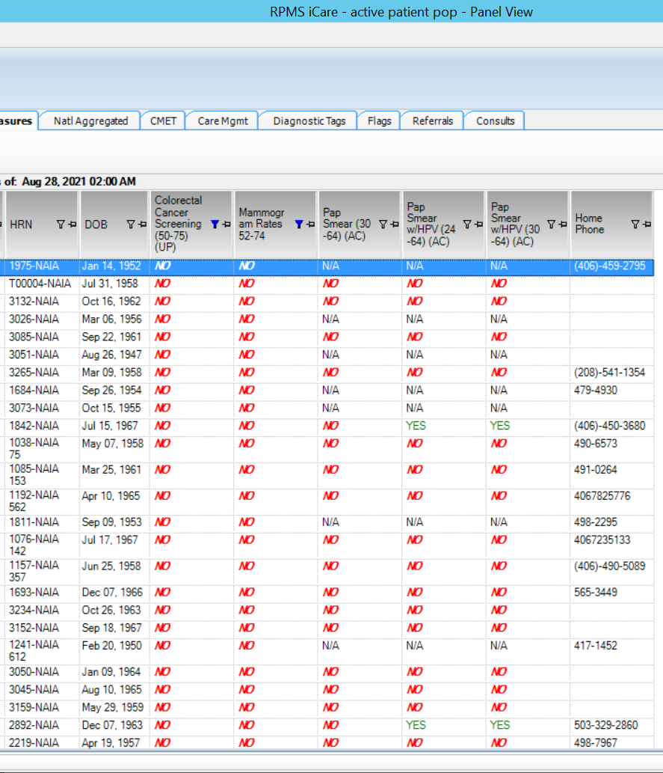

Slide 28
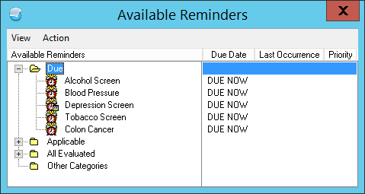

Slide 29
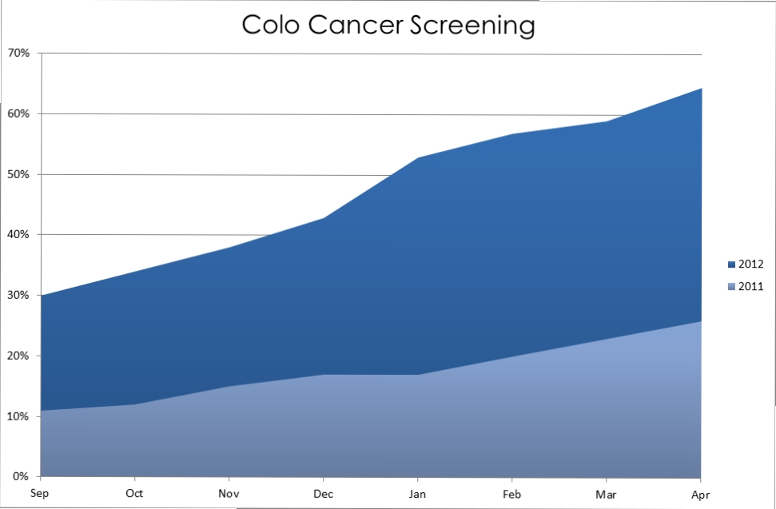

Slide 30
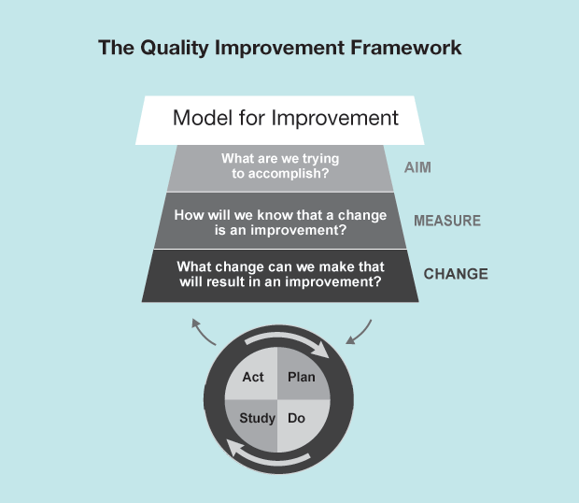

Slide 31
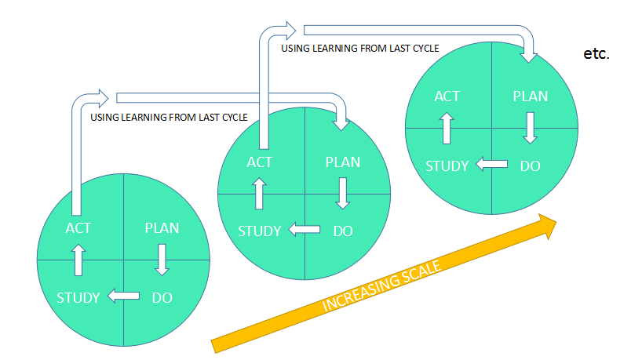

Slide 32
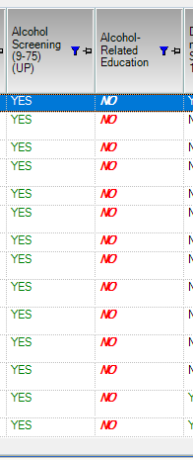

Slide 33
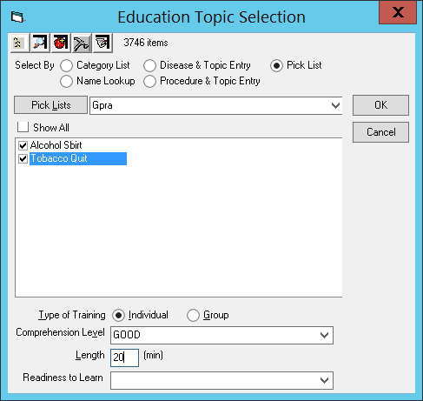

Slide 34
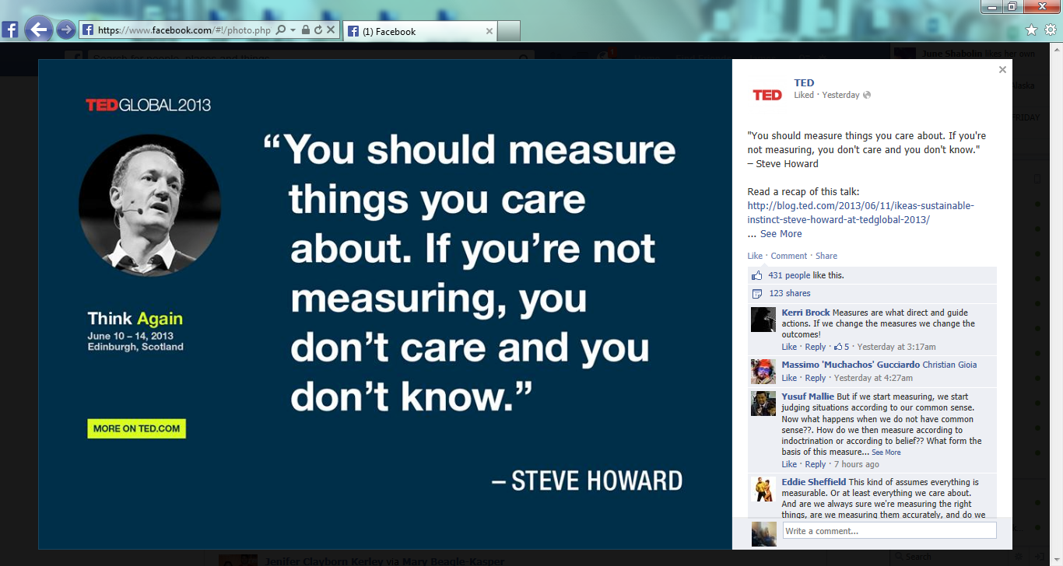

Slide 35
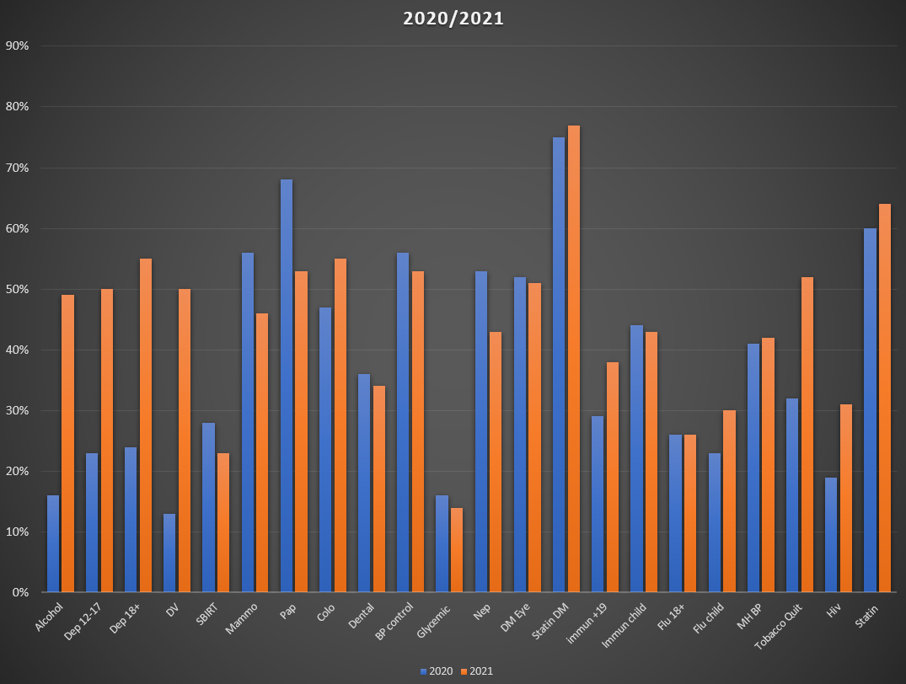

Slide 36
At the end of the day what is it?

Slide 37
Mindset
Notes:
The fifth and final element of the PCMH model is quality care. This means that patients should receive care that is safe, effective, efficient, patient-centered, timely, and equitable. Clinical quality, patient safety, and continuous improvement are some ways to improve the quality of care provided by the care team.

Slide 38

How does this picture make you feel?
This is PCMH
Notes:
Its about being human
Why, cute? Smile?

Slide 39
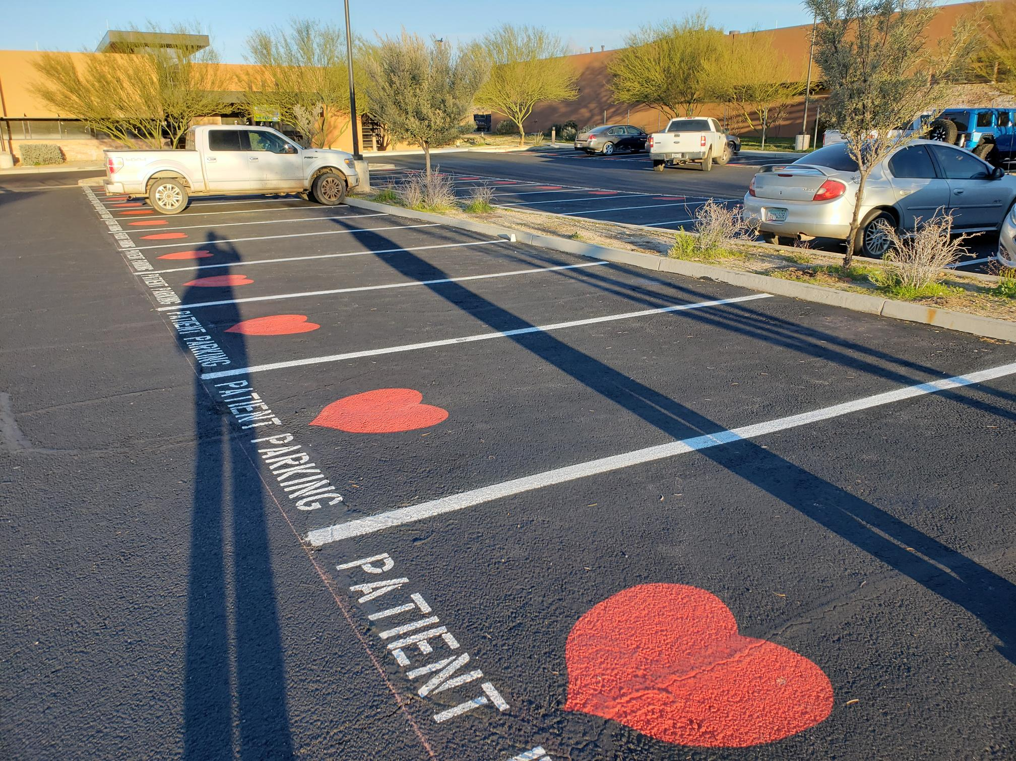
Notes:
The fifth and final element of the PCMH model is quality care. This means that patients should receive care that is safe, effective, efficient, patient-centered, timely, and equitable. Clinical quality, patient safety, and continuous improvement are some ways to improve the quality of care provided by the care team.

Slide 40
So where are you ?

Slide 42
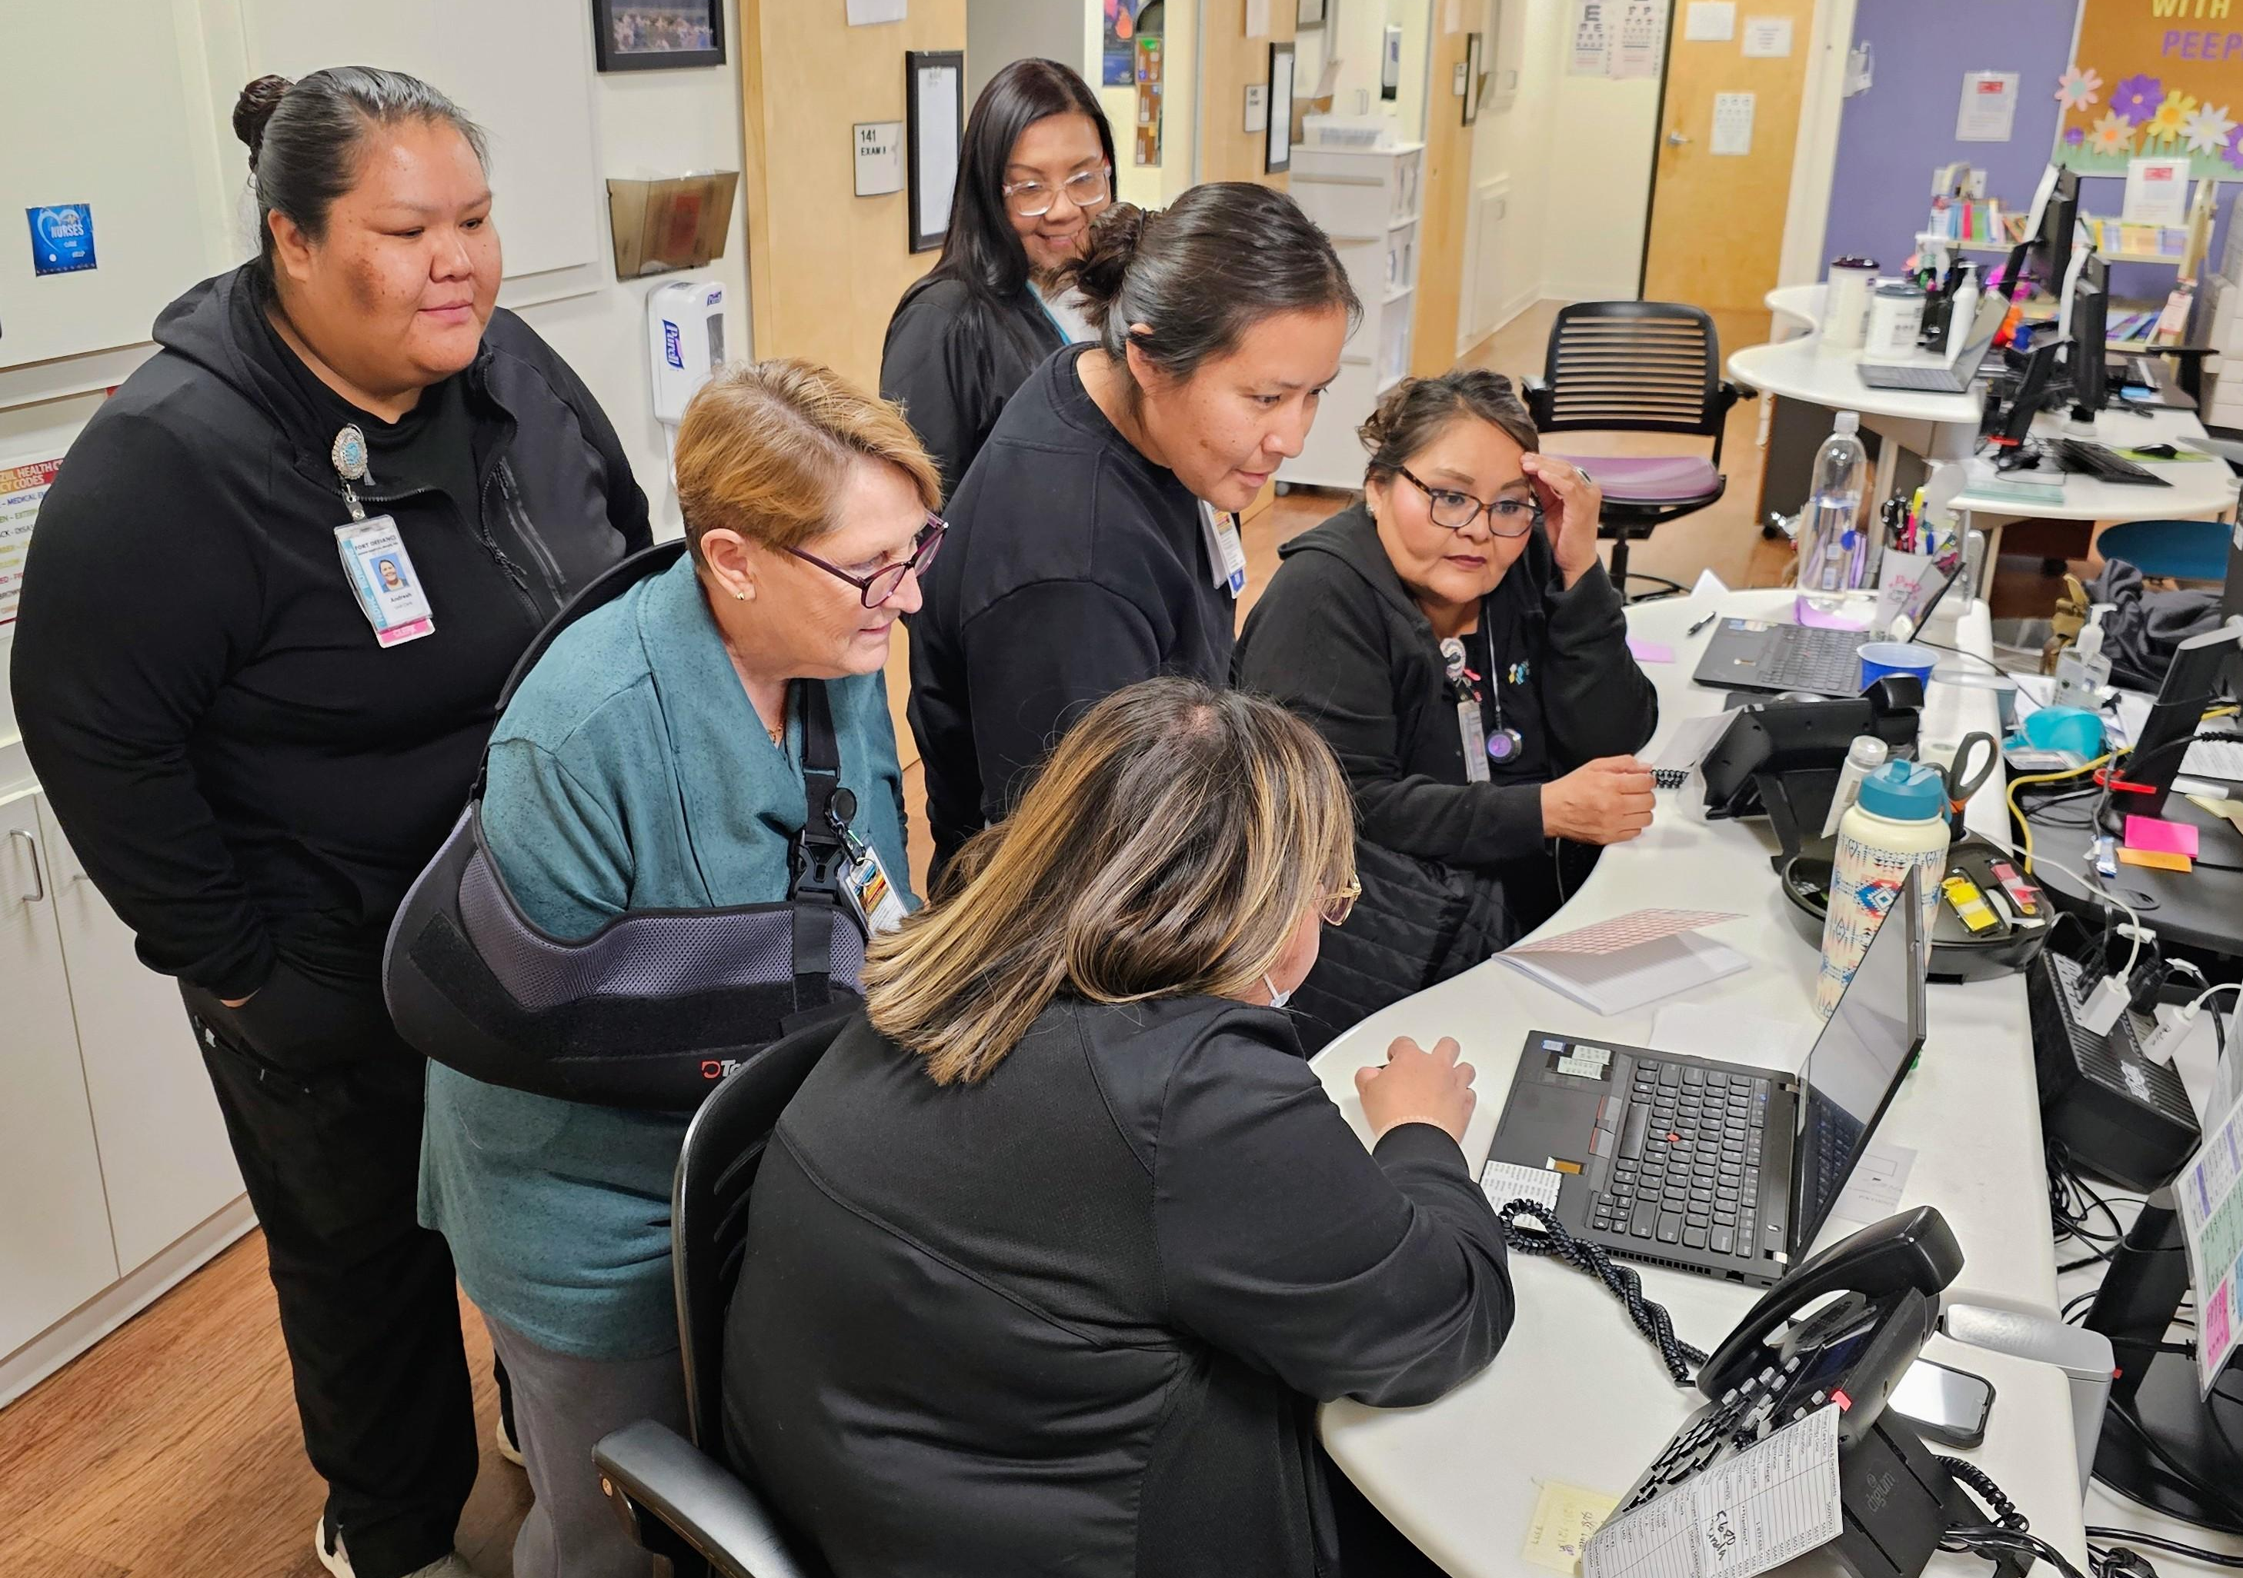

Slide 43
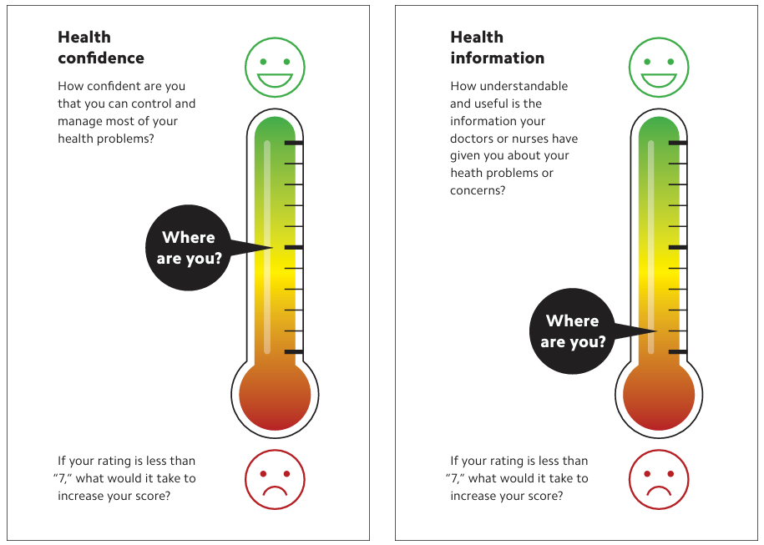

Slide 44
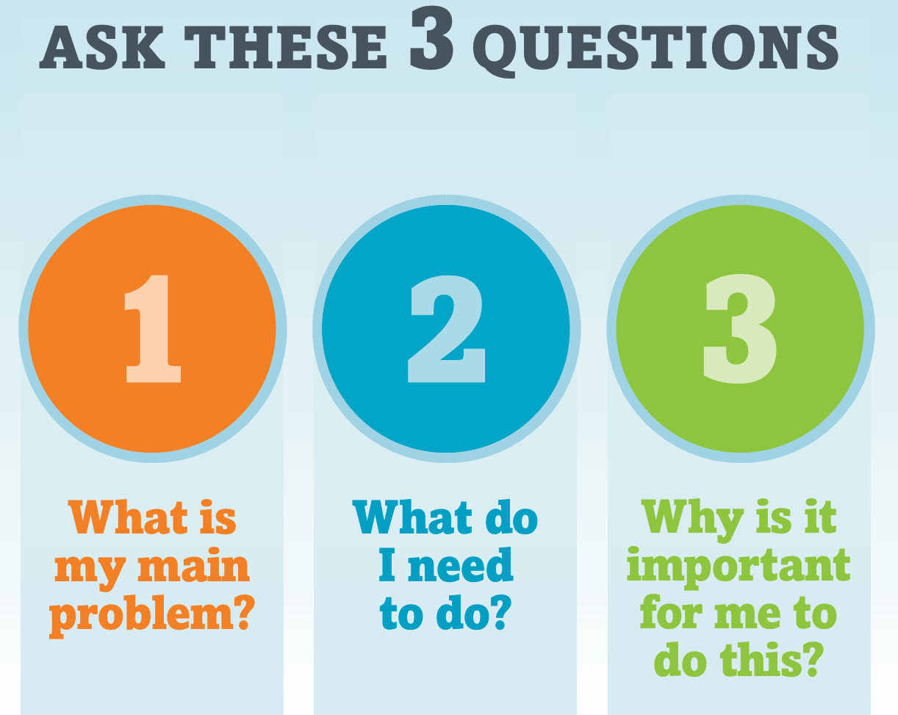
Notes:
The fifth and final element of the PCMH model is quality care. This means that patients should receive care that is safe, effective, efficient, patient-centered, timely, and equitable. Clinical quality, patient safety, and continuous improvement are some ways to improve the quality of care provided by the care team.

Slide 45
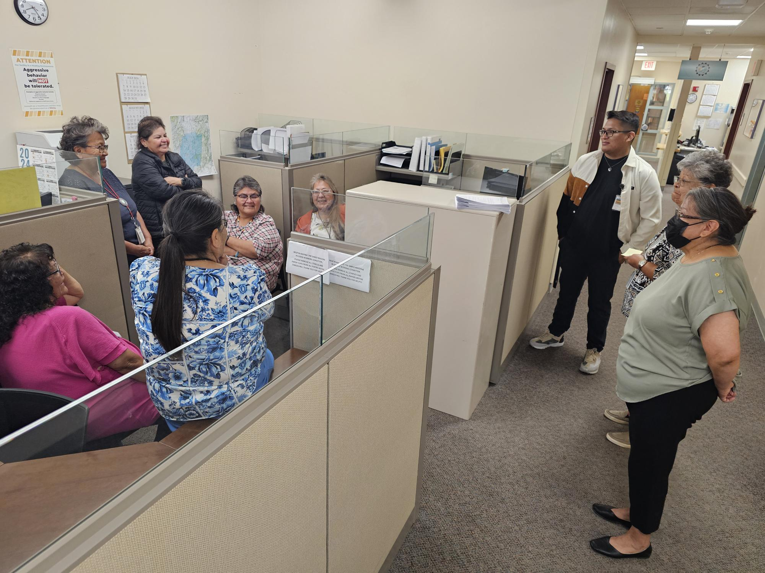

Slide 46
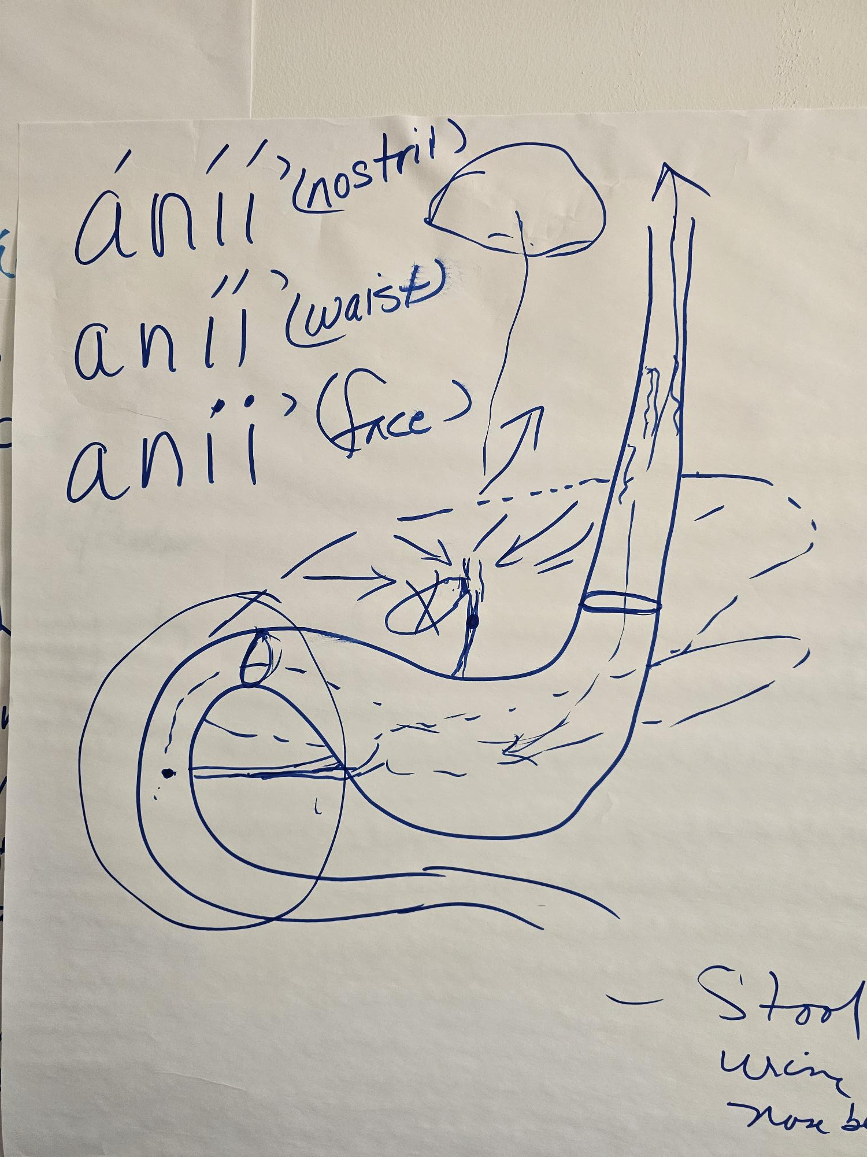
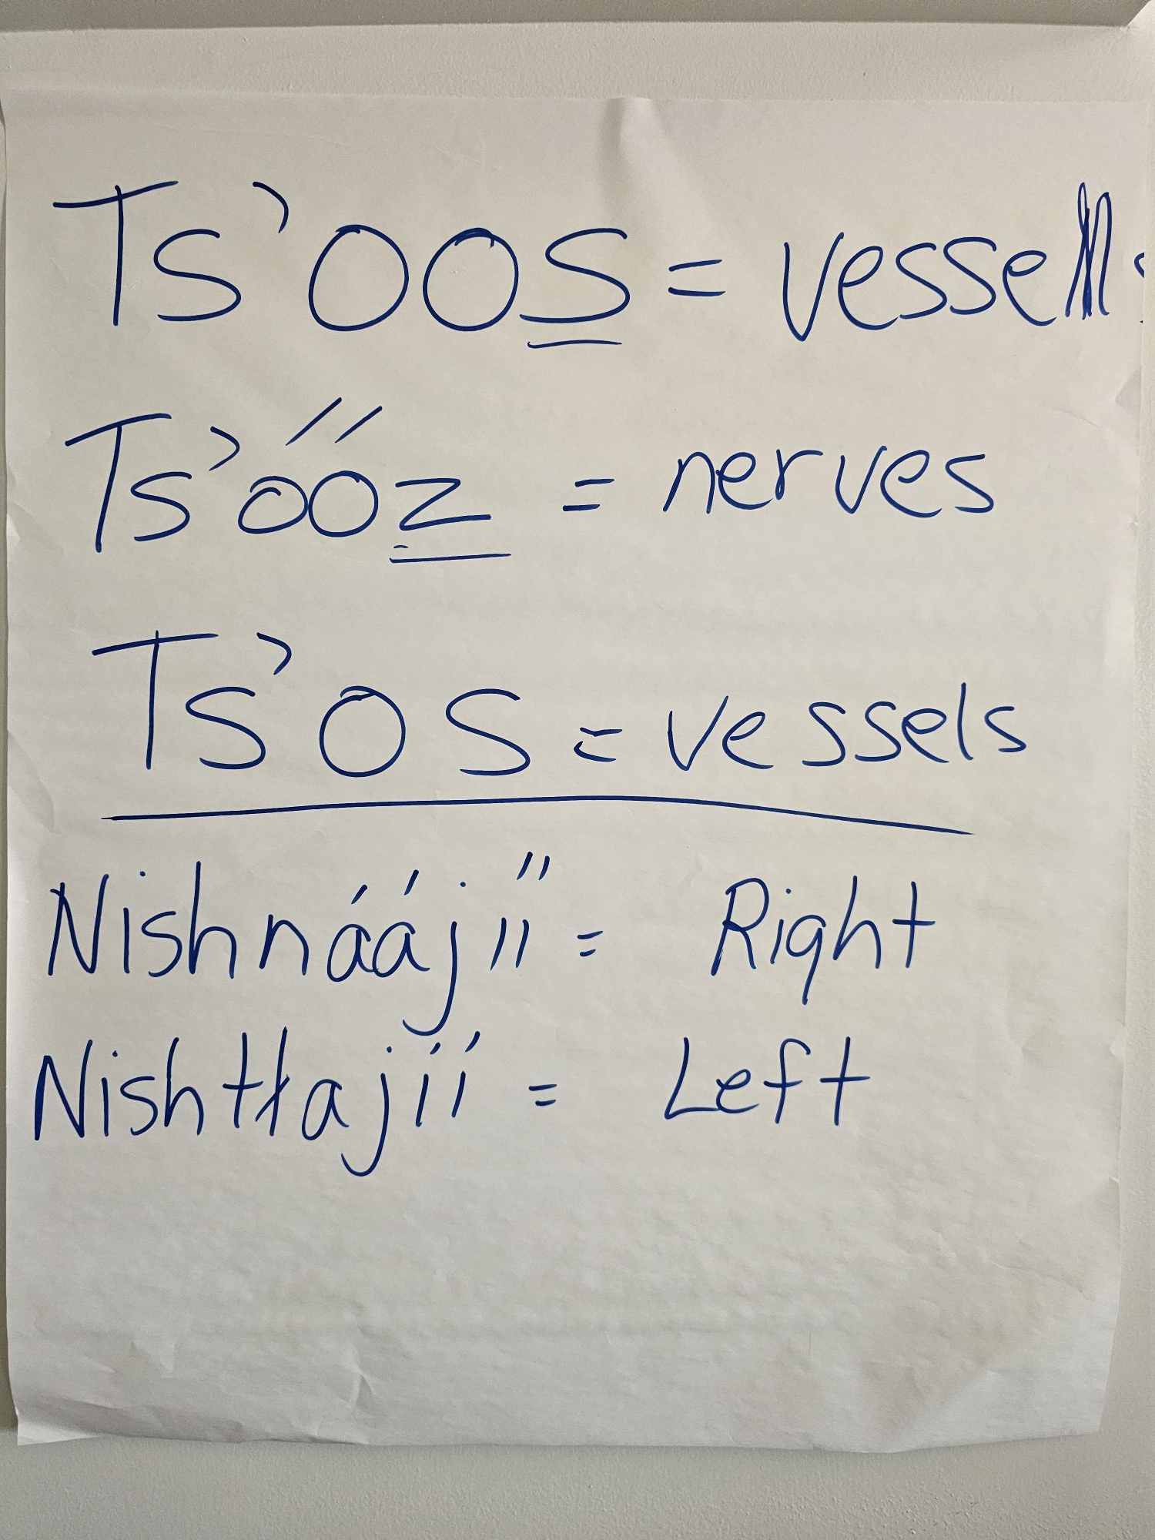

Slide 47
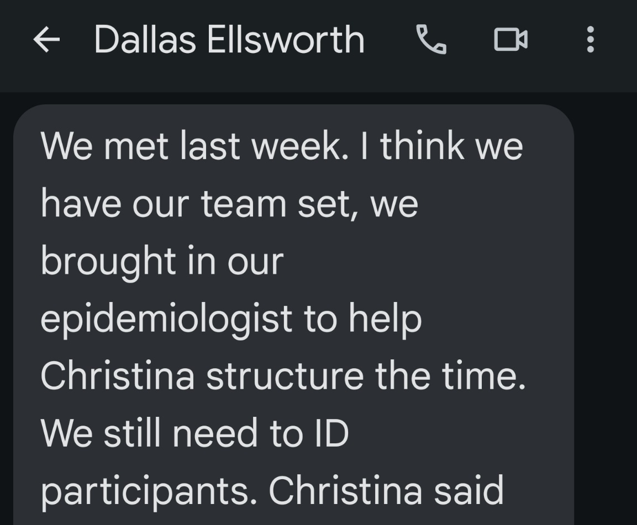
Patient Advisory Committee

Slide 48
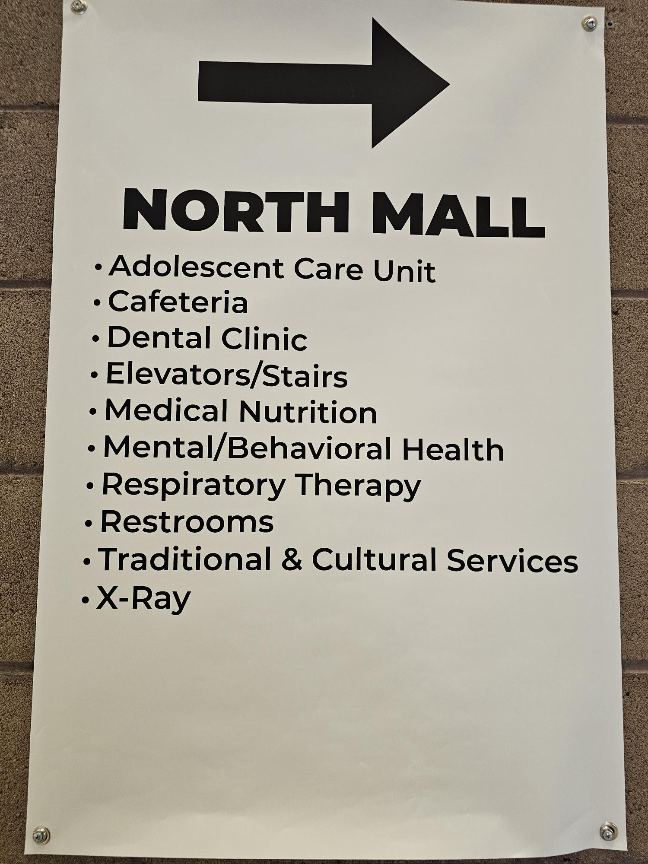
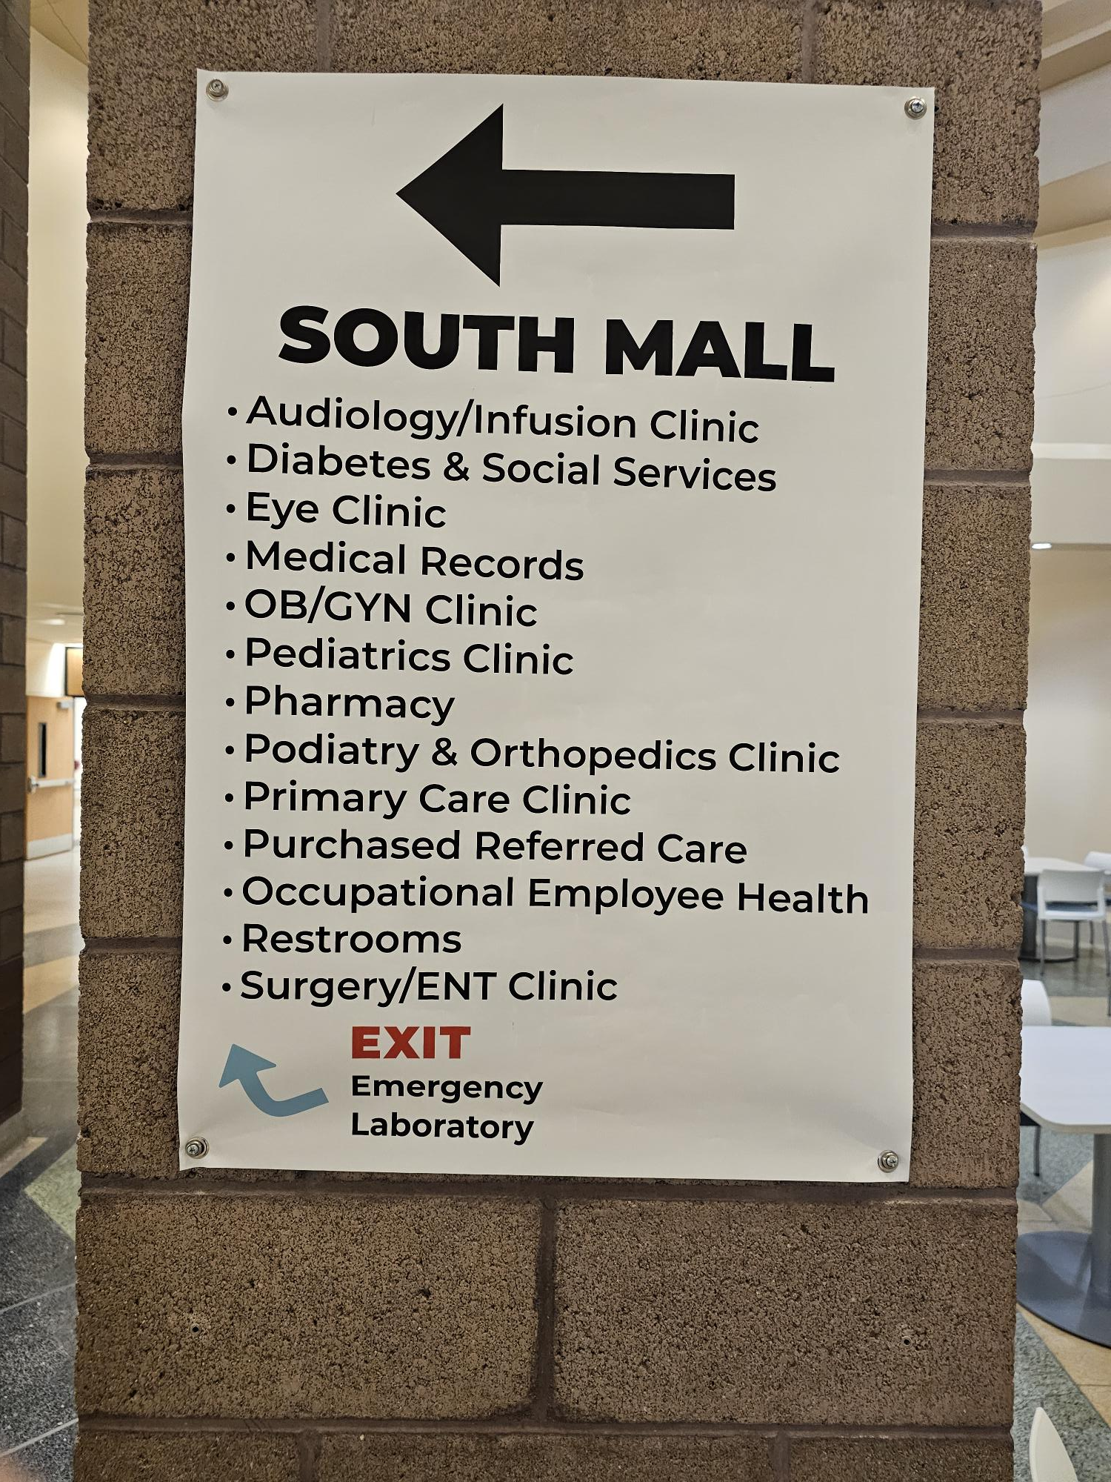

Slide 49
Gila River
Avg Margin
2023 = +15%
Gila River Health Care gets $118 million from IHS
With a budget of $300 million to keep the lights on
They not only make up the difference, but walk away
With $45m in profit which must put back into services

Slide 50
San Carlos
Avg Margin
2023 = +11%
We don’t know what they won on the settlement
But right now, their biggest problem is
how many helicopters to buy

Slide 51
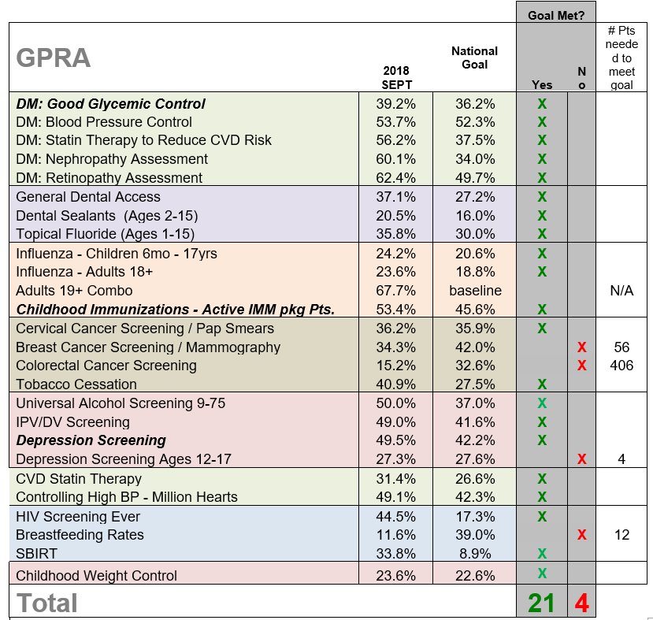
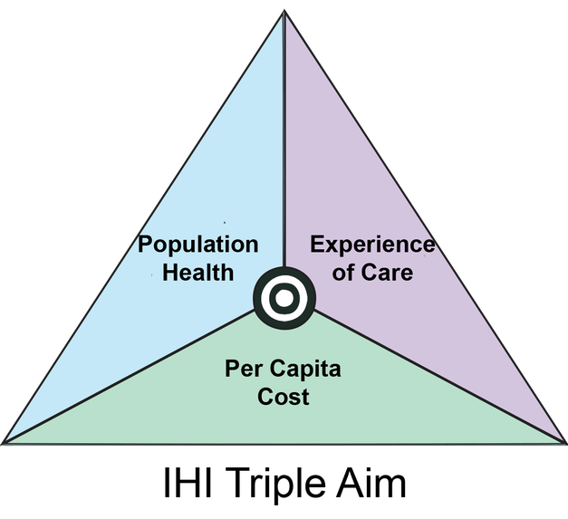
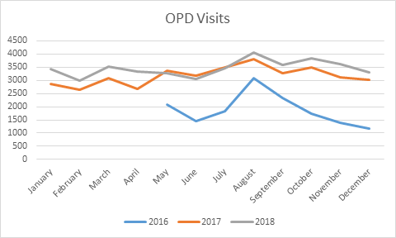
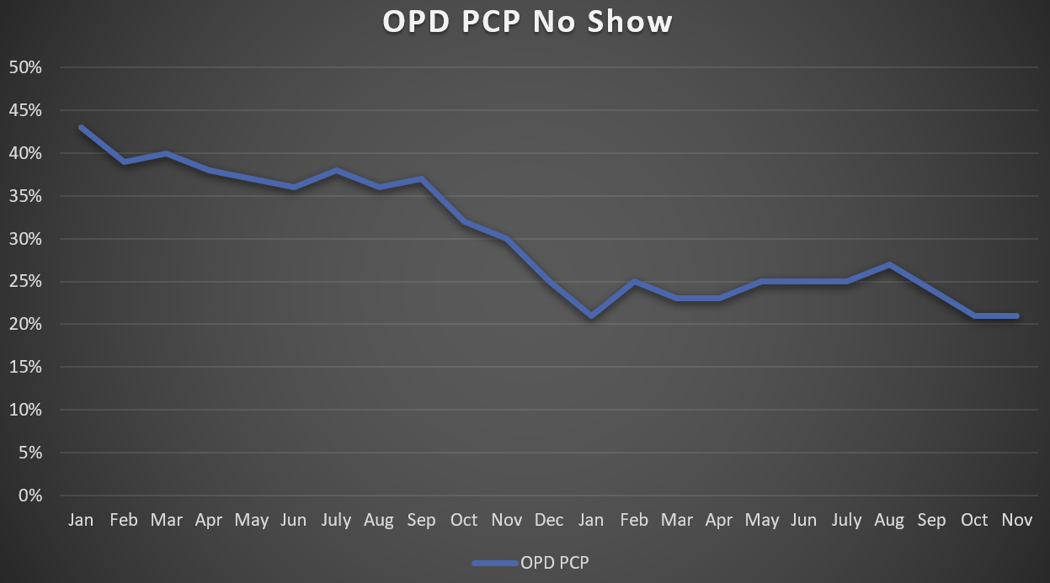
Patient Satisfaction
95%

Slide 52
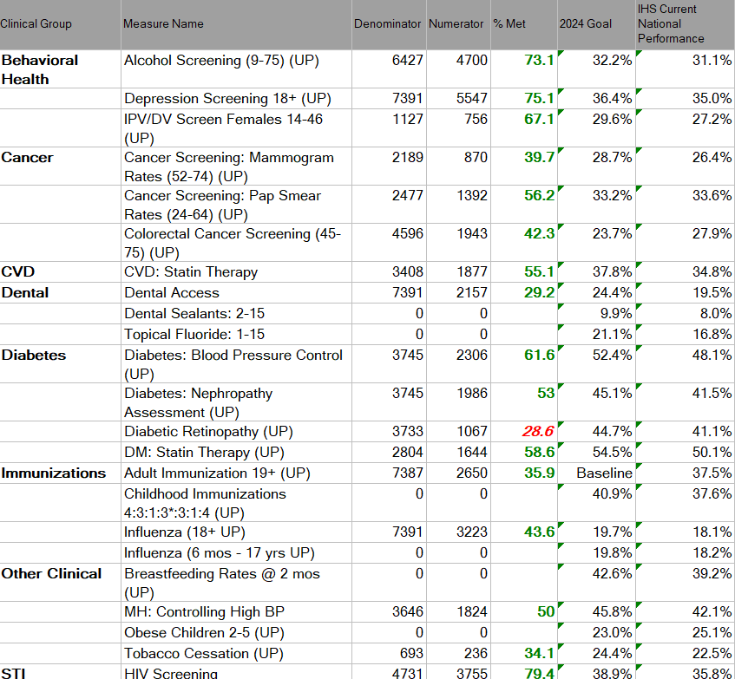

Slide 53
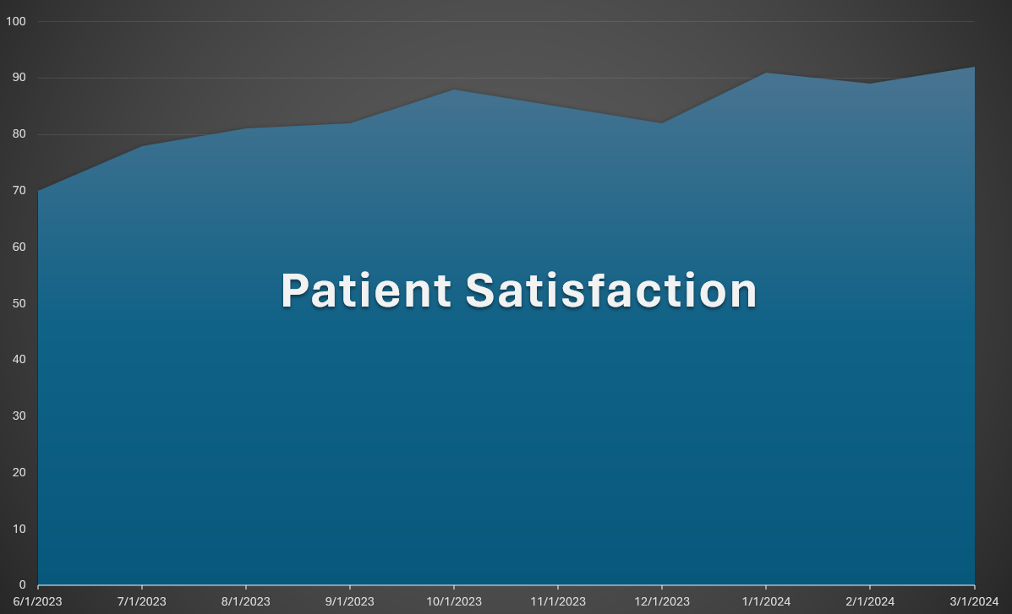

Slide 54
$10m over revenue projection

Slide 55


