Slide 1
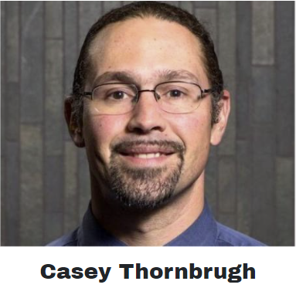



USET Tribal Climate Resilience Program
Assists Tribal Nations with climate change adaptation planning, provides technical support in planning efforts
USET Office of Environmental Resource Management (OERM)
Director: Jerry Pardilla
Asst. Dir.: Lea Zeise
Program Manager and Climate Science Liaison to NE/SE CASCs
Mashpee Wampanoag
Assistant Climate Science Liaison to NE/SE CASCs
Forest Adaptation Technical Assistant
Mi’kmaq Nation
Climate Graduate Student Intern

Slide 2
USET Tribal Climate Resilience Program
Funded via grants available to Tribal organizations through the Bureau of Indian Affairs – Tribal Climate Resilience Branch (BIA-TCRB)
Program Goals:
Technical support to assist Tribal Nations with climate change adaptation planning
Liaison support to connect Tribal Nations with resources at regional Climate Adaptation Science Centers (CASCs) and other partners to support Tribal adaptation planning and resilience to climate change.

Slide 3
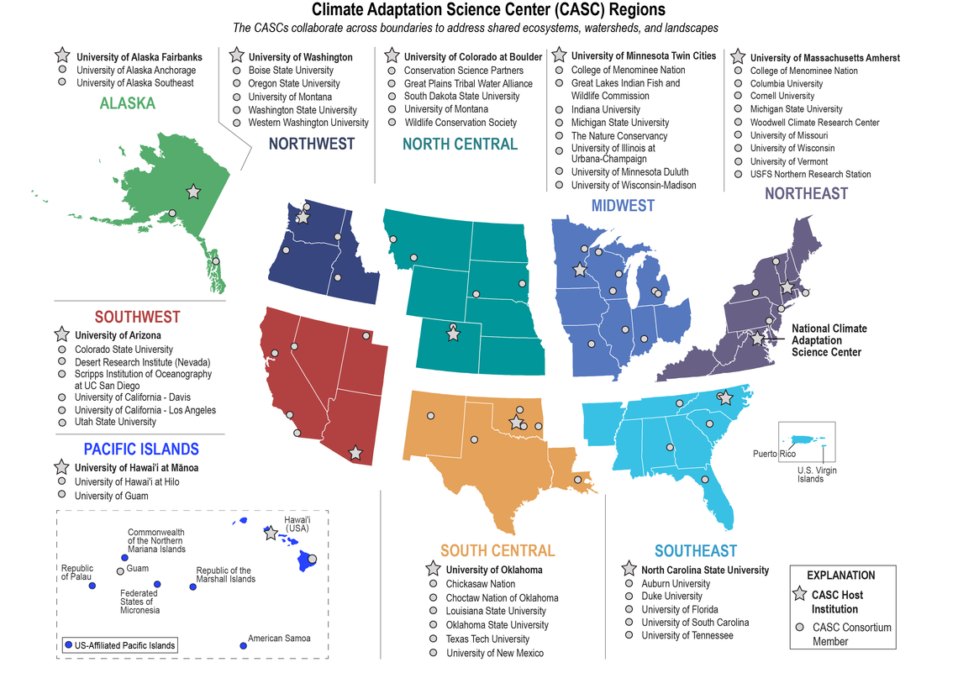
Liaison support: CASC Tribal Engagement Strategy Planning
Climate Adaptation Science Centers in the USET region
Long-term collaboration with USGS Climate Adaptation Science Center staff and scholars
  Webpage information update
  Tribal science priorities
    Outreach and discussions with Tribal employees
  Workplan for engagement

Slide 4
USET Climate Program
Both
Climate Adaptation Science Centers
Technical support
Apply existing science to plans and decisions
Review and feedback on writing drafts
Student internships
Mostly natural resources focus but expanding
Workshops and webinars
New research to help inform plans
Graduate student fellowships

Slide 5
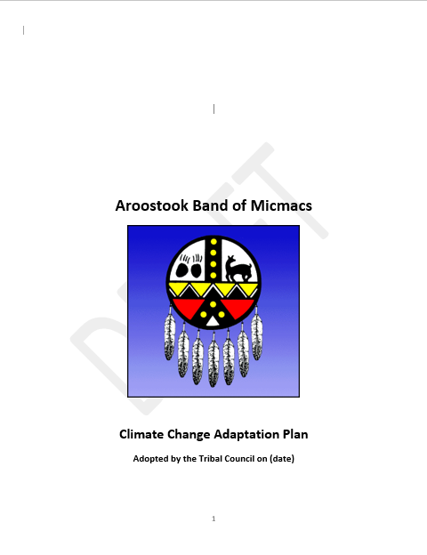
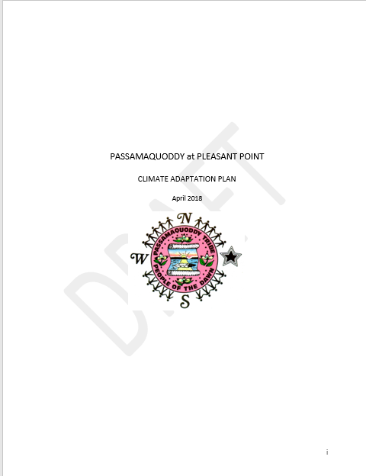
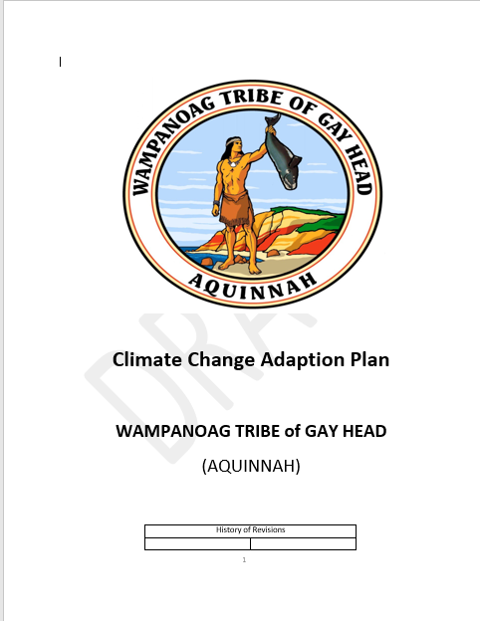

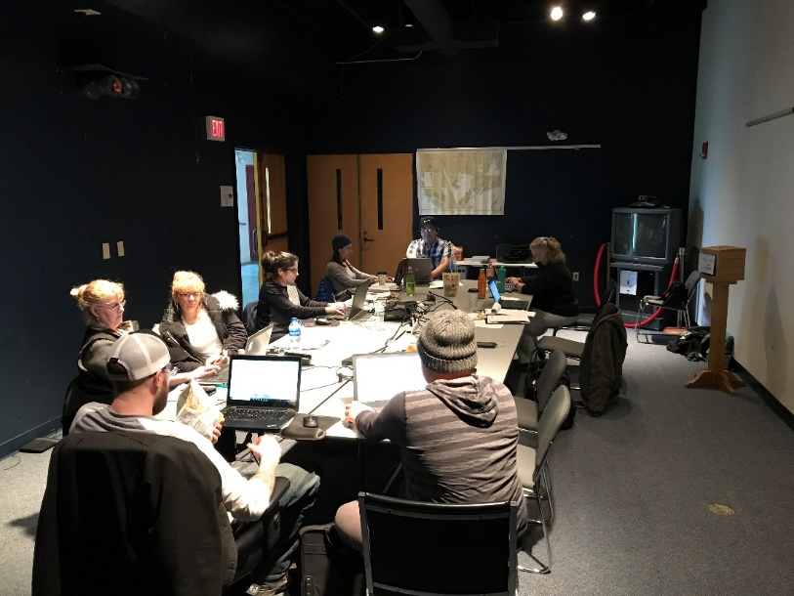
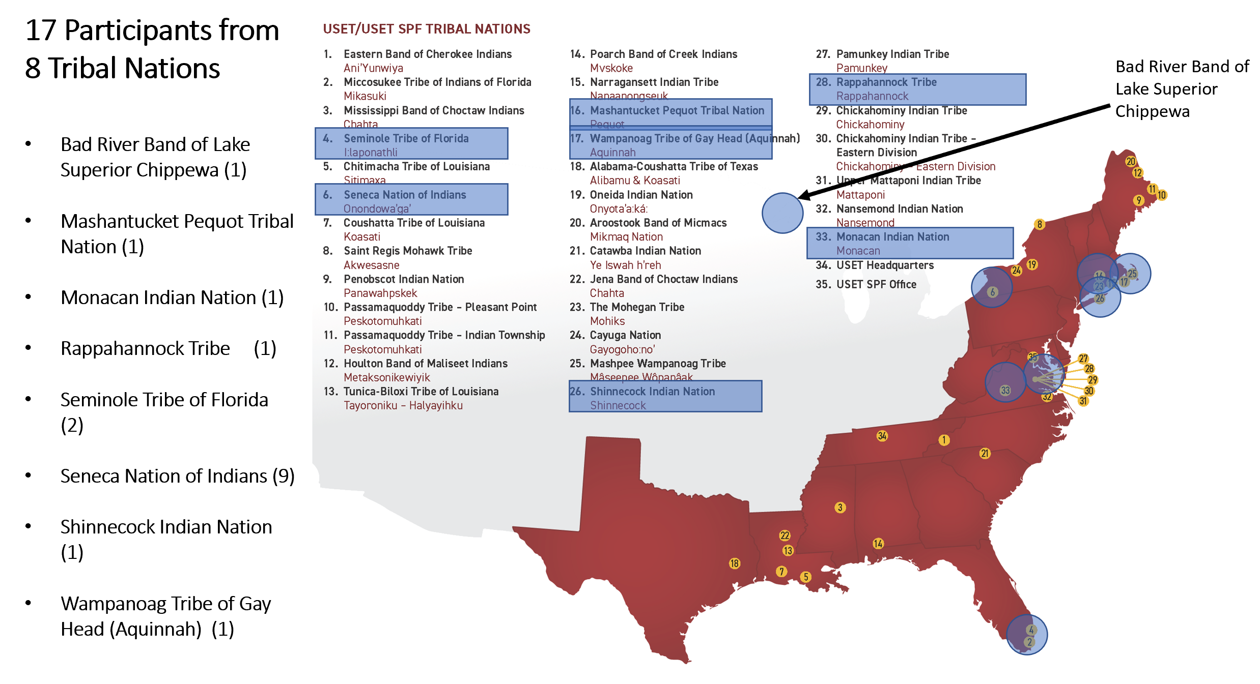
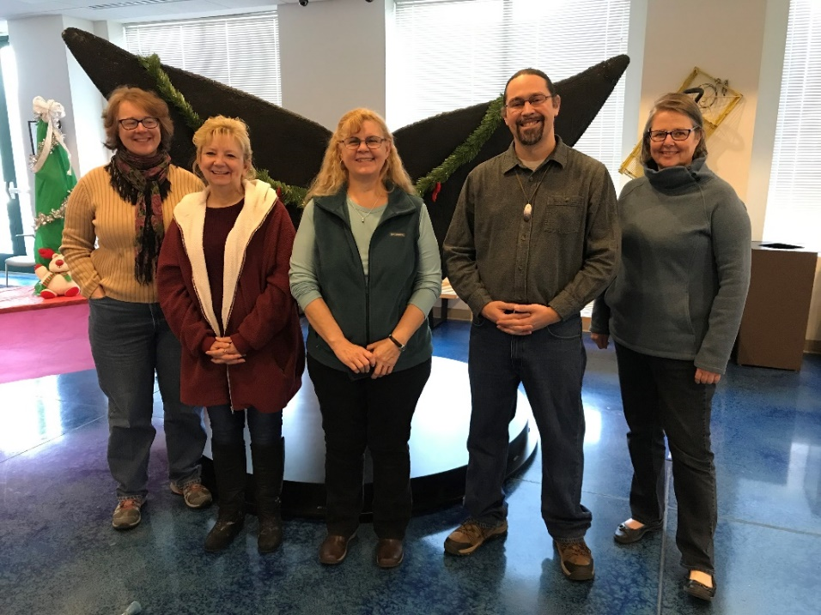
Technical Support: USET-OERM Tribal Climate Change Vulnerability Assessment/Adaptation Plan Writing Retreats 2018-2021

Slide 6
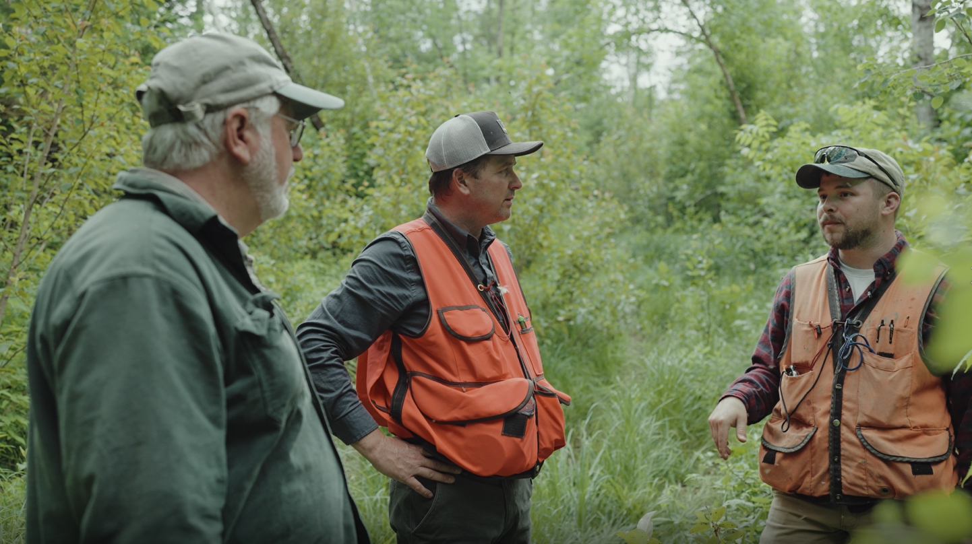

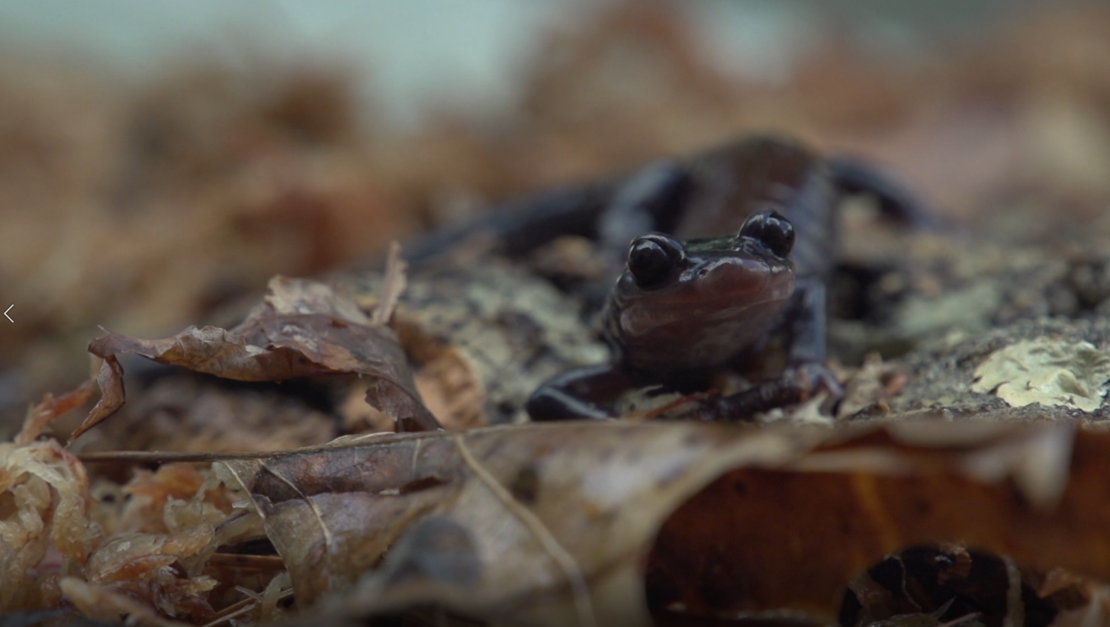
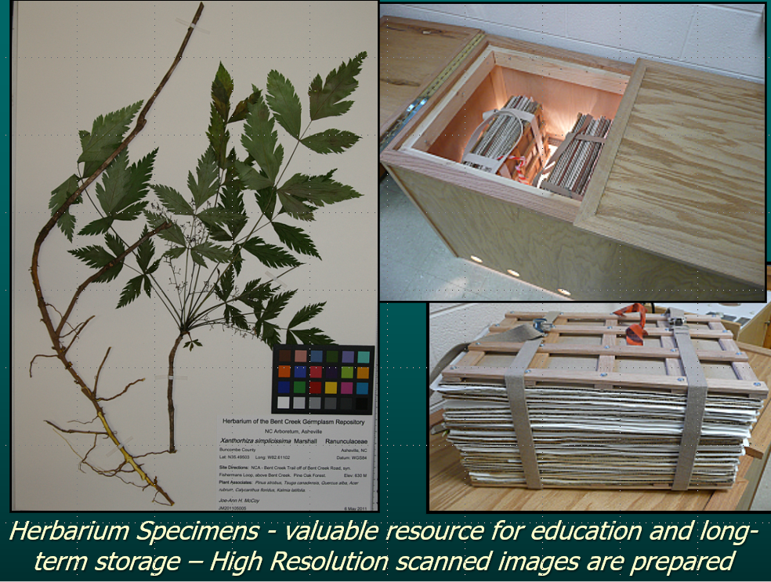

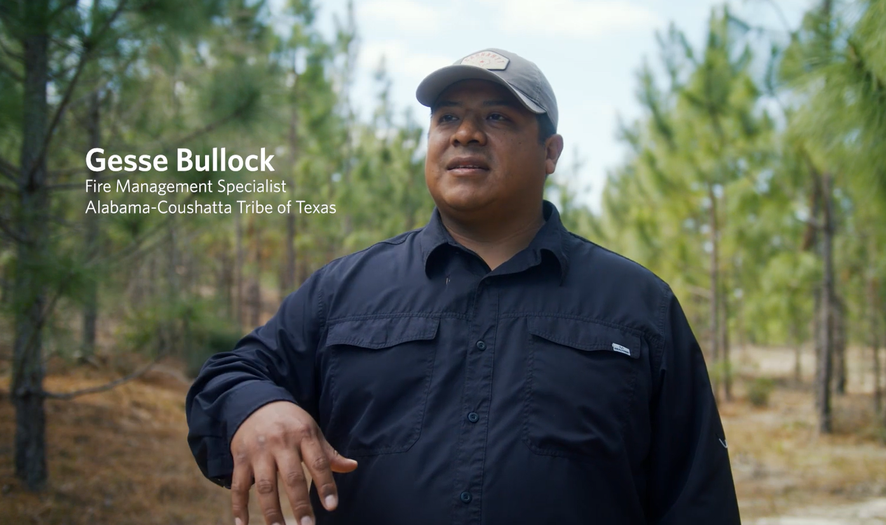


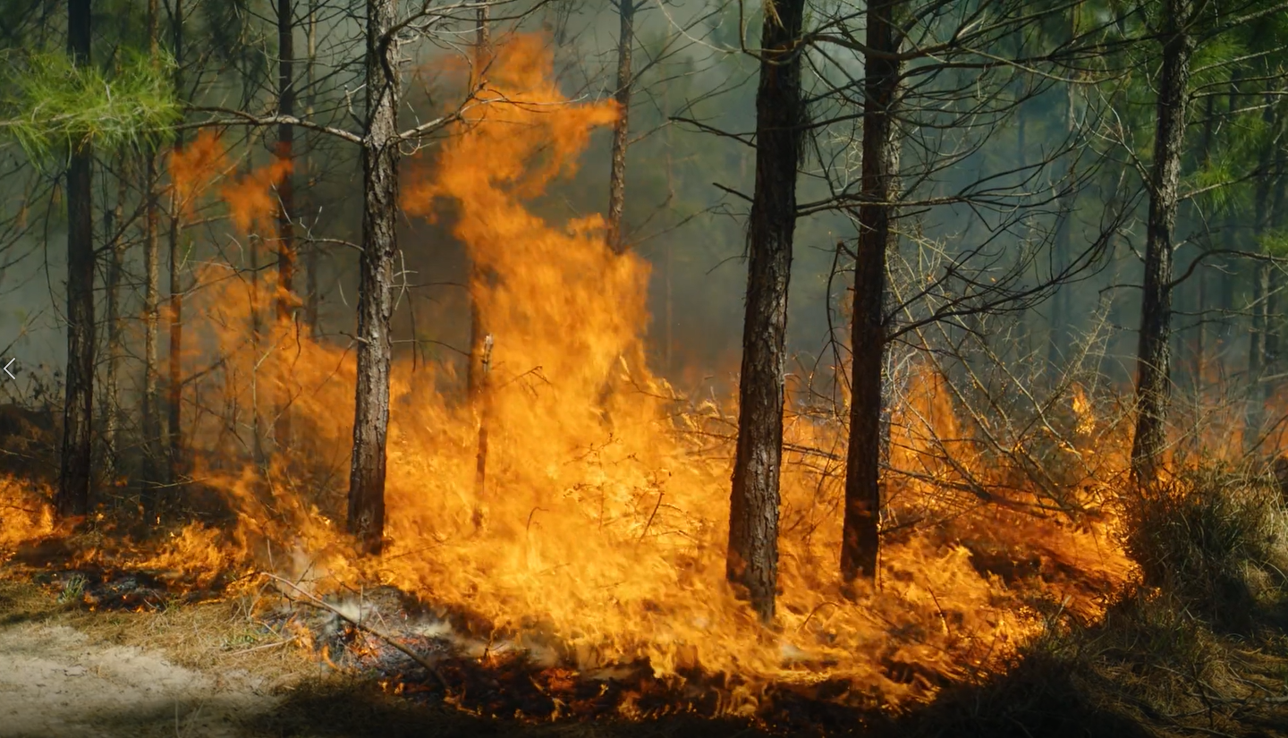
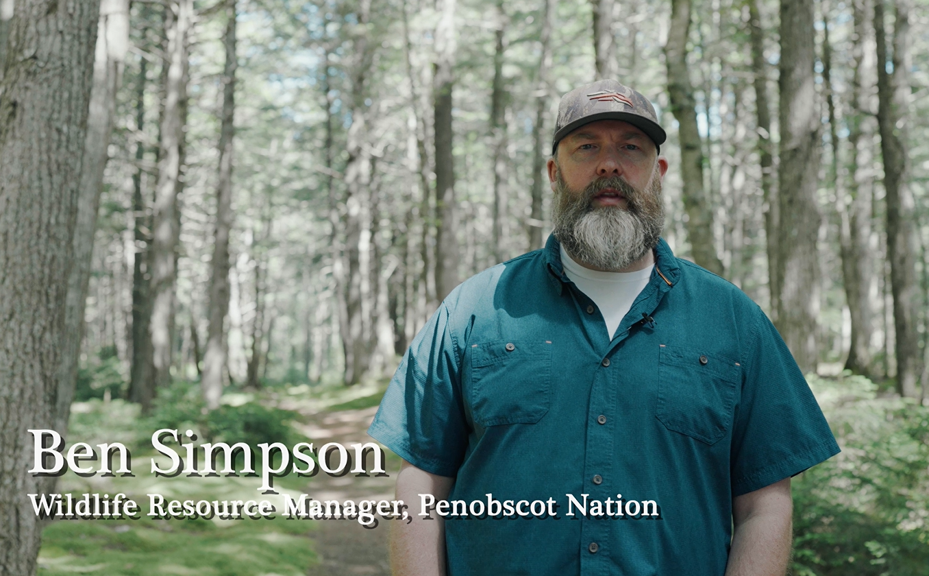
Technical Support: USET Forest and Wetlands Webinar Training Series
Mi’kmaq Nation – Brown/Black Ash Forest Adaptation
Alabama- Coushatta Tribe of Texas – Longleaf Pine Restoration
Penobscot Nation – Vernal Pool Protection in Forestry
Eastern Band of Cherokee Indians – Wetland Herbarium & Seed Saving

Slide 7
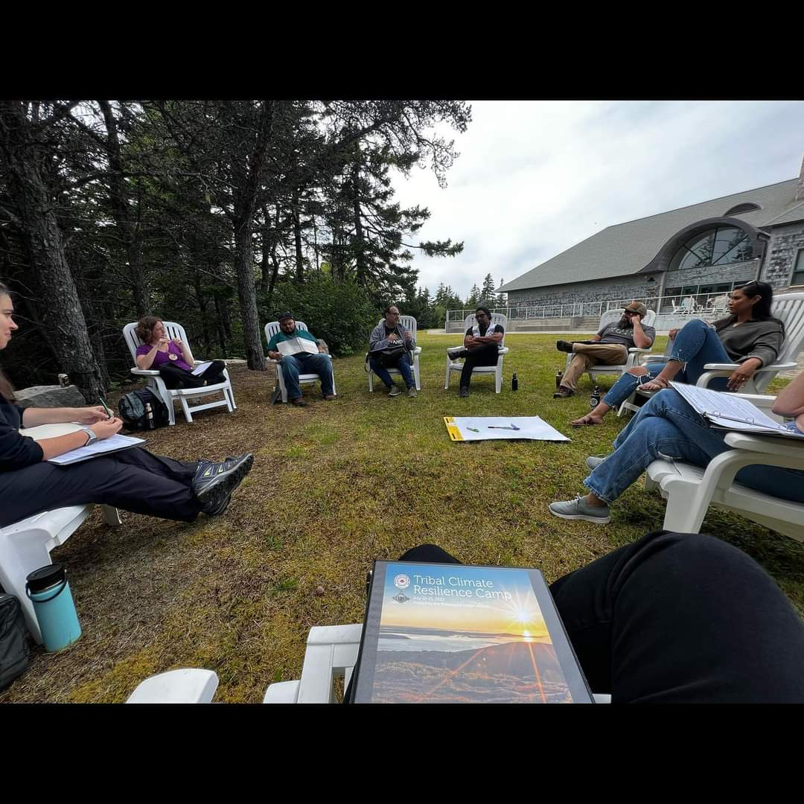
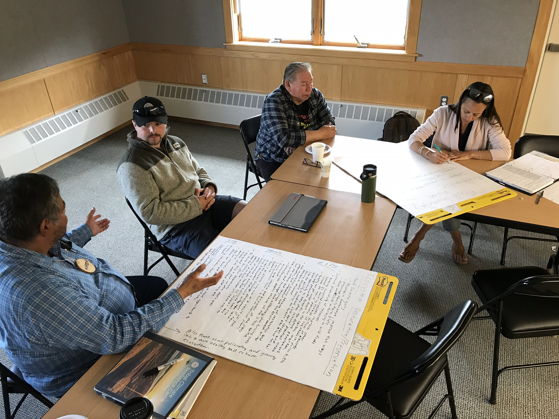
Technical Support: Climate Camps
Tribal Nation leaders, natural resources staff, climate change coordinators, planners, etc. attend as teams to build skills, gather information, and develop community & Tribal government engagement strategies and plans

Slide 8
USET-OERM Tribal Climate Resilience Camp
The USET Tribal Climate Resilience Camp supports Tribal Nation delegations/teams of Tribal leaders, climate change coordinators, planners, and program managers to build skills, gather information, and develop Tribal policies and plans needed for Tribal Nations to address climate change impacts.
Tribal Nation teams
  Learn examples of Tribal climate change adaptation planning.
  Identify resources from climate adaptation science centers, Tribal organizations and other partners.
  Build camaraderie with their team members and across Tribal departments.
  Develop climate adaptation to fit the values and priorities of their Tribal Nation/community.
  Create a strategy to engage their Tribal Nation/community in climate change
  adaptation planning.

Slide 9


Slide 10
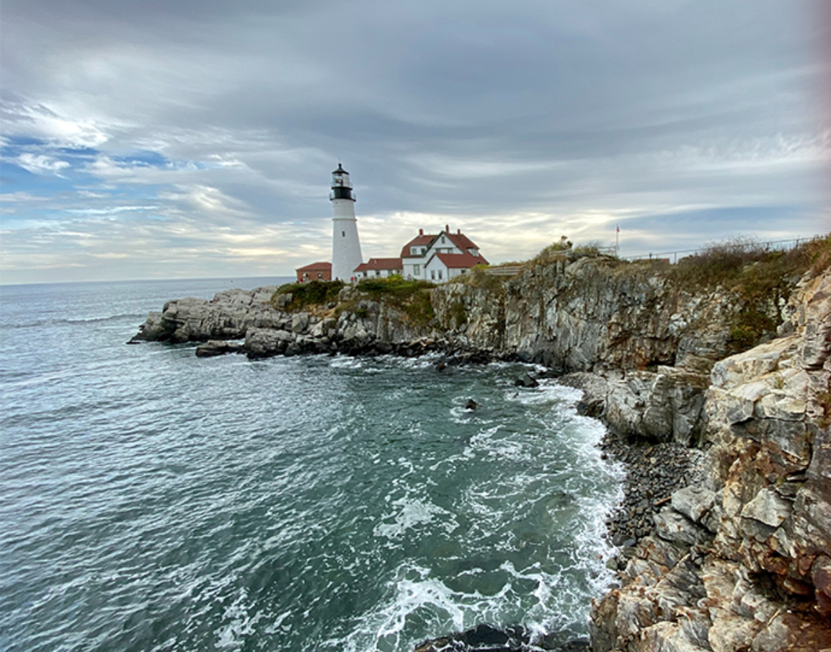
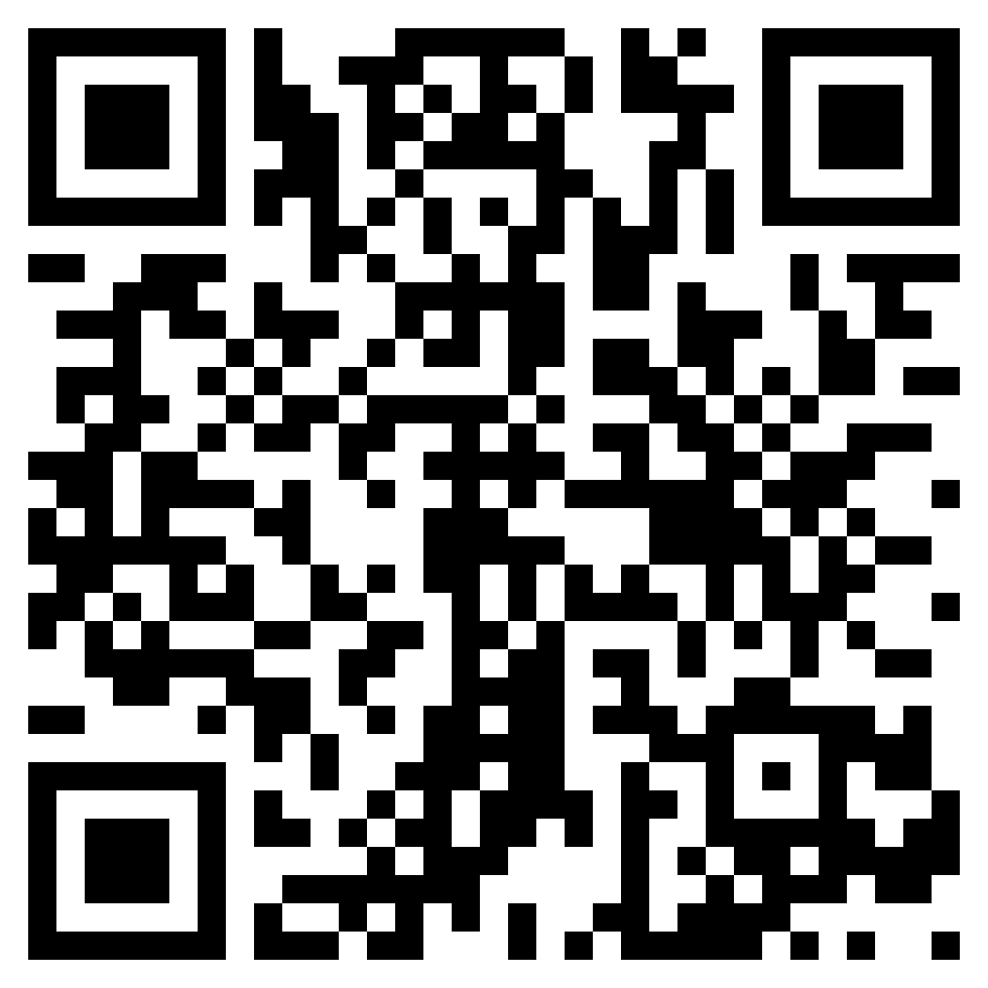
USET Climate Resilience 2023
USET Climate Program Web Page Climate Change – United South & Eastern Tribes (usetinc.org)
USET-OERM Tribal Climate Resilience Camp July 10-14 2023 USET Tribal Climate Resilience Camp – United South & Eastern Tribes (usetinc.org)
Scan to Register for the Camp

