Slide 1
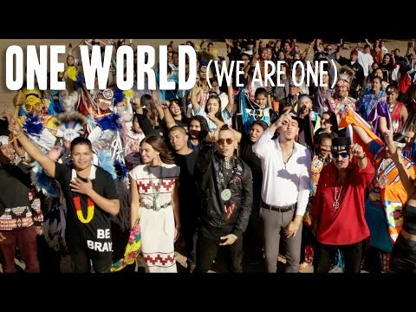
Welcome to
Reclaiming Native Psychological Brilliance Behavioral Health ECHO Series
One World (We Are One)
Produced by IllumiNative and Native artists to demonstrate through song and dance the richness, diversity, and beauty of Indian Country
Notes:
05:08

Slide 2
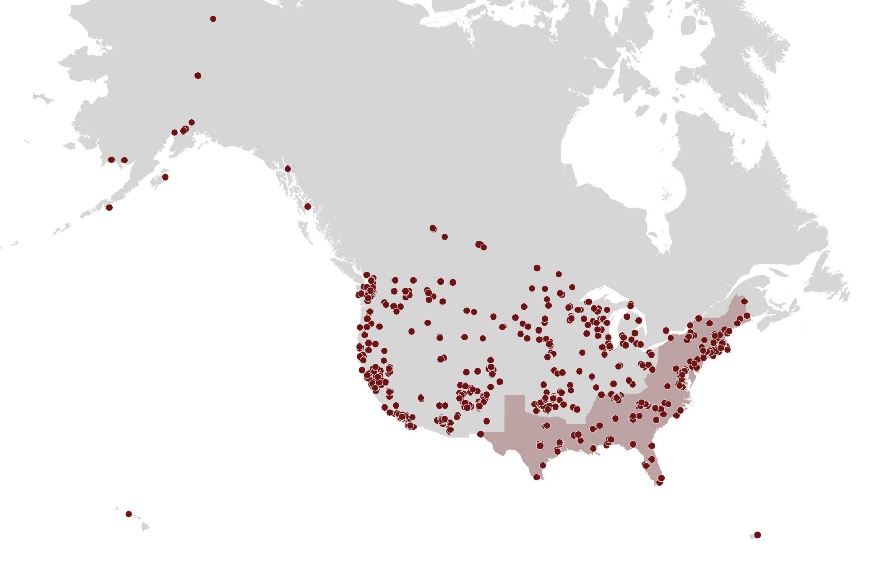

Reclaiming Native Psychological Brilliance Indian Country ECHO "Reach"
January 22 – November 22:​
Over 1500 registrants​
Registrants by month ranged from 317 to 486 people per month​
Number of actual attendees ranged from 112 to 200 people/month​
Number of post-views ranged from 57 to 721​
Registrants represented at least 372 Tribal Nations​
52 federal and state partner organizations​
99 Native organizations​
84 schools and universities​
117 hospitals, health clinics, and treatment centers​
All 12 of the Tribal Epidemiology Centers​
Notes:
Amanda / Jessie
Map from Nov 2022

Slide 3
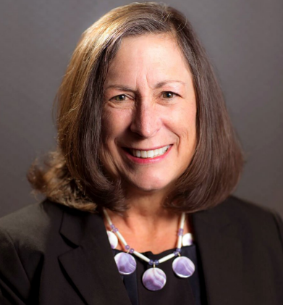
Chief Marilynn “Lynn” (Many Hearts) Malerba
Kickoff to the Inaugural Reclaiming Native Psychological series, blessing.

Slide 4
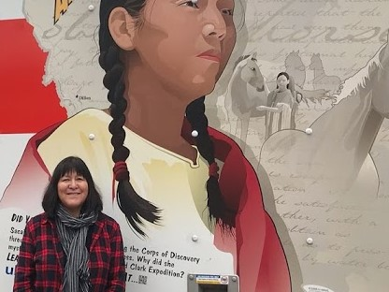
January 25
Introduction to “Reclaiming Native Psychological Brilliance” series
Holly Echo-Hawk, MSc (Pawnee)
Tribal Behavioral Health Subject Matter Expert (SME) for:
New England Mental Health Technology Center (MHTTC) and C4 Innovations
Kauffman and Associates
Opioid Response Network

Slide 5
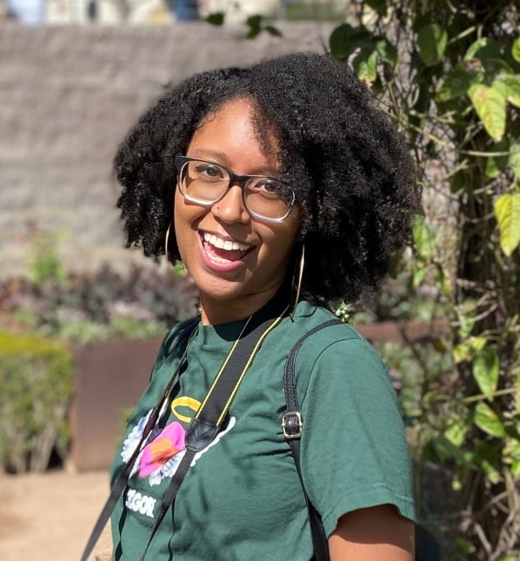
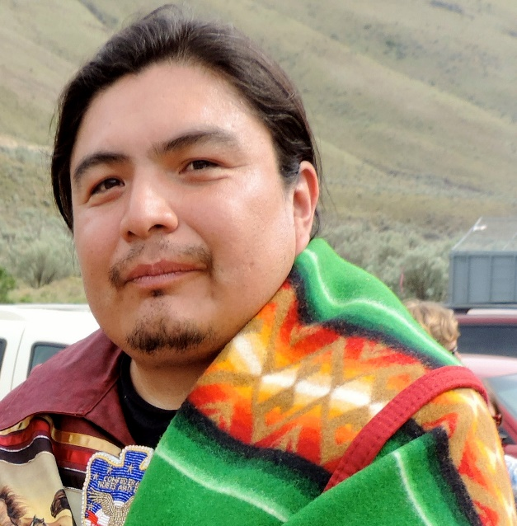
February 22
Nurturing Psychological Brilliance and Resilience in Native Youth
Indigenous Education, Inc. (Cobell)
Melvin Monette-Barajas (Turtle Mountain Band of Chippawa Indians)
Maloni Fox (Mandan, Hidatsa, Arikara Nation)
Indi-gen(i)ous Young Adults
Zoe Harris (Mashpee Wampanoag)
Johnny Buck (Wanapum/Yakama)

Slide 6
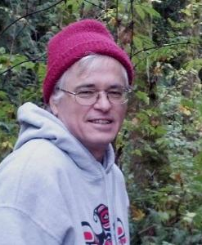
March 22
Native influence on modern psychological theory and Impact of western world view on Indigenous behavioral health
Jeff King, PhD
Muscogee (Creek) Nation of Oklahoma
Professor, Western Washington University

Slide 7
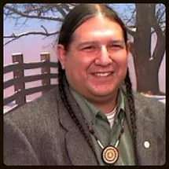
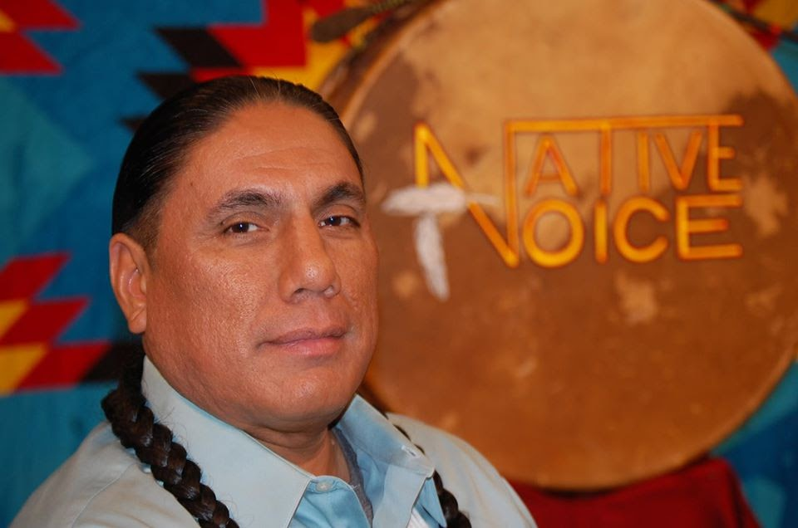
April 26
Native help-declining and help-seeking
Art Martinez, Phd (Chumash)
Tribal psychologist
Mike Duncan (Maidu/ Wailaki / Wintun and Western Band Shoshone)
CEO, Native Dads Network

Slide 8
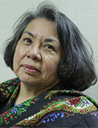
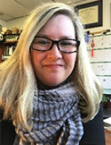
May 24
Native Trauma Layers and
Post-Traumatic Growth
Dolores BigFoot, PhD (Caddo)
Director of Project Making Medicine (1994-current) tribal expertise in cultural adaptation of Trauma treatment approaches
Susan Schmidt, PhD , Counseling Psychologist
Project Making Medicine trainer and clinical supervision

Slide 9
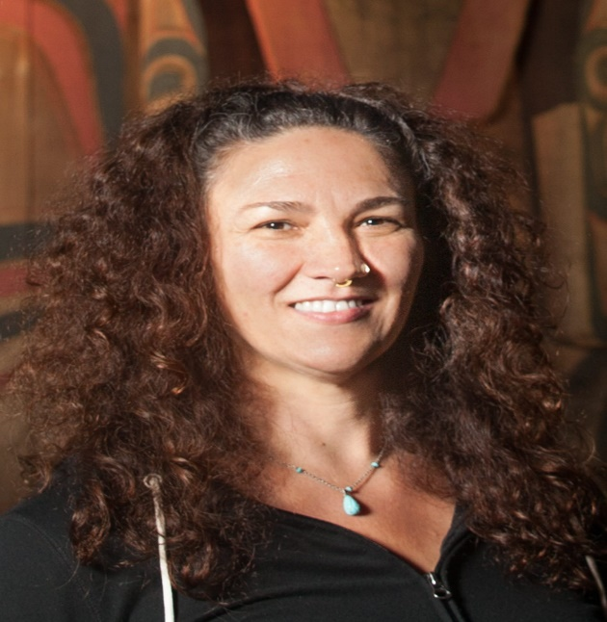
June 28
Sacred Trust: Assessment and diagnosis through Indigenous lens
Jeff King (Muscogee) , Western Washington University
Danica Love Brown (Choctaw), NW Portland Area Indian Health Board

Slide 10
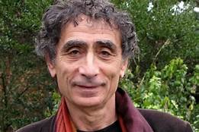
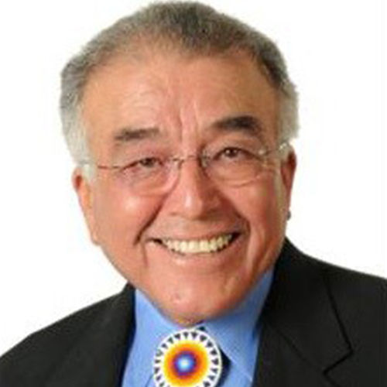
July 26 (TED Talk)
Substance Use and Hungry Ghosts
Gabor Maté, MD (18-minute Ted Talk)
Author of In the Realm of Hungry Ghosts
Native Commentary: Don Coyhis (Mohican), Founder and Chairman of Board, White Bison, Inc.
Facilitator: Harry Brown, MD (Physician at Cherokee Indian Hospital and USET Medical Epidemiologist

Slide 11
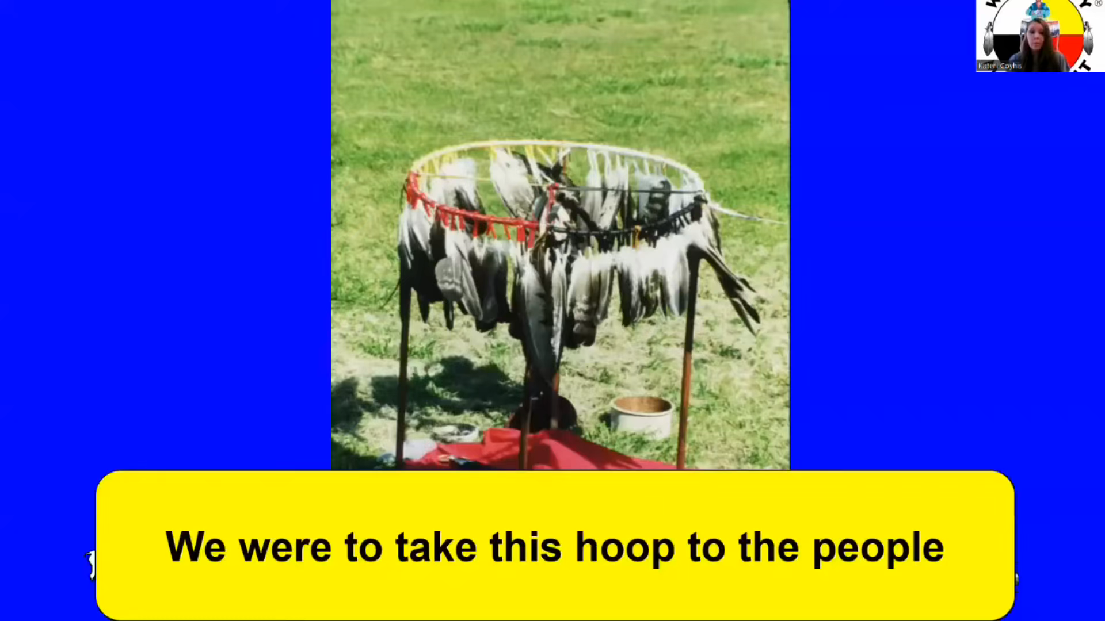
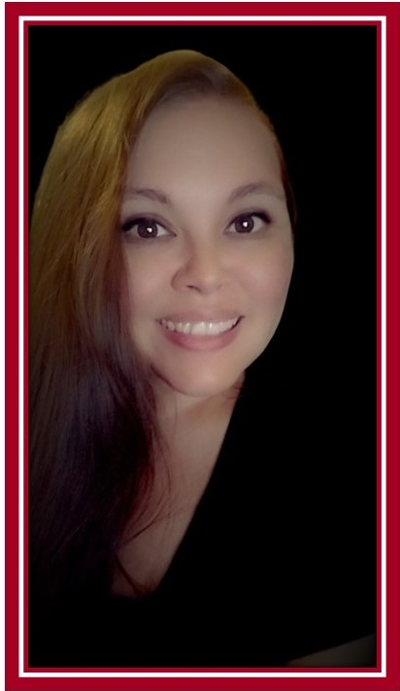
August 23
Indigenous healing practices in Native life re-balance
Kateri Coyhis, Executive Director, White Bison, Inc.

Slide 12
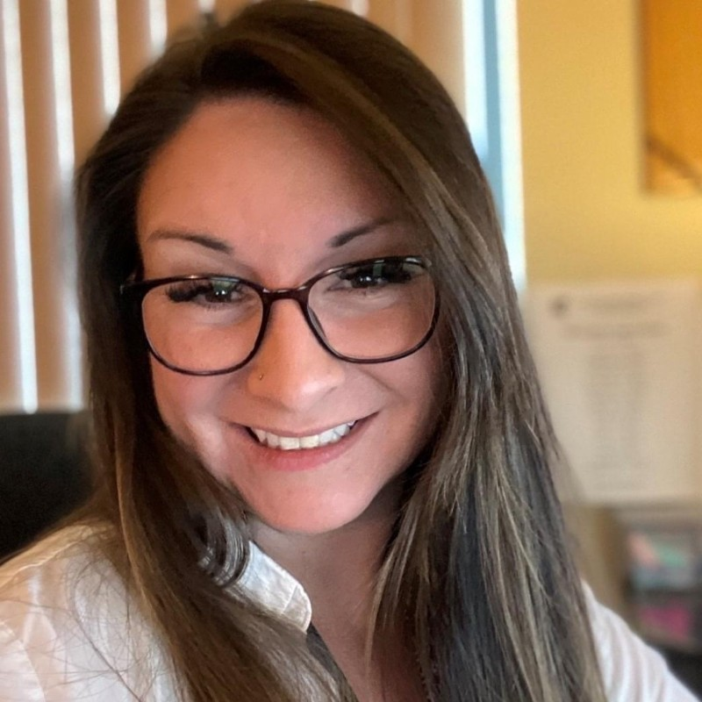
September 27
Inspiring Life Transformation: Strength-Based Resources & Relapse and Crisis Preparedness
Rochelle Williams
Tribal Operations Manager
Behavioral Health|Crisis Services
Volunteers of America Western Washington
Native & Strong Lifeline
for Native people in Washington State
The nation’s only tribal serving 988 call center nation’s only tribal serving 988 call center

Slide 13
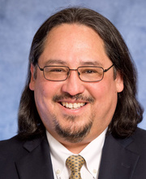
October 25
Reframing Native Mental Health
Joseph P. Gone, PhD (Gros Ventre)
Professor of Anthropology and of Global Health and Social Medicine
Faculty Director, Harvard University Native American Program

Slide 14
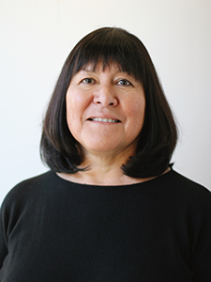

November 22
Open Discussion Forum – Planning for 2023 Series
Facilitator: Holly Echo-Hawk

Slide 15
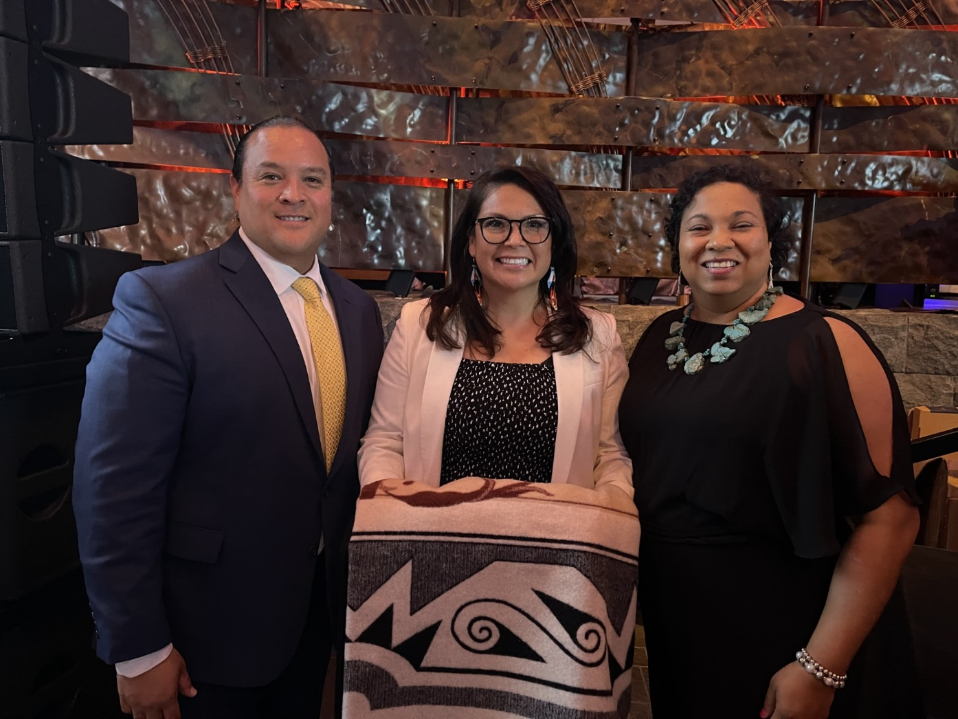
2022 NIHB National Impact Award Winner
“This series explores the innate intelligence, balance, resources, strengths and resilience of ALL our Native people..”
Accepting the award for the team:
Bernice Youpee-Jordan
(Fort Peck Sioux Nation)
Public Health Program Manager
THPS, United South and Eastern Tribes, Inc. for the Tribal Behavioral Health ECHO Webinar Series
Onawa M. Miller
(Quechan Indian Tribe)
Tribal Health Program Support Director
United South and Eastern Tribes, Inc.
Kitcki Carroll
(Cheyenne and Arapaho Tribes)
Executive Director
United South and Eastern Tribes, Inc.

