Slide 1
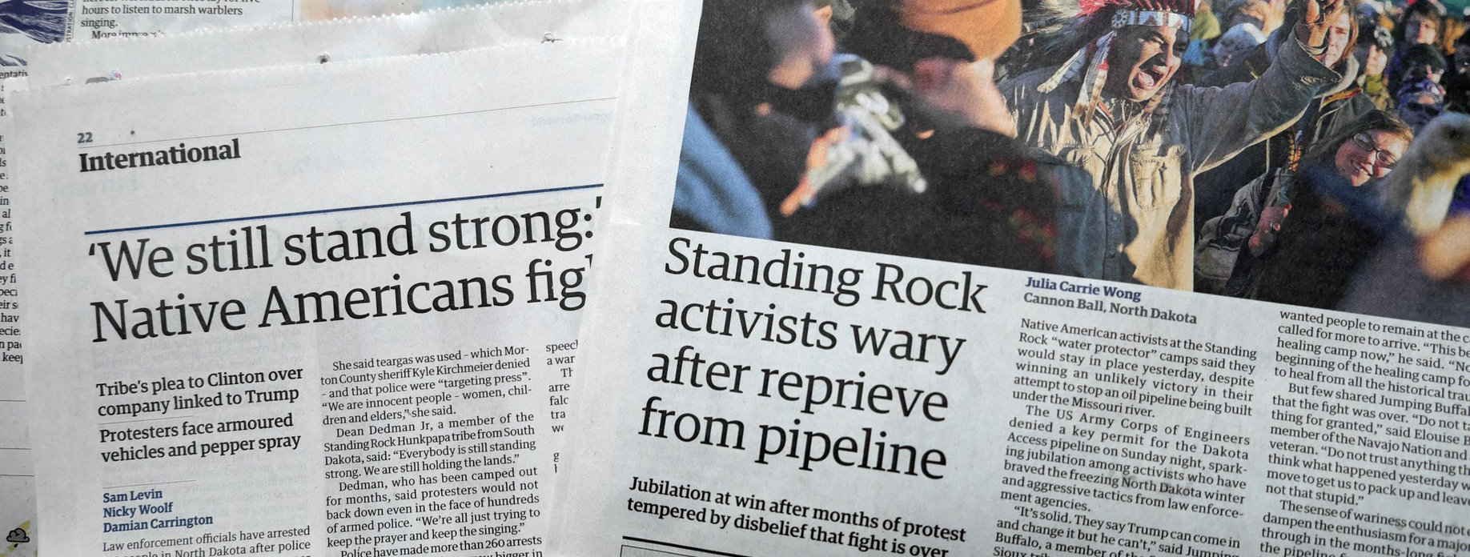

Tribal Activism
Communications Strategy Matters

Slide 2


Slide 3
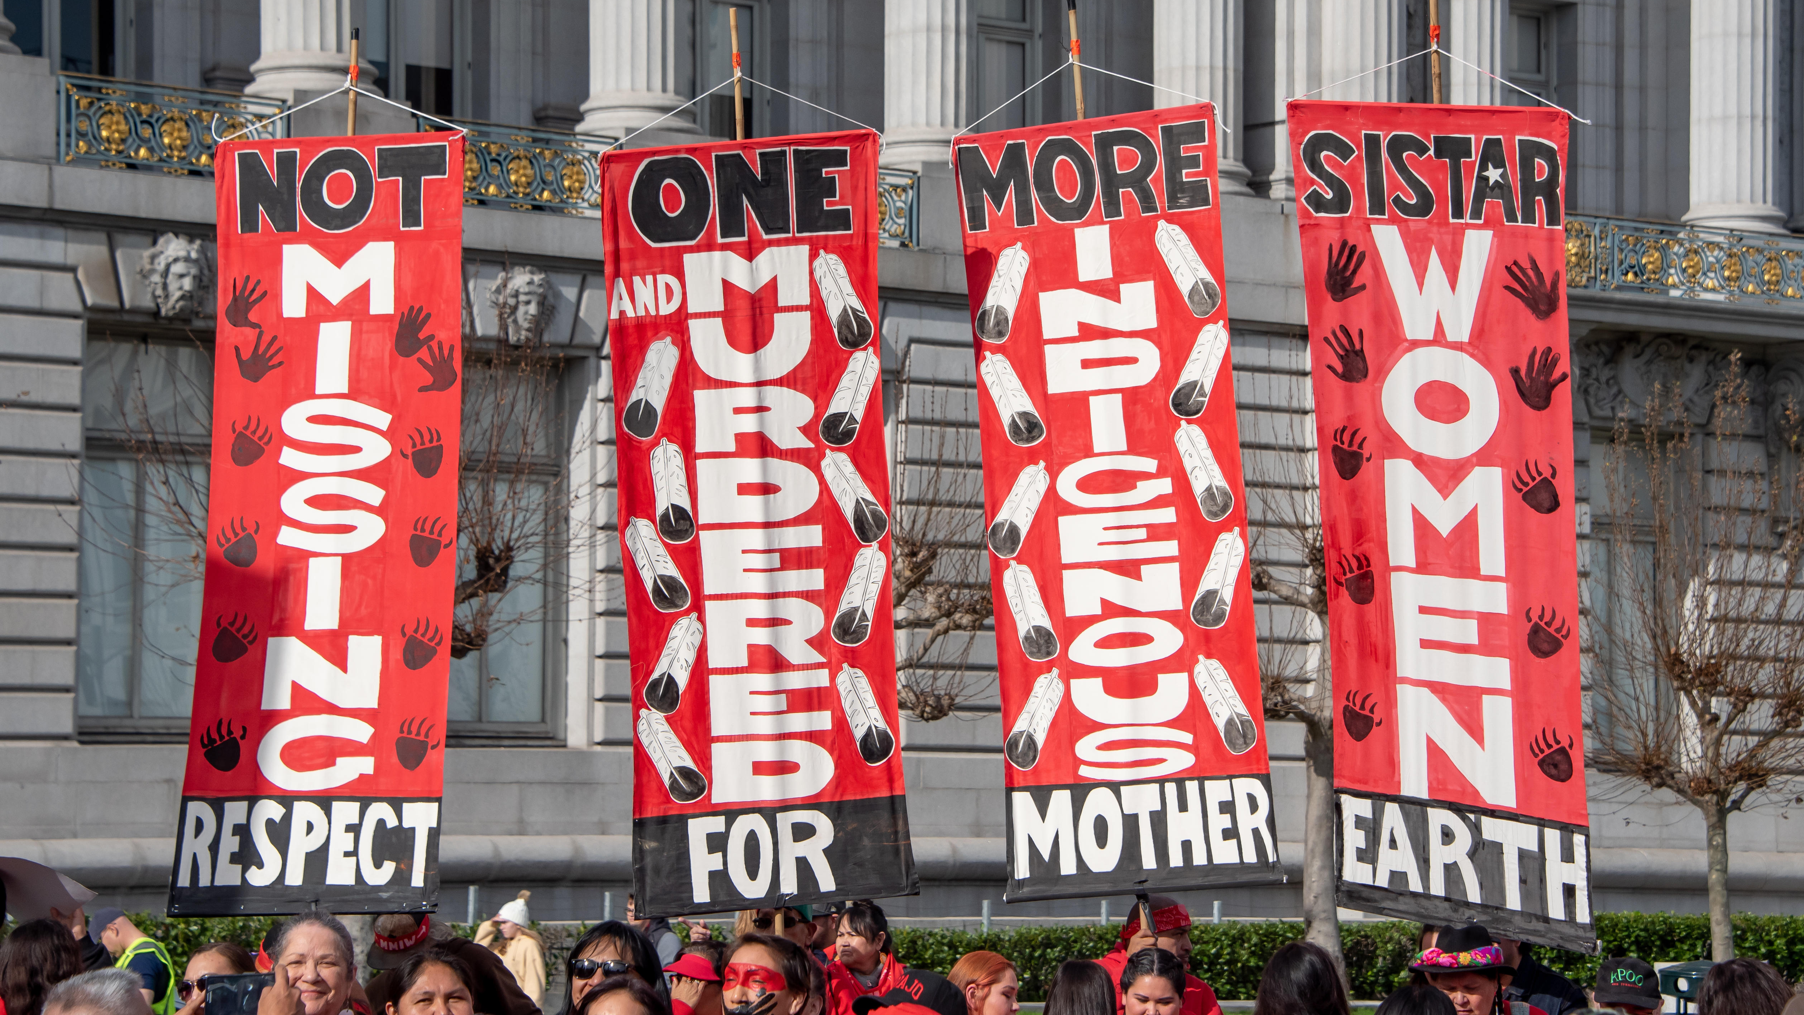
WHAT IS ACTIVISM?
Activism refers to intentional efforts undertaken by individuals or groups to bring about social, political, economic, or environmental change.
Notes:
Activists are driven by a desire to challenge existing power structures, address injustice, and advocate for a more equitable and sustainable world. Activism encompasses a wide range of actions, from grassroots organizing and protests to lobbying, advocacy, and online campaigns.

Slide 4
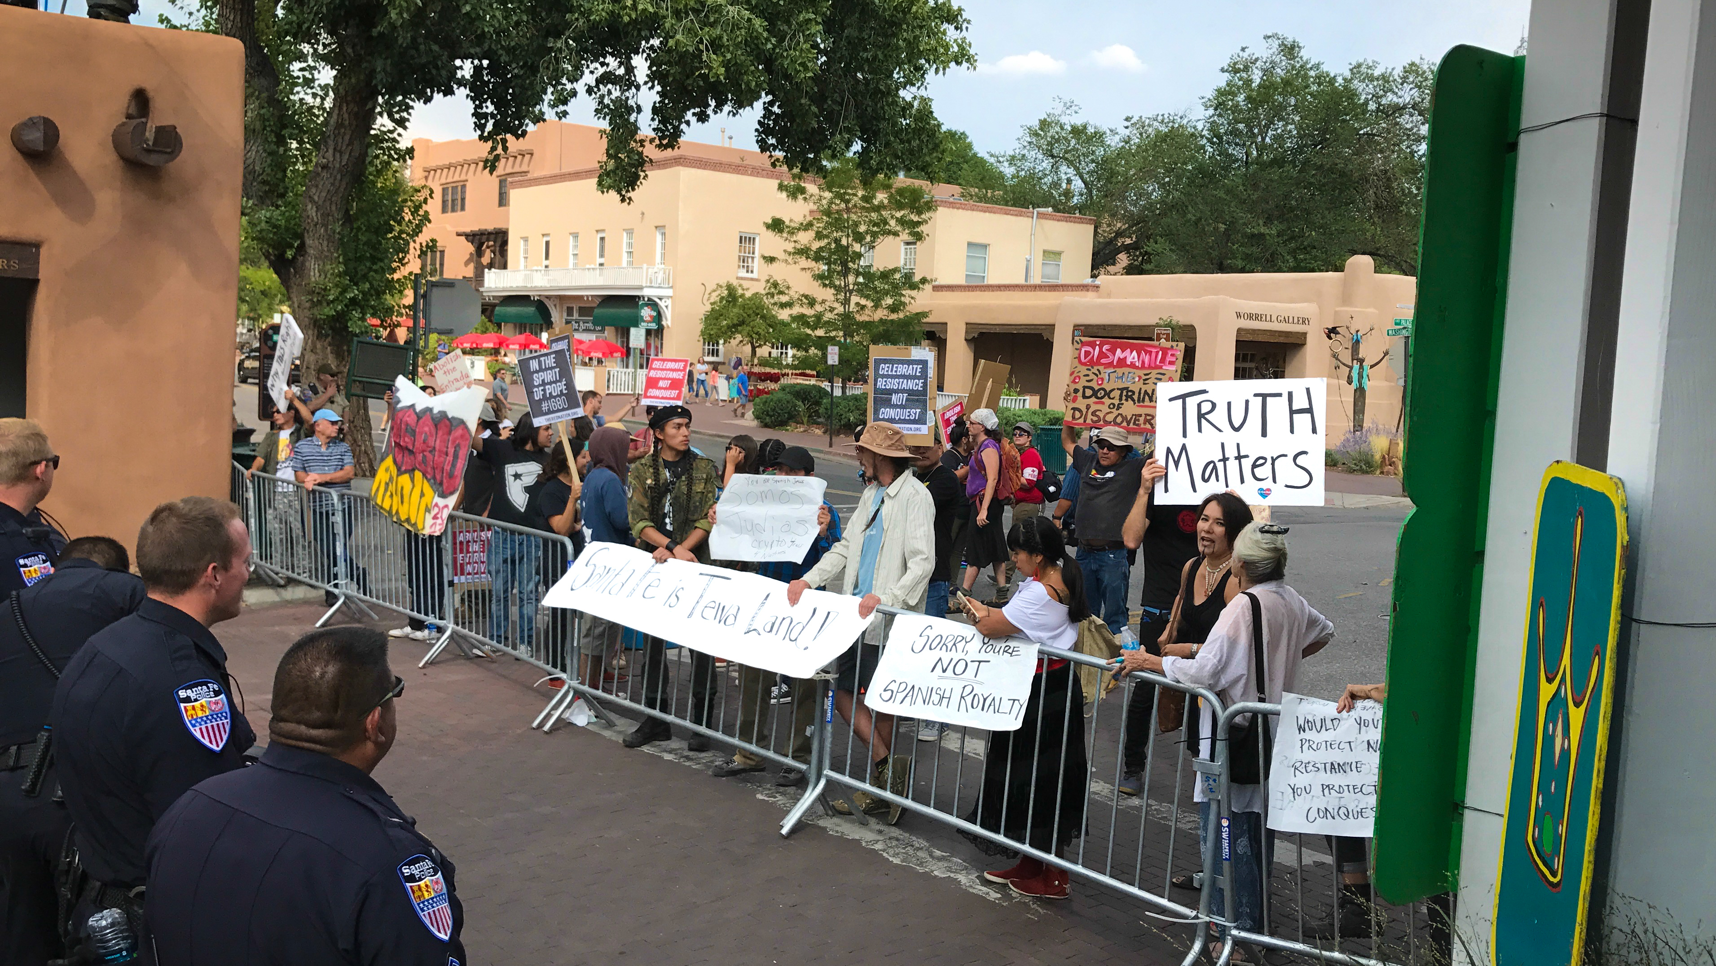
HOW DO ACTIVISM AND COMMUNICATIONS INTERSECT?
Communication plays a pivotal role in activism by serving as a powerful tool for amplifying marginalized voices, raising awareness about social issues, and mobilizing communities.
It’s not easy!

Slide 5
The challenges
Activists face unique communication challenges in their efforts to bring about social change.
Some of those challenges include:
Countering Misinformation
Engaging Diverse Audiences
Maintaining Authenticity
Building Coalitions and Collaboration
Overcoming Resistance and Opposition
Balancing Urgency and Emotional Impact
Navigating Media Landscape
Notes:
Countering Misinformation: Activists often have to contend with misinformation, propaganda, and false narratives that can undermine their cause. They must actively address and counter misinformation through fact-checking, evidence-based arguments, and credible sources. However, countering misinformation can be challenging, as false information can spread quickly and have a lasting impact on public perception.
Engaging Diverse Audiences: Activists strive to reach and engage diverse audiences with varying perspectives, beliefs, and levels of awareness. This requires tailoring messages and communication strategies to resonate with different demographic groups, cultural contexts, and levels of understanding. It can be challenging to bridge gaps in knowledge and experiences to effectively communicate the urgency and relevance of social issues to a broad audience.
Maintaining Authenticity: Authenticity is crucial in activism to build trust and credibility with audiences. Activists must maintain a consistent and genuine voice in their communication, aligning their actions with their stated values and principles. Maintaining authenticity can be challenging in the face of public scrutiny, external pressures, or the need to navigate complex political environments. Striking the right balance between passion and professionalism is important to avoid being perceived as disingenuous.
Building Coalitions and Collaboration: Activists often work in coalitions and partnerships to amplify their impact. However, coordinating communication efforts among diverse organizations and individuals can present challenges. Aligning messaging, maintaining a unified front, and ensuring effective communication within coalitions require careful coordination, consensus-building, and mutual respect.
Overcoming Resistance and Opposition: Activists frequently encounter resistance and opposition from individuals or groups who may hold conflicting beliefs or interests. Communicating with those who are resistant to change or actively oppose the cause can be challenging. It requires skillful communication strategies, such as active listening, respectful dialogue, and evidence-based arguments, to foster understanding, address concerns, and bridge ideological divides.
Balancing Urgency and Emotional Impact: Activists often advocate for issues that are deeply personal and urgent. Balancing the need to convey the gravity of the situation with maintaining emotional well-being can be a challenge. Activists must find ways to communicate effectively without causing burnout or compassion fatigue among themselves or their audience.
Navigating Media Landscape: Activists need to navigate the media landscape to gain visibility and coverage for their cause. However, media biases, limited resources, and the competition for attention can pose challenges. Activists must develop media relations skills, craft compelling stories, and leverage various communication channels to gain media coverage and shape public discourse.

Slide 6
Telling your story
Authenticity and storytelling are powerful tools in activism, as they have the ability to deeply connect with audiences and foster empathy.
Storytelling is a powerful means of communication that has been used for centuries to convey ideas, share experiences, and evoke emotions.
By combining authenticity and storytelling, activists can create a powerful narrative that resonates with audiences, promotes empathy, and drives meaningful change.
Targeted messaging is also a crucial aspect of effective activism communication.
Notes:
Authenticity refers to being genuine, sincere, and true to oneself and one's values. In activism, authenticity plays a crucial role in building trust, credibility, and emotional connection with audiences. When activists communicate authentically, it humanizes their cause and helps to bridge the gap between the advocate and the audience. Authenticity allows activists to establish trust, inspire action, build connections.
Storytelling is a powerful means of communication that has been used for centuries to convey ideas, share experiences, and evoke emotions. In activism, storytelling allows activists to engage emotionally, make complex issues accessible, inspire empathy and understanding, and amplify marginalized voices.
By combining authenticity and storytelling, activists can create a powerful narrative that resonates with audiences, promotes empathy, and drives meaningful change. Personal narratives have the potential to inspire individuals to view social issues through a more compassionate lens and take action to support the cause.
Targeted messaging is also a crucial aspect of effective activism communication. It involves tailoring messages to specific audiences, taking into account their values, interests, and cultural contexts. By implementing targeted messaging, activists can enhance their communication efforts, effectively engage diverse audiences, and mobilize support for their cause. It allows for a more personalized and impactful approach to advocacy, increasing the likelihood of achieving meaningful social change.

Slide 7
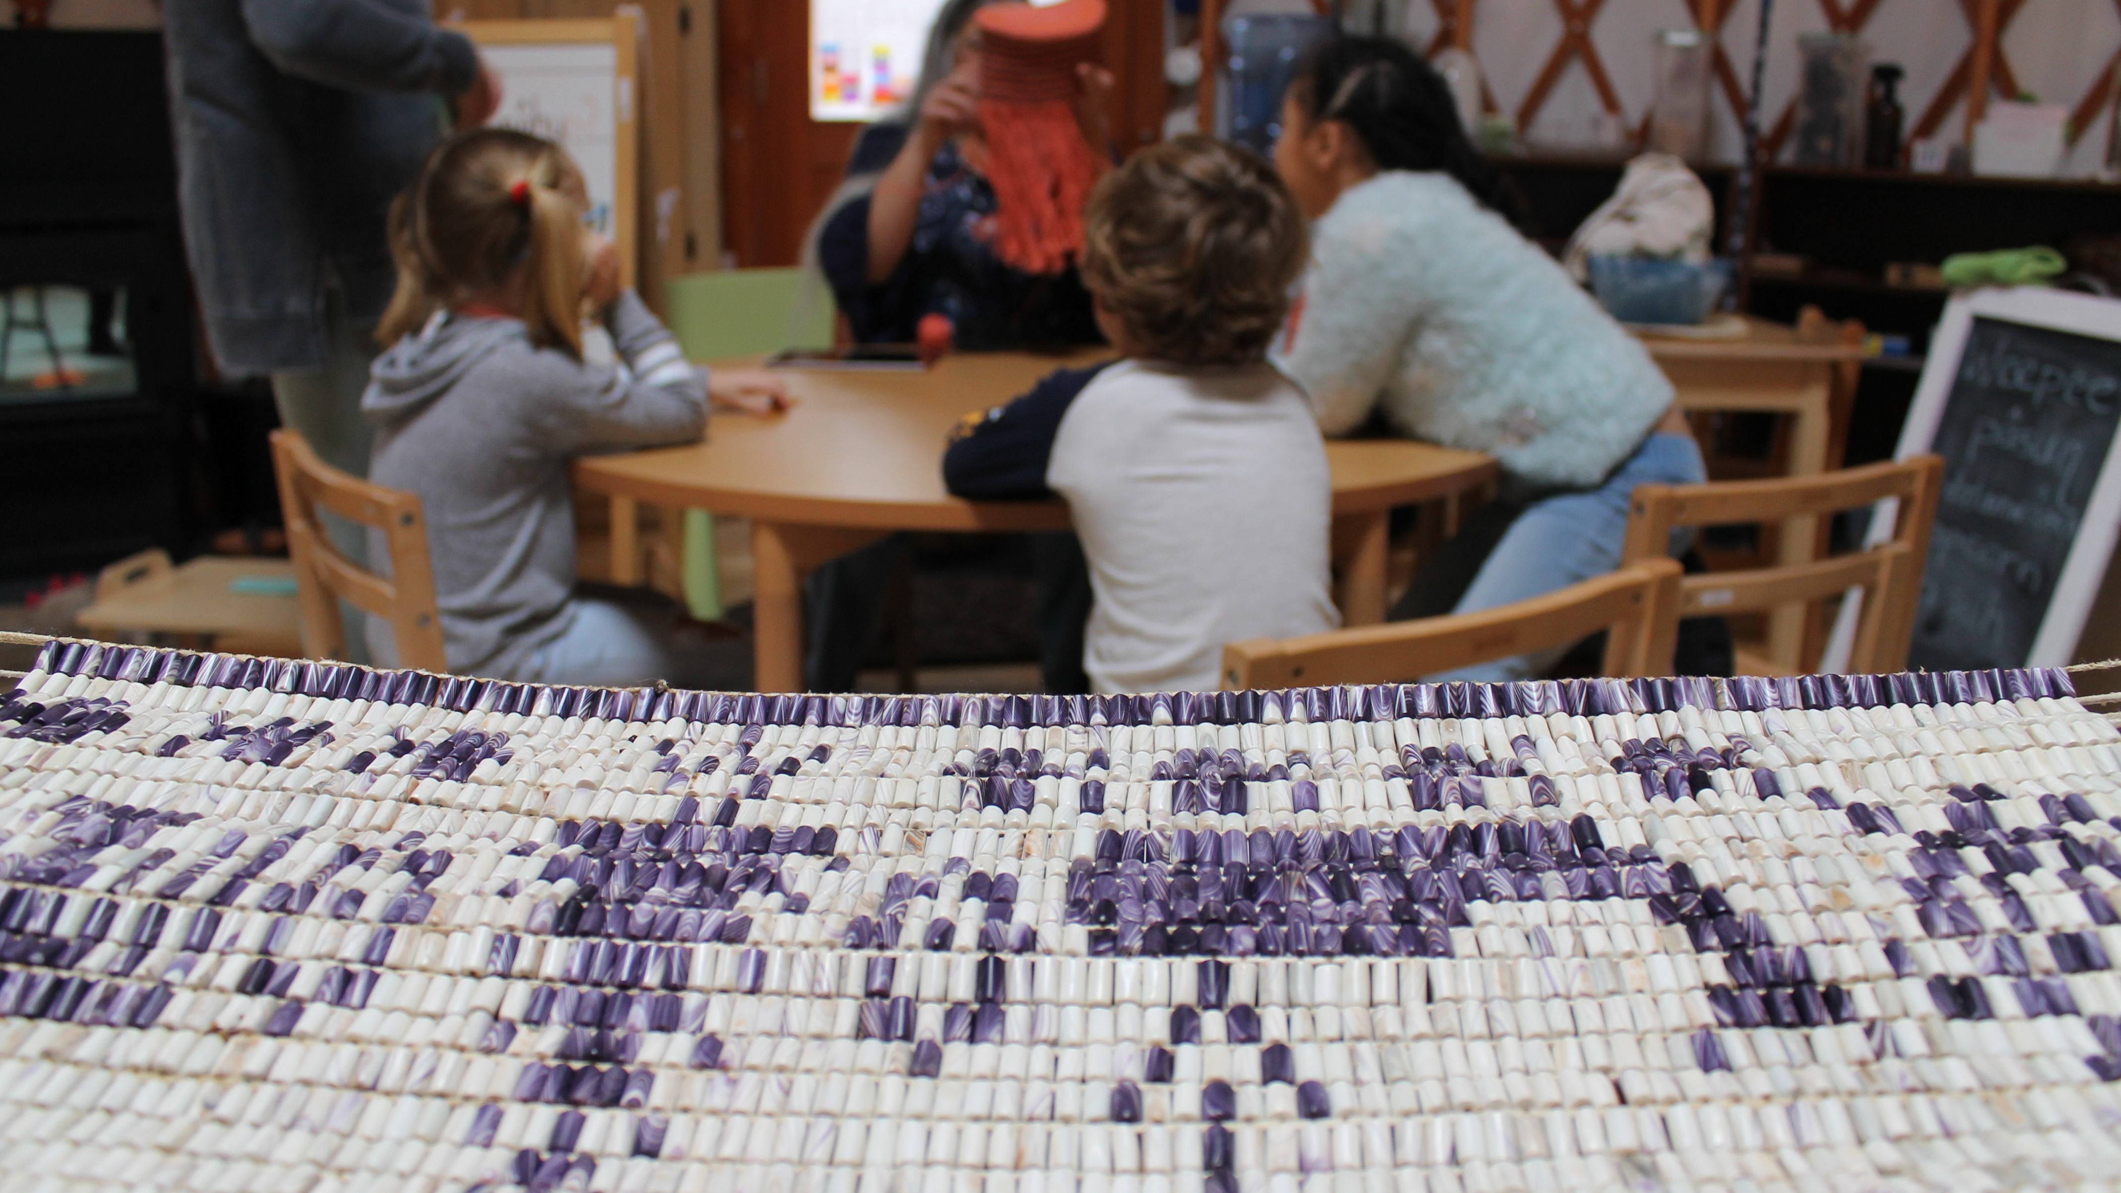
FRAMING AND MESSAGING
Framing and messaging strategies are crucial in activism as they shape how issues are perceived, understood, and responded to by the audience.
Notes:
DEFINITION: A framing strategy in activist communications refers to the intentional use of language, symbols, and narratives to shape the way an issue or cause is perceived by the public and to mobilize support for the activists' goals.
DEFINITION: A messaging strategy in activist communications refers to the deliberate planning and crafting of messages to effectively convey an activist's goals, values, and desired outcomes. It involves creating clear, compelling, and persuasive messages that resonate with the target audience and inspire action or support for the cause.

Slide 8

IS IT WORKING?
Remember to regularly evaluate the impact of your framing and messaging strategies through feedback, engagement metrics, and ongoing dialogue with your audience. Adapt and refine your messaging based on evolving needs and responses.

Slide 9
SOCIAL MEDIA CHANGED THE GAME
Social media platforms have revolutionized activism by providing powerful tools for amplifying activist messages, building networks, and facilitating online organizing.
It Amplifies Activist Messages:
Wide Reach, Viral Potential, Hashtag Activism
It Builds Networks and Communities:
Connectivity, Mobilization, Networking Opportunities
It Facilitates Online Organizing:
Information Sharing, Grassroots Campaigns, Real-Time Updates, Online Advocacy
Notes:
It Amplifies Activist Messages:
Wide Reach: Social media platforms have a massive user base, allowing activists to reach a global audience with their messages. Activists can share stories, photos, videos, and infographics to raise awareness about social issues and engage a large number of people quickly and effectively.
Viral Potential: Social media enables content to go viral, spreading rapidly through shares, likes, and retweets. Activist messages can gain significant traction, attracting attention from media outlets, influencers, and policymakers, thereby amplifying the reach and impact of the message.
Hashtag Activism: Hashtags are powerful tools for organizing and aggregating content around specific issues or campaigns. Activists can create and promote hashtags to unify conversations, rally supporters, and encourage widespread participation in online discussions.
It Builds Networks and Communities:
Connectivity: Social media platforms enable activists to connect with like-minded individuals and organizations across geographical boundaries. Activists can form communities, share knowledge, collaborate on projects, and provide mutual support. This connectivity fosters a sense of belonging, collective identity, and solidarity.
Mobilization: Social media acts as a mobilization tool, allowing activists to disseminate calls to action, promote events, and organize rallies, protests, and other forms of collective action. The ease of sharing information and updates quickly and widely enhances the mobilization capacity of activists.
Networking Opportunities: Activists can build valuable networks by connecting with influencers, experts, journalists, and other key stakeholders. Social media platforms facilitate direct engagement and dialogue with individuals who can contribute to the cause, including potential partners, supporters, or donors.
It Facilitates Online Organizing:
Information Sharing: Social media enables activists to share information, resources, research findings, and news articles related to their cause. This facilitates the dissemination of critical information, educates the audience, and keeps supporters informed about developments in the field.
Grassroots Campaigns: Activists can launch grassroots campaigns online, leveraging social media to engage supporters in online petitions, letter-writing campaigns, boycotts, or fundraising efforts. These campaigns can create a sense of collective action and drive tangible outcomes.
Real-Time Updates: Social media allows activists to provide real-time updates on events, actions, and emergencies. They can share live videos, photos, and updates from the ground, creating transparency and urgency in their advocacy.
Online Advocacy: Activists can use social media platforms to engage in online advocacy, reaching out to policymakers, government officials, and corporate entities. Through targeted messages, activists can advocate for policy changes, demand accountability, and push for corporate social responsibility.

Slide 10
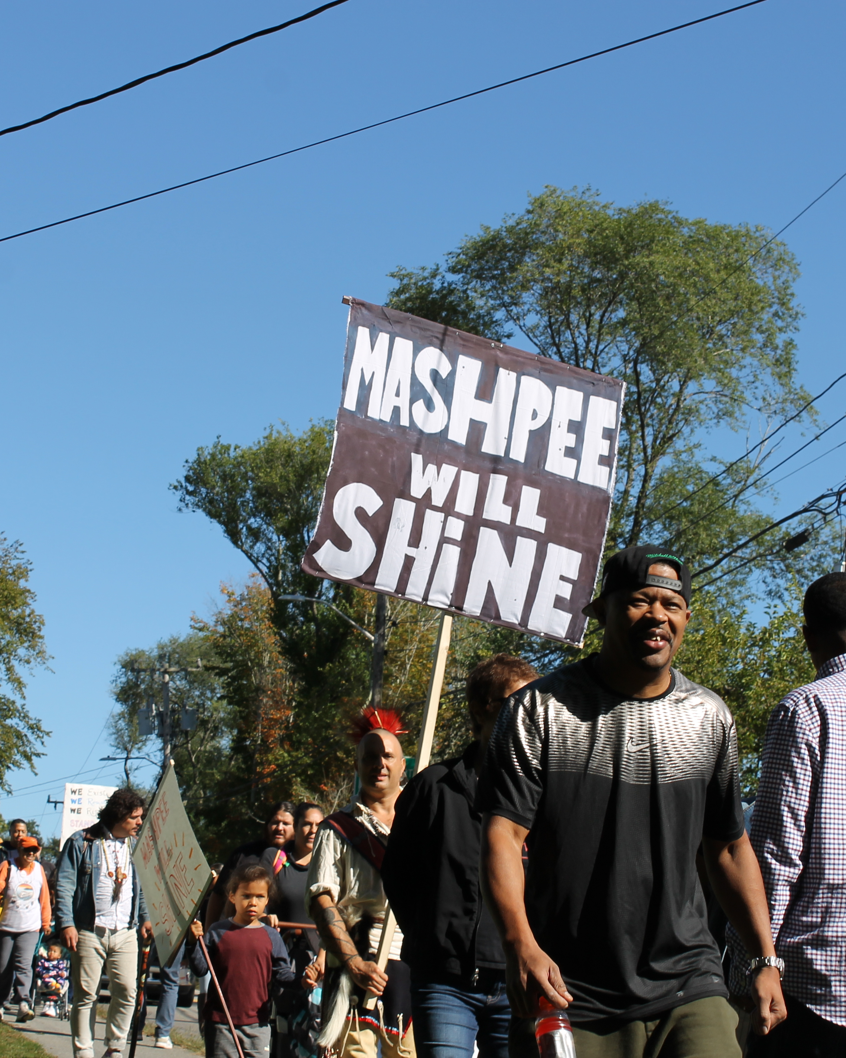
A STRONG TOOLKIT
It's important for activists to develop social media strategies that align with their goals and target audience.
There are many tools that that can be put in a toolkit. they include media relations and press releases, grassroots organizing, digital advocacy, visual communication and engaging with Influencers and partners.
When engaging in activism, it's important to be prepared for potential challenges, including backlash, criticism, and dealing with opposition.
Notes:
Consider the unique opportunities and challenges of each platform, maintain authenticity, and engage in meaningful dialogue with their audience. Regular monitoring, evaluation, and adaptation of social media efforts are essential for maximizing impact and staying connected with supporters.
Steven mentioned several that we utilized for the Mashpee Wamapnoag Tribe earlier …

Slide 11
8 STRATEGIES FOR ADDRESSING CHALLENGES
Social media platforms have revolutionized activism by providing powerful tools for amplifying activist messages, building networks, and facilitating online organizing.
Maintain Clarity of Purpose
Respond with Respect and Empathy
Practice Active Listening
Educate and Inform
Build Alliances and Seek Support
Use Positive Messaging
Practice Self-Care and Seek Support
Document and Address Harassment
Notes:
Maintain Clarity of Purpose: Stay focused on the purpose and goals of your activism. Understand that criticism and opposition are inevitable when challenging the status quo. Remind yourself and your supporters of the importance of your cause and the positive impact you are striving to achieve.
Respond with Respect and Empathy: When facing criticism or opposition, respond with respect and empathy, even if the other party is not doing the same. Engage in constructive dialogue and seek to understand the concerns and perspectives of others. Address criticisms with evidence-based arguments, data, and personal stories, whenever possible.
Practice Active Listening: Listen attentively to the concerns and criticisms raised by others. This demonstrates your willingness to engage in open dialogue and find common ground. By actively listening, you may also gain insights into potential areas for improvement or areas where misunderstandings can be clarified.
Educate and Inform: Address criticism and opposition by providing factual information and educating others about your cause. Share research, statistics, and credible sources to support your arguments and counter misinformation. This approach can help dispel myths or misconceptions and promote a better understanding of the issues at hand.
Build Alliances and Seek Support: Form alliances and seek support from like-minded individuals, organizations, and communities. Collaborating with others who share your values and goals can provide a stronger collective voice and help withstand criticism or opposition. Engage in coalition-building efforts to amplify your message and widen your impact.
Use Positive Messaging: Emphasize the positive aspects of your activism, such as the potential for social change, community empowerment, and the benefits of a more equitable society. Highlight success stories, achievements, and positive impacts to counter negativity and inspire others to support your cause.
Practice Self-Care and Seek Support: Advocacy work can be emotionally demanding, particularly when facing backlash or criticism. Take care of your mental and emotional well-being by practicing self-care strategies. Surround yourself with a supportive community, seek professional help if needed, and take breaks when necessary to avoid burnout.
Document and Address Harassment: In some cases, backlash and opposition can escalate to harassment or threats. Document any instances of harassment and report them to the appropriate authorities. Reach out to support networks, legal resources, or advocacy organizations that specialize in protecting activists' safety and well-being.

Slide 12
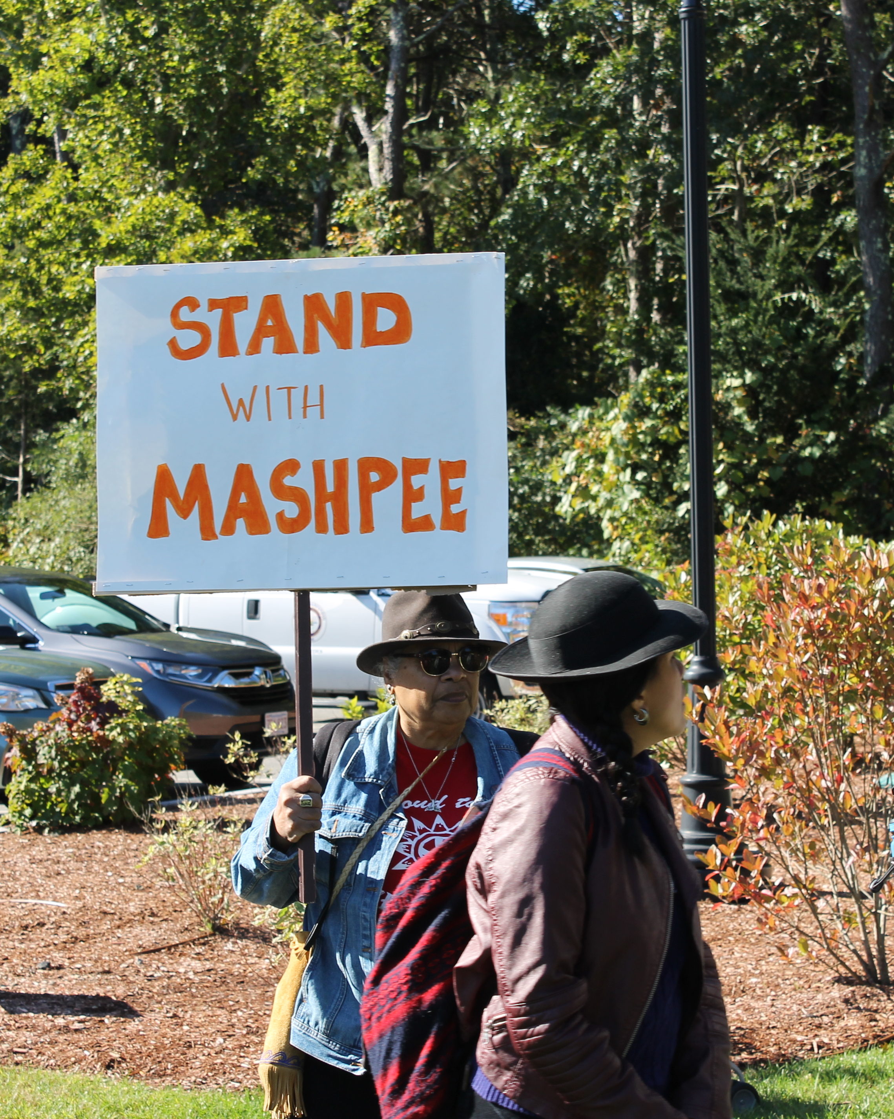
STAY THE COURSE
Remember that facing opposition is often a sign that your activism is challenging existing power structures and making an impact.
Ethical communications, transparency, and accountability are essential components of effective activism.
Notes:
Remember that facing opposition is often a sign that your activism is challenging existing power structures and making an impact. Stay resilient, learn from constructive feedback, and use it as an opportunity for growth and improvement. Your dedication and perseverance can lead to meaningful change, even in the face of adversity.
Ethical communications, transparency, and accountability are essential components of effective activism. They ensure that activists maintain integrity, build trust with their audience, and uphold ethical standards.
By embracing ethical communications, activists can uphold the values and principles they stand for, build trust with their audience, and foster a culture of integrity and accountability. These principles are vital in maintaining the long-term impact and legitimacy of activism efforts.

Slide 13
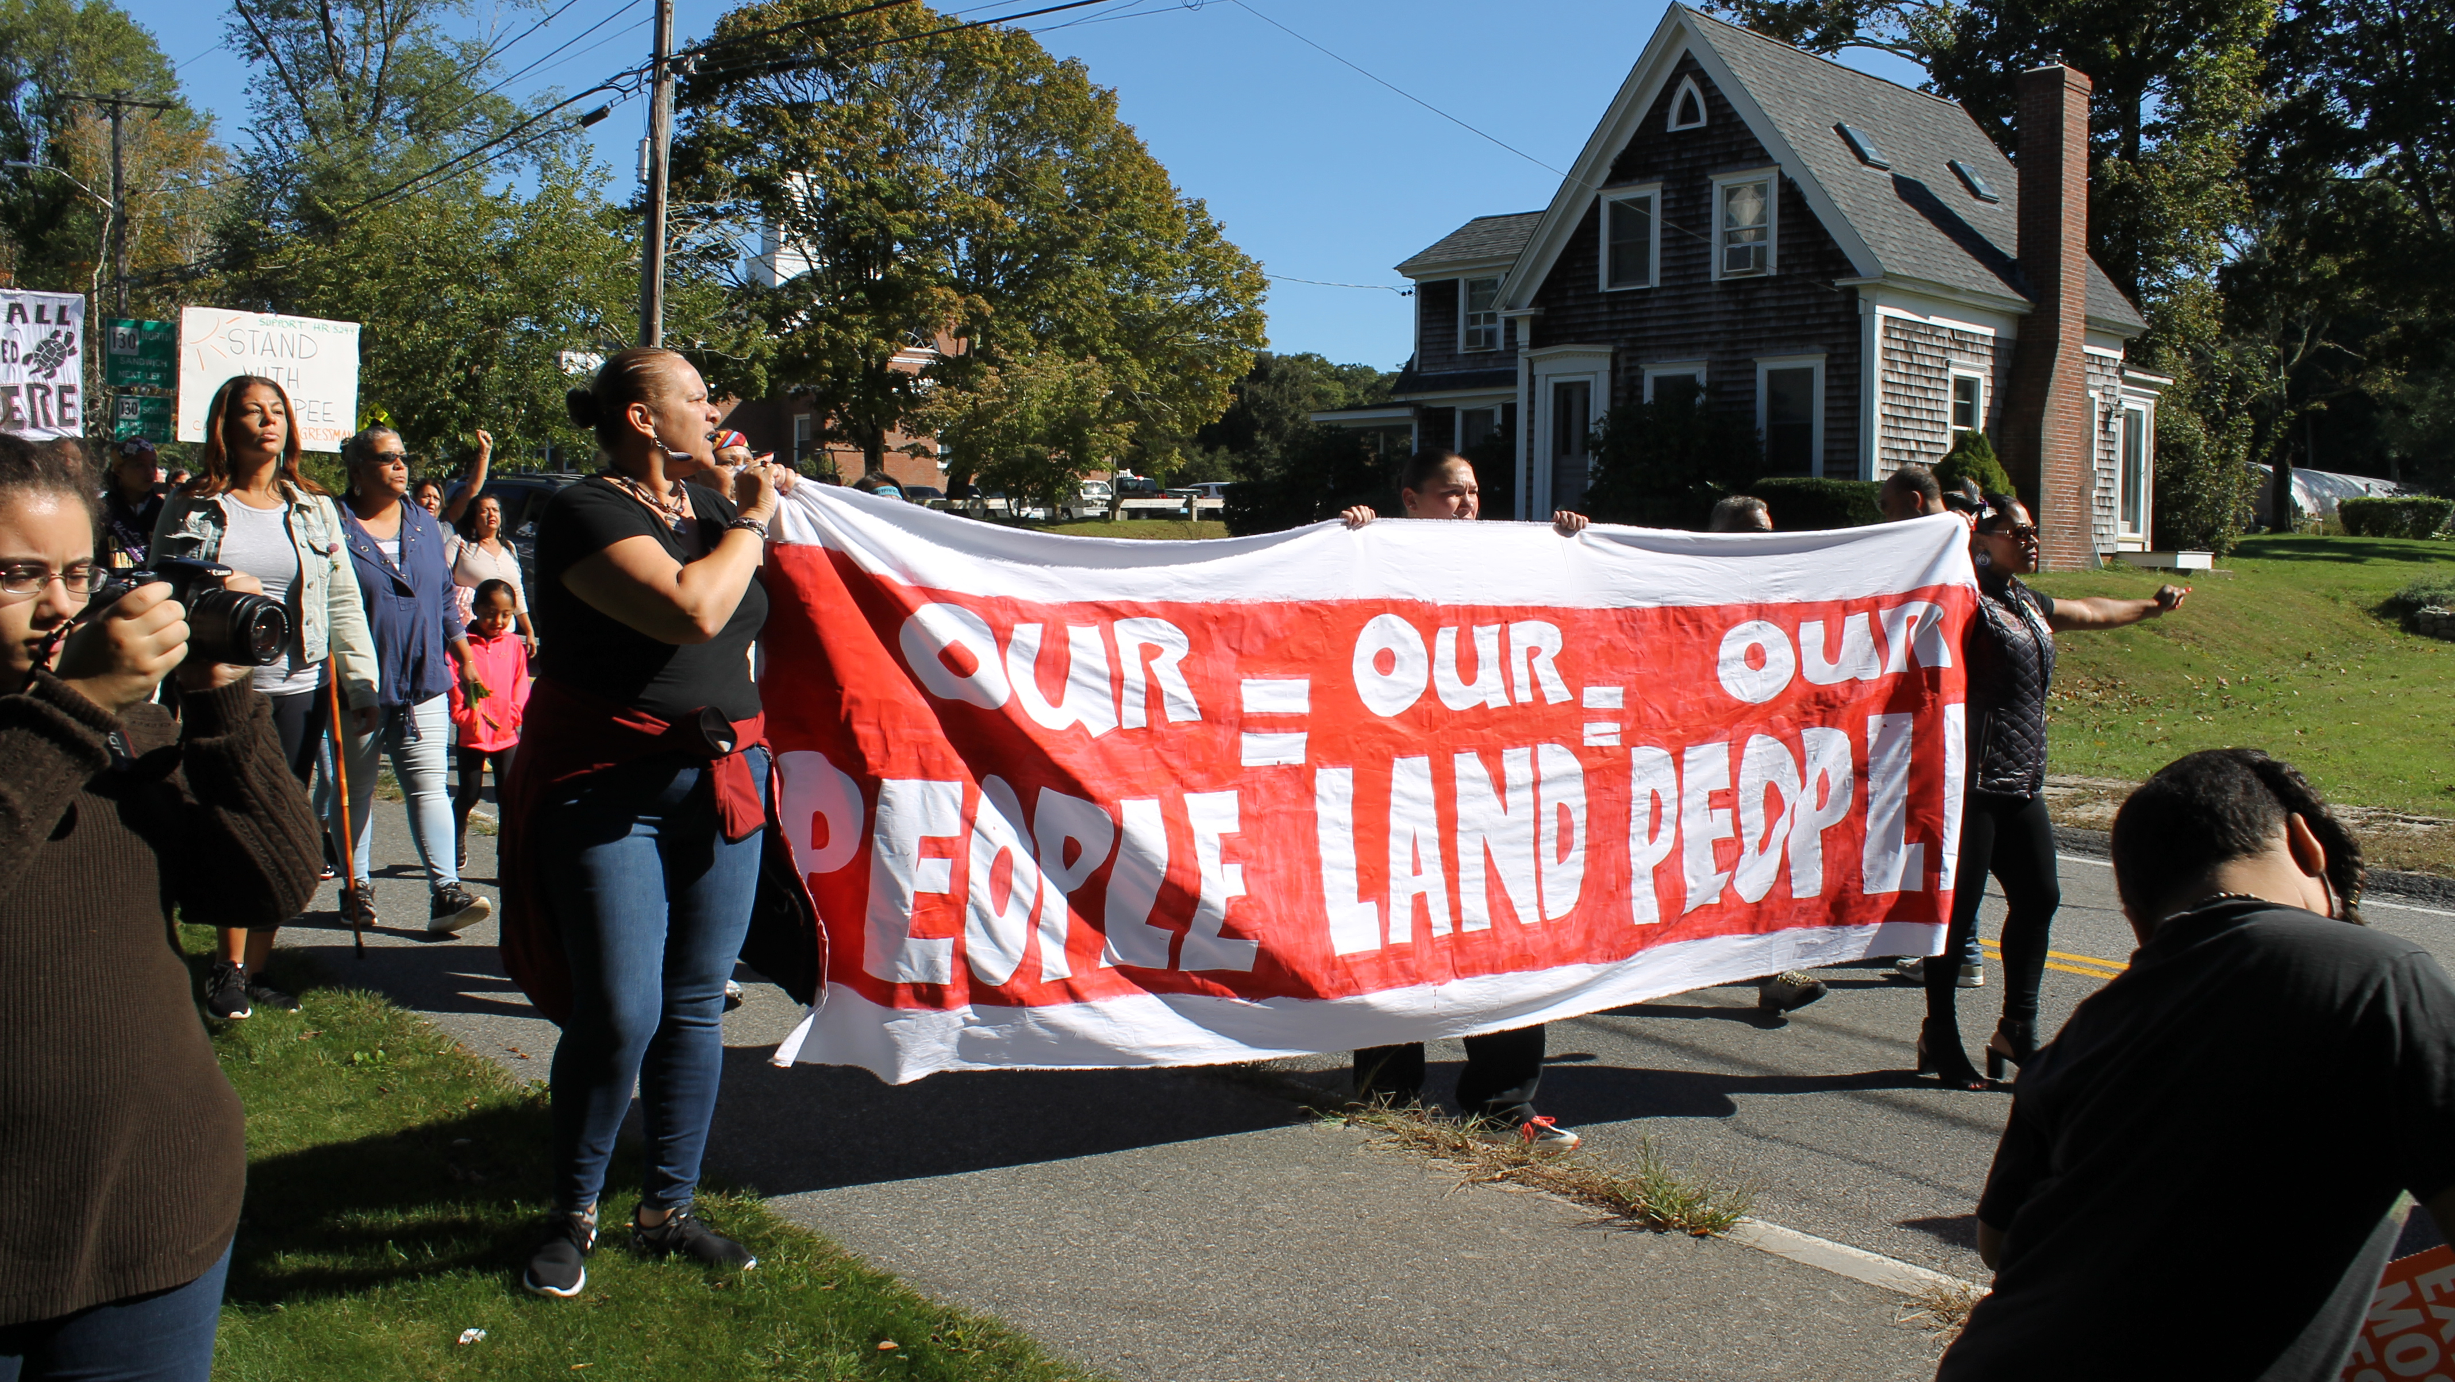
PUTTING IT INTO ACTION
Mashpee Wampanoag Were Threatened with the dispossession of its land.
Notes:
Case study: Mashpee Wampanoag Tribe.
Who is the Mashpee Wampanoag Tribe:
xx
Timeline:
Since 2010, the Mashpee Wampanoag Tribe has faced several significant developments and challenges. Here are some key events:
Federal Recognition: In 2007, the Mashpee Wampanoag Tribe gained federal recognition from the United States government, acknowledging their status as a sovereign tribal nation. This recognition provided certain rights and benefits to the tribe.
Land into Trust: In 2015, the Department of the Interior announced that it had taken approximately 321 acres of land into trust on behalf of the Mashpee Wampanoag Tribe. This decision meant that the tribe's land would be held in trust by the federal government, ensuring its protection and enabling the tribe to exercise self-governance.
Casino Project: In 2016, the Mashpee Wampanoag Tribe pursued plans to develop a resort casino in Taunton, Massachusetts. The proposed First Light Resort & Casino aimed to boost the tribe's economic development and create jobs for both tribal members and the surrounding community.
Legal Challenges: The Mashpee Wampanoag Tribe faced legal challenges to their land and casino plans. In 2016, a lawsuit was filed challenging the Department of the Interior's decision to take the land into trust. In 2018, a federal judge ruled against the tribe, stating that the Department of the Interior lacked the authority to take the land into trust.
Reservation Status: The legal setback in 2018 jeopardized the tribe's reservation status, as the court's decision could potentially lead to the loss of their land in trust. The Department of the Interior, under the Trump administration, reversed its previous decision, and the tribe's reservation status was put into question.
Land into Trust: A federal judge blocked the administration’s move and sent the matter to the Department of the Interior for reconsideration. In February 2021, the Biden administration withdrew the government’s appeal on the case.
Current Status: Mashpee Wampanoag officials waited for months for a final decision on the status of their land from the Department of the Interior. It was finally granted December 2021.
Examples of activism to effectuate change:

Slide 14


Slide 15
KEY TAKEAWAYS FROM TODAY’S TALK
Activism and Communication
Authenticity and Storytelling
Targeted Messaging
Framing and Messaging Strategies
Utilizing Social Media
Addressing Challenges
Ethical Communications, Transparency, and Accountability
Collective Power of Effective Communication
Notes:
Activism and Communication: Communication plays a vital role in activism by amplifying marginalized voices, raising awareness, and mobilizing communities.
Authenticity and Storytelling: Authenticity builds trust and fosters connections with audiences, while storytelling evokes empathy and inspires action.
Targeted Messaging: Tailor messages to specific audiences, considering their values, interests, and cultural contexts for maximum impact.
Framing and Messaging Strategies: Effective framing shapes how issues are perceived, using inclusive language and leveraging emotions to inspire action.
Utilizing Social Media: Social media platforms are powerful tools for amplifying activist messages, building networks, and facilitating online organizing.
Addressing Challenges: Activists must be prepared to address challenges such as backlash, criticism, and dealing with opposition. Maintaining clarity, respectful engagement, and seeking support are crucial in navigating these challenges.
Ethical Communications, Transparency, and Accountability: Ethical communications uphold integrity, build trust, and prioritize transparency and accountability. They foster informed consent, counter disinformation, and uphold human rights and social justice.
Collective Power of Effective Communication: By harnessing the collective power of effective communication, individuals, communities, and movements can challenge oppressive systems, advocate for social justice, and drive meaningful, long-lasting social change. It empowers individuals to recognize their agency, join together, and work towards a more equitable and inclusive world.

Slide 16
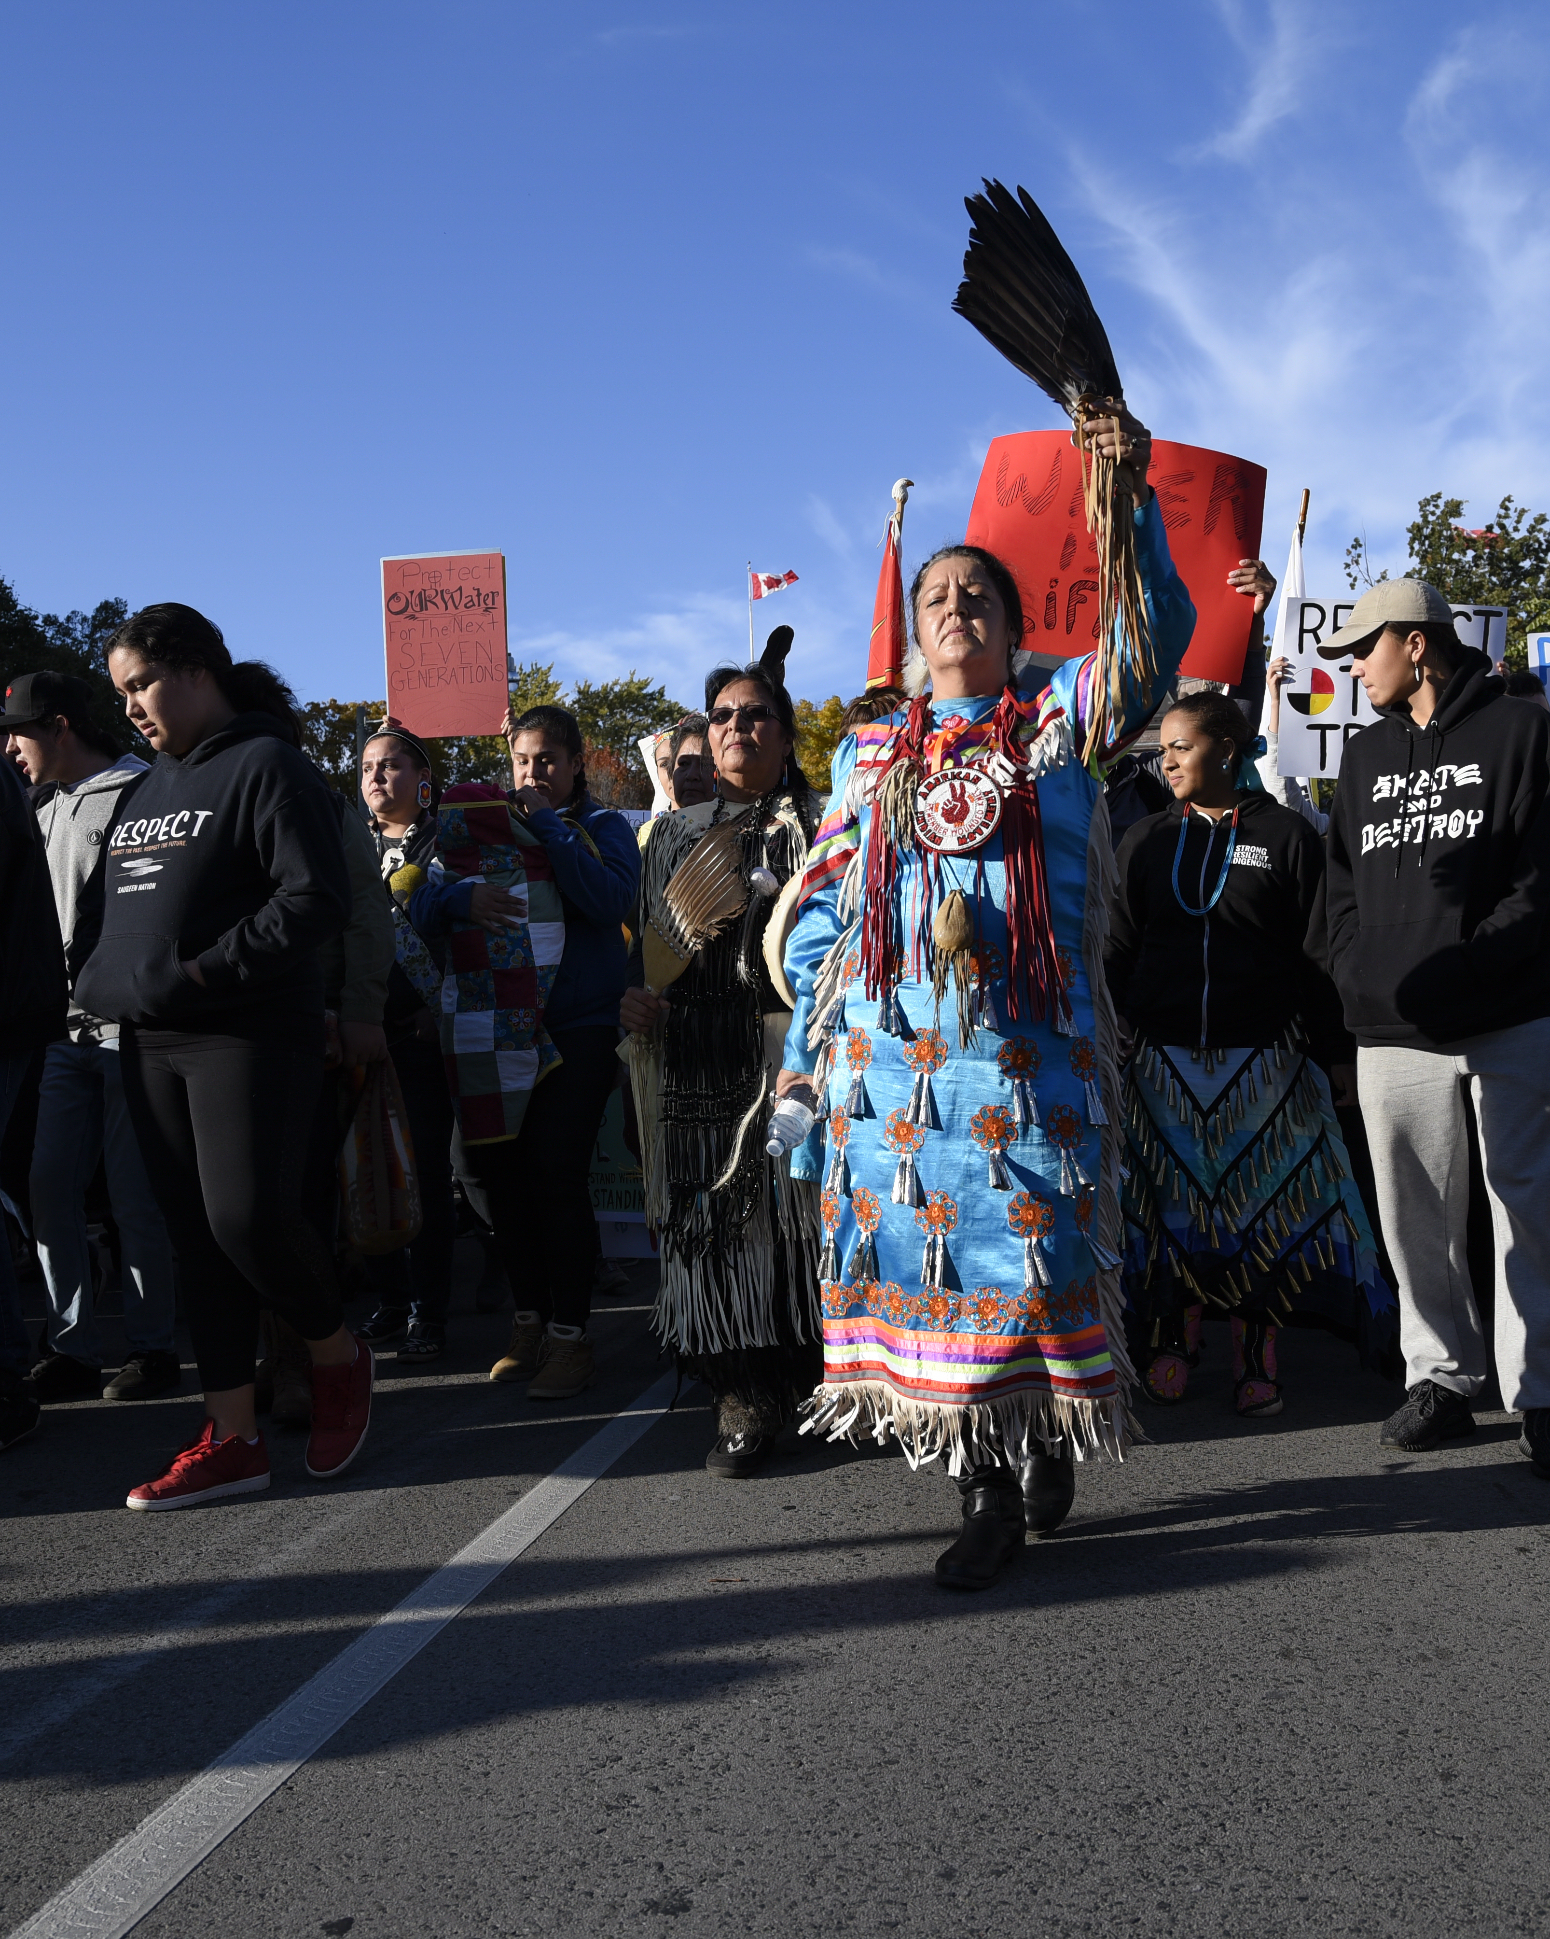
OUR STORY
Remember, effective activism communication is an ongoing process that requires adaptability, learning, and continuous evaluation.
By harnessing the collective power of effective communication, individuals, communities, and movements can challenge oppressive systems, advocate for social justice, and drive meaningful, long-lasting social change.
Notes:
It empowers individuals to recognize their agency, join together, and work towards a more equitable and inclusive world.

Slide 17
WHAT’S NEXT?
A Communications Toolkit from USET
Notes:
Tease toolkit we will be developing with USET
Open Q&A

