Slide 1

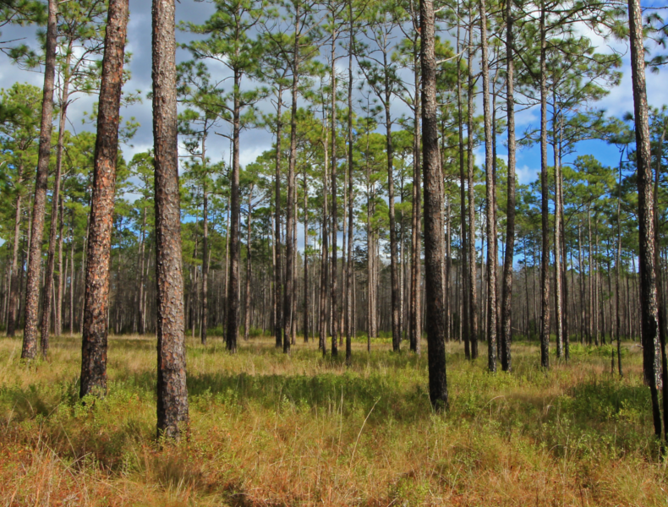
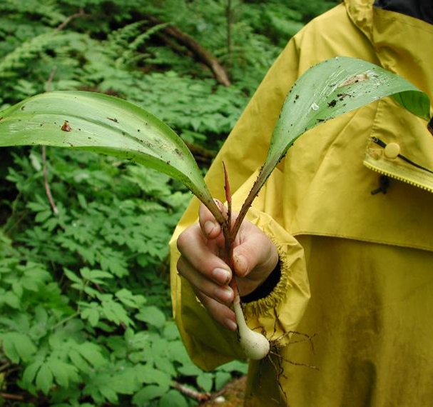
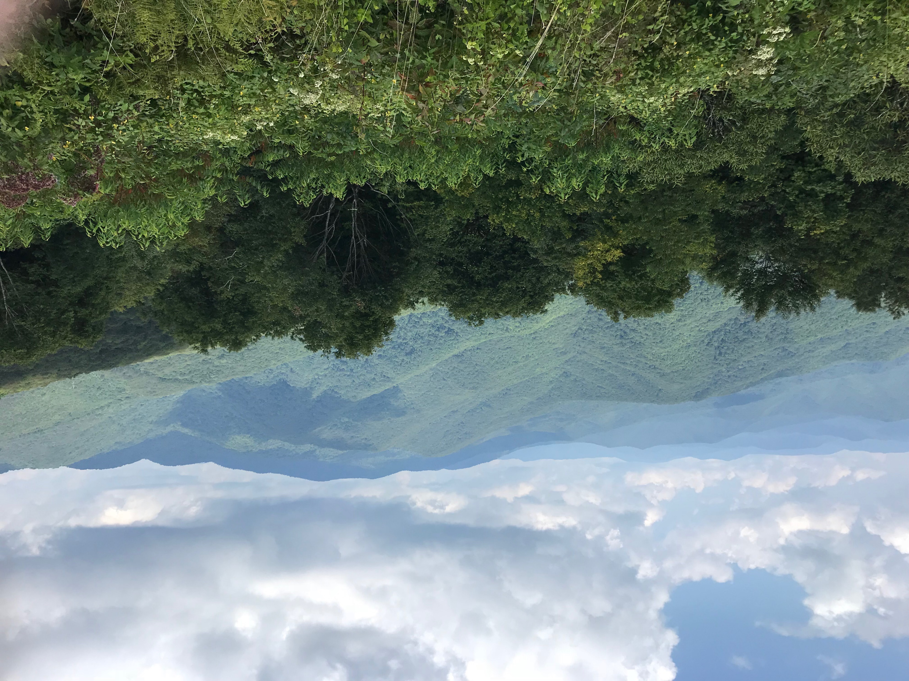
Climate Change: Adaptation Responses to reduce the Vulnerability and Impacts to the Built Infrastructure, and Integration of Adaptation Tools and Resources in Infrastructure Planning
Casey Thornbrugh Ph.D.
Climate Program Manager/Tribal Climate Science Liaison
Steph Courtney Ph.D.
Assistant Tribal Climate Science Liaison
Tyler Everett M.F., L.F.
Forest Adaptation Technical Assistant
Notes:
Tribal Introduction
Professional Introduction
Today I will be providing two presentations, starting with an overview of Recent Climate Events in the USET Region.
30 seconds

Slide 2
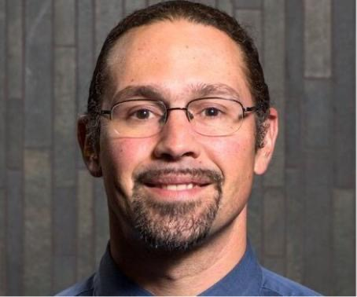

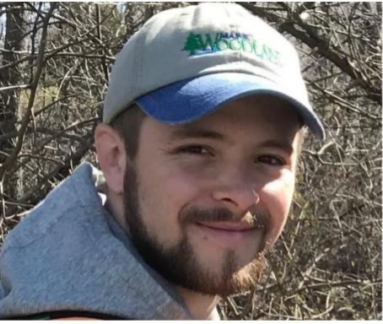

USET-OERM Climate Resilience Program Team
Casey Thornbrugh Ph.D.
Tribal Climate
Science Liaison/
Climate Program Manager
Steph Courtney Ph.D.
Assistant Tribal Climate Science Liaison
Tyler Everett M.F., L.F.
Forest Adaptation
Technical Assistant
Ha Nguyen Xuan M.A.
Forest Adaptation
Technical Assistant
Notes:
Now zooming out, it is very important to mention that this deep freeze event in the Gulf coincided with Warming in the Arctic.
Shown here is a map of North America, Greenland, the Atlantic Ocean, Europe, and North Africa. The colors indicate temperatures, red and yellows being warm as expected in Tropical and subtropical areas, green is cool, blues, violate, and white are cold as expected in Sub-Arctic and Arctic areas.
On February 16, 2020, Centerville Texas recorded a high temperature of 65 degrees, which is pretty close to average.
Thousands of miles to the Northeast in central Greenland in the Arctic the temperature was about 45 degrees below zero, profoundly cold, but expected on an ice sheet in Greenland in February.
Now to highlight the deep freeze event a year later on February 16, 2021 Centerville, Texas is 16 degrees, 49 degrees colder than the same time last year.
However, Central Greenland was only 13 degrees below zero, still very cold but 32 degrees warmer than the same time last year.
1:15
(3:25)

Slide 3
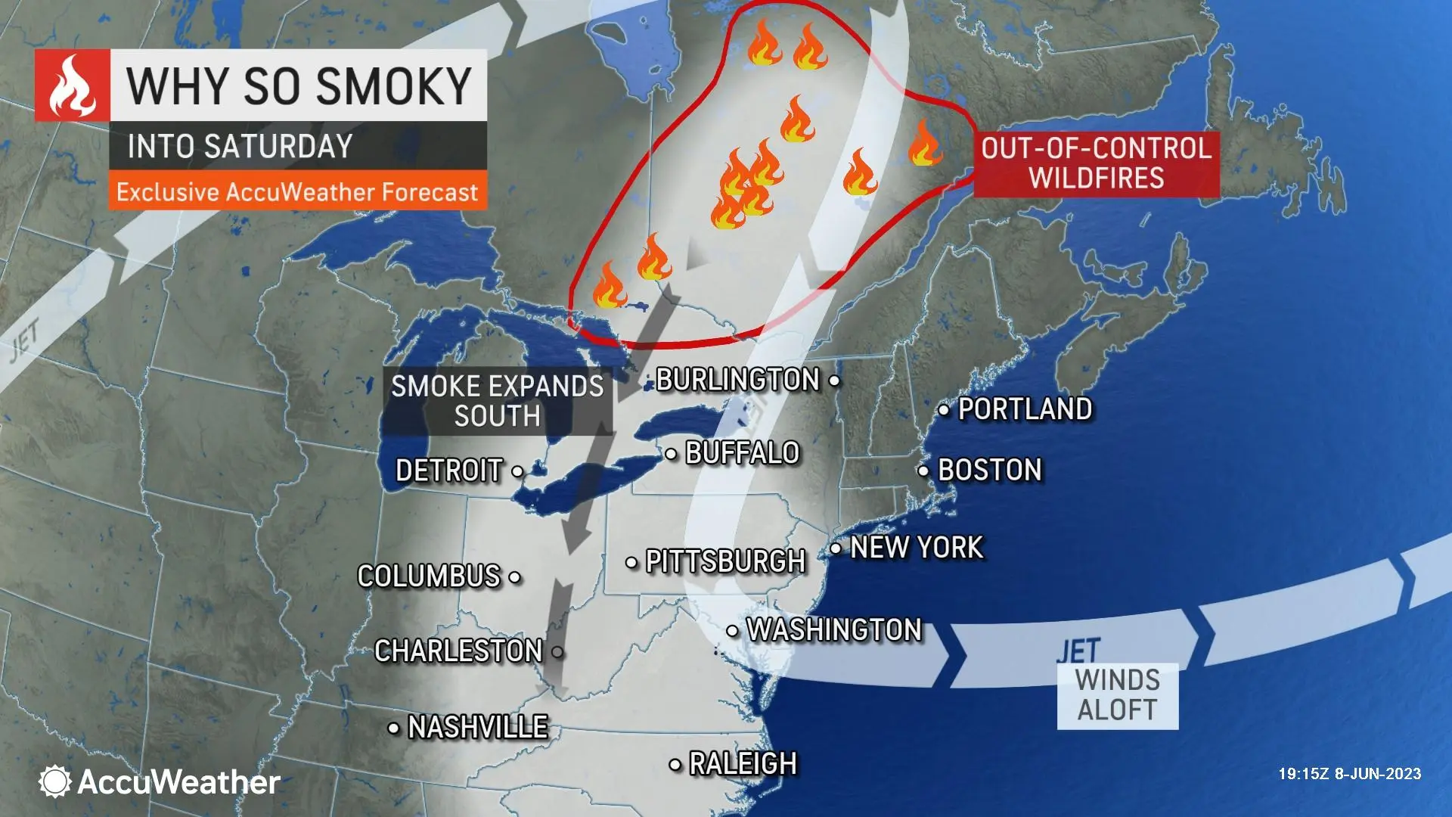
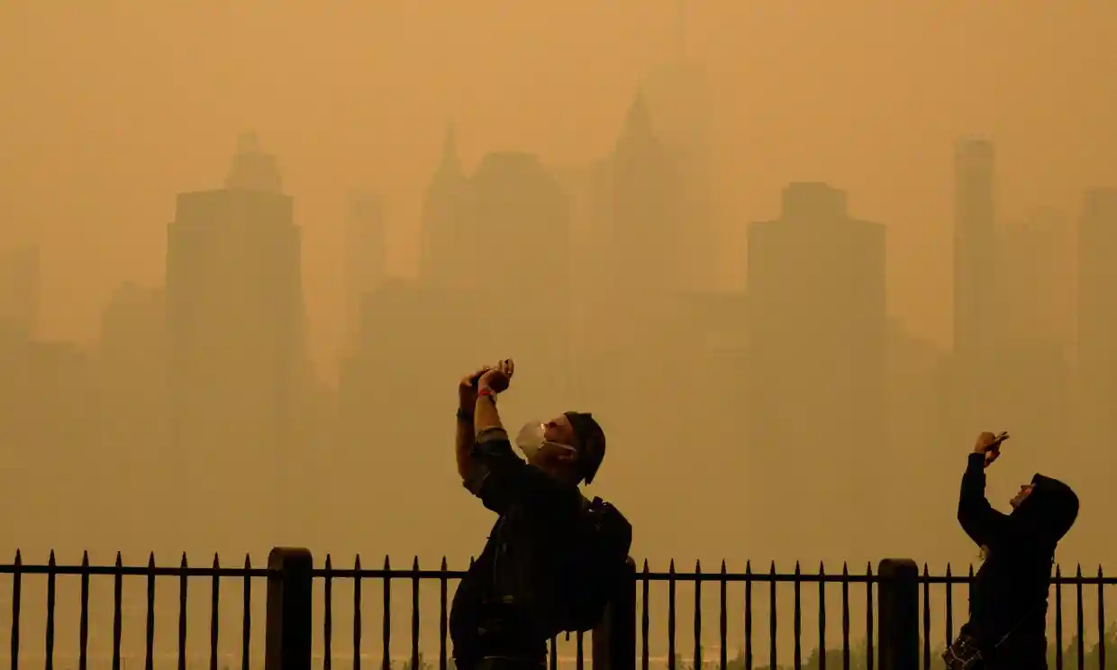
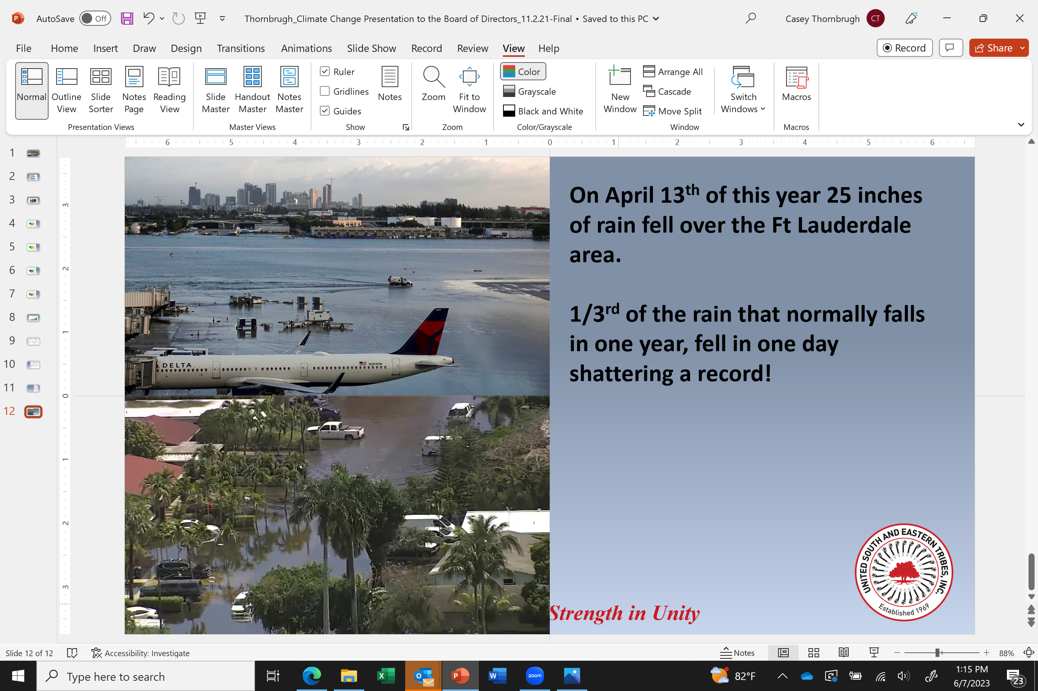
Wildfires in Quebec and Air Quality impacts in the USET Region
As of Sunday, June 11 there were 450 wildland fires across Canada with 117 burning in Quebec.
Significance
Earliest and worst late spring/early summer wildland fire season in Canada on record.
Distant fires have air quality
Impacts in the USET region
Notes:
Now zooming out, it is very important to mention that this deep freeze event in the Gulf coincided with Warming in the Arctic.
Shown here is a map of North America, Greenland, the Atlantic Ocean, Europe, and North Africa. The colors indicate temperatures, red and yellows being warm as expected in Tropical and subtropical areas, green is cool, blues, violate, and white are cold as expected in Sub-Arctic and Arctic areas.
On February 16, 2020, Centerville Texas recorded a high temperature of 65 degrees, which is pretty close to average.
Thousands of miles to the Northeast in central Greenland in the Arctic the temperature was about 45 degrees below zero, profoundly cold, but expected on an ice sheet in Greenland in February.
Now to highlight the deep freeze event a year later on February 16, 2021 Centerville, Texas is 16 degrees, 49 degrees colder than the same time last year.
However, Central Greenland was only 13 degrees below zero, still very cold but 32 degrees warmer than the same time last year.
1:15
(3:25)

Slide 4
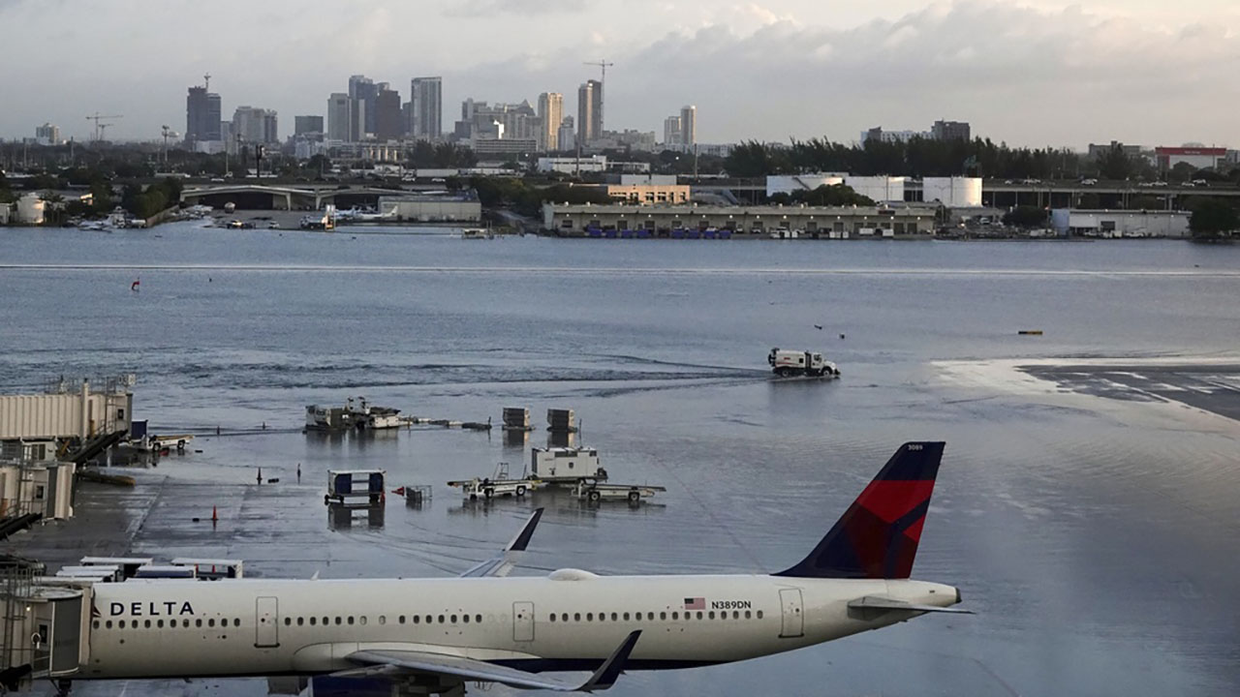
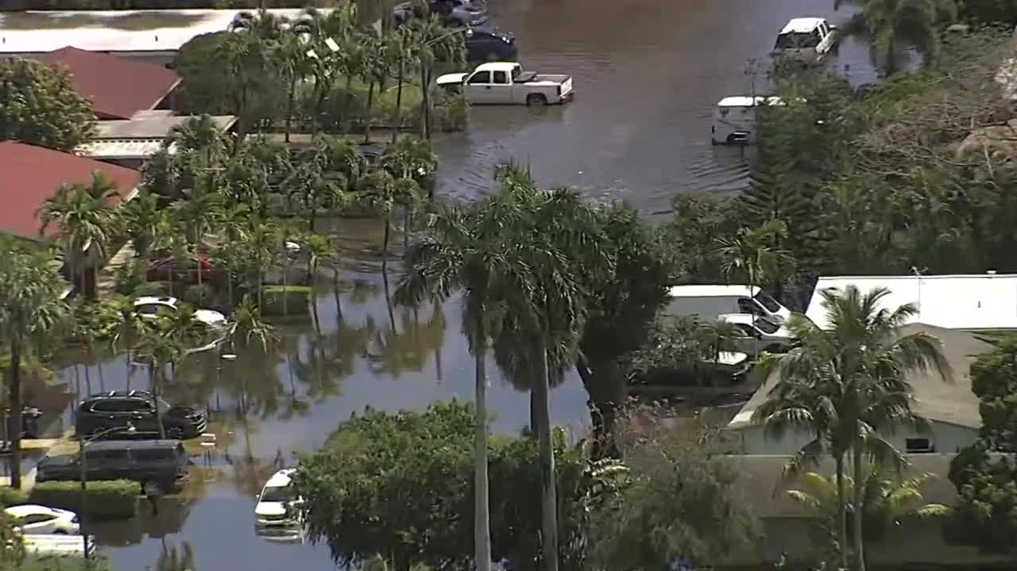
On April 13th of this year 25 inches of rain fell over the Ft Lauderdale area.
40% of the rain that normally falls in one year, fell in one day!
Significance
A warmer atmosphere holds more moisture thus more frequent heavy rain events.
However, droughts are
occurring in between events.
Notes:
Now zooming out, it is very important to mention that this deep freeze event in the Gulf coincided with Warming in the Arctic.
Shown here is a map of North America, Greenland, the Atlantic Ocean, Europe, and North Africa. The colors indicate temperatures, red and yellows being warm as expected in Tropical and subtropical areas, green is cool, blues, violate, and white are cold as expected in Sub-Arctic and Arctic areas.
On February 16, 2020, Centerville Texas recorded a high temperature of 65 degrees, which is pretty close to average.
Thousands of miles to the Northeast in central Greenland in the Arctic the temperature was about 45 degrees below zero, profoundly cold, but expected on an ice sheet in Greenland in February.
Now to highlight the deep freeze event a year later on February 16, 2021 Centerville, Texas is 16 degrees, 49 degrees colder than the same time last year.
However, Central Greenland was only 13 degrees below zero, still very cold but 32 degrees warmer than the same time last year.
1:15
(3:25)

Slide 5
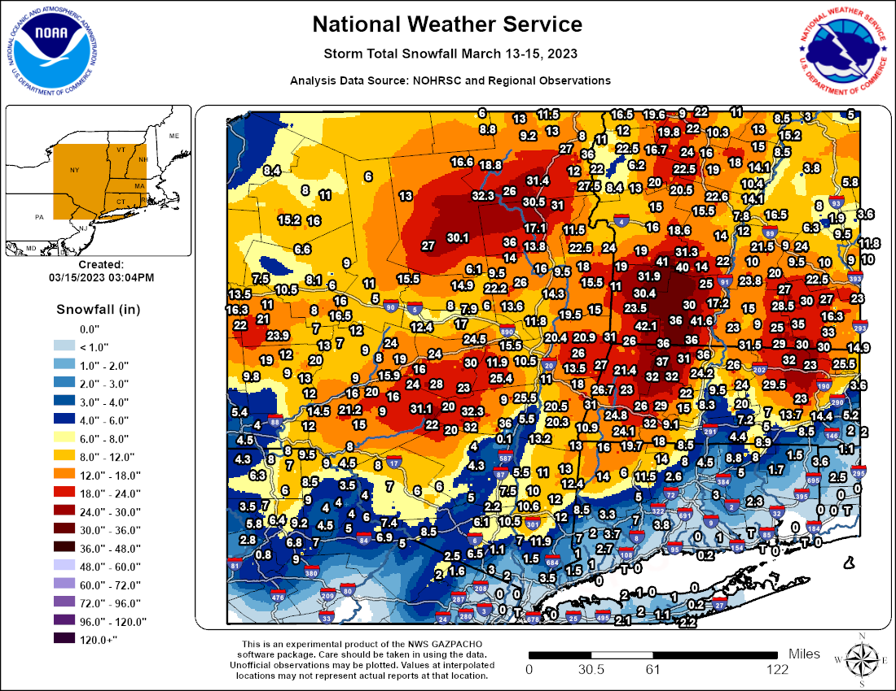
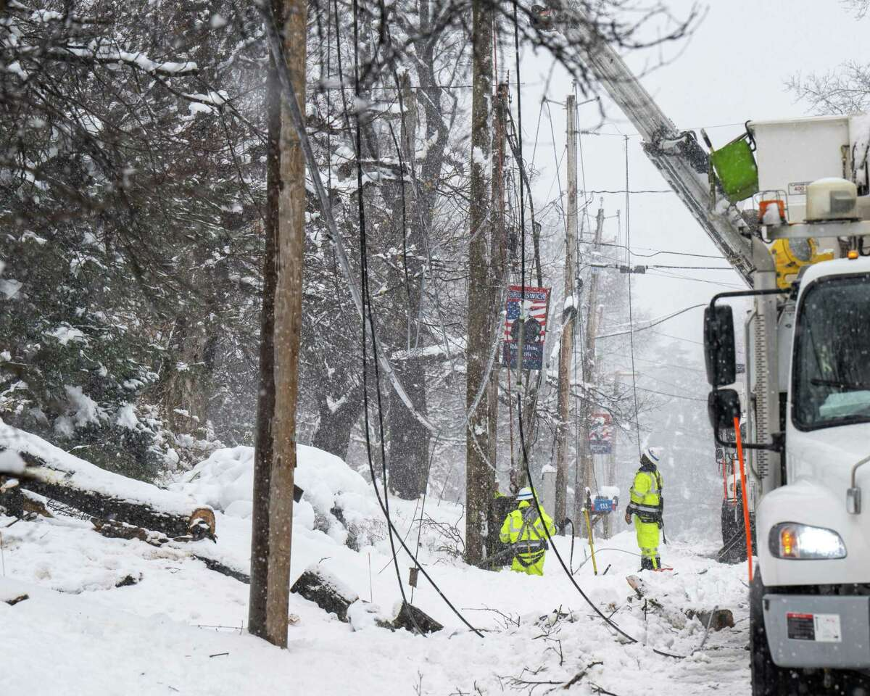
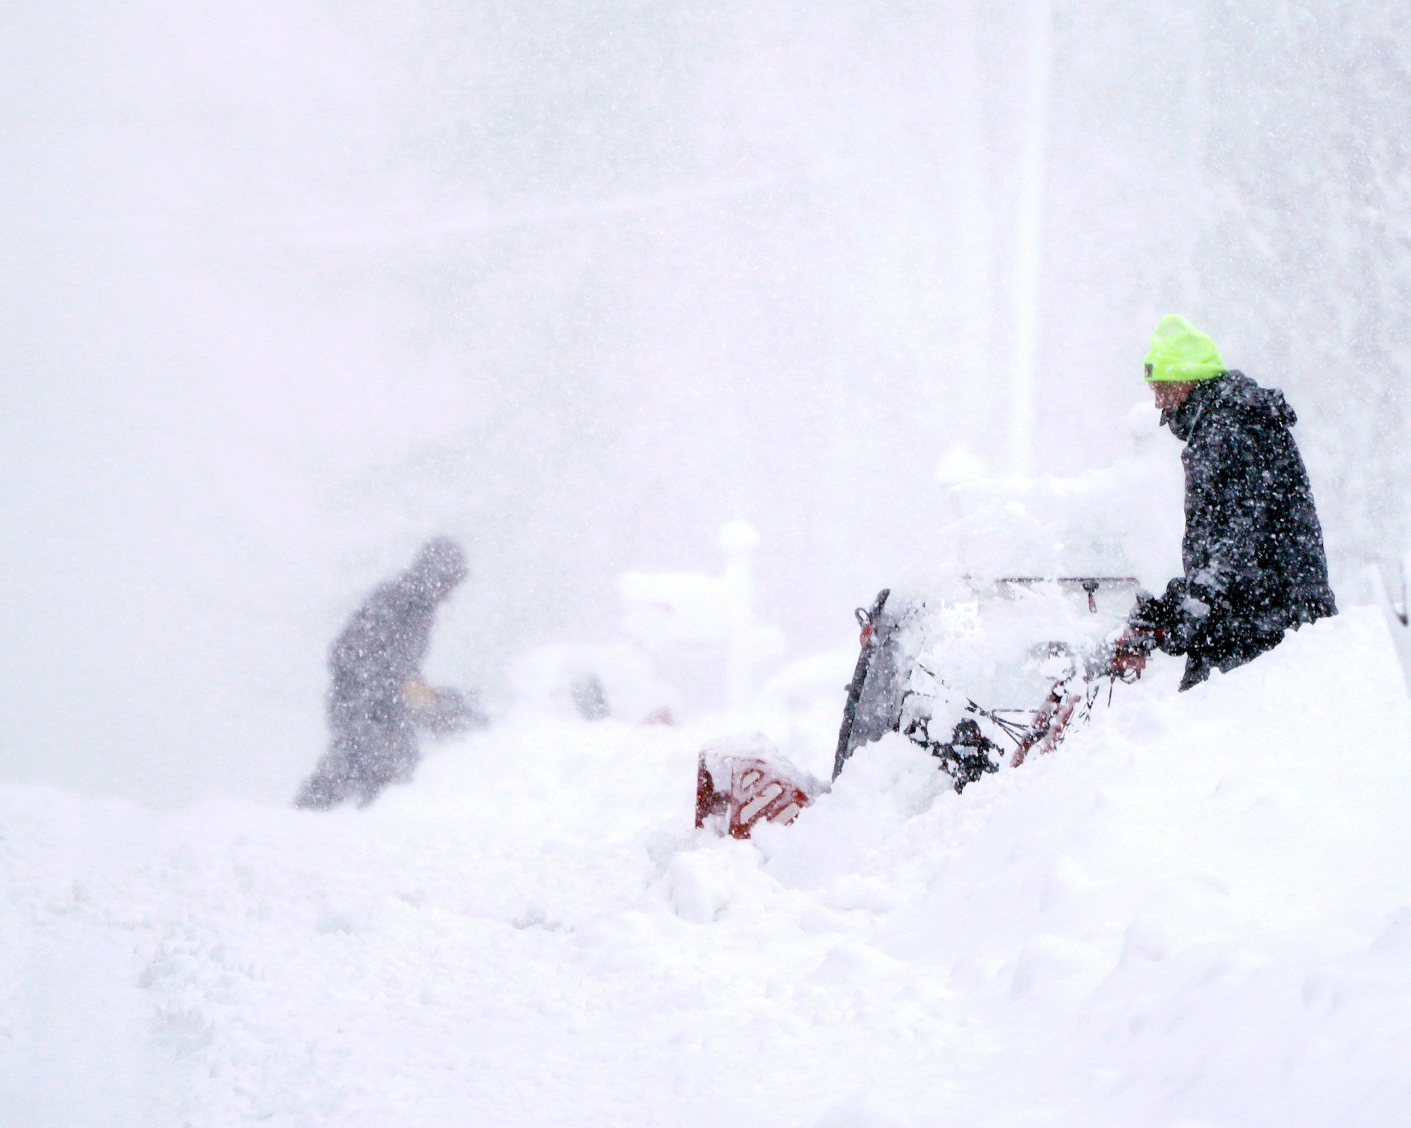
March 13-15th of this year 2-3 ft of snow fell in upstate NY, VT, NH & MA.
Significance
It was the latest and the only big snowstorm/Nor’easter of the season.
The Great Lakes were ice-free and the north Atlantic was relatively warm allowing for abundant moisture to be drawn into the storm.
Notes:
Now zooming out, it is very important to mention that this deep freeze event in the Gulf coincided with Warming in the Arctic.
Shown here is a map of North America, Greenland, the Atlantic Ocean, Europe, and North Africa. The colors indicate temperatures, red and yellows being warm as expected in Tropical and subtropical areas, green is cool, blues, violate, and white are cold as expected in Sub-Arctic and Arctic areas.
On February 16, 2020, Centerville Texas recorded a high temperature of 65 degrees, which is pretty close to average.
Thousands of miles to the Northeast in central Greenland in the Arctic the temperature was about 45 degrees below zero, profoundly cold, but expected on an ice sheet in Greenland in February.
Now to highlight the deep freeze event a year later on February 16, 2021 Centerville, Texas is 16 degrees, 49 degrees colder than the same time last year.
However, Central Greenland was only 13 degrees below zero, still very cold but 32 degrees warmer than the same time last year.
1:15
(3:25)

Slide 6
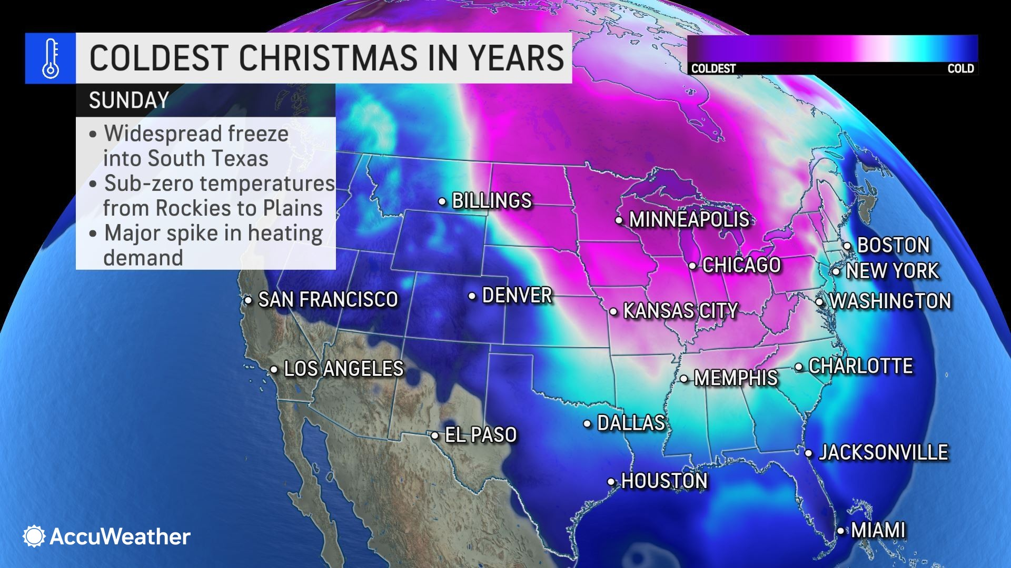
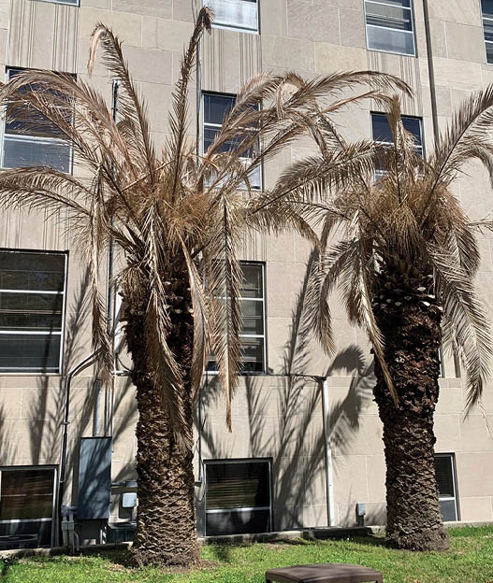
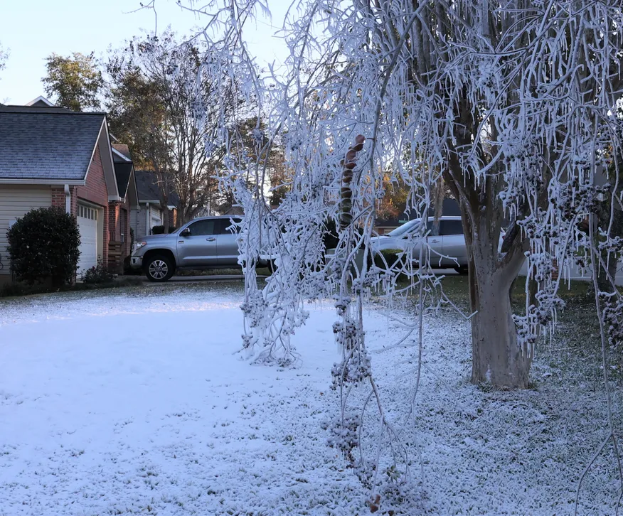
December 21-25th Arctic Blast
Significance
Although winter 2022-2023 was much warmer than average, 1-2 Arctic blasts per winter can do a lot of damage to ecosystems, agriculture, and infrastructure.
A warming Arctic is opening the door for severe cold outbreaks to intrude into subtropical parts of North America.
Notes:
Now zooming out, it is very important to mention that this deep freeze event in the Gulf coincided with Warming in the Arctic.
Shown here is a map of North America, Greenland, the Atlantic Ocean, Europe, and North Africa. The colors indicate temperatures, red and yellows being warm as expected in Tropical and subtropical areas, green is cool, blues, violate, and white are cold as expected in Sub-Arctic and Arctic areas.
On February 16, 2020, Centerville Texas recorded a high temperature of 65 degrees, which is pretty close to average.
Thousands of miles to the Northeast in central Greenland in the Arctic the temperature was about 45 degrees below zero, profoundly cold, but expected on an ice sheet in Greenland in February.
Now to highlight the deep freeze event a year later on February 16, 2021 Centerville, Texas is 16 degrees, 49 degrees colder than the same time last year.
However, Central Greenland was only 13 degrees below zero, still very cold but 32 degrees warmer than the same time last year.
1:15
(3:25)

Slide 7
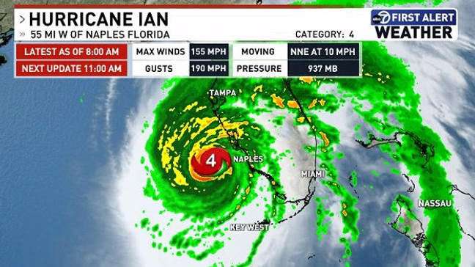
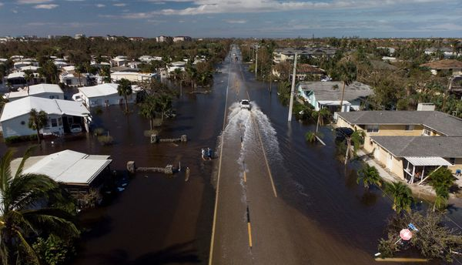
Hurricane Ian, Sep. 28-30
Significance
A warmer Gulf of Mexico and a warmer Atlantic is fueling stronger hurricanes and extending the hurricane season.
Ian was the first hurricane to exceed $100 B in losses in Florida and 3rd costliest in US history.
Notes:
Now zooming out, it is very important to mention that this deep freeze event in the Gulf coincided with Warming in the Arctic.
Shown here is a map of North America, Greenland, the Atlantic Ocean, Europe, and North Africa. The colors indicate temperatures, red and yellows being warm as expected in Tropical and subtropical areas, green is cool, blues, violate, and white are cold as expected in Sub-Arctic and Arctic areas.
On February 16, 2020, Centerville Texas recorded a high temperature of 65 degrees, which is pretty close to average.
Thousands of miles to the Northeast in central Greenland in the Arctic the temperature was about 45 degrees below zero, profoundly cold, but expected on an ice sheet in Greenland in February.
Now to highlight the deep freeze event a year later on February 16, 2021 Centerville, Texas is 16 degrees, 49 degrees colder than the same time last year.
However, Central Greenland was only 13 degrees below zero, still very cold but 32 degrees warmer than the same time last year.
1:15
(3:25)

Slide 8
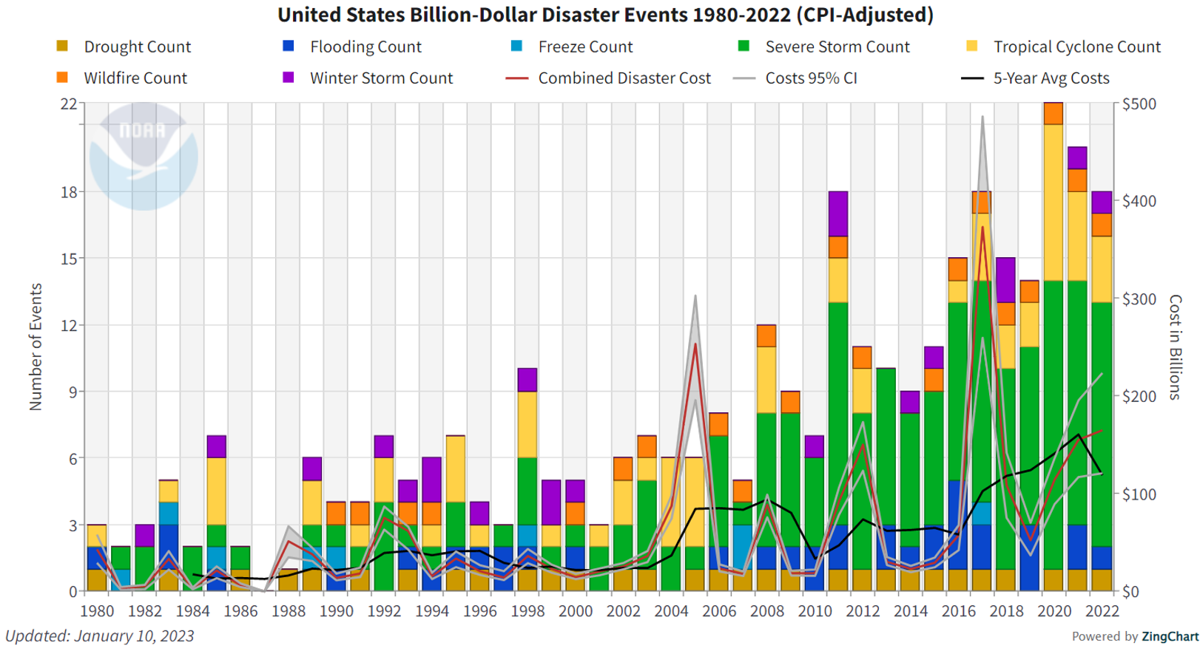
Increasing losses in recent years

Slide 9
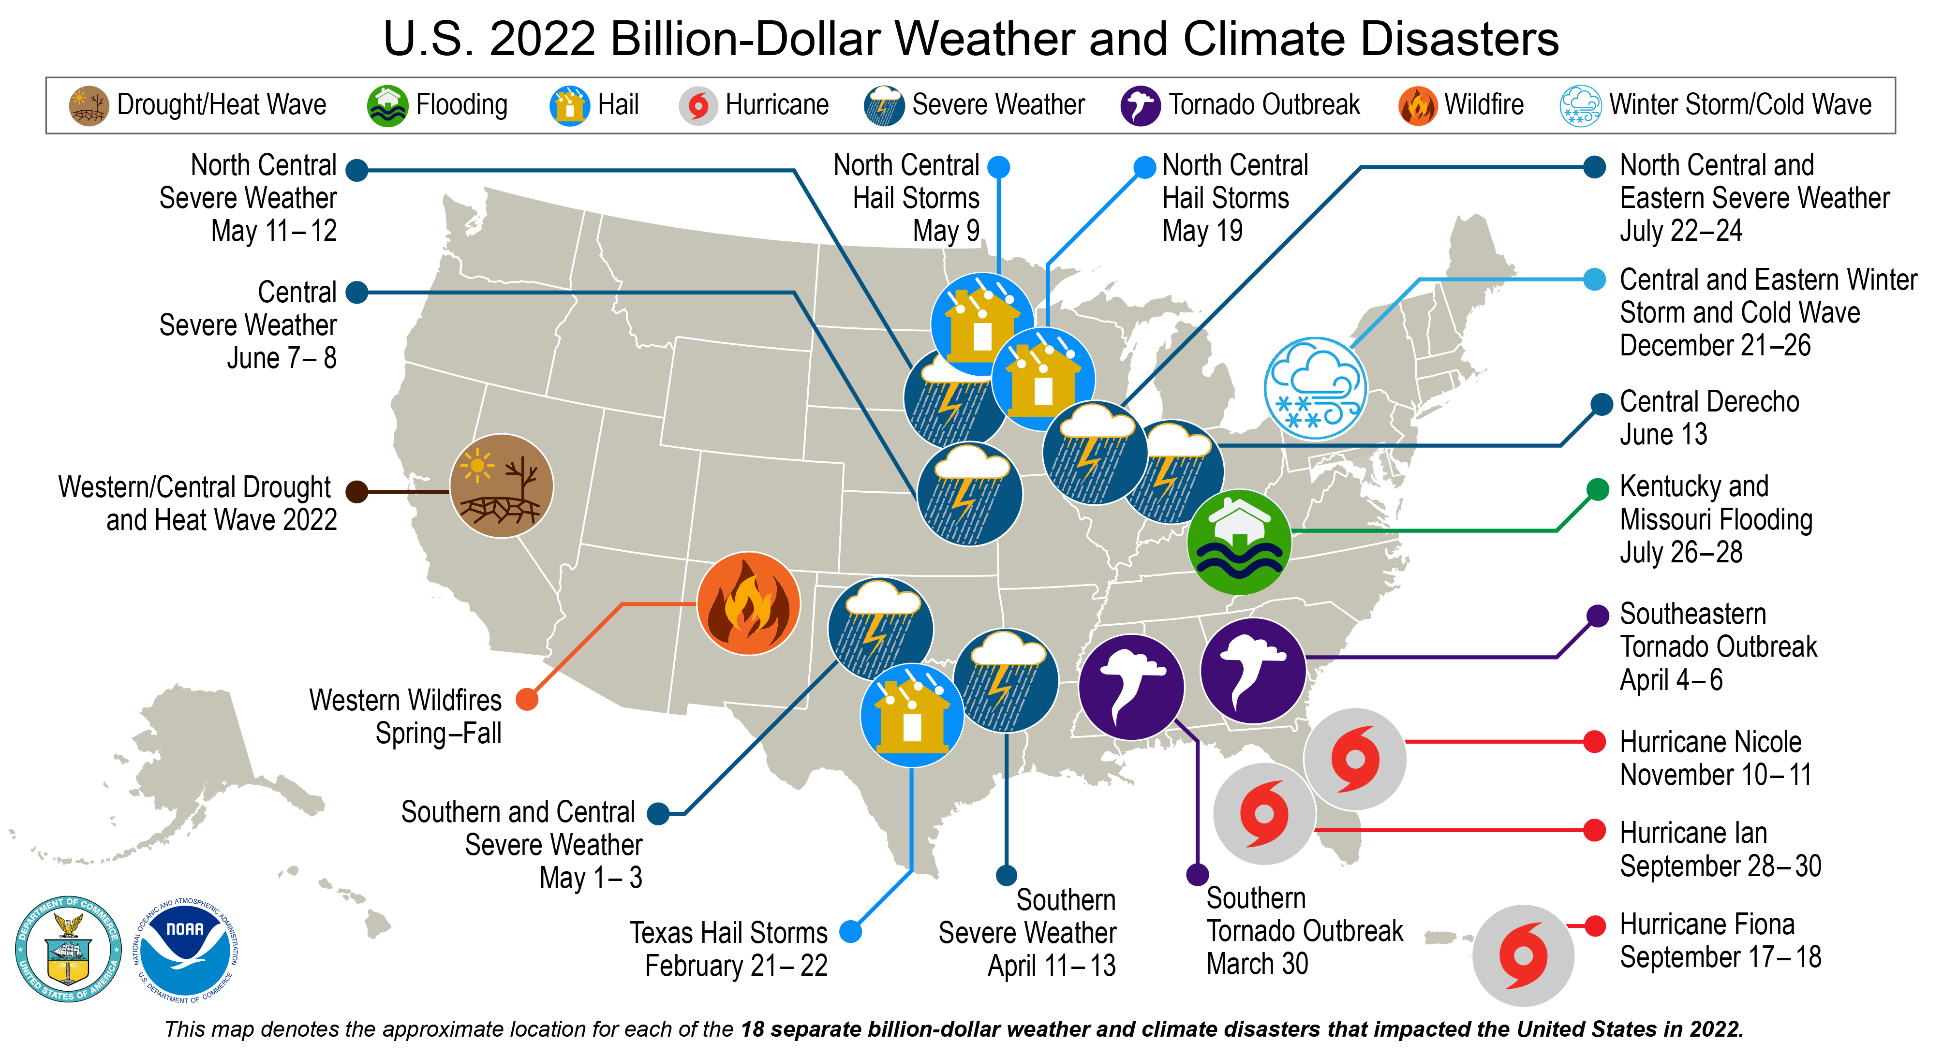
USET region sees many costly events
Notes:
Billion dollar event every 2.5 weeks, on avg (every 3 weeks in 2022)

Slide 10

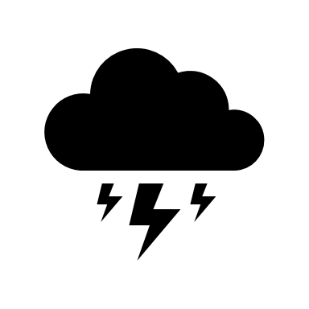


Natural hazards don’t have to become disasters
Risk of Disaster & Impact of Event =
Vulnerability
Community
Preparation
Resources
Hazard
Frequency
Intensity
Climate
Response
Resilience
Healing
Recovery
Notes:
We know the hazards will continue, especially without extreme mitigation action and greenhouse emission reductions – but our action and investments can make a huge difference in the impact on our communities.
The science determines the middle (and mitigation addresses it) – the other two are about consistent investment in adaptation and healthy communities.
Services and infrastructure – physical and beyond

Slide 11
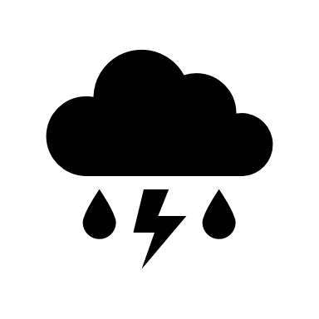

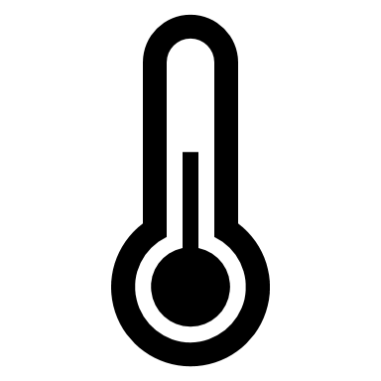
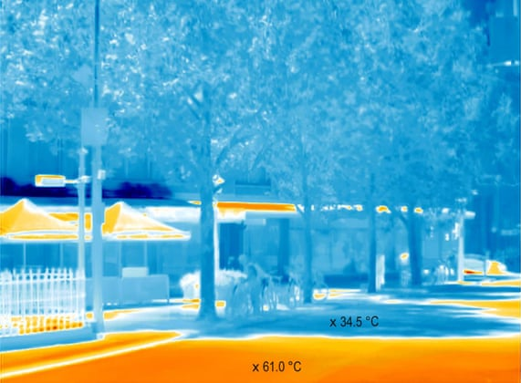
Infrastructure impacts and adaptation: Energy
Climate context:
83% of power outages are from weather-related events
64% more outages from 2011-2021 vs. 2000-2010
Higher temperatures lead to greater power demand and can lower energy supply
Adaptation and opportunities:
Power grid upgrades
Energy efficiency upgrades
Renewable energy often more resilient
Green infrastructure to reduce demand
Notes:
It’s easy to focus on the extremes, but much of the harm from climate change and opportunity to take action will be in the every day !
Source: https://assets.ctfassets.net/cxgxgstp8r5d/73igUswSfOhdo7DUDVLwK7/bb0a4e95e1d04457e56106355a1f74b9/2022PowerOutages.pdf
Image: The Guardian

Slide 12
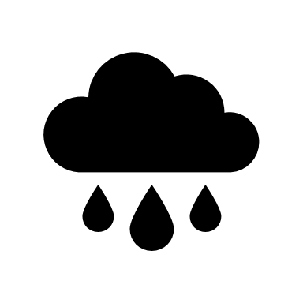

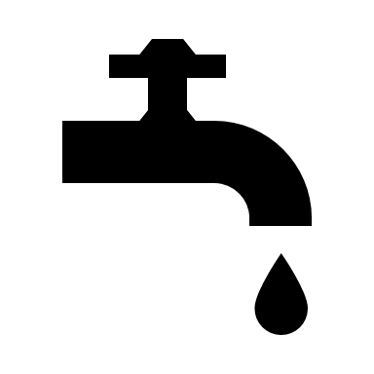
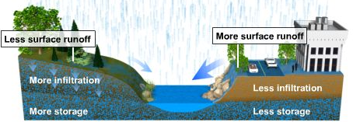
Infrastructure impacts and adaptation: Water
Climate context:
More extreme precipitation – more floods and drought
Rising temperatures increase demand in many sectors (agriculture) and stressors (evaporation, HABs, SLR)
Intersections with socioeconomics (wastewater systems)
Adaptation and opportunities:
Green infrastructure – dozens of options!
Wastewater utility expansion, upgrades, capacity
Water conservation and reuse practices
Co-benefits for ecosystems, health, property
Notes:
Green infrastructure: increasing water infiltration to decrease runoff
Image: UCAR COMET program

Slide 13

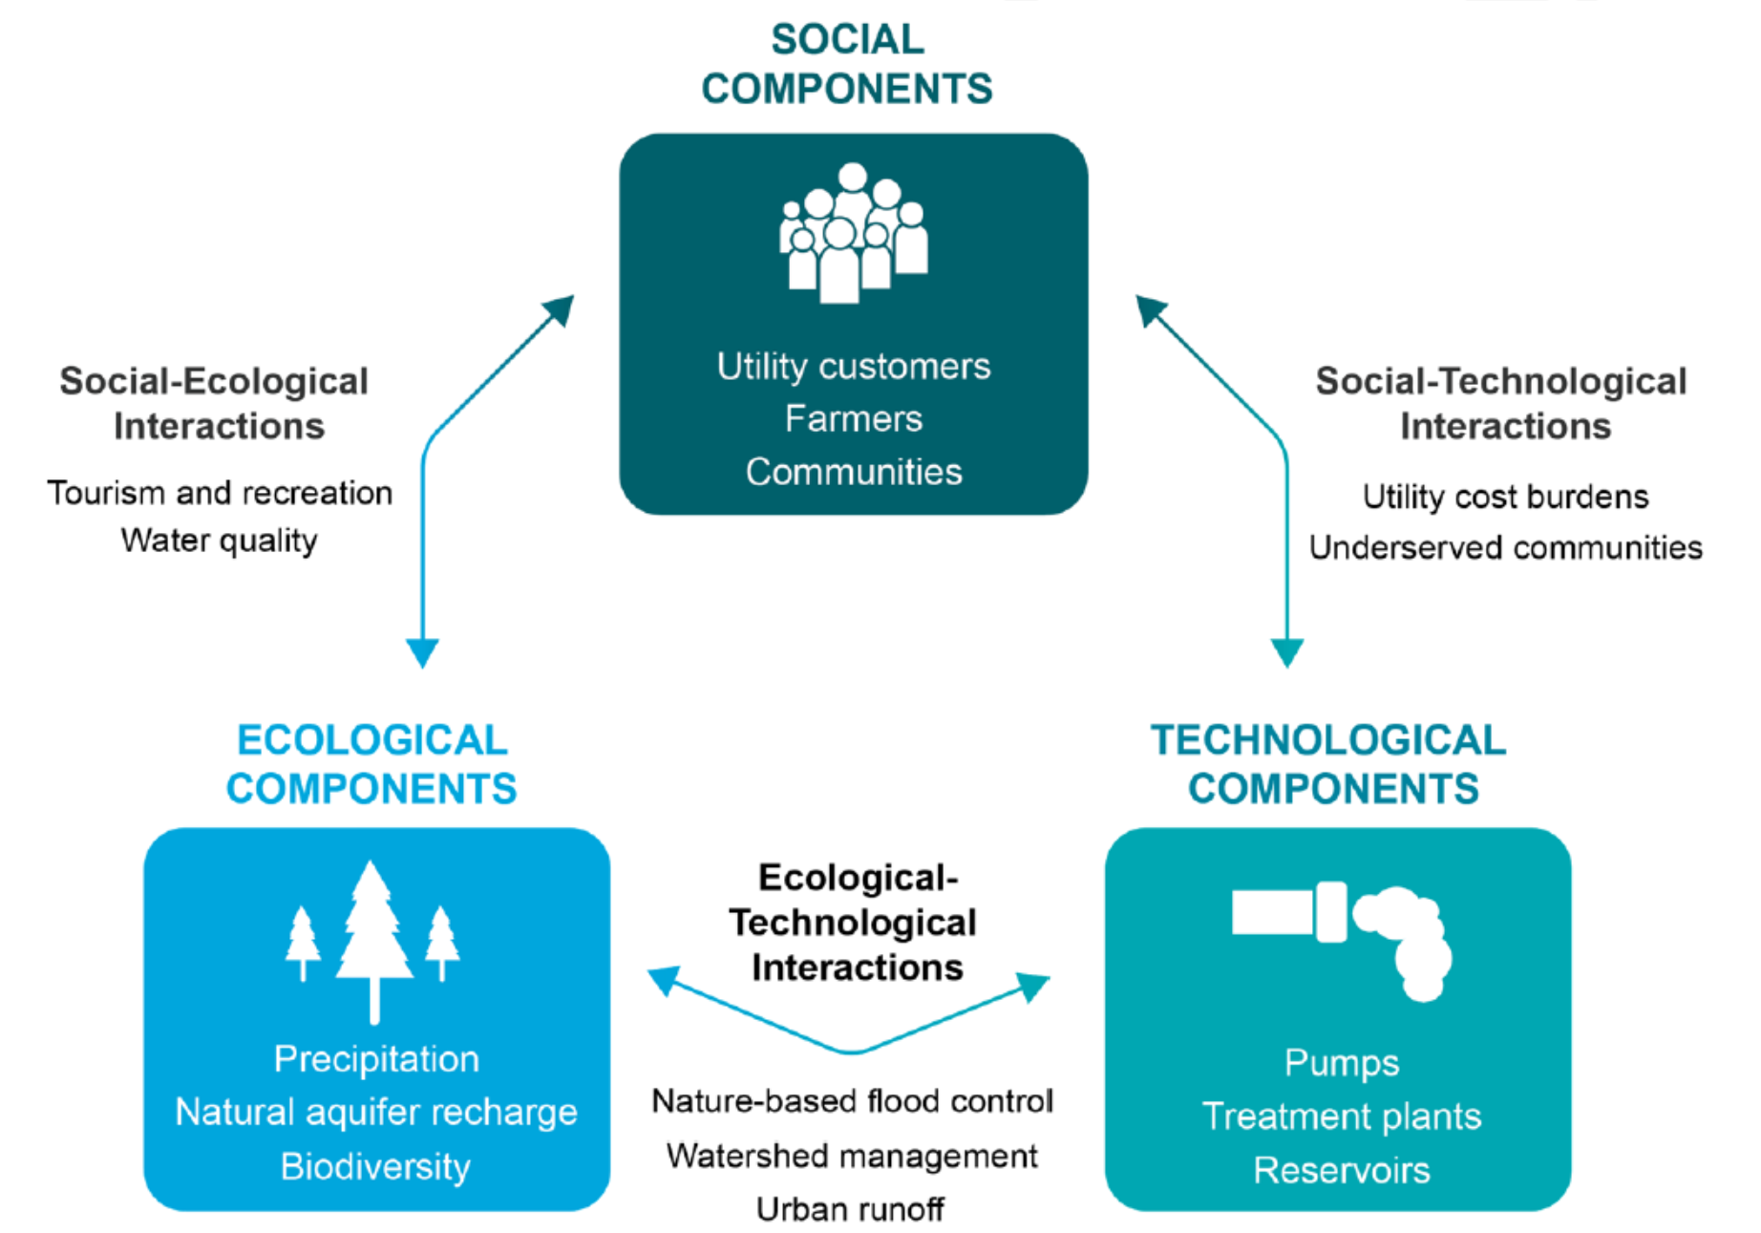



















Climate impacts all kinds and aspects of infrastructure – improvements and adaptation in each are important
Ecological components
Technological components
Social components
Markolf 2018
Notes:
We know the hazards will continue, especially without extreme mitigation action and greenhouse emission reductions – but our action and investments can make a huge difference in the impact on our communities.
The science determines the middle (and mitigation addresses it) – the other two are about consistent investment in adaptation and healthy communities.
Services and infrastructure – physical and beyond

Slide 14
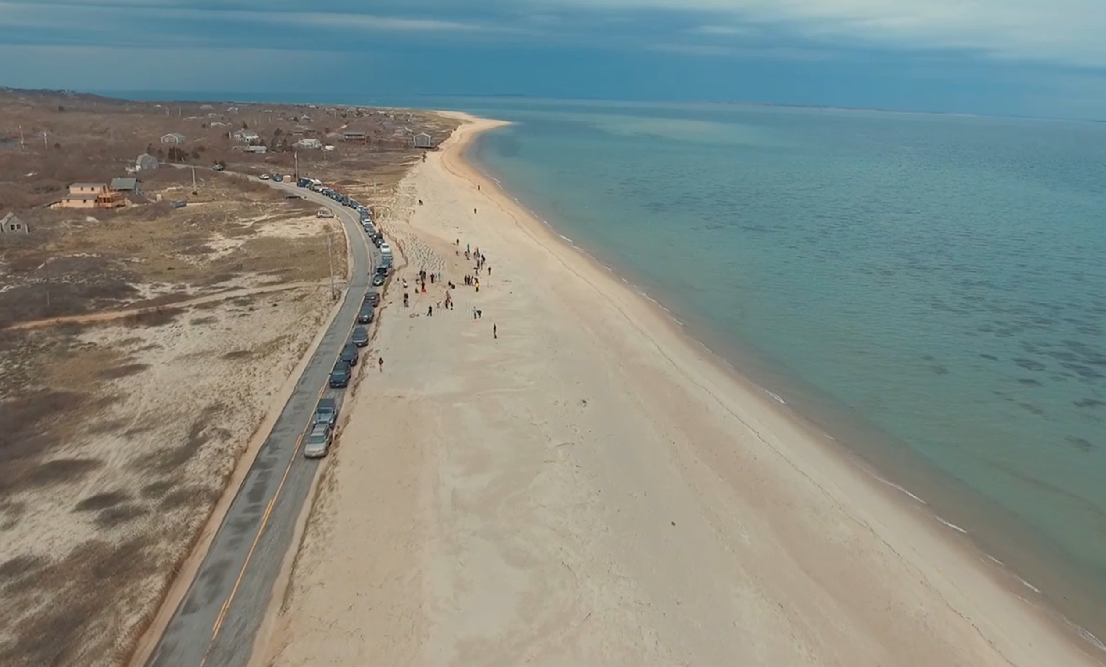
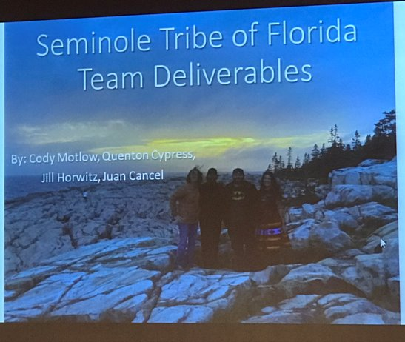
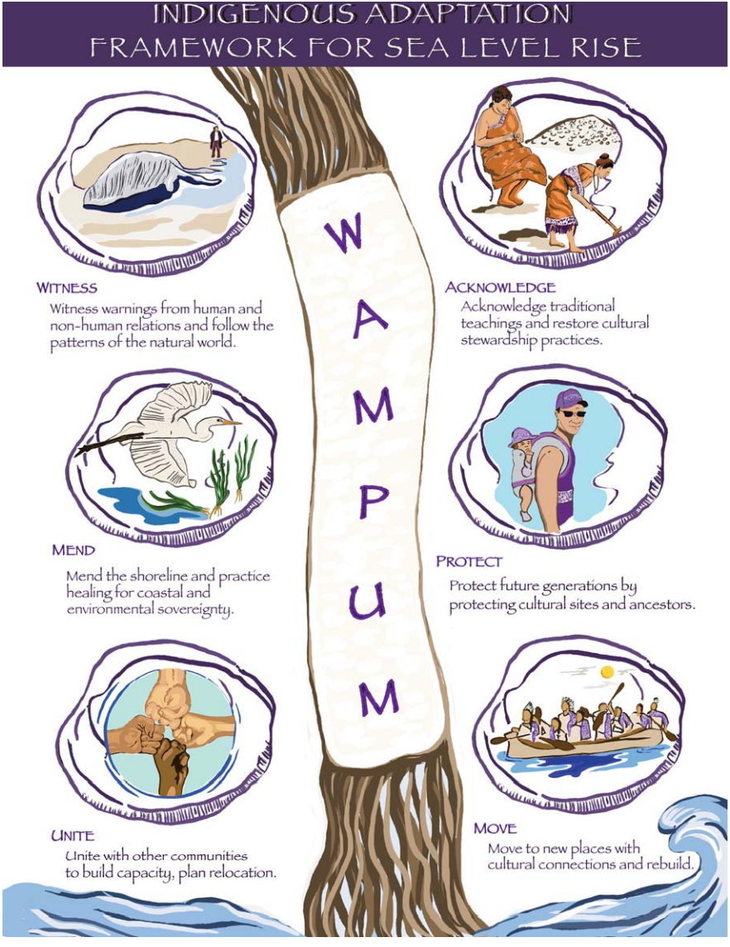
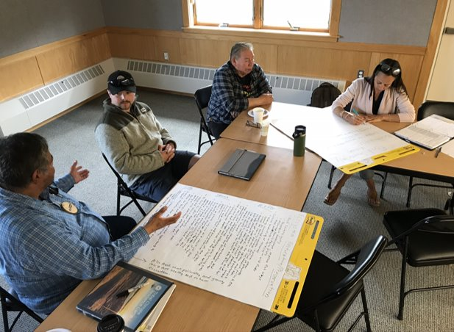
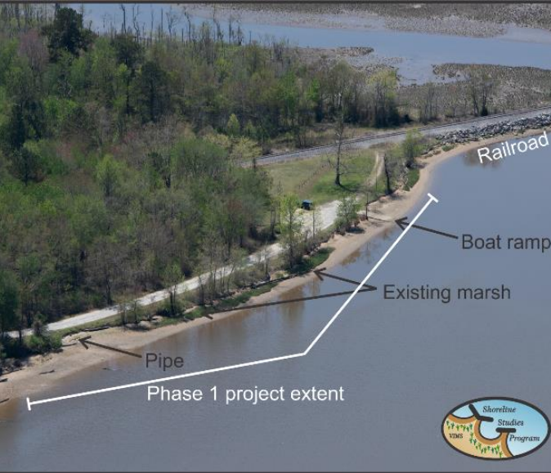
Climate Change Adaptation & Resilience in the USET Region
Notes:
INTRO
Forest Infrastructure Concern Under a Changing Climate
For Starters…What do we use Forest Roads for? What is the importance of this forest infrastructure? Forest roads a critical in supporting…..
Access (Hunting, Fishing, Gathering of Traditional Foods, medicines, and ceremonial resources)
They support Forest Management (Conducting timber harvests, gathering forest resource data, wildlife surveys, forest health surveys, Habitat improvement treatments, etc..)
Fire Fighting (Access to areas where wildland fires is a concern is hugely important, fire roads also provide a break in fuel load for those fires)
Outdoor Recreation (Beyond fishing and hunting we have paddling, hiking, camping, and much more recreation that our forests provide us, and the infrastructure of forest roads contribute to this luxury)

Slide 15
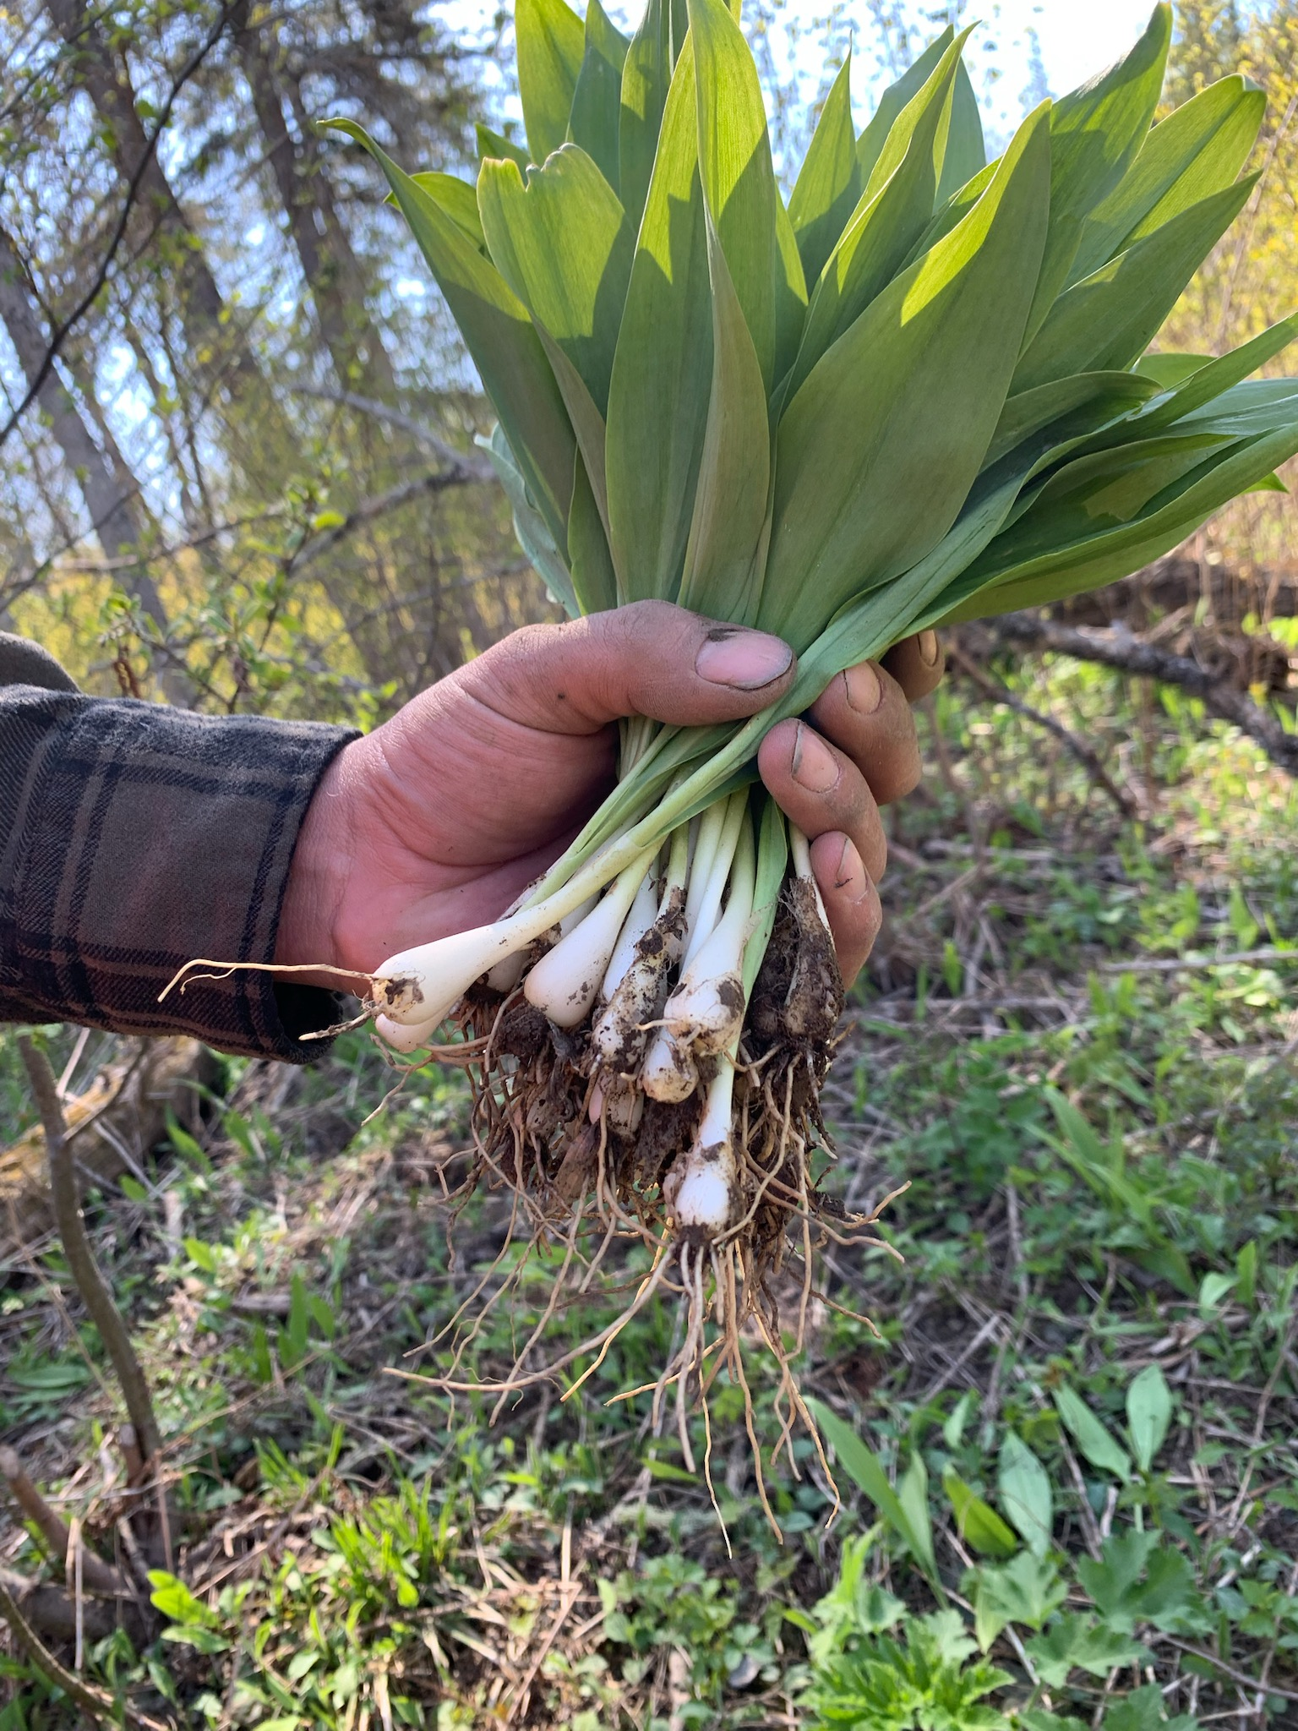
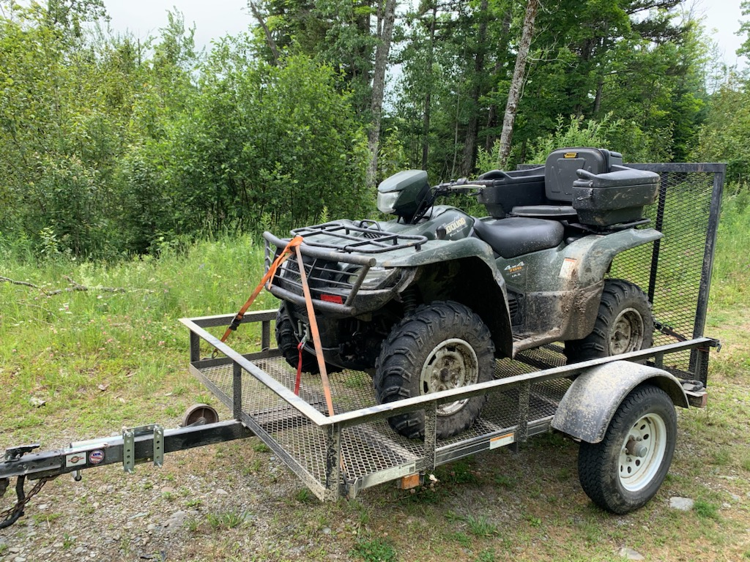
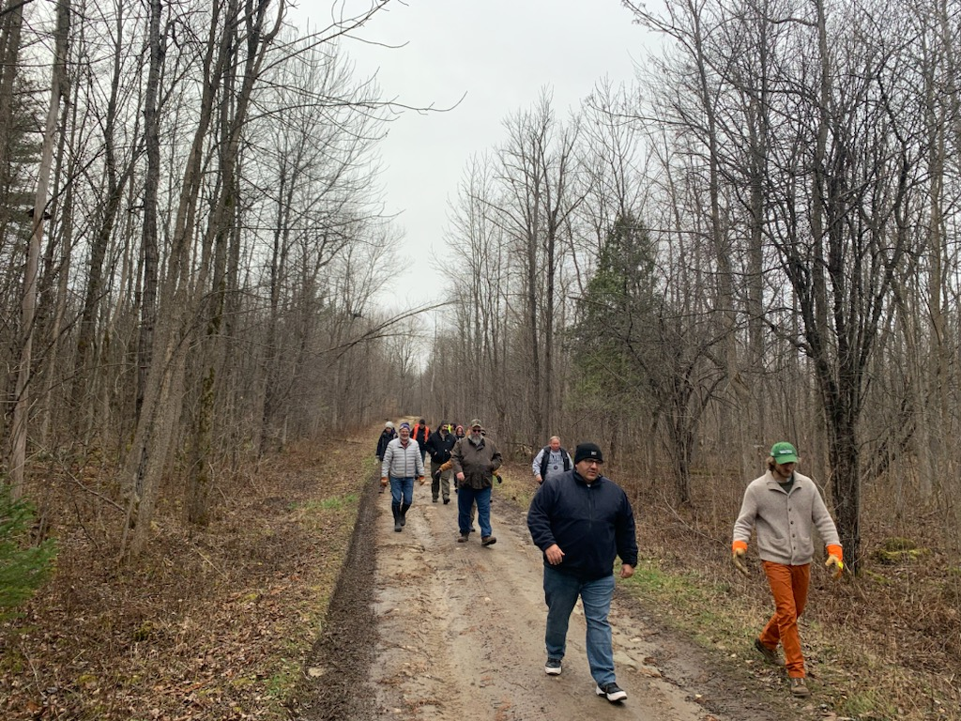
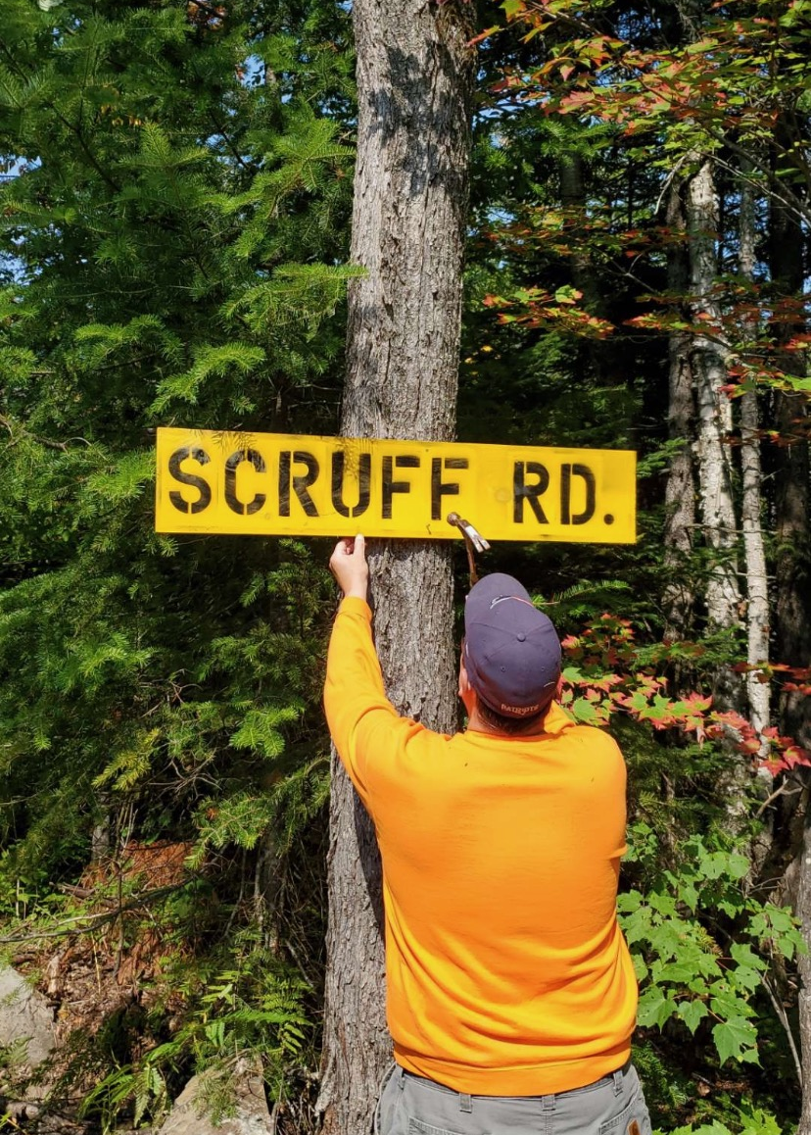
Forest Infrastructure Concerns Under a Changing Climate
The Importance & Uses of Forest Roads
Provide Critical Access
Forest Management
Fire Fighting
Outdoor Recreation
Notes:
INTRO
Forest Infrastructure Concern Under a Changing Climate
For Starters…What do we use Forest Roads for? What is the importance of this forest infrastructure? Forest roads a critical in supporting…..
Access (Hunting, Fishing, Gathering of Traditional Foods, medicines, and ceremonial resources)
They support Forest Management (Conducting timber harvests, gathering forest resource data, wildlife surveys, forest health surveys, Habitat improvement treatments, etc..)
Fire Fighting (Access to areas where wildland fires is a concern is hugely important, fire roads also provide a break in fuel load for those fires)
Outdoor Recreation (Beyond fishing and hunting we have paddling, hiking, camping, and much more recreation that our forests provide us, and the infrastructure of forest roads contribute to this luxury)

Slide 16
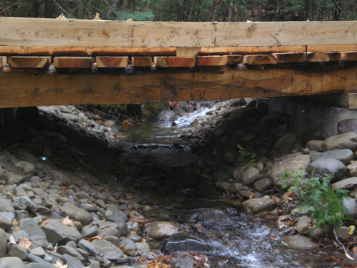
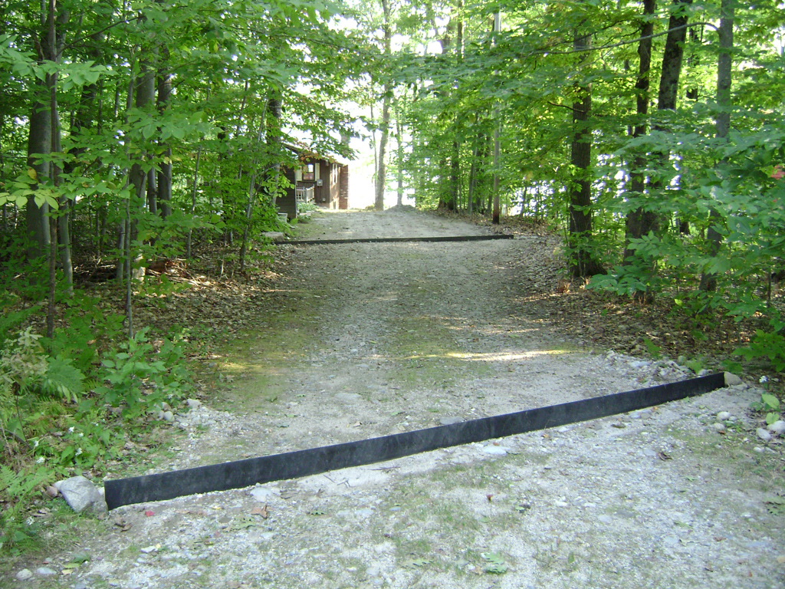
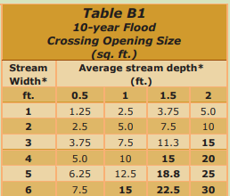
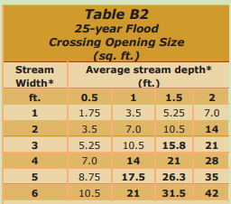
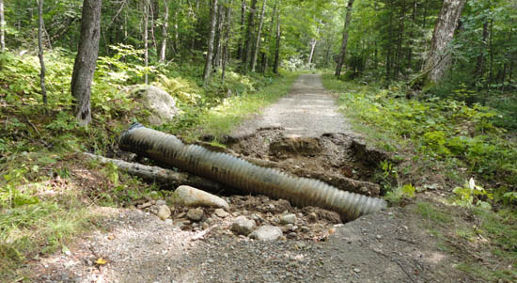
Climate Smart Forest Roads - Water Quality & Forest Roads
Climate Impact(s) of Concern: More Frequent Heavy Precipitation Events & Intense Storms, Changes in Spring Thaw in Northern Climates, Less Snow & Shorter Winter Season
Potential Adaptation Actions
Sounds Road Construction
Size Culverts Based on 25-year Flood Events
Use BMPs to Address Erosion
Impact to Forest Infrastructure:
Erosion
Bridge and Crossing Washouts
High Siltation Events into Waterways
Notes:
Climate Smart Forest Road Infrastructure and primarily we want to consider Water Quality and our Forest Roads
The Climate Impact(s) of Concern here would be Frequent Heavy Precipitation Events & Intense Storms, Changes in Spring Thaw in Northern Climates, Less Snow & Shorter Winter Season
Considering The Impacts to Forest Infrastructure here we should recognize Both of these climate impacts can....
Subject forest road to increased erosion during those severe precipitation events.
We can see situations of altered stream flows leading to bridge/crossing washouts if culverts are improperly sized or installed incorrectly.
And lastly There can be an increased frequency of high siltation events of which could negatively impact surface water quality.
Some Potential Adaptation Actions to consider in forest infrastructure:
Thoughtful and proper road construction can minimize the erosion of forest roads during heavy precipitation. Roads should be constructed in a way to shed water and avoid puddling. The ditches and roadways may benefit from water bar installations that serve as tool for slowing water velocity and directing it toward natural filtration, even roads that are properly constructed get worn out overtime with heavy traffic. If a road is not needed, closing it out to access by motor vehicles can prolong the life of the road and minimize the upkeep to prevent erosion.
Generally, culverts are sized according to 10-year flooding events. However, know the impacts of climate change we can Consider looking at 25- or even 50-year flood events to base culvert sizing. For critically valuable stream habitat, you can create more ecologically suitable crossings that maintain a natural stream substrate and disturb the natural flow of the stream much less.
Referencing any best management practices for water resources in your region can be useful to find additional acceptable strategies to minimize siltation. This could include waterbars as I mentioned but also, thoughtful road layout that takes advantage of natrual vegetation to serve as a filter to slow water velocity and minimize water volume, and the use of geotextiles and rip rap to stabilize stream banks and crossing approaches, especially during and soon after construction. Planting stream banks with stablizing vegetation is also a suitable strategy here.

Slide 17
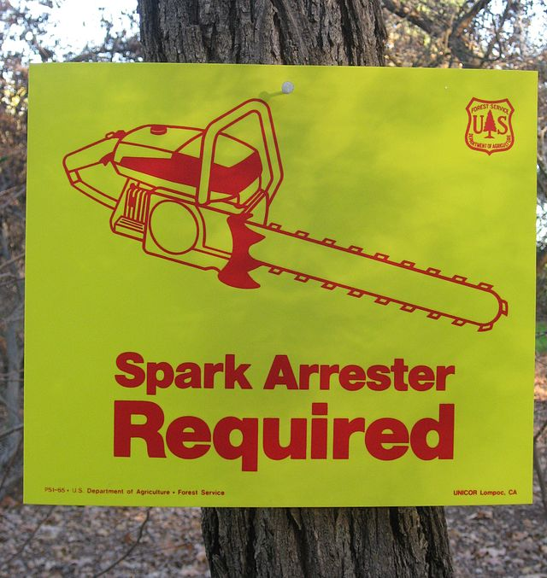
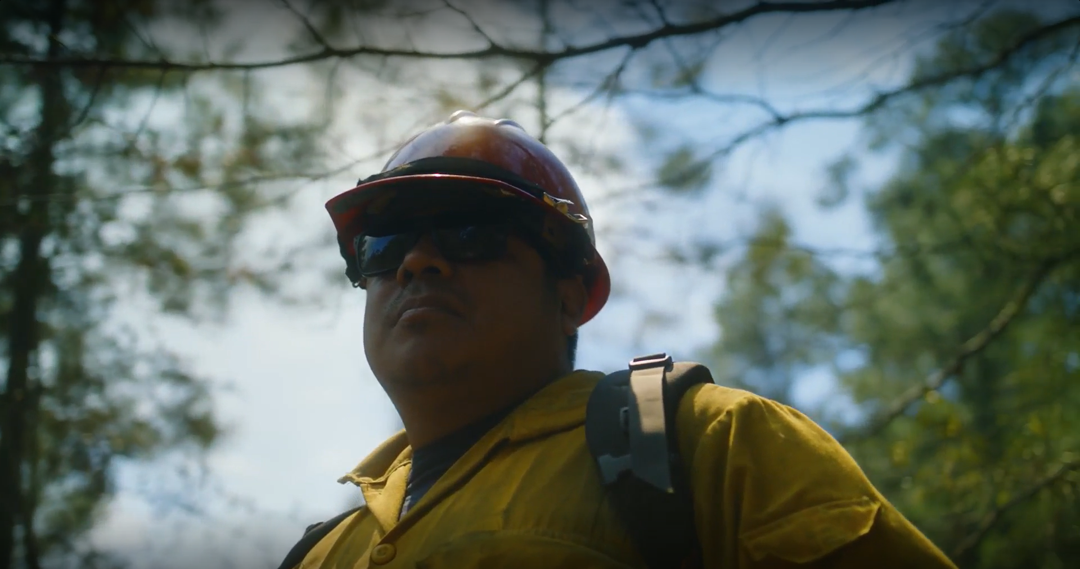
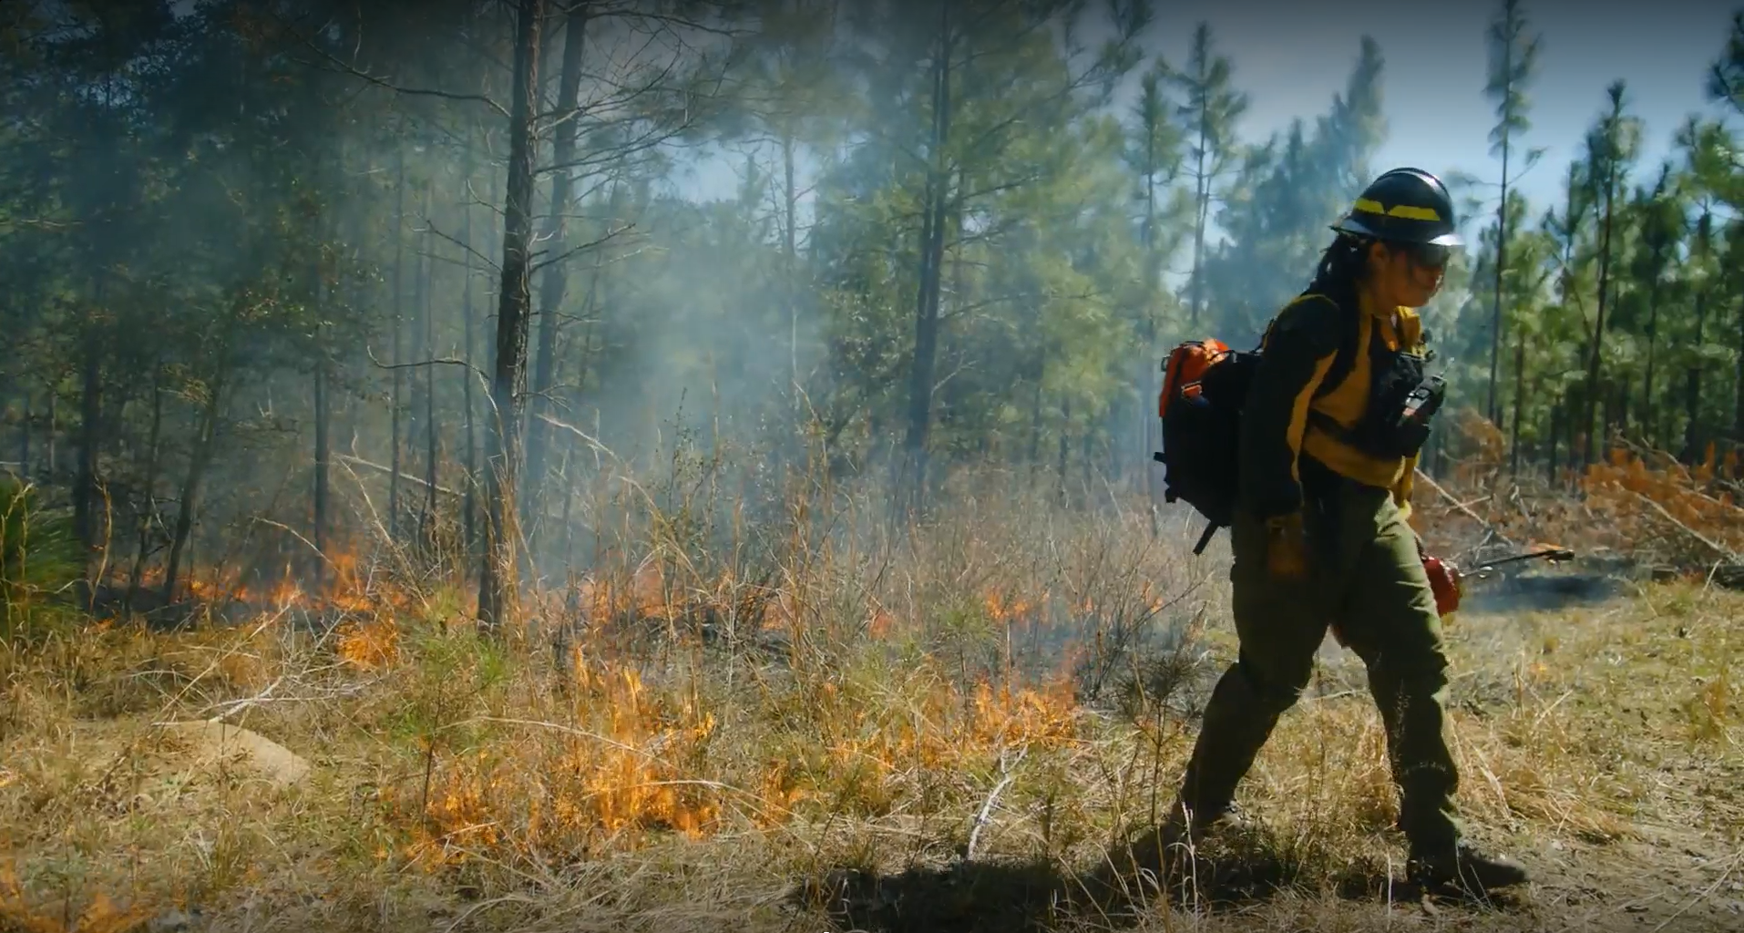
Wildland Fire in the Forests of the USET Region
Climate Impact(s) of Concern: Reduced Summer Soil Moisture & Increased Drought Stress, Untimely Flashy/Pulsed Precipitation
Impact to Forest Infrastructure:
Increased Need for Improved Forest Roads
Increased Need for Emergency Response Plan
Infrastructure Needs For Decreased Air Quality
Existing Infrastructure Under Threat
Potential Adaptation Actions
Consider Fuels Reduction Management
Establish or Improve Forest Roads
Harvest Equipment Should have Spark Arrestors
Establish Air Quality Monitoring Stations
Air Filters in At-Risk Homes
BMPs in WUI Areas
Notes:
Wildland Fire in The USET Region
The Climate Impact(s) of Concern here would be Reduced Summer Soil Moisture & Increased Drought Stress, Untimely Flashy/Pulsed Precipitation.
Wildland fire is a concern in our forests across the USET region. However, in today's forests we see this impact more prevalently out west. But, southeastern U.S. forests could begin to see wildland fire concerns similar to that of the forests out west based on current climate projections. The Northeast and Mid-atlantic areas would also benefit from establishing the infrastructure needed to respond to such events as they too could become more prevalent in these regions over time based on climate projections. The projections indicate less timely precipitation with wetter fall and winter months depending on where your community is. The precipitation comes down intensely over a short period of time and does not stay in our soils for as long as it would if precipitation was not so pulsed. This in turn leads to more droughty conditions, particularly in the spring and summer months when our forests are trying to grow. With that said, climate scientists have noted that these projections on drought and precipitation do not carry high degrees of certainty. What we do have a higher degree of certainty with is out continual increase in temperature. We know temperature will rise but these other variables are more uncertain. However, in recent years we can all recall these intense droughts when these are coupled with that untimely and flashy precipitation, lightning strikes and a slew of other igniters bring wildland fire concerns to areas where it may not have been historically a concern. With the impacts of wildfire, we have the following implications and considerations with forest infrastructure:
Decreased air quality as a result of wildland fire near and far from your community.
Existing infrastructure under threat (homes, facilities, electrical systems, etc..)
Some Potential Adaptation Actions to consider in forest infrastructure:
Sounds Forest Management can address the fuel loads in our forests to decrease the ladder fuels that would ramp up forest fires to larger scale wildfires.
By infrastructure, what I mean, again, is forest roads. forest roads or fire lanes providing a man-made fuel break that can prevent the continued spread of wildland fire and they give emergency response vehicles access to the front lines of the fire for containment and control. Without them these key response variables would be absent. These roads may need to be established in your community or improved to maintain their efficacy in such events. Furthermore, this is not quite and aspect of infrastructure per say, but it would be important to add to your inspections of timber harvest operations that all harvest equipment being used is equipped with an approved/suitable spark arrestor to minimize chance of equipment set fires.
Establishing air quality monitoring sites in the community can provide real-time detections in changes to air quality. When wildfire smoke particles make their way into your community at risk populations within the community should limit their exposure outside due to health concerns. Air filters in the homes of these at-risk populations, which include Pregnant women, our elders, Children, and those with a predisposing medical condition, can be a critical service/ or aspect of infrastructure to provide to the community during these events.
Having a plan in place in the event of a wildland fire is critical. Knowing who can respond whether its internal with a fire crew on the reservation or within the community or an outside department or agency that comes in to assist. Identifying this ahead of time can be critical. With every passing minute the existing infrastructure in the community becomes more at risk, homes, buildings, facilities, electrical networks can all be consumed by a blaze that goes unaddressed. Homeowners and property managers can address these pre-emptively by reducing combustible materials in the WUI area or wildland Urban Interface, the area around homes and buildings. Across the USET region we are quiet a bit more fortunate than many are out west in an ability to find a water supply to fight these fires. Lakes, ponds, rivers and canals can all serve as a vital resources in fighting wildland fires, knowing where these are and how to utilize them will be critical in response and should be described in emergency preparedness plans.

Slide 18
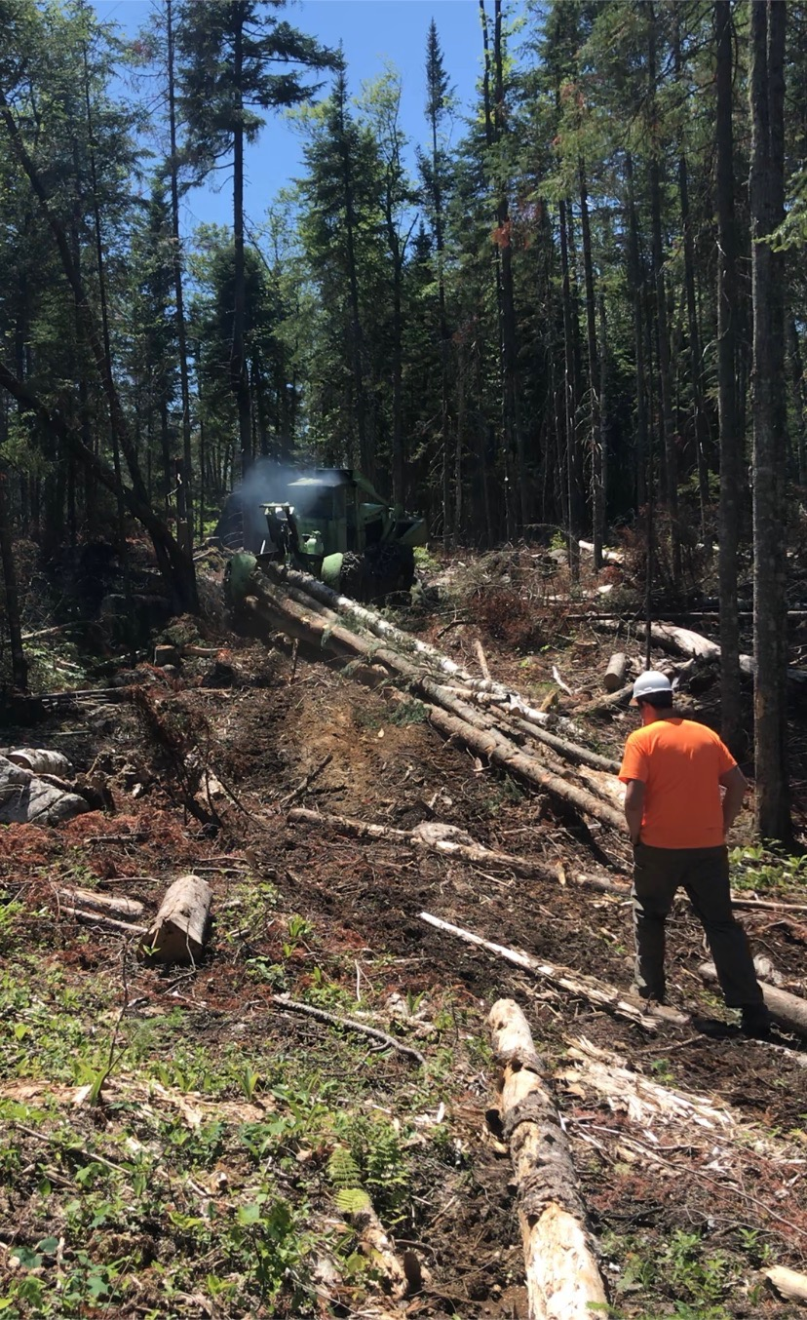
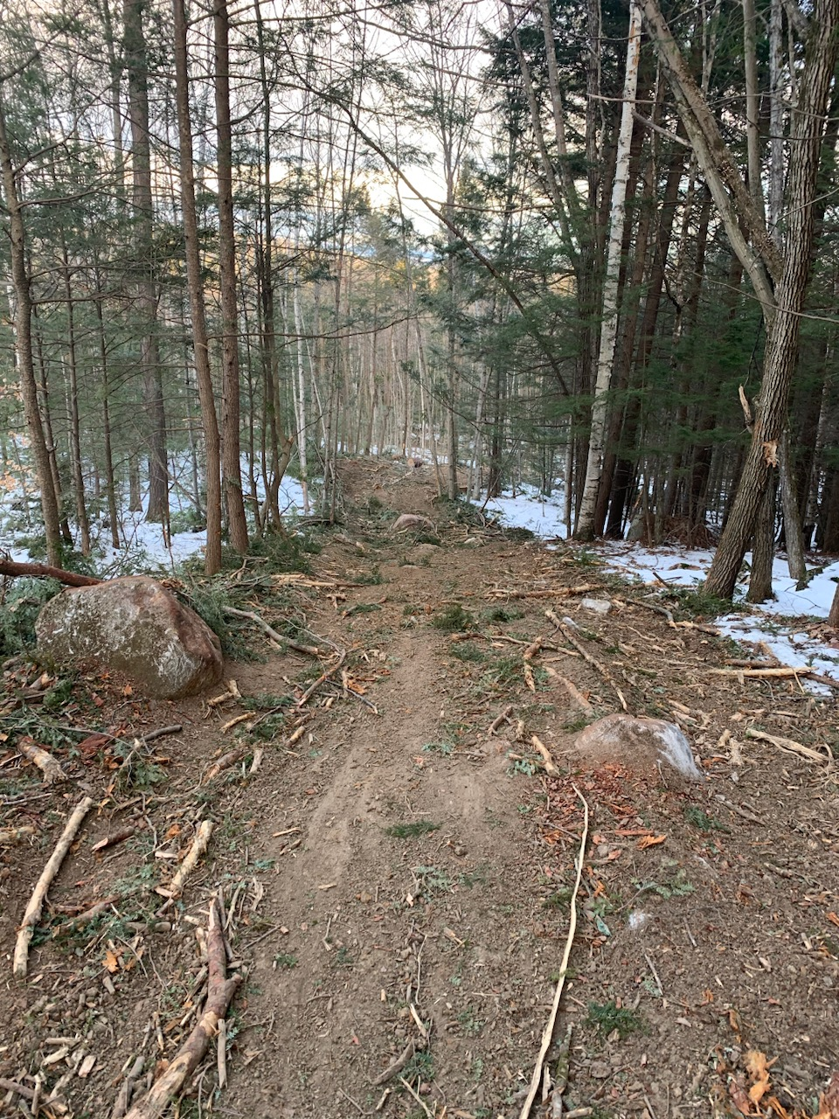
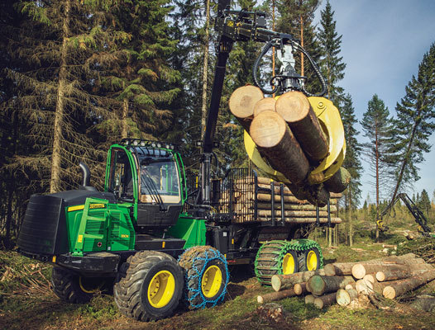
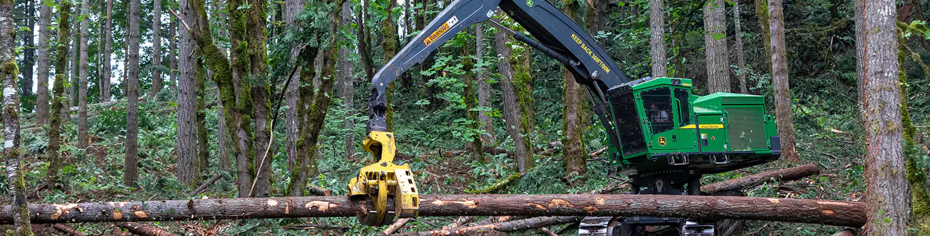
Changing Harvest Conditions
Climate Impact(s) of Concern: More Altered Seasonal Changes in Precipitation, Less Snow & Shorter Winter Season, Altered Spring Thaw
Impact to Forest Infrastructure:
Harvest Operations May Need to Shut Down
Timing of Harvest May Not Be Feasible
Potential Adaptation Actions
Consider Alternative Harvest Equipment
Adjust the Timing of Harvest
Notes:
Changing Harvest Conditions
Climate Impact of concern:
The changes in our climate have changed the harvest conditions throughout the seasons in our forests. In order to do the management that make our forest more resilient to climate change we may need to enter the forest with harvest equipment. The best timing of that varies depending on the site and current weather conditions. As an example some harvest areas are winter ground meaning harvests need to occur on frozen ground. The Passamaquoddy Tribe has found situations where sites generally thought to be winter ground were actually in worse condition for harvesting during the winter when a winter weather season was not favorable (which is a situation expected to increase in frequency with climate change in the northeast) These sites had snow pack experience rain events overtop which softened the frozen soil below the snow and made harvest condition less than ideal. This leads to shutdowns of harvest operations. Although this is not a direct connection to infrastructure it has implications closely related to it in my opinion so I decided to include this in this presentation.
Potential Adaptation Actions:
You can adapt the timing of harvest. In the case of the Passamaquoddy Forestry Department, there has been times when harvest conditions were more favorable in winter ground areas late in the summer when conditions were very droughty.
The type of equipment used in harvest operations can minimize soil compaction and allow entry when the soil is in a more sensitive state while still minimizing sedimentation. A traditional feller-buncher, grapple skidder operation yarding whole trees is the most soil compaction and disturbance you might see however it is still a viable option in many situations. Choosing to go with a hand crew (or chainsaw and cable skidder crew) with good training can be a less intrusive route as is a cut-to-length harvest system (a dangle-head processor and forwarder). In both of these lesser intrusive strategies the branches of harvested trees can be removed in the woods then be deposited in the harvest trails to serve as a layer of protection to the soil below. It also leaves valuable nutrients in the forest to break down and return to the soil.

Slide 19
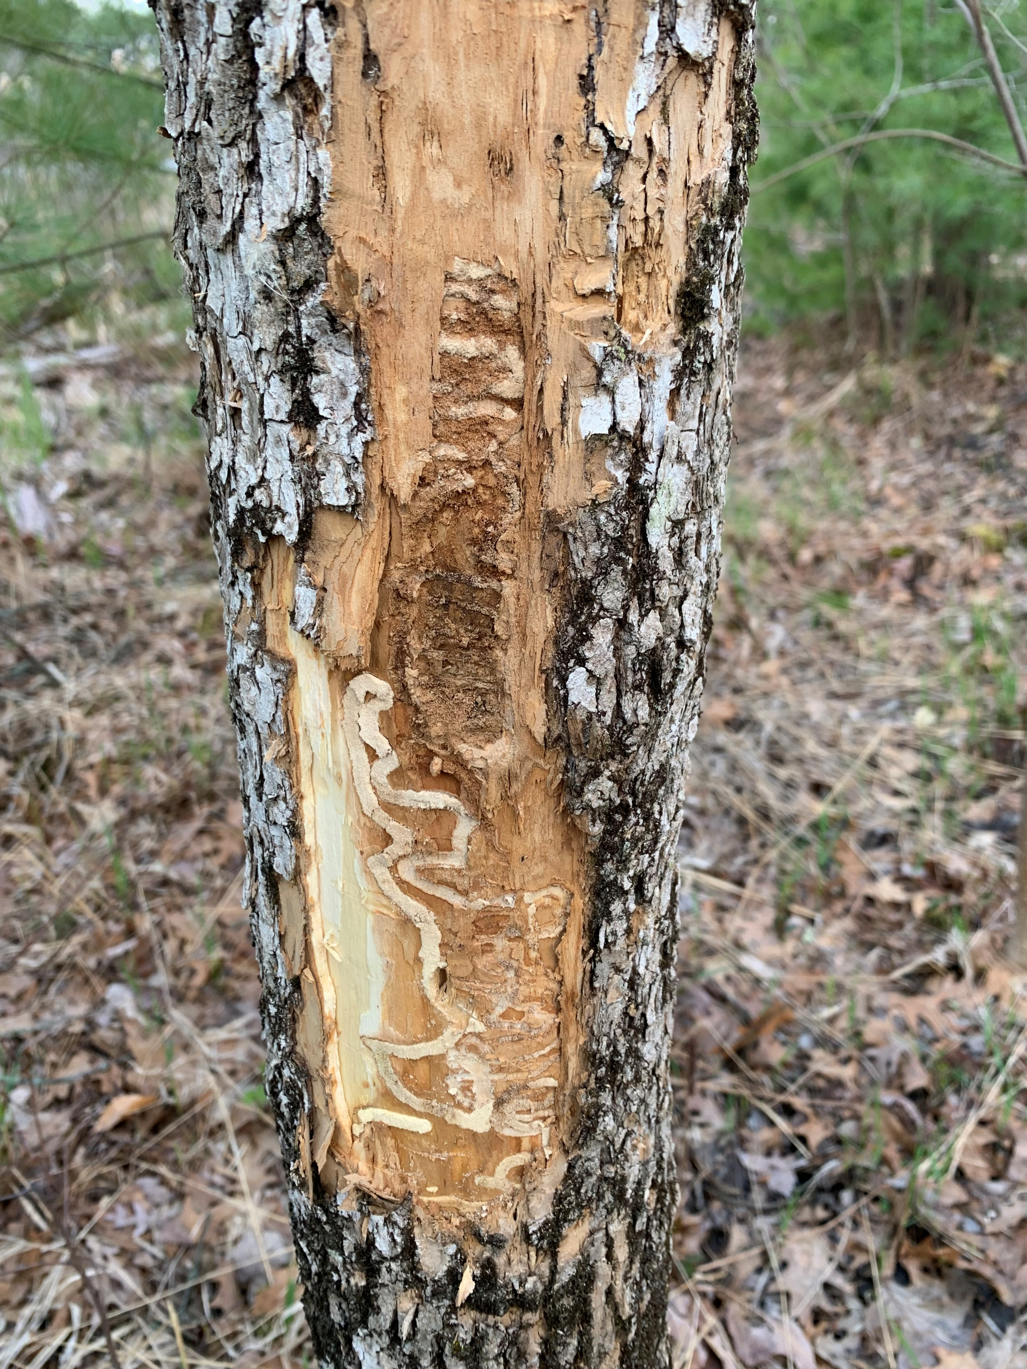


Increased Abundance of Hazard Trees
Climate Impact(s) of Concern: Increased Insect Pests and Forest Pathogens, Changes in Patterns of Herbivory
Impact to Forest Infrastructure:
Dead Standing Timber Creates Hazard Trees
Dead Standing Timber Poses Risk for Wildfire
Downed Trees Can Block Access via Forest Roads
Downed Trees Can Damage Existing Infrastructure
Potential Adaptation Actions
Early Detection of Forest Health Concerns
Integrated Pest Management Programs
Notes:
Increased Abundance of Hazard Trees
Climate impact:
Various threats can degrade the health of forest trees. When dead standing timber is around it serves wildlife values but can also be considered a hazard tree, especially when close to urban areas, and high foot traffic areas like recreational trails and along forest roads. Removing these trees can be costly but for improved safety it can be critical, downed trees can prevent access via roads that are blocked from traffic like emergency vehicles. Those downed trees can take down powerlines and damage property. All of which pose human health concerns. Considering the impacts of climate change, perhaps the most likely culprit for this increase in hazard trees is the impact of increased insect pests, disease, and pathogens in our forests both native and non-native. Unlike the droughty condition and changes in precipitation there is a higher degree of certainty regarding increased insects, disease, and pathogens in our forests. Especially in the mid-atlantic and northeast regions where this impact is viewed as one of the biggest threats to forests. When these trees are sick from these impacts, they become intense fuel potential for a wildfire and a perhaps this impact is more noteworthy in what might drive the potential for wildland fire in those regions.
Potential Adaptation Actions:
In all forest health concerns early detection is critical and so it is paramount that monitoring for high impacts forest pests occurs when necessary and general forest health monitoring surveys are done on a regularly occurring basis.
When pests are detected management actions that minimize their impact can be carried out to limit the increase in hazard trees that pose a threat to existing infrastructure. This can be done through a comprehensive integrated pest/disease/or pathogen management plan.

Slide 20

Adaptation Tools and Resources in
Infrastructure Planning
USET-OERM Climate Change Page – Climate Change Tools and Resources
https://www.usetinc.org/departments/oerm/climate-change/
NOAA Sea Level Rise Viewer
https://coast.noaa.gov/slr/
Tribal Climate Adaptation Guidebook
https://pnwcirc.org/sites/pnwcirc.org/files/tribal_climate_adaptation_guidebook.pdf
BIA Branch of Tribal Climate Resilience
https://www.bia.gov/bia/ots/tcr
ITEP Tribes and Climate Change Program
http://www7.nau.edu/itep/main/tcc/
Scan to Access the USET Climate Webpage
Notes:
INTRO
Forest Infrastructure Concern Under a Changing Climate
For Starters…What do we use Forest Roads for? What is the importance of this forest infrastructure? Forest roads a critical in supporting…..
Access (Hunting, Fishing, Gathering of Traditional Foods, medicines, and ceremonial resources)
They support Forest Management (Conducting timber harvests, gathering forest resource data, wildlife surveys, forest health surveys, Habitat improvement treatments, etc..)
Fire Fighting (Access to areas where wildland fires is a concern is hugely important, fire roads also provide a break in fuel load for those fires)
Outdoor Recreation (Beyond fishing and hunting we have paddling, hiking, camping, and much more recreation that our forests provide us, and the infrastructure of forest roads contribute to this luxury)

Slide 21
Funding Opportunities
BIA Branch of Tribal Climate Resilience - $45+ million funded in 2022
(RFP not released yet for 2023, but soon coming)
Climate Adaptation
Category 1. Trainings and Workshops (maximum request: $150,000)
Category 2. Adaptation Planning (maximum request: $250,000)
Category 3. Travel Support for Adaptation Planning (maximum request: $15,000)
Category 6. Capacity Building for Scoping Efforts (maximum request: $65,000)
Category 10. Implementation of Climate Adaptation Strategies (maximum request: $2,000,000)
Category 13. International ITEK Virtual Exchange (maximum request: $10,000)
Ocean and Coastal Management
Category 4. Ocean and Coastal Management Planning (maximum request: $150,000)
Category 5. Travel Support for Ocean and Coastal Management (maximum request: $15,000)
Relocation, Managed Retreat, or Protect-in-Place
Category 7. Relocation, Managed Retreat, or Protect-in-Place Planning (maximum request: $300,000)
Category 11. Implementation of Community Relocation, Managed Retreat, or Protect-in-Place Actions (maximum request: $3,000,000)
Category 12. Relocation, Managed Retreat, or Protect-in-Place (RMP) Coordinator (maximum request: $150,000 per year for up to three years)
Internships and Youth Engagement
Category 8. Internships (maximum request: $50,000)
Category 9. Youth Engagement (maximum request: $50,000)
Notes:
INTRO
Forest Infrastructure Concern Under a Changing Climate
For Starters…What do we use Forest Roads for? What is the importance of this forest infrastructure? Forest roads a critical in supporting…..
Access (Hunting, Fishing, Gathering of Traditional Foods, medicines, and ceremonial resources)
They support Forest Management (Conducting timber harvests, gathering forest resource data, wildlife surveys, forest health surveys, Habitat improvement treatments, etc..)
Fire Fighting (Access to areas where wildland fires is a concern is hugely important, fire roads also provide a break in fuel load for those fires)
Outdoor Recreation (Beyond fishing and hunting we have paddling, hiking, camping, and much more recreation that our forests provide us, and the infrastructure of forest roads contribute to this luxury)

Slide 22
Other Funding Opportunities
NOAA Tribal Engagement in Regional Ocean Partnership Priorities
(Applications due August 30, 2023)
NFWF National Coastal Resilience Fund 2023 Request for Proposals (Invited Proposals due June 28) - Nature-based solutions to coastal resilience
Department of Energy/Office of Clean Energy Demonstrations – Energy Improvements in Rural or Remote Areas (pre-applications due July 13, full applications due October 12)
Department of Energy/Grid Deployment Office – Grid Resilience State and Tribal Formula Grants Program (due August 31)
Notes:
INTRO
Forest Infrastructure Concern Under a Changing Climate
For Starters…What do we use Forest Roads for? What is the importance of this forest infrastructure? Forest roads a critical in supporting…..
Access (Hunting, Fishing, Gathering of Traditional Foods, medicines, and ceremonial resources)
They support Forest Management (Conducting timber harvests, gathering forest resource data, wildlife surveys, forest health surveys, Habitat improvement treatments, etc..)
Fire Fighting (Access to areas where wildland fires is a concern is hugely important, fire roads also provide a break in fuel load for those fires)
Outdoor Recreation (Beyond fishing and hunting we have paddling, hiking, camping, and much more recreation that our forests provide us, and the infrastructure of forest roads contribute to this luxury)

Slide 23



Another Resource:
Regional Climate Adaptation Science Centers (CASCS)
Northeast Climate Adaptation Science Center (NE CASC)
https://necasc.umass.edu/
Southeast Climate Adaptation Science Center (SE CASC)
https://secasc.ncsu.edu/
South Central Climate Adaptation (SC CASC)
https://southcentralclimate.org/
Notes:
Mnetion NE SE SC CASCs

Slide 24
Kutâputunumuw! Wela’lin! Thank You!
Casey Thornbrugh Ph.D.
Climate Program Manager/Tribal Climate Science Liaison
CThornbrugh@USETINC.ORG
Steph Courtney Ph.D.
Assistant Tribal Climate Science Liaison
scourtney@usetinc.org
Tyler Everett M.F., L.F.
Forest Adaptation Technical Assistant
teverett@usetinc.org
Scan to Access the USET Climate Webpage
Notes:
Mnetion NE SE SC CASCs

