Slide 1
Bivalent COVID-19 Boosters
Anna Garrett
USET Staff Epidemiologist

Slide 2
Bivalent COVID-19 Boosters
Includes 2 different mRNA components of SARS-CoV-2 virus
  Original strain
  BA.4 and BA.5 lineage of omicron variant
  Why?
    Majority of cases are omicron lineages (BA.4, BA.5)
      Mutation in spike protein → more infectious & less susceptible to original vaccine strain
    Predicted to continue circulating through fall and winter
    Only for use after completed primary series (monovalent)

Slide 3
Timeline
August 31, 2022: FDA Emergency Use Authorization
September 1, 2022: CDC Advisory Committee on Immunization Practices endorses recommendation

Slide 4
Key Points
Pfizer-BioNTech single dose bivalent COVID-19 booster dose authorized for ages 12 & older
Moderna single dose bivalent COVID-19 booster dose authorized for ages 18 & older
Monovalent mRNA COVID-19 vaccine booster dose no longer authorized for ages 12 & older

Slide 5
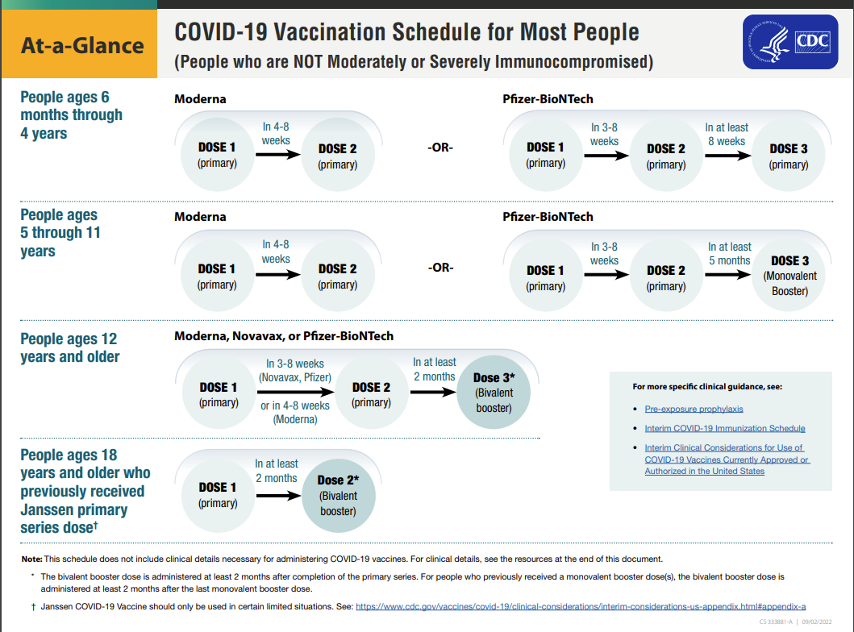

Slide 6
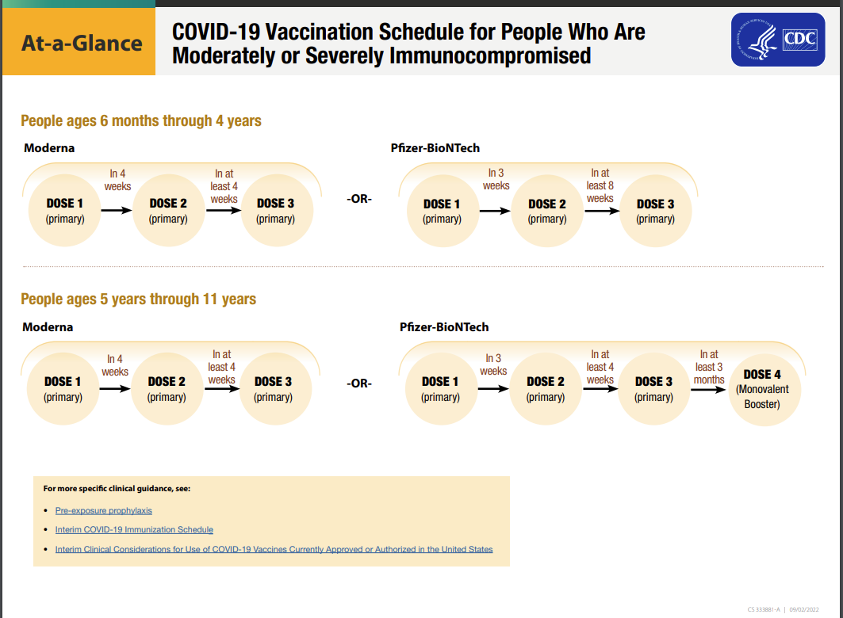

Slide 7
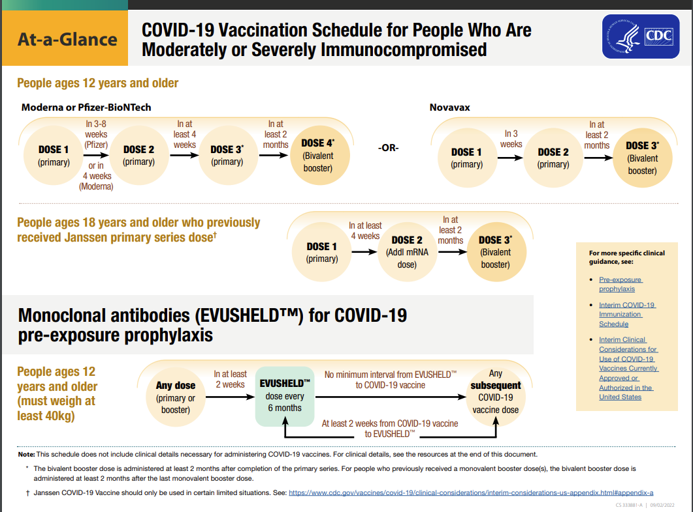

Slide 8
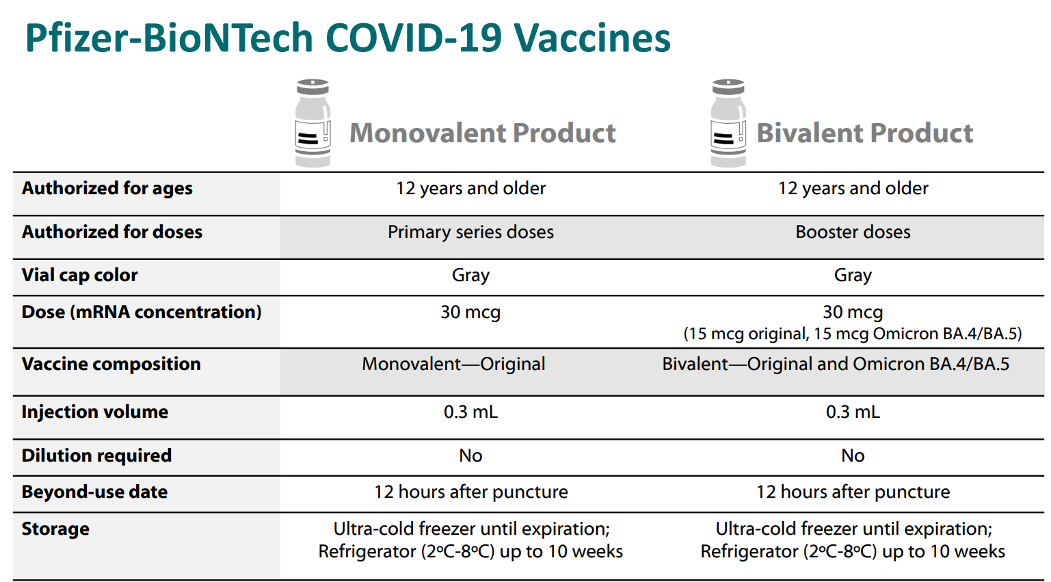

Slide 9
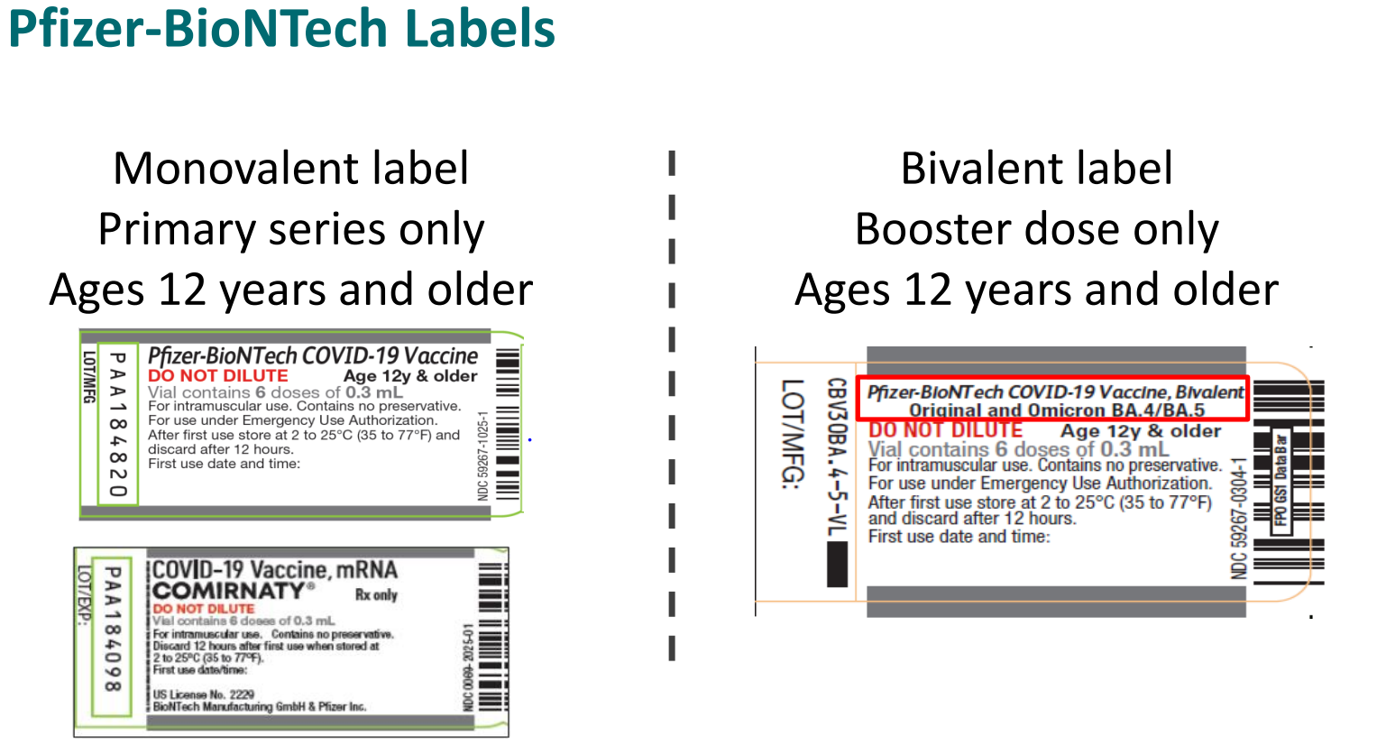

Slide 10
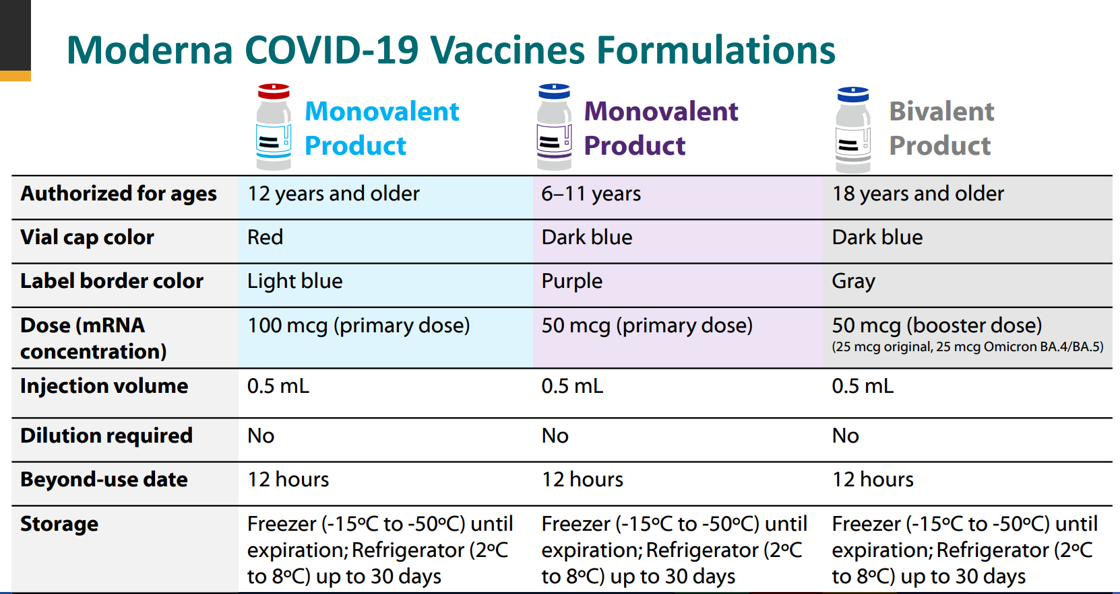

Slide 11
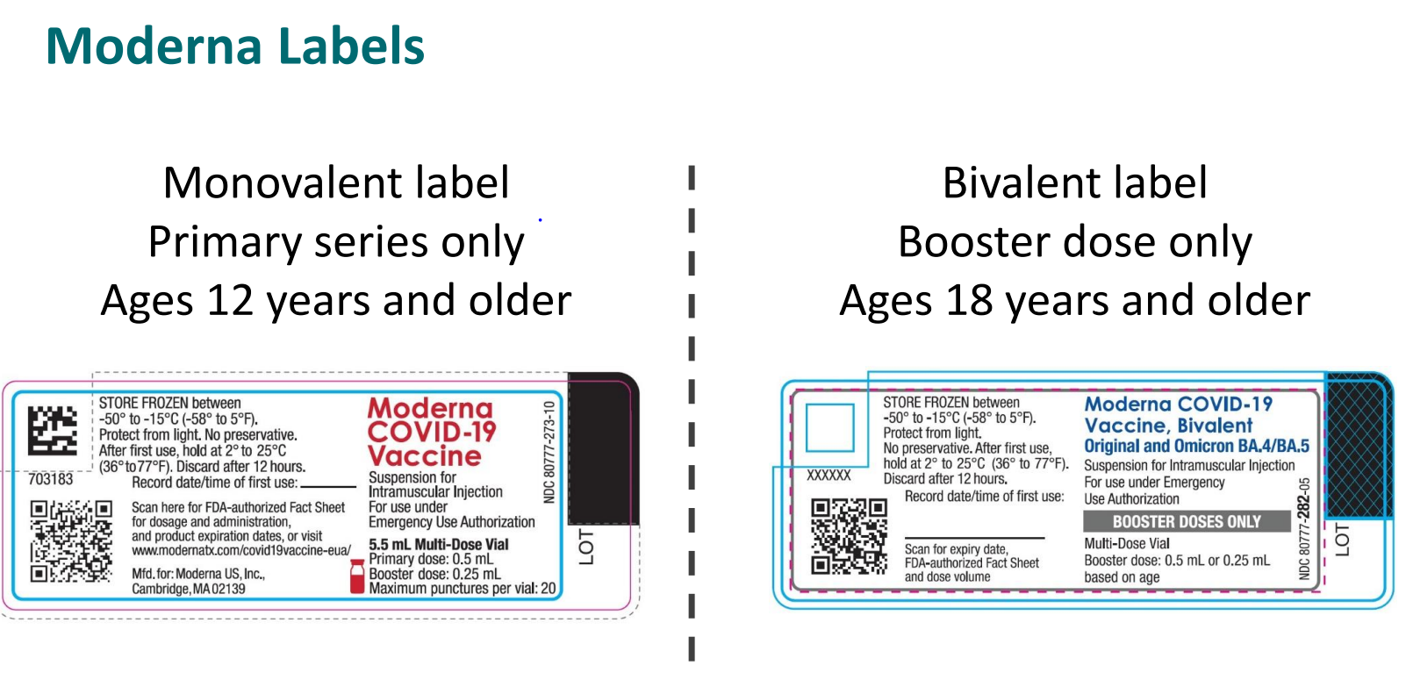

Slide 12
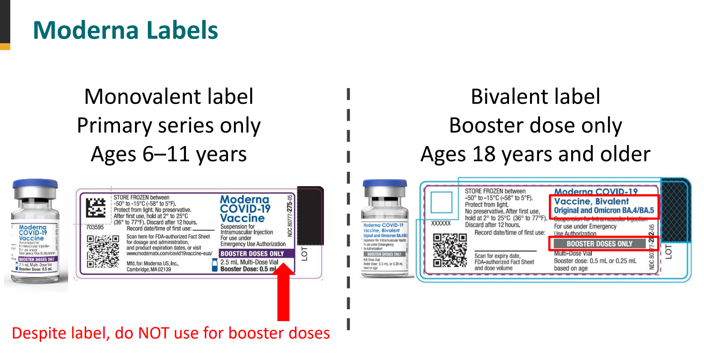

Slide 13
What is “Up to Date”?
Per CDC:
“You are up to date with your COVID-19 vaccines if you have completed a COVID-19 vaccine primary series and received the most recent booster dose recommended for you by CDC.
Vaccine recommendations are based on your age, the vaccine you first received, and time since last dose. People who are moderately or severely immunocompromised have different recommendations for COVID-19 vaccines.”
Notes:
https://www.cdc.gov/coronavirus/2019-ncov/vaccines/stay-up-to-date.html?s_cid=11706:cdc%20covid%20booster:sem.ga:p:RG:GM:gen:PTN:FY22

Slide 14
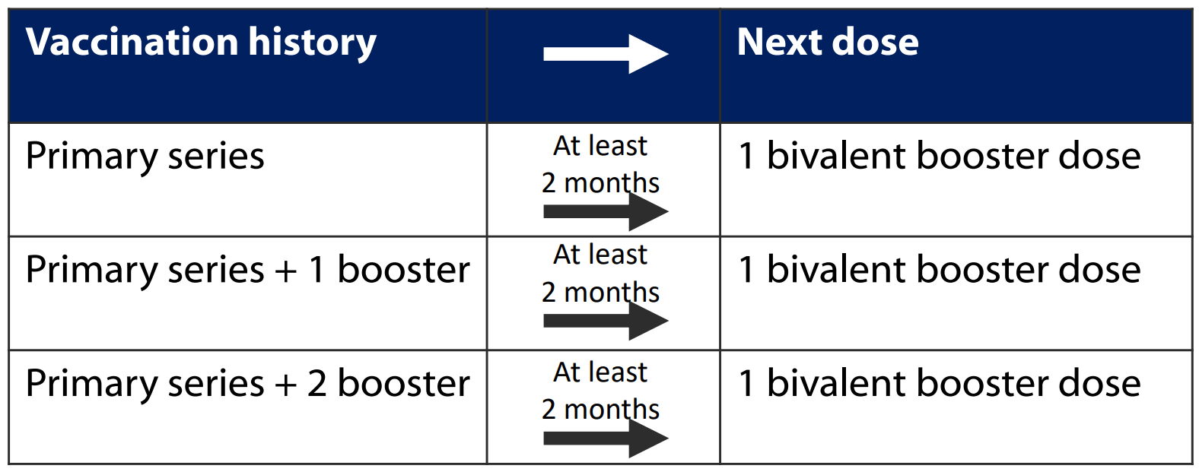
Booster Dose Simplification
No longer counting booster doses → Bivalent booster dose for all eligible
Notes:
https://www.cdc.gov/vaccines/acip/meetings/downloads/slides-2022-09-01/09-covid-hall-508.pdf

Slide 15
Timing Considerations
At least 2 months after primary series
Current or past SARS-CoV-2 infection
  3 months after symptom onset or positive test result
  At minimum, recovery from acute illness, isolation complete
  Consider individual risk factors

Slide 16
COVID Vaccine Product Mixing
Primary series: not recommended to mix products
  Pfizer-BioNTech, Moderna, Novavax
  Booster doses:
    Age 18+: may get different product for booster (Pfizer-BioNTech, Moderna)
    Age 12-17: may get different product for booster (Pfizer-BioNTech)
    Age 5-11: Pfizer-BioNTech primary series should get Pfizer-BioNTech booster)
    Age 12+: may get bivalent Pfizer-BioNTech, Moderna booster
      No longer eligible for monovalent booster
      Novavax not authorized as booster dose
Notes:
https://www.cdc.gov/coronavirus/2019-ncov/vaccines/stay-up-to-date.html?s_cid=11706:cdc%20covid%20booster:sem.ga:p:RG:GM:gen:PTN:FY22

Slide 17
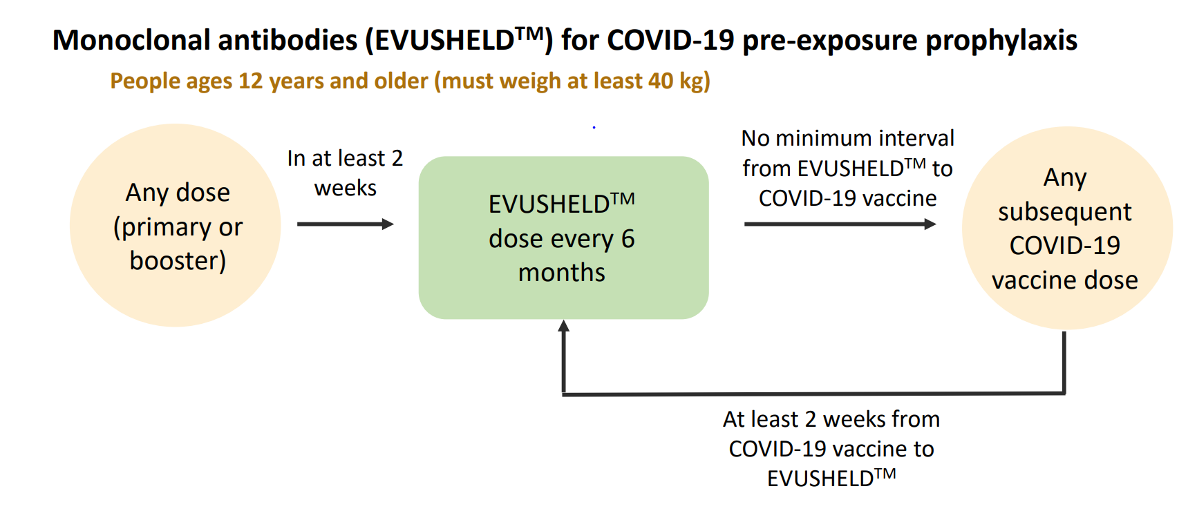
EVUSHELD Timing

Slide 18
Coadministration of Vaccines
Per CDC: “Providers should offer all vaccines for which a person is eligible at the same visit”
“Routine administration of all age-appropriate doses or vaccines simultaneously is recommended as best practice for people whom no specific contraindications exist at the time of the healthcare visit”
Example: Influenza and bivalent booster
NOTE: adolescent/young males may consider waiting 4 weeks after JYNNEOS/ACAM2000 before receiving COVID-19 vaccines due to unknown risk of myocarditis
  Should not delay getting prophylaxis because of recent COVID vaccine
  No minimum interval between COVID and orthopoxvirus vaccine is necessary
Notes:
https://www.cdc.gov/poxvirus/monkeypox/interim-considerations/jynneos-vaccine.html

Slide 19
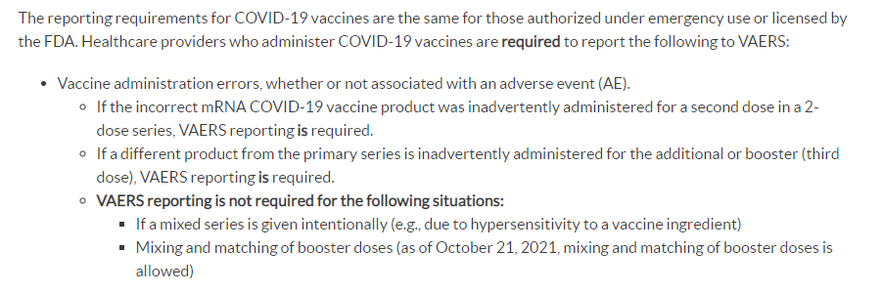
Vaccine Adverse Event Reporting System (VAERS)
Notes:
https://vaers.hhs.gov/reportevent.html

Slide 20
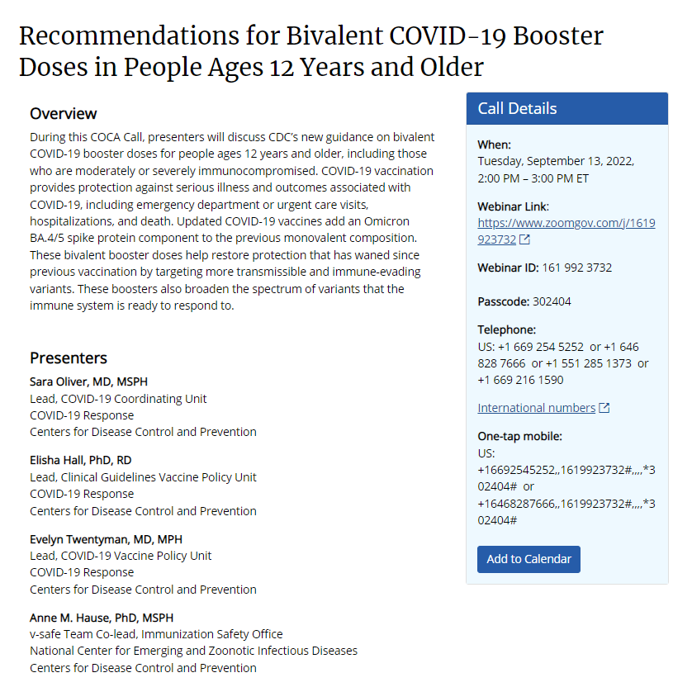
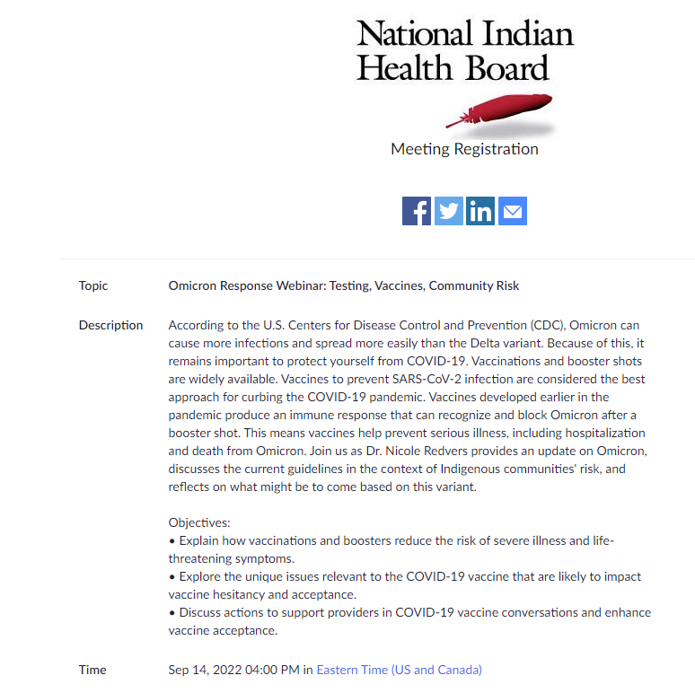



Upcoming Calls
Notes:
COCA Call Information: https://emergency.cdc.gov/coca/calls/2022/callinfo_091322.asp
NIHB Register: https://us02web.zoom.us/meeting/register/tZcsde2gqjsrG9ZZpqxiiDNxOLCYQhTq0C59

Slide 21
Resources
Interim Clinical Considerations for Use of COVID-19 Vaccines
CDC Interim Clinical Considerations for COVID-19: Bivalent Boosters
CDC Stay Up to Date with COVID-19 Vaccines
FDA Authorization Announcement
ACIP Evidence for Recommendation
JYNNEOS Vaccine
VAERS

